Slide 1
Date: Monday 25th January
L.O. To be able to order the planets and identify key properties
Subject: Science

Slide 2
The Solar System is made up of all the planets that orbit our Sun. In addition to planets, the Solar System also consists of moons, comets, asteroids, minor planets, and dust and gas.

Slide 3
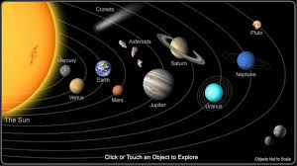
Find out about the solar system and learn the order of the planets with a song in this video!
Copy and paste this link into a web browser:
https://www.bbc.co.uk/bitesize/topics/zdrrd2p/articles/ztsqj6f

Slide 4
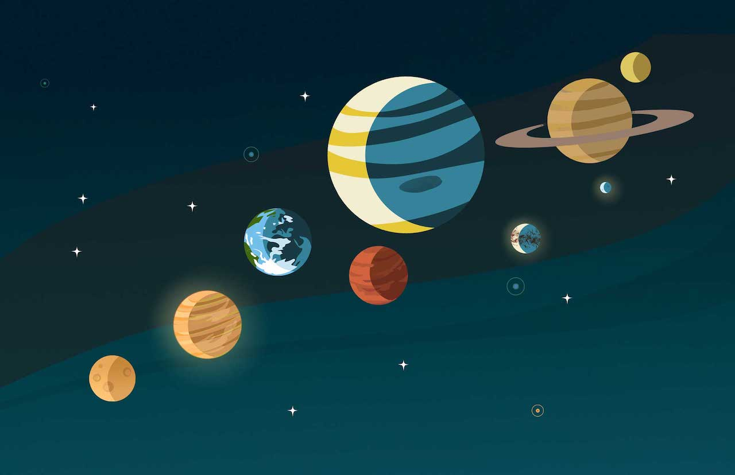
The planets are:
Mercury
Venus
Earth
Mars
Jupiter
Saturn
Uranus
Neptune
Pluto (dwarf planet)
Our solar system is made up of planets which orbit the sun.
There are 8 planets and one dwarf planet.
Do you know the names of any?
What could help us to remember the order?

Slide 5
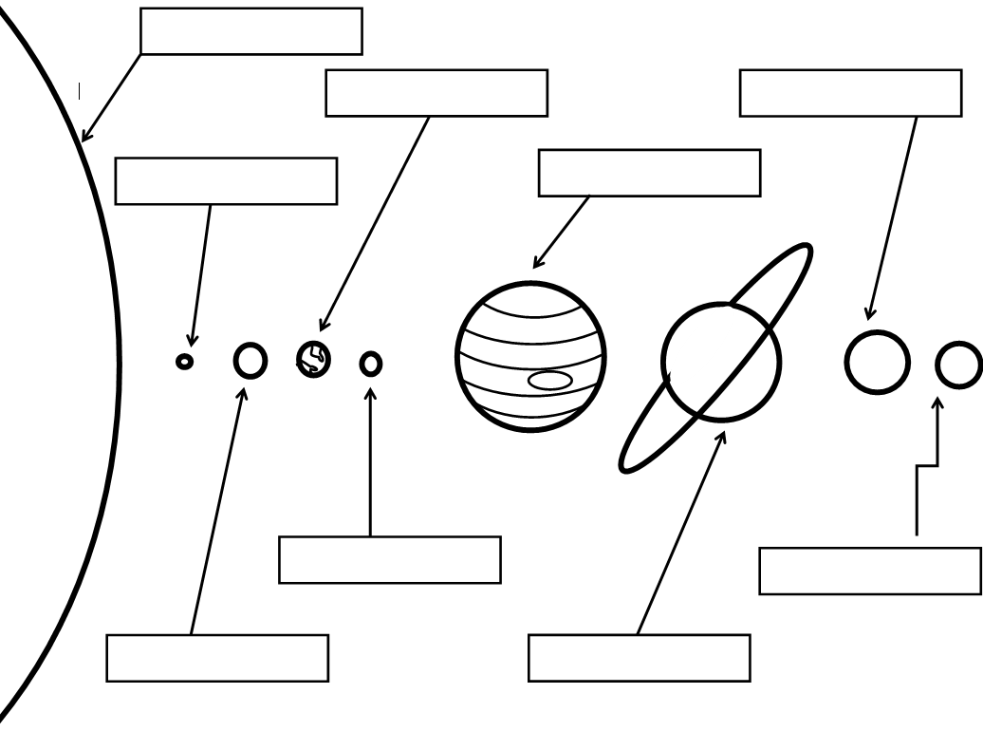
Task1!! LO To be able to label the order the planets
Draw and label the planets in the correct order. This can be complete on the diagram.
Then write out the sentences filling in the blanks.

Slide 6
Using a mnemonic
A mnemonic is a tool that helps you to memorise something specific, for example:
My very easy method just set up nine planets. My Very Energetic Mother Just Served Us Nine Pizzas.
My Very Educated Mother Just Showed Us Nine Planets.
Task: Think of a mnemonic of your own to
help you remember the planets.
Write it on some paper.
Mercury
Venus
Earth
Mars
Jupiter
Saturn
Uranus
Neptune
Pluto (dwarf planet)

Slide 7
Researching the different planets and identifying properties relating to them:
For your next task, read through the information on the next slides to find out facts about the different planets. Or you can research your own facts.
Task: Create a fact file about the different planets (pick at least 3), this can be done on paper or on the computer (such as ppt or word). Remember don’t just copy, try and put sentences into your own words.

Slide 8
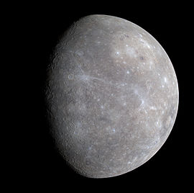
Mercury
Key Facts
Size/Diameter: 3100 miles
Orbit/days in a year 88 days
Distance from Sun: 36 million miles
Moons: None
Temperature: Sunny side rises to 400° Celsius.
Dark side goes down to -200°
Made from iron and rock, the surface of Mercury is covered with craters and completely dry. There is no possibility of life on Mercury.
Named after the Roman messenger god that was known for moving fast, because the planet orbited the sun more quickly than other planets.

Slide 9
Venus
Key Facts
Size/Diameter: 7520 miles
Orbit: 262 days
Distance from Sun: 67 million miles
Moons: None
Temperature: 860° Celsius.
There is no life at all on Venus and life could never be supported there because of the extreme heat and the atmosphere. It is made of a central iron core and a rocky mantle, similar to the composition of Earth.
Named after the Roman goddess of love and beauty.

Slide 10
Earth
Key Facts
Size/Diameter: 7928 miles
Orbit: 365 days
Distance from Sun: 93 million miles
Moons: One
Temperature: Varies
As the Earth orbits round the Sun it tilts very slightly and so gives us the seasons. When the Earth has tilted so that the northern half of the Earth is a little away from the Sun, the northern hemisphere (meaning half of the Earth’s sphere) has winter. Made of mainly iron and nickel.
Named after: Unlike the other planets, Earth does not directly share a name with an ancient Roman deity.
The name Earth derives from the eighth century Anglo-Saxon word erda, which means ground or soil.

Slide 11
Mars
Key Facts
Size/Diameter: 4200 miles
Orbit: 687 days
Distance from Sun: 141 million miles
Moons: Two
Temperature: Drops to -87 degrees Celsius in the winter and rises to -5 degrees Celsius in the summer.
Made of iron, nickel and sulfur, Mars is covered by craters from objects like asteroids and meteorites hitting the planet. Today, 43,000 such craters have been found and that only includes the large ones!
Named after the Roman god of war because of it’s red colour.

Slide 12
Jupiter
Key Facts
Size/Diameter: 88,846 miles
Orbit: 12 years
Distance from Sun: 483 million miles
Moons: 79
Temperature: - 145 Celsius
The largest planet in the solar system, the gas giant Jupiter is approximately 318 times bigger than Earth. If the mass of all of the other planets in the solar system were combined into one "super planet," Jupiter would still be two and a half times as heavy. Made of mostly hydrogen and helium
Named after the Roman king of the gods

Slide 13
Saturn
Key Facts
Size/Diameter: 75,098 miles
Orbit: 29 and a half years
Distance from Sun: 886 million miles
Moons: 62
Temperature: - 168 Celsius
The rings all orbit Saturn at different speeds and have gaps between them. Made of mostly hydrogen and helium.
Named after the Roman father of the god Jupiter, who was also the god of agriculture.

Slide 14
Uranus
Key Facts
Size/Diameter: 31000 miles
Orbit: 84 years
Distance from Sun: 1782 million miles
Moons: 27
Temperature: - 224 Celsius
Most of the centre of Uranus is a frozen mass of ammonia and methane, which gives it the blue-green colour. The atmosphere also contains hydrogen and helium. Made of hot fluid of “icy” materials including water, methane, and ammonia
Named after the father of the Roman god, Saturn

Slide 15
Neptune
Key Facts
Size/Diameter: 29000 miles
Orbit: 165 years
Distance from Sun: 2793 million miles million miles
Moons: 14
Temperature: - 218 Celsius
Neptune is one of the four “gas giants”. Like Jupiter, Saturn and Uranus, it is composed only of gas. Neptune is a great ball of hydrogen and helium. Made of dense hot fluid of “icy” materials such as water, ammonia, and methane.
Named after the Roman god of the sea. The Greeks called their god of the sea, Poseidon.

Slide 16
Here is a table which could be used to present the information and properties of the different planets.
Planet
Distance from sun
Colour
Size
Orbit
Named after
Temperature
Made out of
Moons
Interesting facts
Research three of the planets in the solar system and make a table (as above)to show their properties

Slide 17
Date: Tuesday 26th January
L.O To be able to identify scientific evidence about how our understanding of the Earth evolved.
Subject: Science

Slide 18
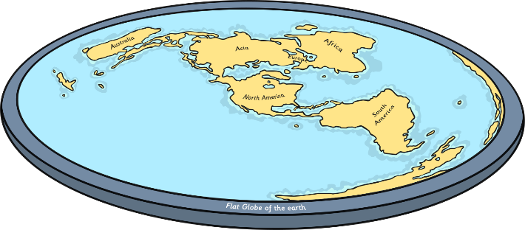
Flat Earth Versus Spherical Body
There are some people who believe that the Earth is flat and not spherical, as scientific evidence shows. Which do you believe? Can you think of reasons why people might have the opinion the Earth is flat?
What are the arguments for a spherical Earth?
What are the arguments for a flat Earth?
Video courtesy of Stephan Deutsch (@vimeo.com) – granted under creative commons licence - attribution

Slide 19
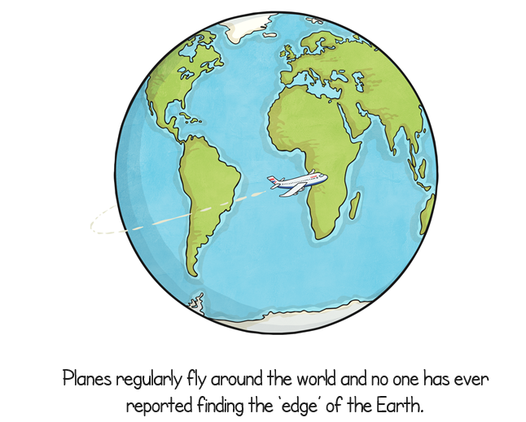
Read over the facts on the next few slides. Which do you think they provide evidence to support:
The Earth is round.
The Earth is flat.

Slide 21
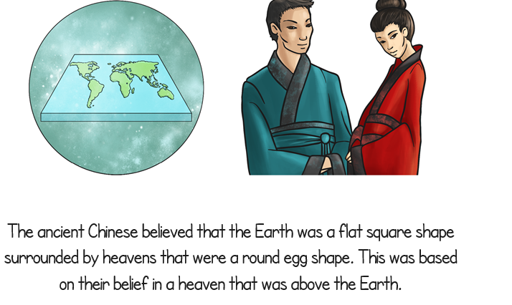

Slide 25
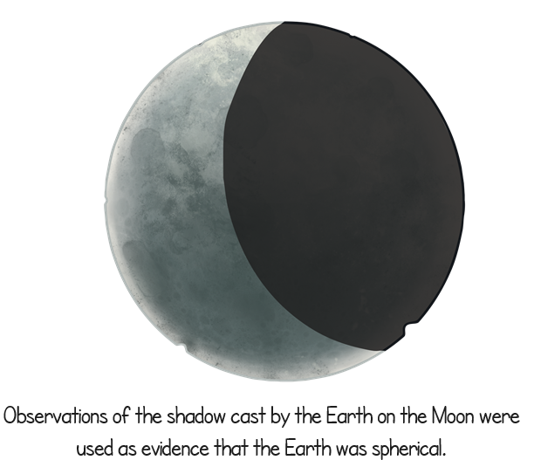

Slide 26
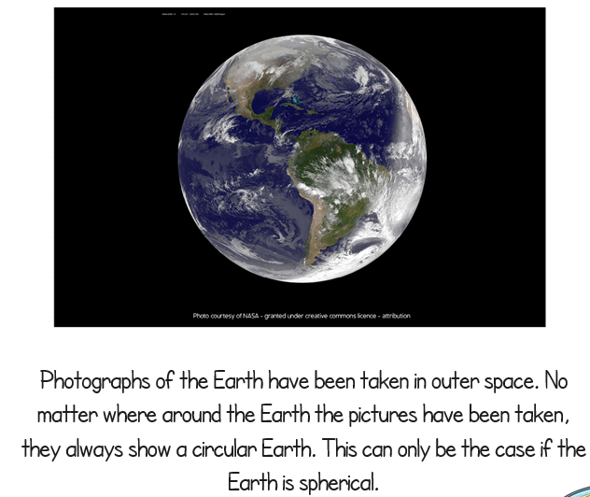

Slide 27
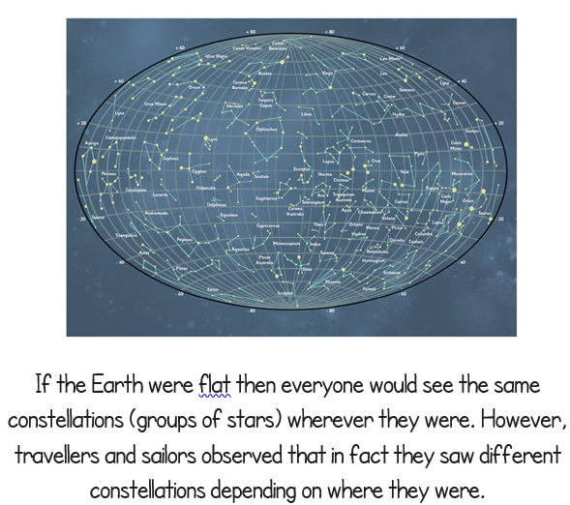

Slide 28
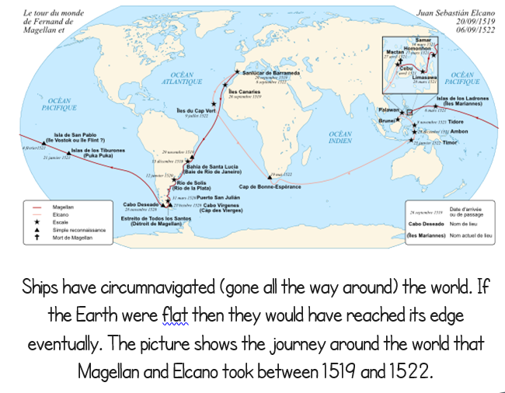

Slide 29
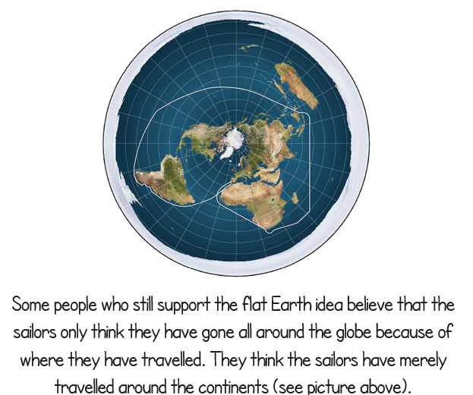

Slide 30
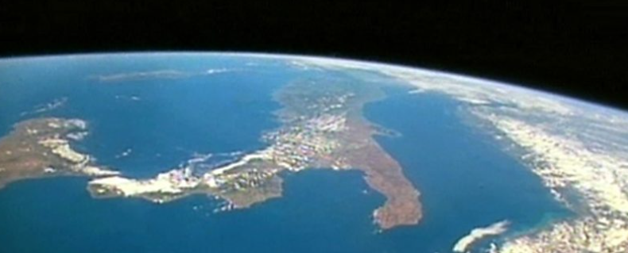
How do we know the Earth is spherical?
https://www.bbc.co.uk/bitesize/clips/zd3fb9q
Copy and paste the link into a web browser

Slide 31
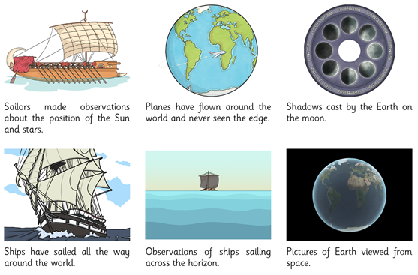
L.O To be able to identify scientific evidence about how the Earth evolved .
Task:
Write down your views on what you think the strongest evidence is that the Earth is spherical, and why.
My first reason for this is:
My second reason for this is:
Add some pictures to illustrate your answers.
Video courtesy of Stephan Deutsch (@vimeo.com) – granted under creative commons licence - attribution

Slide 32
Date: Wednesday 27th January:
L.O To be able to understand the impact of the movement of the Earth.
Subject: Science

Slide 33
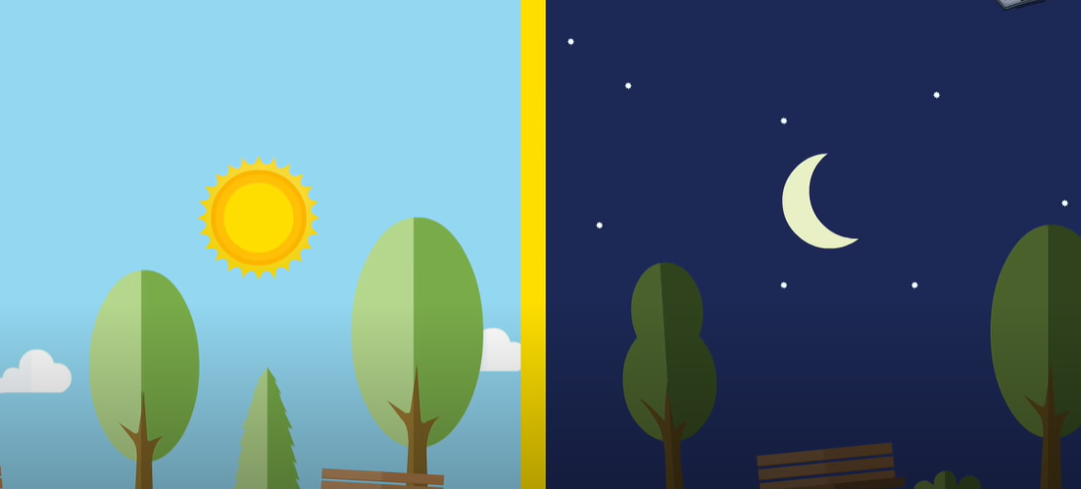
Watch the video that explains about day and night
https://www.youtube.com/watch?v=Wr-CRKsTYGs

Slide 34
The Earth is a sphere, or ball, which spins round and round as it travels around the sun.
One side of the Earth faces the Sun, while the other side faces away into space.
The side facing the Sun is bathed in light and heat – we call this daytime.
The side facing away is cooler and darker, and experiences night.
Because the Earth is constantly spinning, the line between day and night is always moving around the planet.

Slide 35
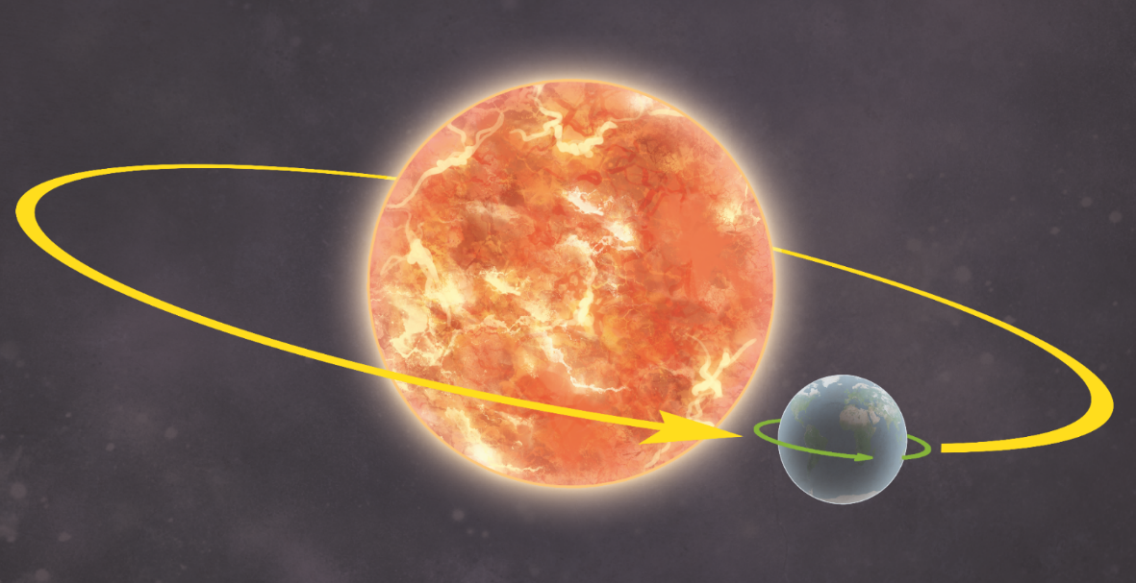
How Does Earth Move?
Earth moves in two ways.
It revolves (orbits) the Sun. One revolution takes just over 365 days.
It rotates (spins) round once every 24 hours.
Earth rotates on its axis. This is an imaginary line that runs from the North Pole to the South Pole.

Slide 36
How Does Earth Move?
The revolution of Earth (once every 365 days) causes the seasons.
The rotation of Earth (once every 24 hours) causes night and day.

Slide 37
Explaining our seasons
The Earth's axis is tilted as it travels around the Sun, so some parts of the Earth receive more sunlight each day than others.
This changes during the year because the Earth moves about the Sun, which gives rise to the seasons.
The UK is in the top half (northern hemisphere) of the Earth. When the northern hemisphere is tilted towards the Sun it is summer in the UK.
Six months later the northern hemisphere is tilted away from the Sun and it is winter.
In Spring, the temperature and day length become longer. In Autumn, they are shorter.

Slide 38
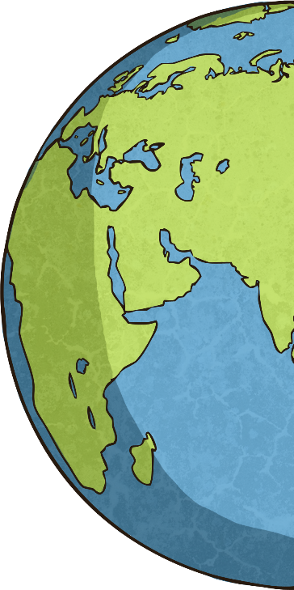
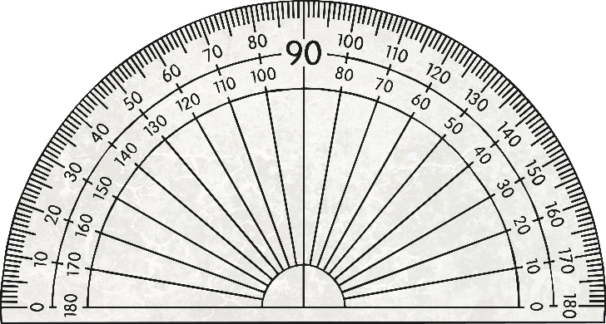
Day and Night
Have you ever noticed that a globe is slightly tilted?
This is because Earth itself is slightly tilted on its axis. Currently, this tilt is 23.5°. However, this can change over thousands of years.
https://www.youtube.com/watch?v=CqkQv617bcw

Slide 39
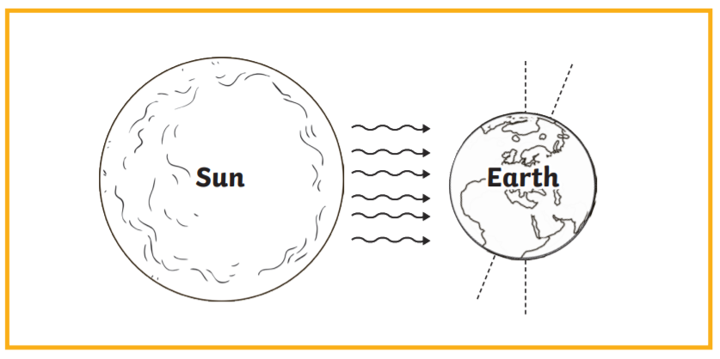
L.O To be able to understand how day and night works and how the movement of the Earth relates to the seasons
Draw the diagram and shade where we will be in night-time.
Copy out the sentences and fill in the blanks.
One side of the Earth faces the ________, while the other side faces away into ____________________.
The Earth _______________ on its axis one each day.
The rotation of Earth causes ______________________________.
When the Sun shines on our part of Earth, we are in ____________________________.
When Earth spins away from the Sun, we are in ________________________________.
Earth rotates on its axis. This is an ____________ line that runs from the _________to the __________________.
The Earth's ____________ is tilted as it travels around the Sun.
When the _______________________________is tilted towards the Sun it is summer in the UK.
When the northern hemisphere is tilted away from the Sun, it is __________________________.
Seasons happen because, The _________axis is _________ as it travels around the Sun, so some parts of the Earth receive more ___________________ each day than others.
night and day imaginary Sun light North pole daytime night-time spins axis reflects South pole northern hemisphere winter Earth's tilted

Slide 40
Date: Thursday 28th January
L.O. To be able to describe the planets.
Subject: French

Slide 41
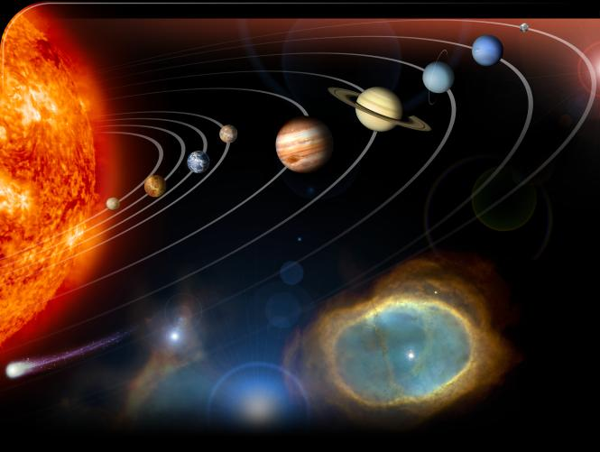
Les planètes

Slide 42
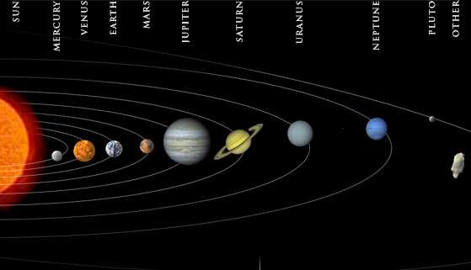
Le système solaire
le soleil
Neptune
Saturne
Vénus
Mars
Uranus
la Terre
Jupiter
Mercure
la lune

Slide 43
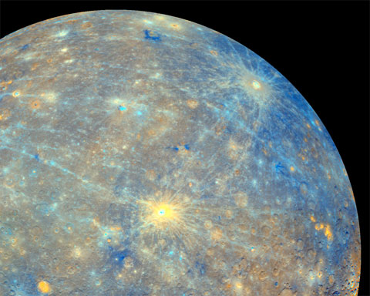
Mercure
C’est une planète bleue

Slide 44
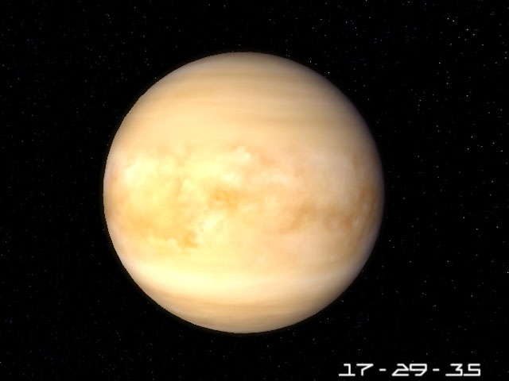
Vénus
C’est une planète jaune

Slide 45
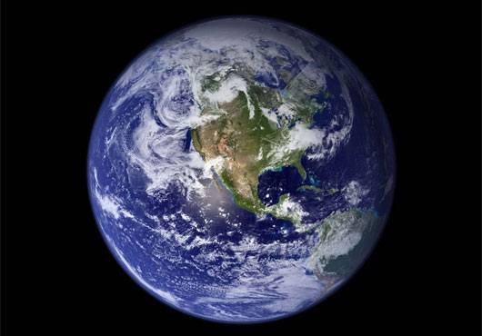
la Terre
C’est une planète bleue et verte

Slide 46
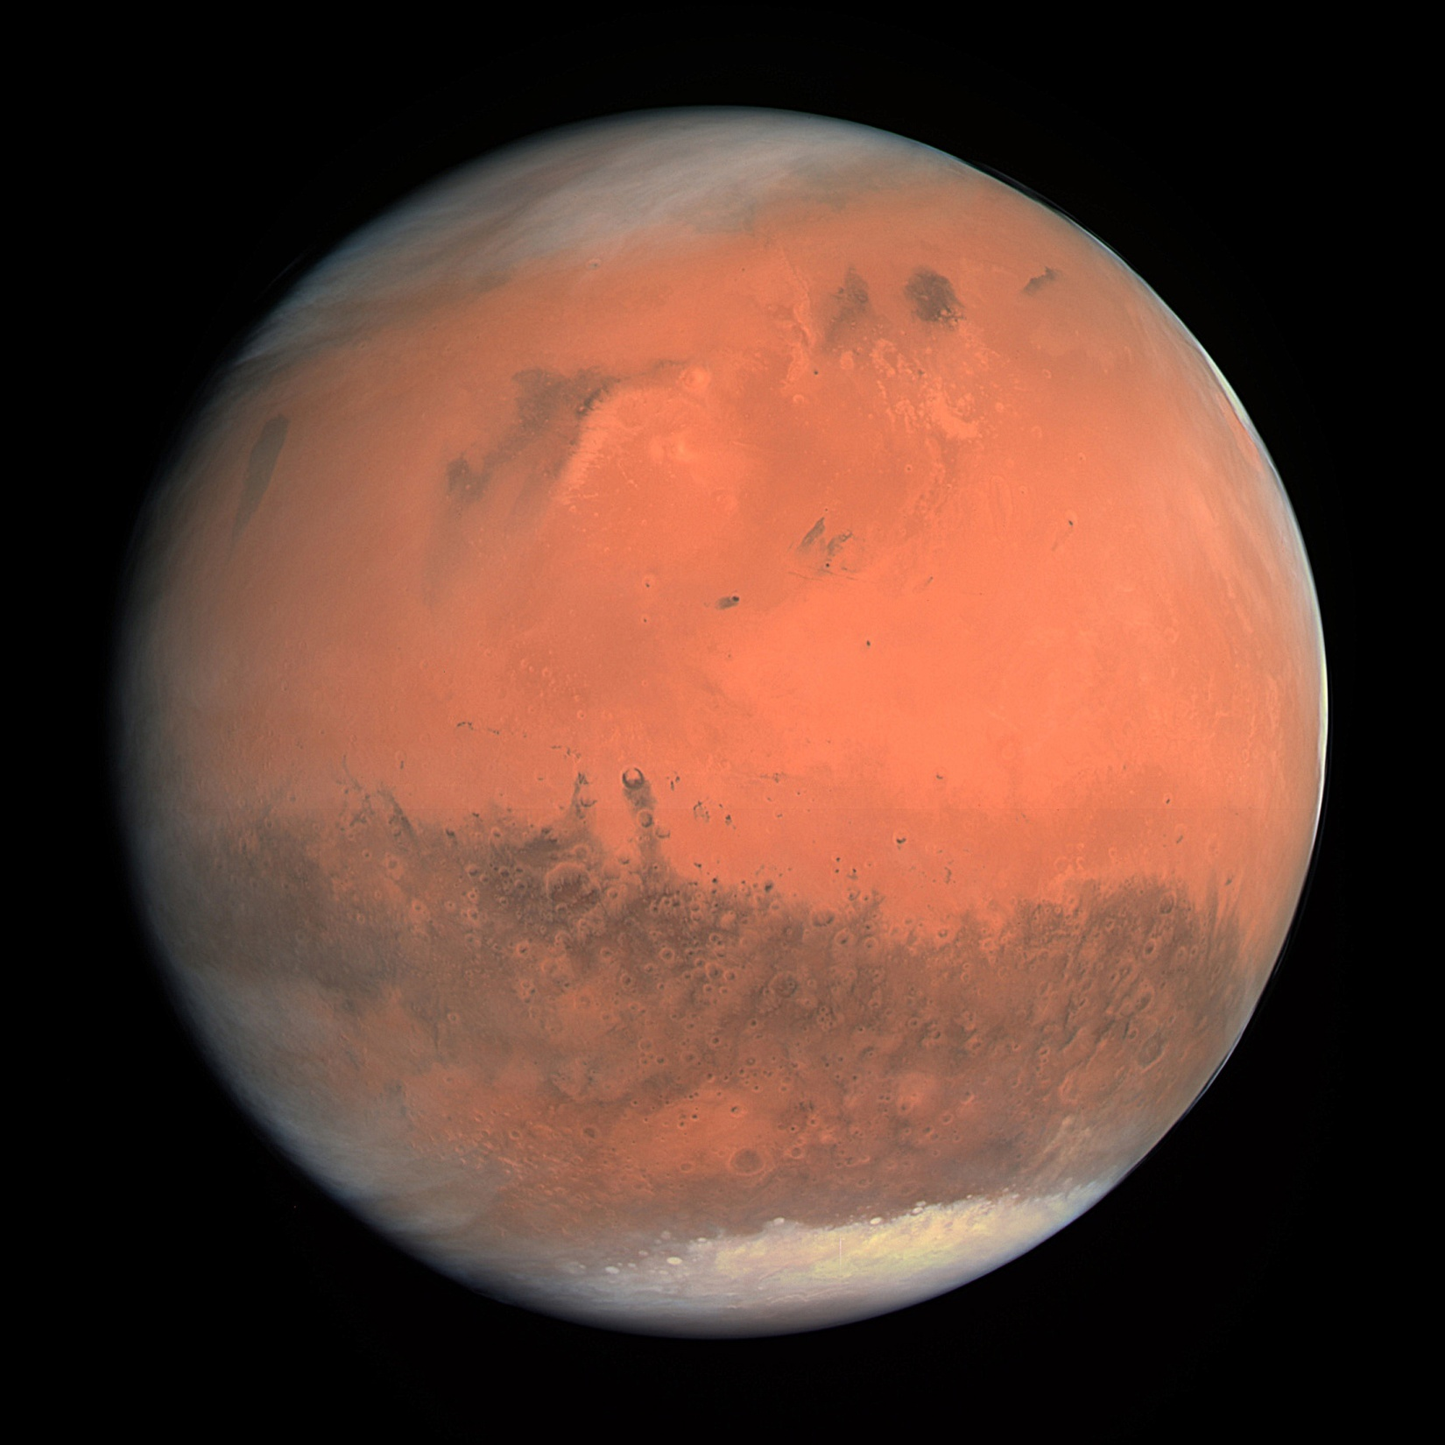
Mars
C’est une planète rouge

Slide 47
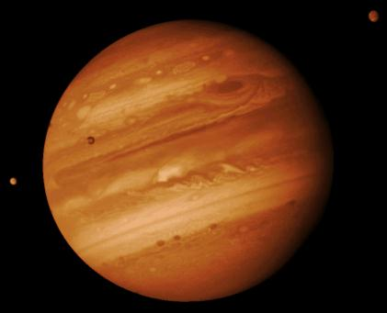
Jupiter
C’est une planète orange

Slide 48
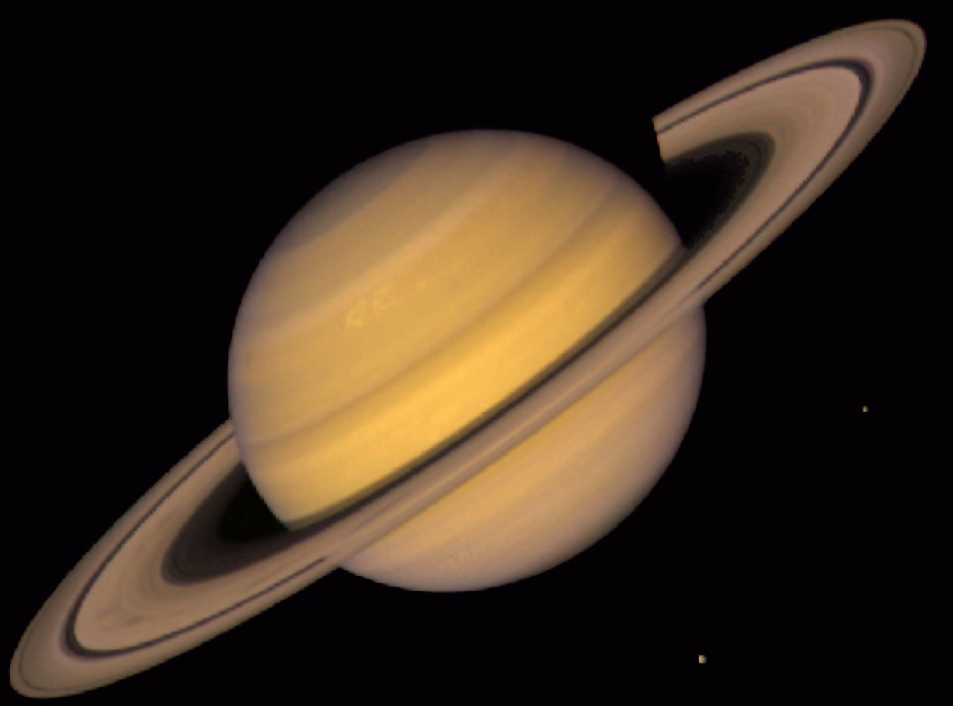
Saturne
C’est une planète orange avec des anneaux

Slide 49
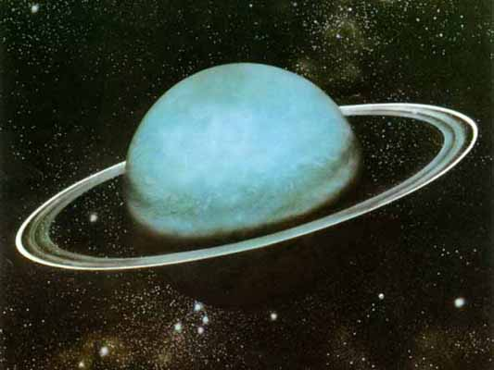
Uranus
C’est une planète verte

Slide 50
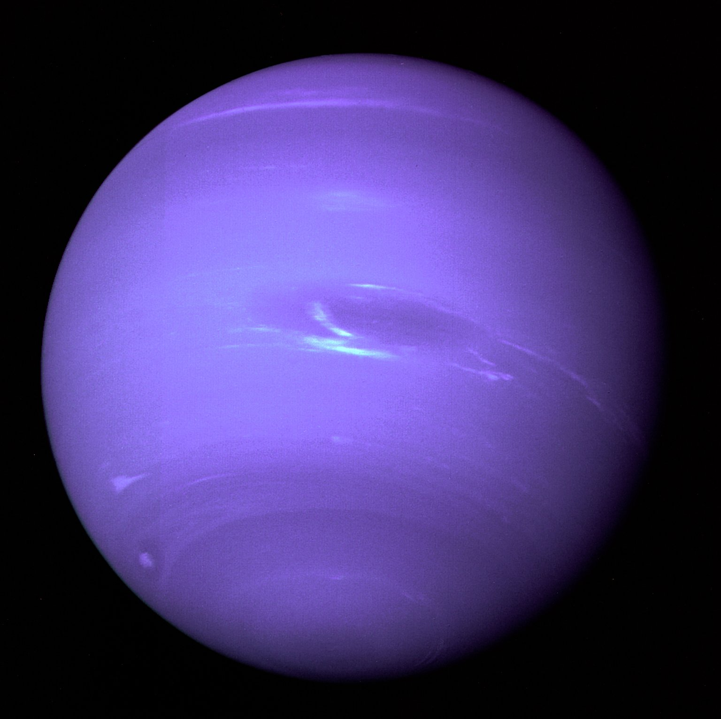
Neptune
C’est une planète bleue

Slide 51
What do you think these words could mean to describe the planets?
chaude
hot
très chaude
very hot
froide
cold
très froide
very cold

Slide 52
__________ est une planète bleue.
Il y fait très froid.
Neptune

Slide 53
__________ est une planète rouge.
Il y fait froid.
Mars

Slide 54
La Terre
__________ est une planète bleue et verte.
Il y fait chaud et froid.

Slide 55
Jupiter
__________ est une planète orange.
Il y fait froid.

Slide 56
__________ est une planète jaune.
Il y fait très chaud.
Vénus

Slide 57
__________ est une planète verte.
Il y fait très froid.
Uranus

Slide 58
__________ est une planète bleu.
Il y fait très chaud et très froid.
Mercure

Slide 59
Saturne
__________ est une grande planète orange.
Il y fait froid.

Slide 60
Draw out the table and add the colour and temperature in French
Planets | Colour | Temperature
Mercure
Vènus
La Terre
Mars
Jupiter
Saturne
Uranus
Neptune

Slide 61
Date: 29.01.2021
LO: To understand what a Digital Footprint is.
Subject: Computing

Slide 62
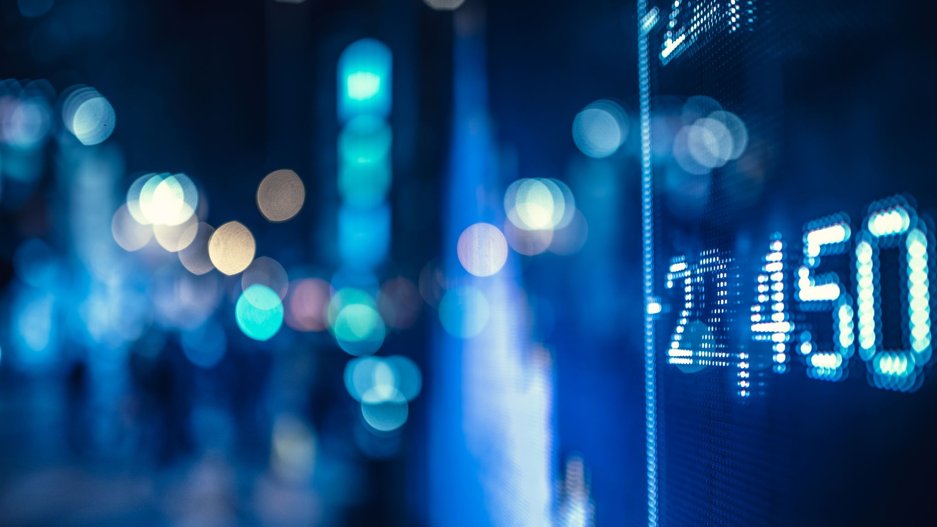
What is a digital footprint?

Slide 63
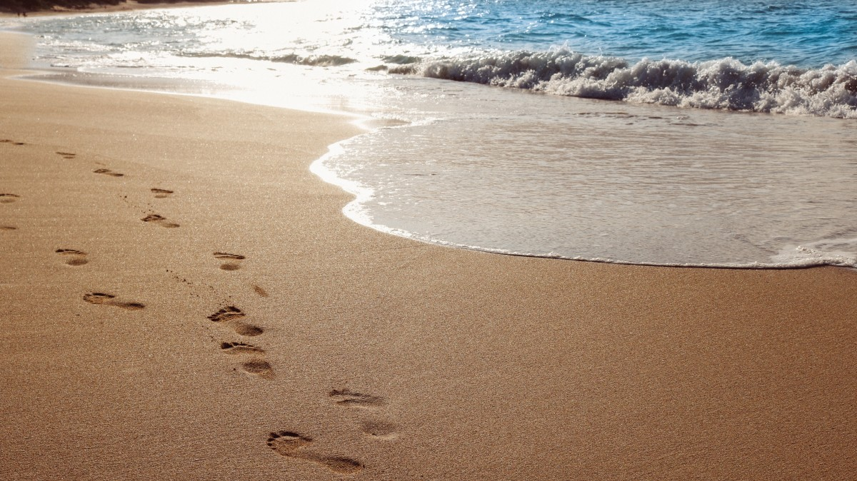
You are walking along a beach. You look behind you, what do you see?
Have you ever been for a walk on the beach and looked behind you to see the footprints your feet left on the sand? After a while, you will notice how far and wide your footprints travel. Have you tried walking lightly to avoid leaving a print? This is almost impossible!

Slide 64
Digital Footprint
Take a look at the following video:
https://www.bbc.co.uk/teach/class-clips-video/pshe-computing-gcse-digital-footprint/zfygbdm

Slide 65
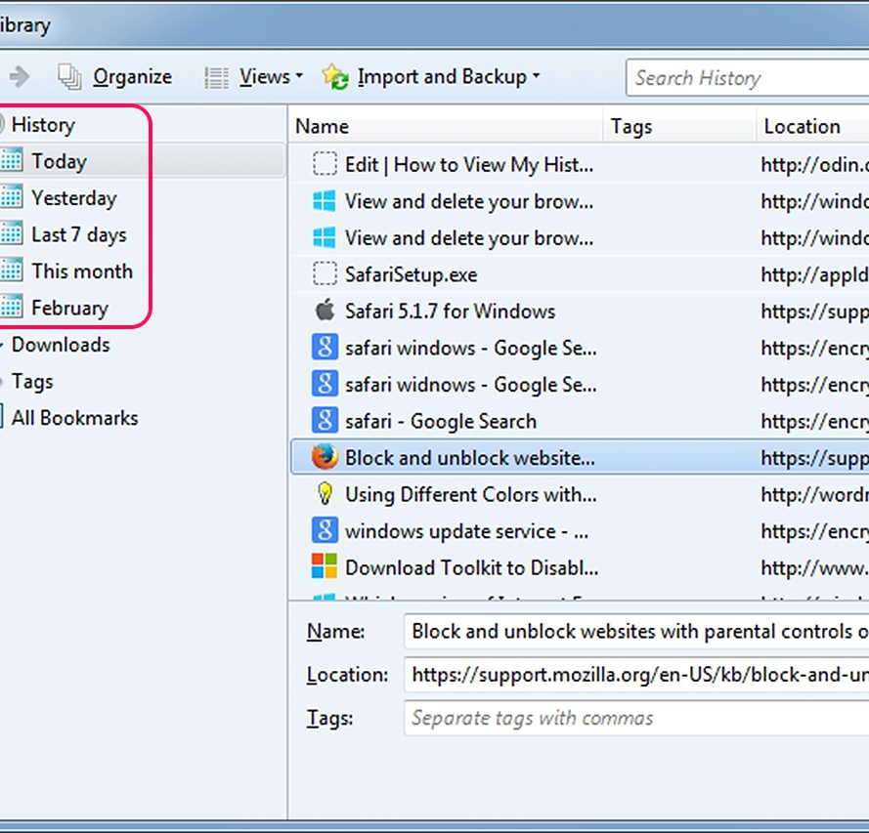
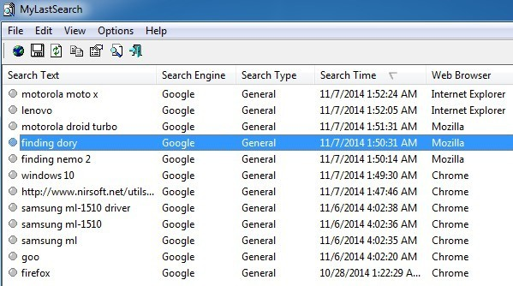
Just like the footprints we leave in the sand at the beach, we leave footprints in other places too, sometimes unknowingly. A digital footprint is a name given to all the visual information we leave behind when taking part in online activities. Have you ever checked the history on your computer to see the different websites you have visited? This is a simple example of a digital footprint however, it can be a little more complicated.

Slide 66
Mr Herdman typing a comment on a YouTube video, leaving a Digital Footprint.

Slide 67
How are digital footprints formed?
Every time we do anything online, the information we provide is leaving a trail. Some examples might include:
• Uploading a video to YouTube or commenting on an existing one
• Emailing a friend
• Posting on social media
• Filling in an online form or registration
• Agree to install programs when prompted by a message
• Searching Google
• Shopping online for items or food
Remember, we are in charge of our digital footprint. This includes a record of online activities like gaming profile, comments, website searches, website visits, blogging, vlogging, videos and photos that we post online.

Slide 68
Why is it important to be aware of the digital footprint that we leave behind online?
It is important to remember that when we leave a digital footprint, it is permanent, unlike the trail that we leave behind at the beach.
It is because that other people can trace your digital footprints online and find out information about you. There are also certain situations when it is inappropriate to share information online. This includes our full name, address, date of birth, school or phone number.

Slide 70
Task 1: On the next slide, complete the 3 columns about your own digital footprint.
This Photo by Unknown Author is licensed under CC BY-NC-ND

Slide 71
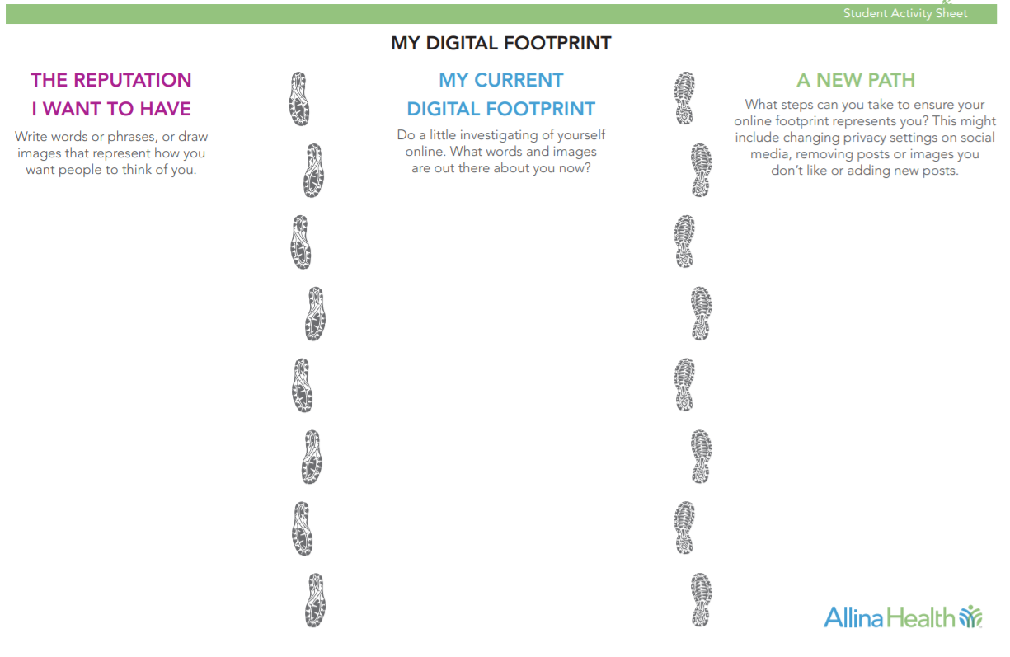
_______________________________________________________________________________________________________________________________________________________________________________________________________________________________________________________________________________________________________________________________________________________________________________________
_______________________________________________________________________________________________________________________________________________________________________________________________________________________________________________________________________________________________________________________________________________________________________________________
_______________________________________________________________________________________________________________________________________________________________________________________________________________________________________________________________________________________________________________________________________________________________________________________

Slide 72
Conclusion
What can you do if you discover things you don’t like about your digital footprint?
1. Tighten your restrictions on social media:
Only accept friend/follow requests from people you know in real life.
Set privacy setting so that information about you (including images) is not visible to the public.
Change settings, if necessary, so that others need your permission to tag you in posts.
2. Delete things that you don’t want others to see. They may not completely go away if they have been shared by others or stored somewhere, but you can usually at least make them harder to find.
3. Reset passwords. Make sure they are strong and do not share them!
4. Carefully consider every time you post or share whether you want it to live on forever, because it might.

