Slide 1
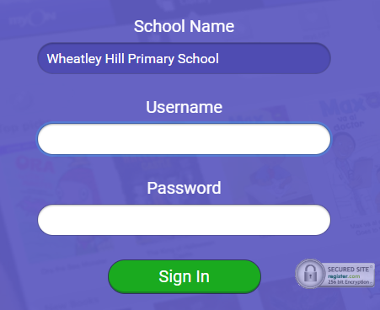
https://www.myon.co.uk/index.html
Remember to use myon for online reading
Example login -
Username
DavidW
Password
password1

Slide 2



Monday 18th – Wednesday 21st January
L.O To be able to spell homophones correctly
There is a spelling activity at the start of each day’s lesson ☺
Subject: English

Slide 3
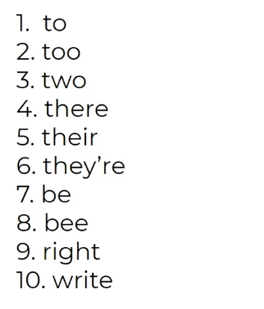
Try and practise your spellings every day ☺
Homophone - a word that is pronounced the same as another word but with a different meaning. It may also be spelt differently
https://classroom.thenational.academy/lessons/to-investigate-homophones-cruk2t
Watch this video for extra help with this week’s spellings
Read through the list. What do the different words mean?

Slide 4
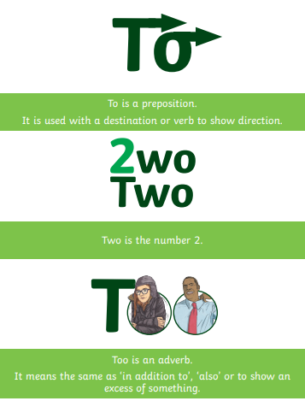
Write a sentence using each homophone correctly
____________________________________________________________________________________________________
____________________________________________________________________________________________________
____________________________________________________________________________________________________

Slide 5
Monday 18th January
L.O To be able to answer questions based on a text
Subject: English

Slide 6
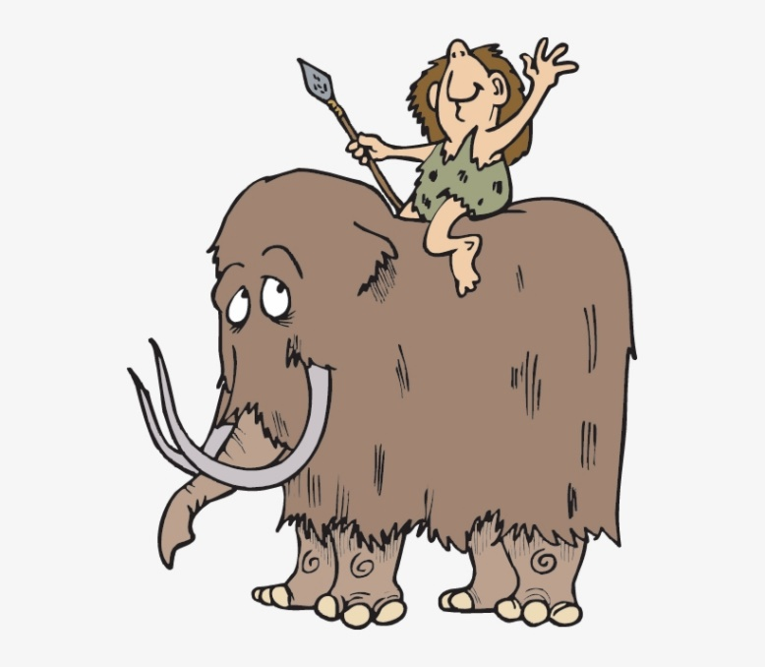
We’re going to start learning about the Stone
Age this week.
Do you know anything about this prehistoric period before we start?
Watch this video for some information
https://www.youtube.com/watch?v=kMHDvAiHxWc

Slide 7
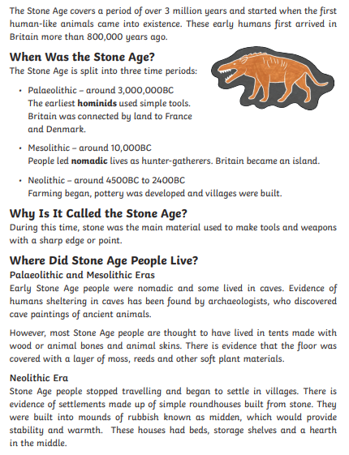
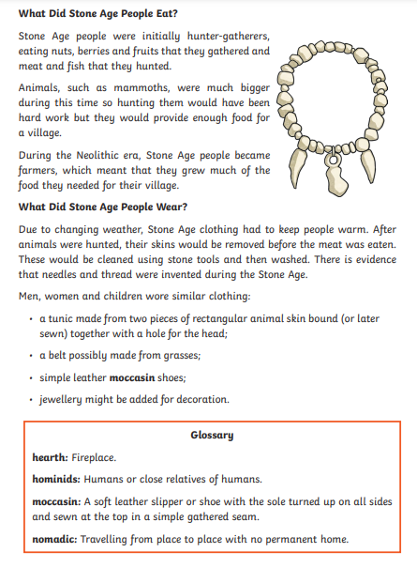

Slide 8
Answer the questions in full sentences, e.g. The Stone Age covers a period of 3 million years.
What are the 3 periods time periods that the Stone Age is split in to?
______________________________________________________________________________________________________________________________________________.
2. Why is it called the Stone Age?
______________________________________________________________________________________________________________________________________________
Why were they known as hunter gatherers?
______________________________________________________________________________________________________________________________________________
What different types of houses were found in the Stone Age?
______________________________________________________________________________________________________________________________________________

Slide 9
5. What is a glossary and why is useful to have on this page?
______________________________________________________________________________________________________________________________________________
6. What was there evidence of in the Stone Age and what was it used for?
______________________________________________________________________________________________________________________________________________
7. Would you like to visit the Stone Age? Explain your answer.
_____________________________________________________________________________________________________________________________________________________________________________________________________________________

Slide 10
Date: Tuesday 12th January
L.O To be able to ask questions about a front cover
Subject: English

Slide 11

Write a sentence using each homophone correctly
____________________________________________________________________________________________________
____________________________________________________________________________________________________
____________________________________________________________________________________________________

Slide 12

This is the new book we are going to be working on, Stone Age Boy.
Before we read the story, we are just going to have a look at the front cover.
Write a list or discuss everything you can see on the picture.
___________________________________________________________________________________________________________________________________________________________________________________________________________________________________________________________________________________

Slide 13
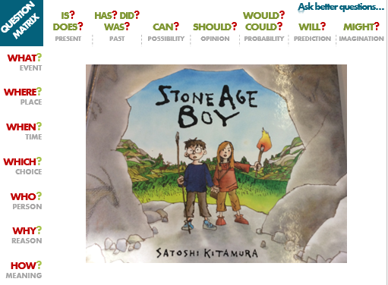
This is called a question matrix and will help us ask better questions
Pick a question from the top and side column to generate your question
E.g.
What will the children use the tools for?

Slide 14

Use the question matrix
to think some questions of your own.
Try to use a number of different question starters for each question.
Remember to use question marks after each sentence
?
______________________________________________________________________________________________
______________________________________________________________________________________________
______________________________________________________________________________________________
______________________________________________________________________________________________
_______________________________________________________________________________________________

Slide 15
Date: Wednesday 13th January
L.O To be able to use ING openers
Subject: English

Slide 16
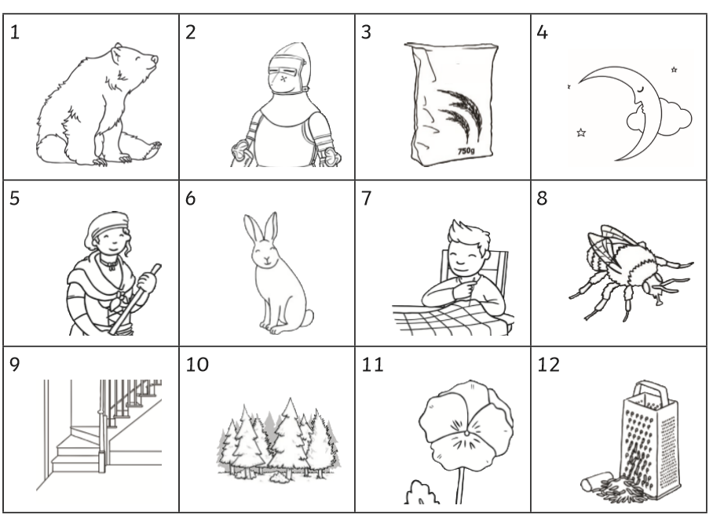
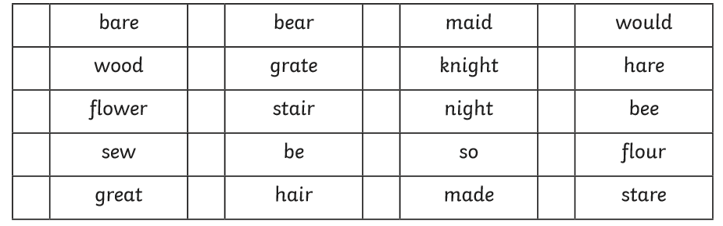
Match the picture to the correct homophone

Slide 17
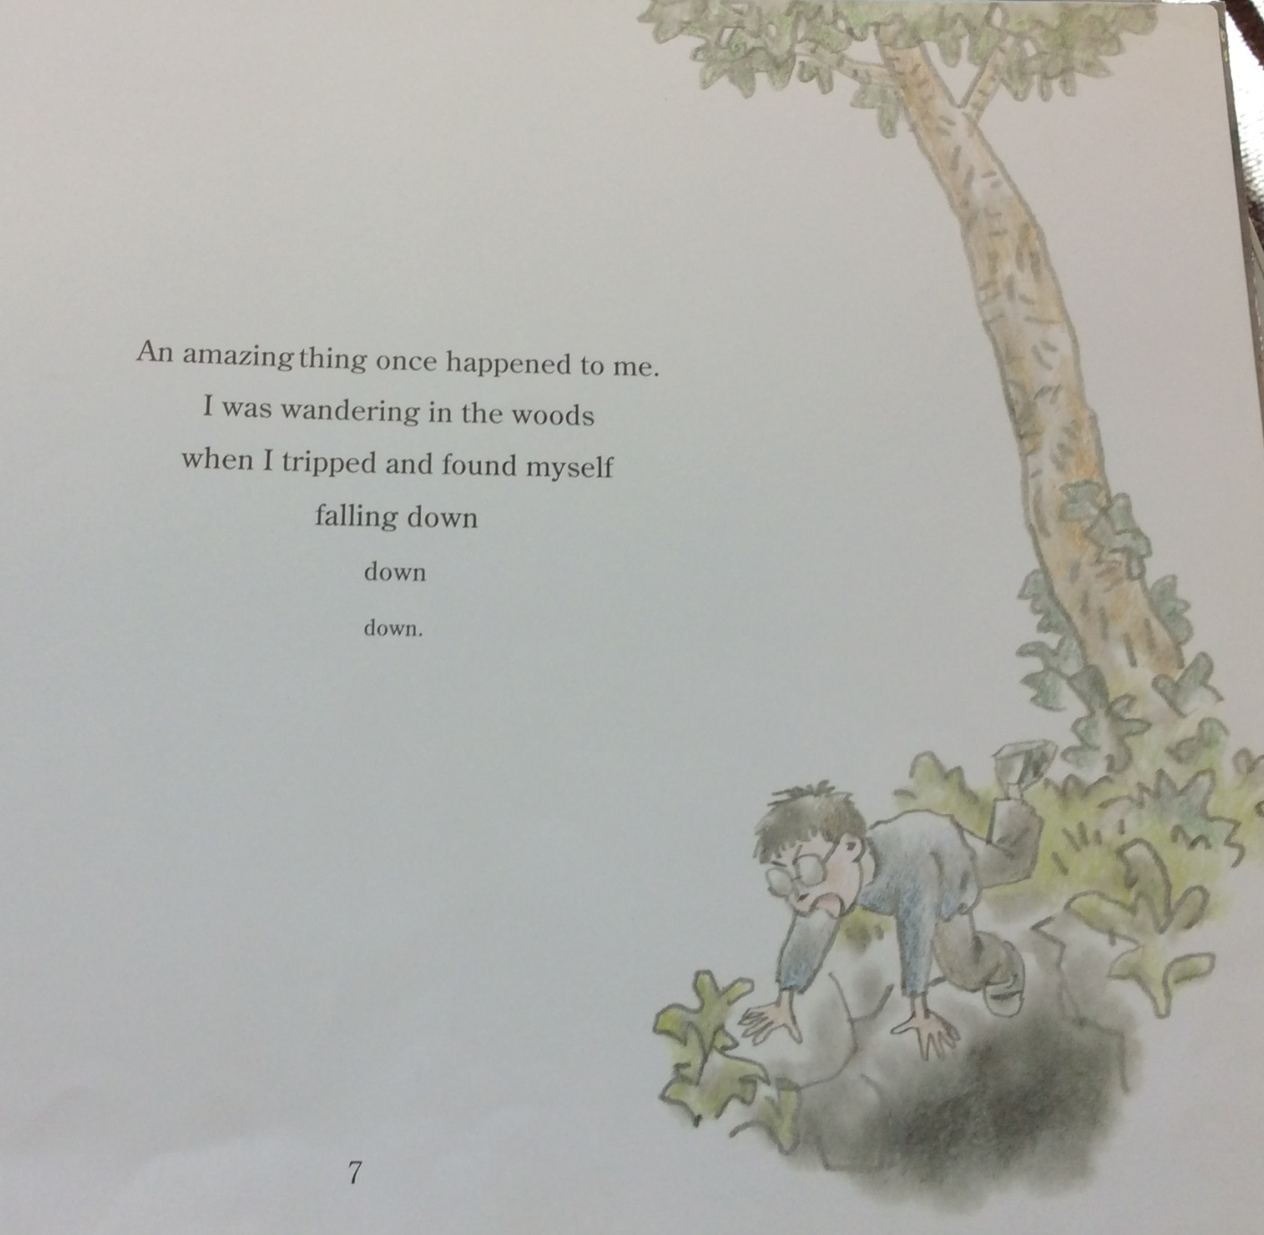
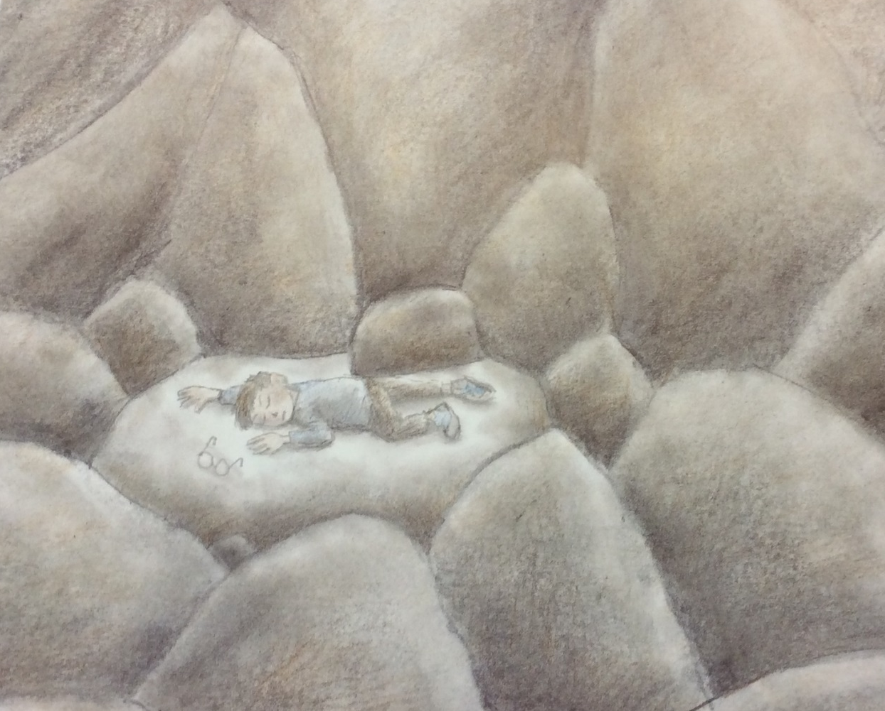
We’re going to read the start of Stone Age Boy today

Slide 18
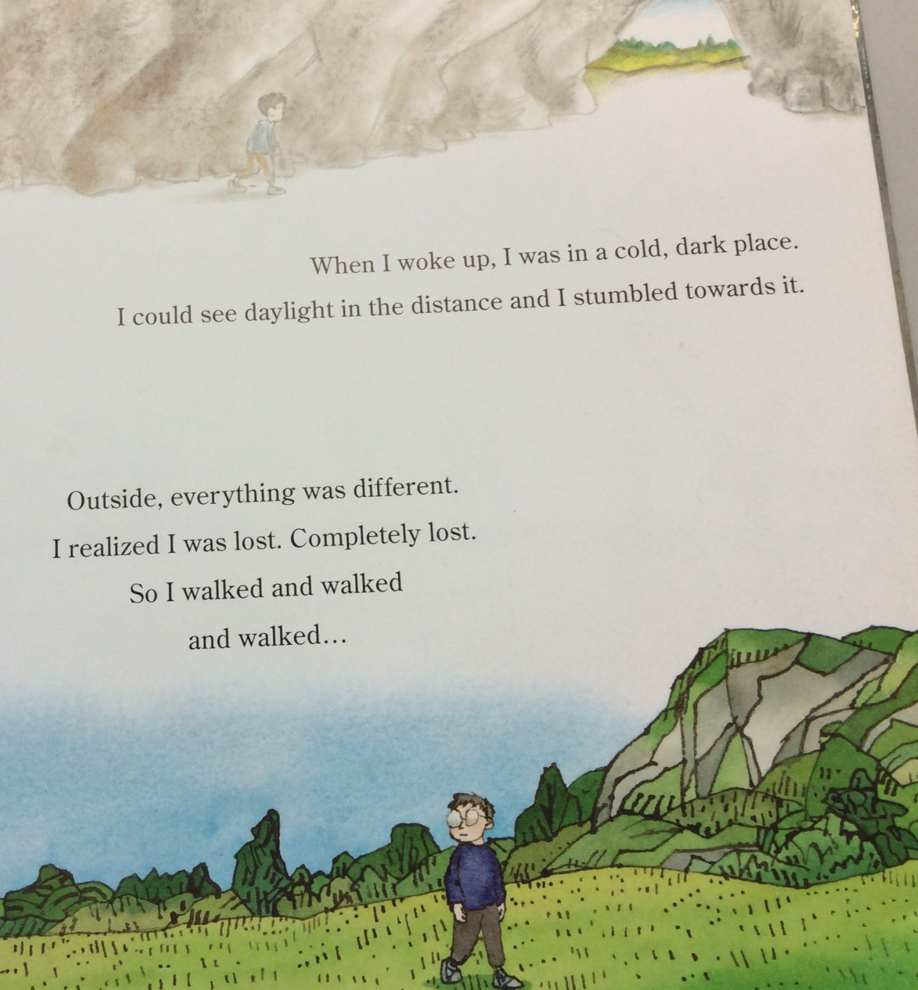
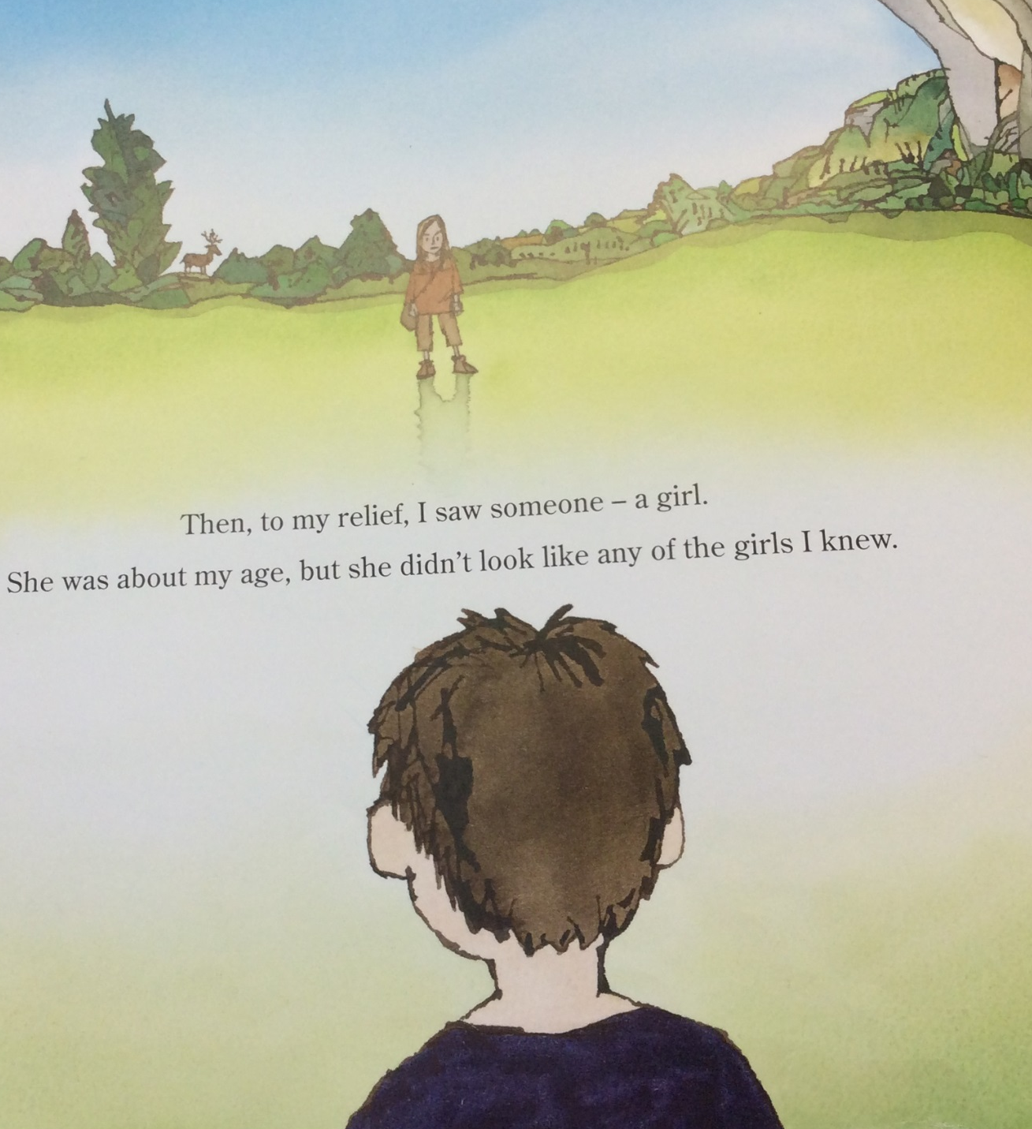

Slide 19
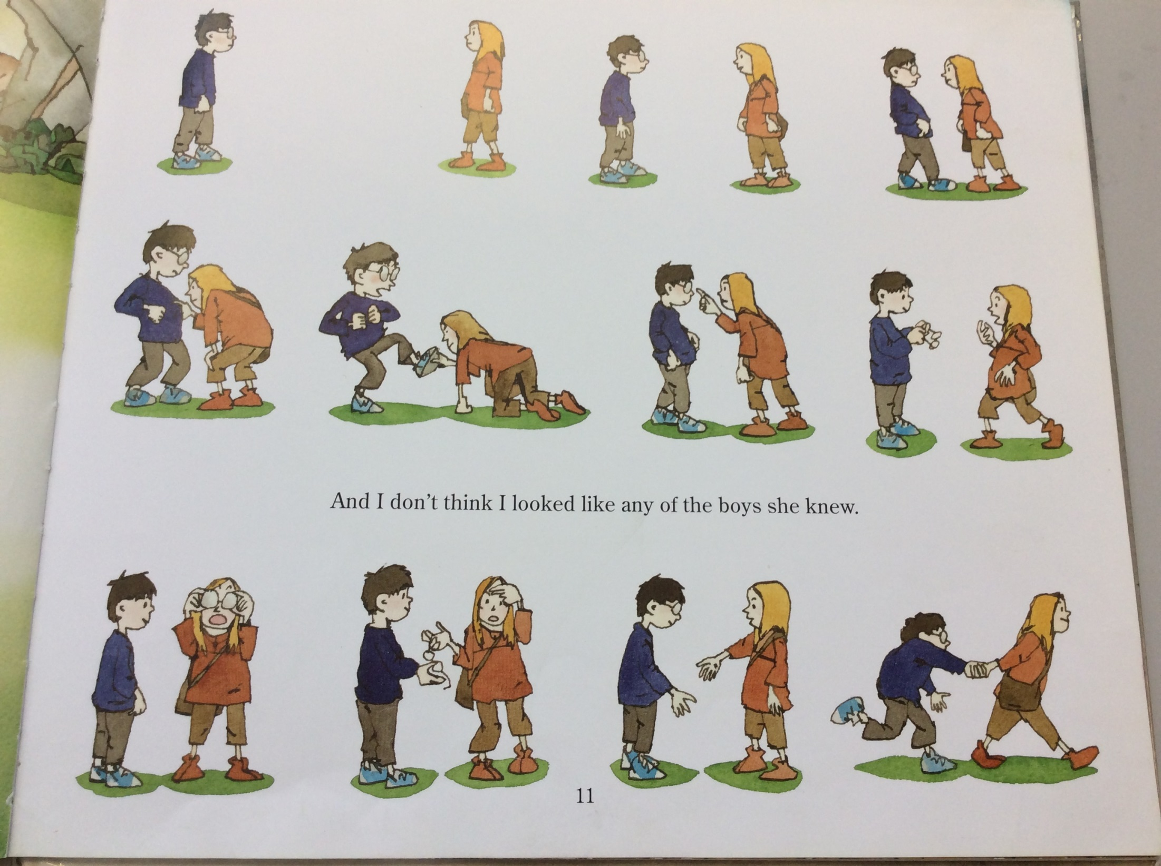

Slide 20
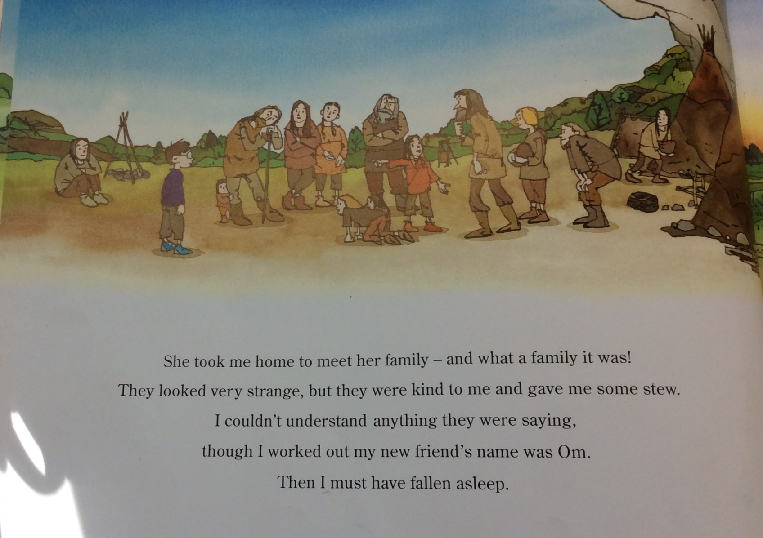

Slide 21
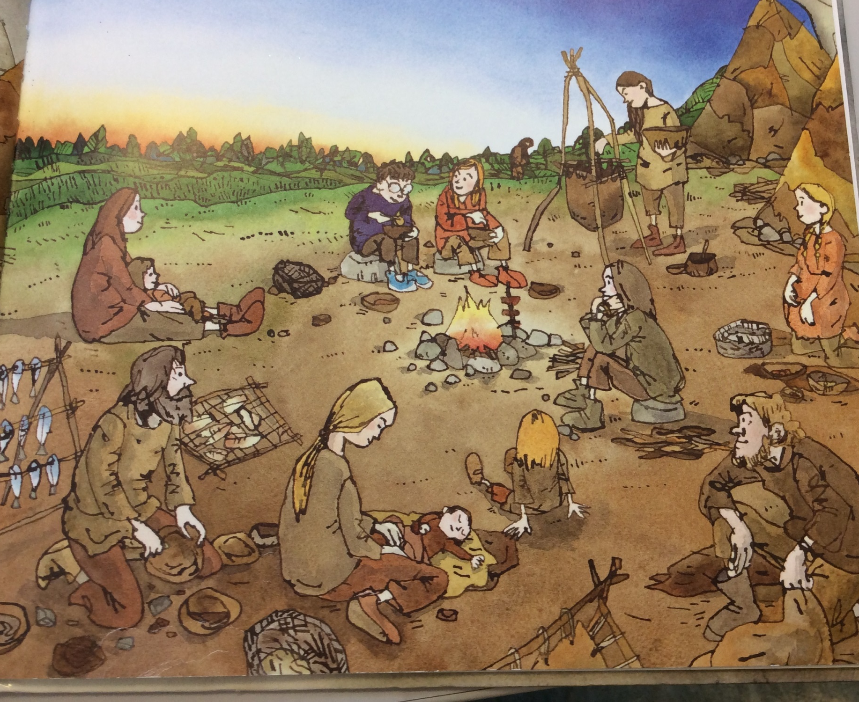
ING openers
The verb (doing word) will go at the beginning of the sentence.
E.g. Looking around the camp, the Stone Age boy saw lots of new, unusual things.
(ing opener) (main clause)
The comma goes after the opening phrase and before the main clause.
The main clause make sense on its.
Make a list of all the things you can see happening in this picture
Remember to start with the verb
Sitting next to the fire,
Eating his dinner,
Watching the Stone Age Boy,
Helping the camp,
____________________________________________________________________

Slide 22
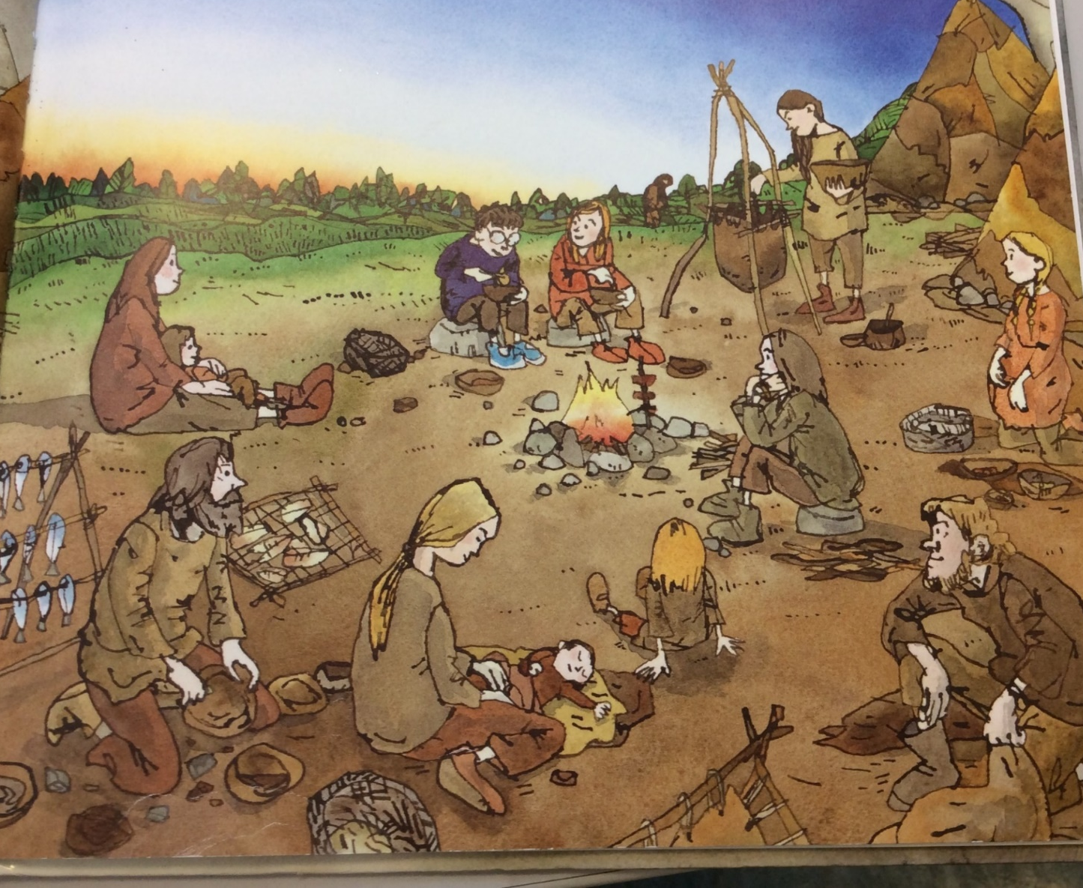
E.g. Looking around the camp, the Stone Age boy saw lots of interesting and unusual things.
1. Feeling amazed, everybody around the camp watched _____________________________________________________________________________________________.
2. __________________________________ , the boy ate his dinner happily.
3. Sitting next to the fire, _______________________________________________________________________

Slide 23

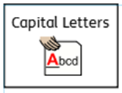

Now try 3 of your own. Remember the comma after the ing opener.
____________________________________________________________________________________________________________________________________________________________________________________________________________________________________________________________________________________________________________________________________________________________________________________________________________________________________________________________________________________________________________________________________________________________

Slide 24
Thursday 21st January
L.O To be able to use inverted commas for speech
Subject: English

Slide 25
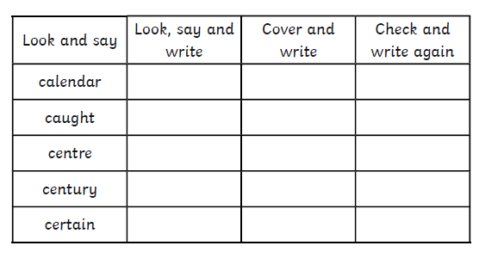
L.O To be able to spell words from the Y3/4 word list

Slide 26
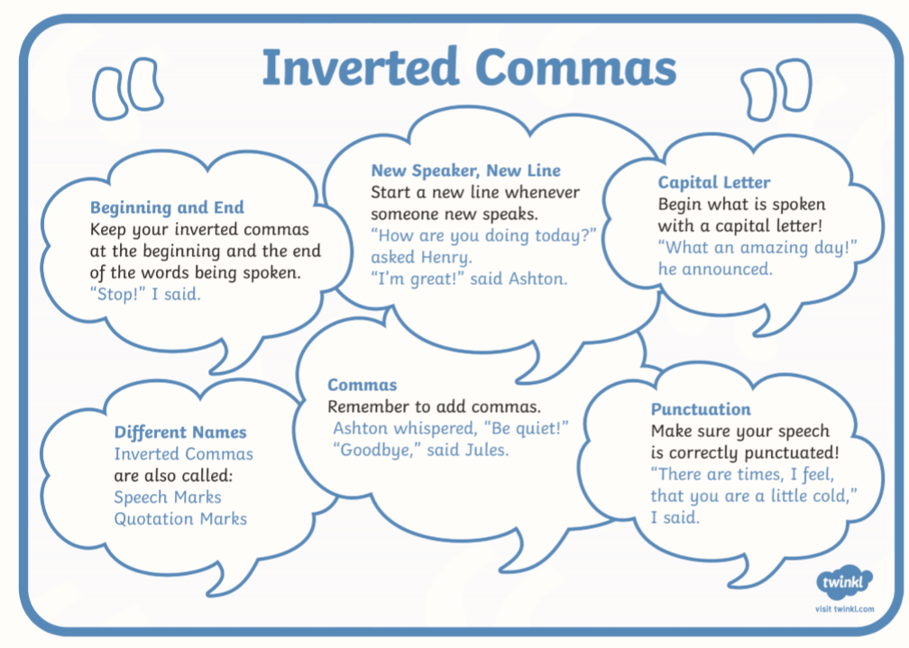
E.G
“Hello Year 3 and 4!” said Mrs White
Inverted commas song
Listening to this to remind you what speech should look like!
https://www.youtube.com/watch?v=uoE9ET6CtaI

Slide 27
Have a think about the Om and the Stone Age boy would be saying to each other

Slide 28
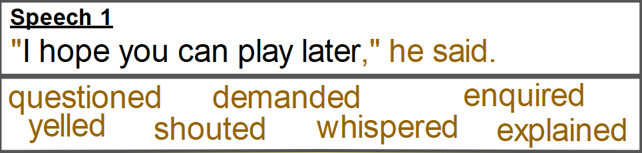
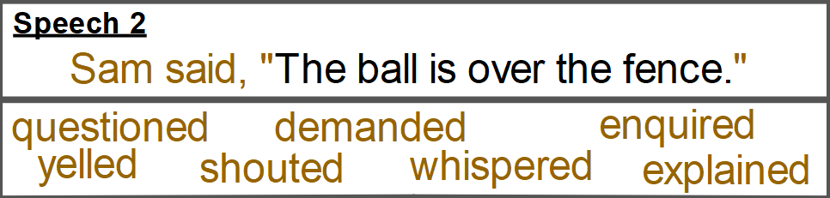
The Stone Age boy said, “Hello, who are you?”
“I’m Om. Where have you came from?” she questioned.
Remember
Inverted commas (speech marks) go around the part that has been spoken.
Punctuation ? ! , goes inside the inverted commas.
Who is speaking can before or after the speech.
I’m Om, where have you came from?
Hello, who are you?

Slide 29
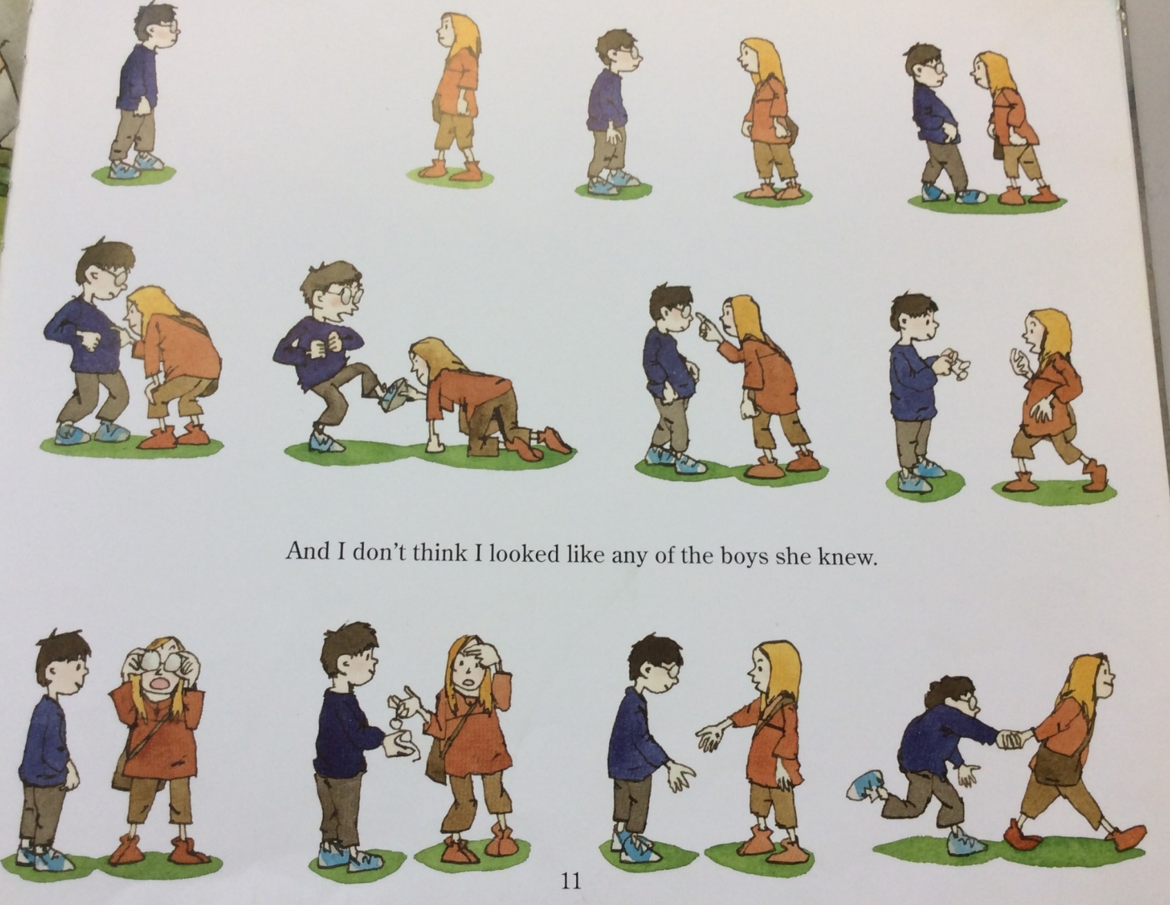
Put the inverted commas around the parts that have been spoken.
1. The boy stated, I fell in the woods and ended up here!
2. You look different! What have you got on your eyes? questioned Om.

Slide 30

Finish the conversation with 4 sentences of your own.
3.________________________________________________________________________________________________________________________________________________________________________________________
4._____________________________________________________________________________________________________________________________________________________________________________________
5.___________________________________________________________________________________________________________________________________________________________________________________
6.__________________________________________________________________________________________________________________________________________________________________________________________

Slide 31
Friday 22nd January
L.O To be able to write a conversation using inverted commas
Subject: English

Slide 32
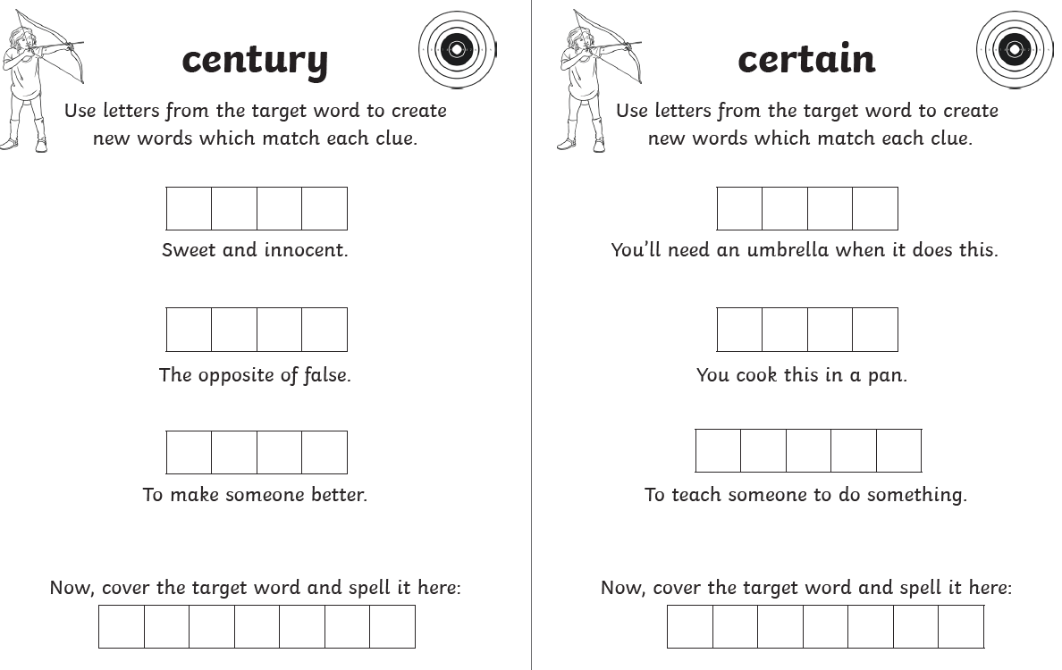
L.O To be able to spell words from the Y3/4 word list

Slide 33
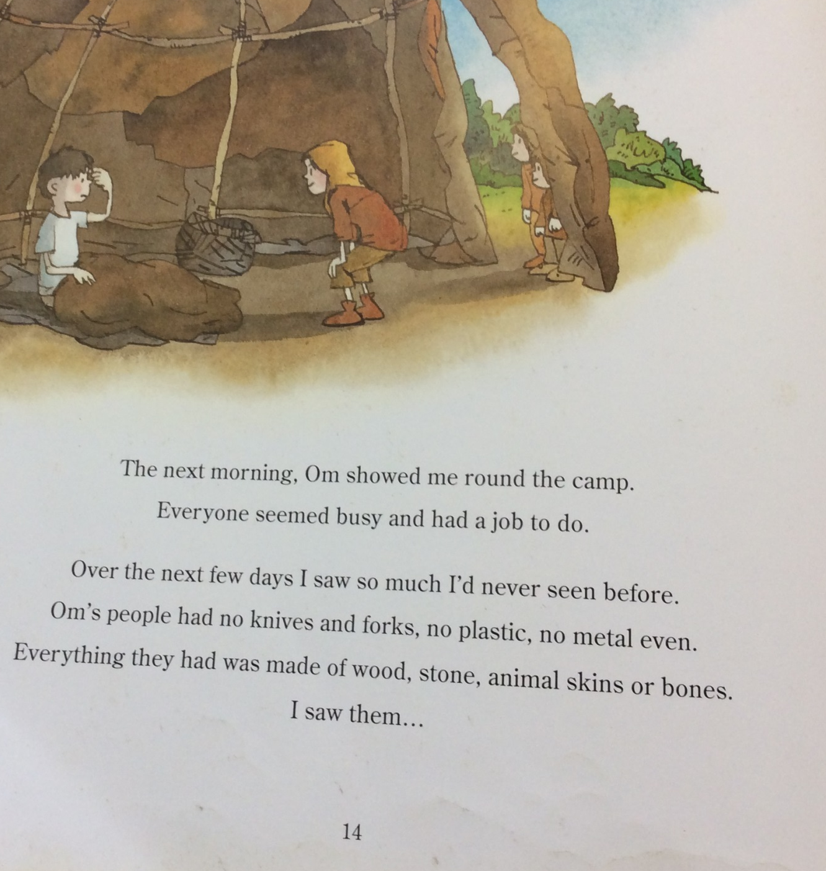
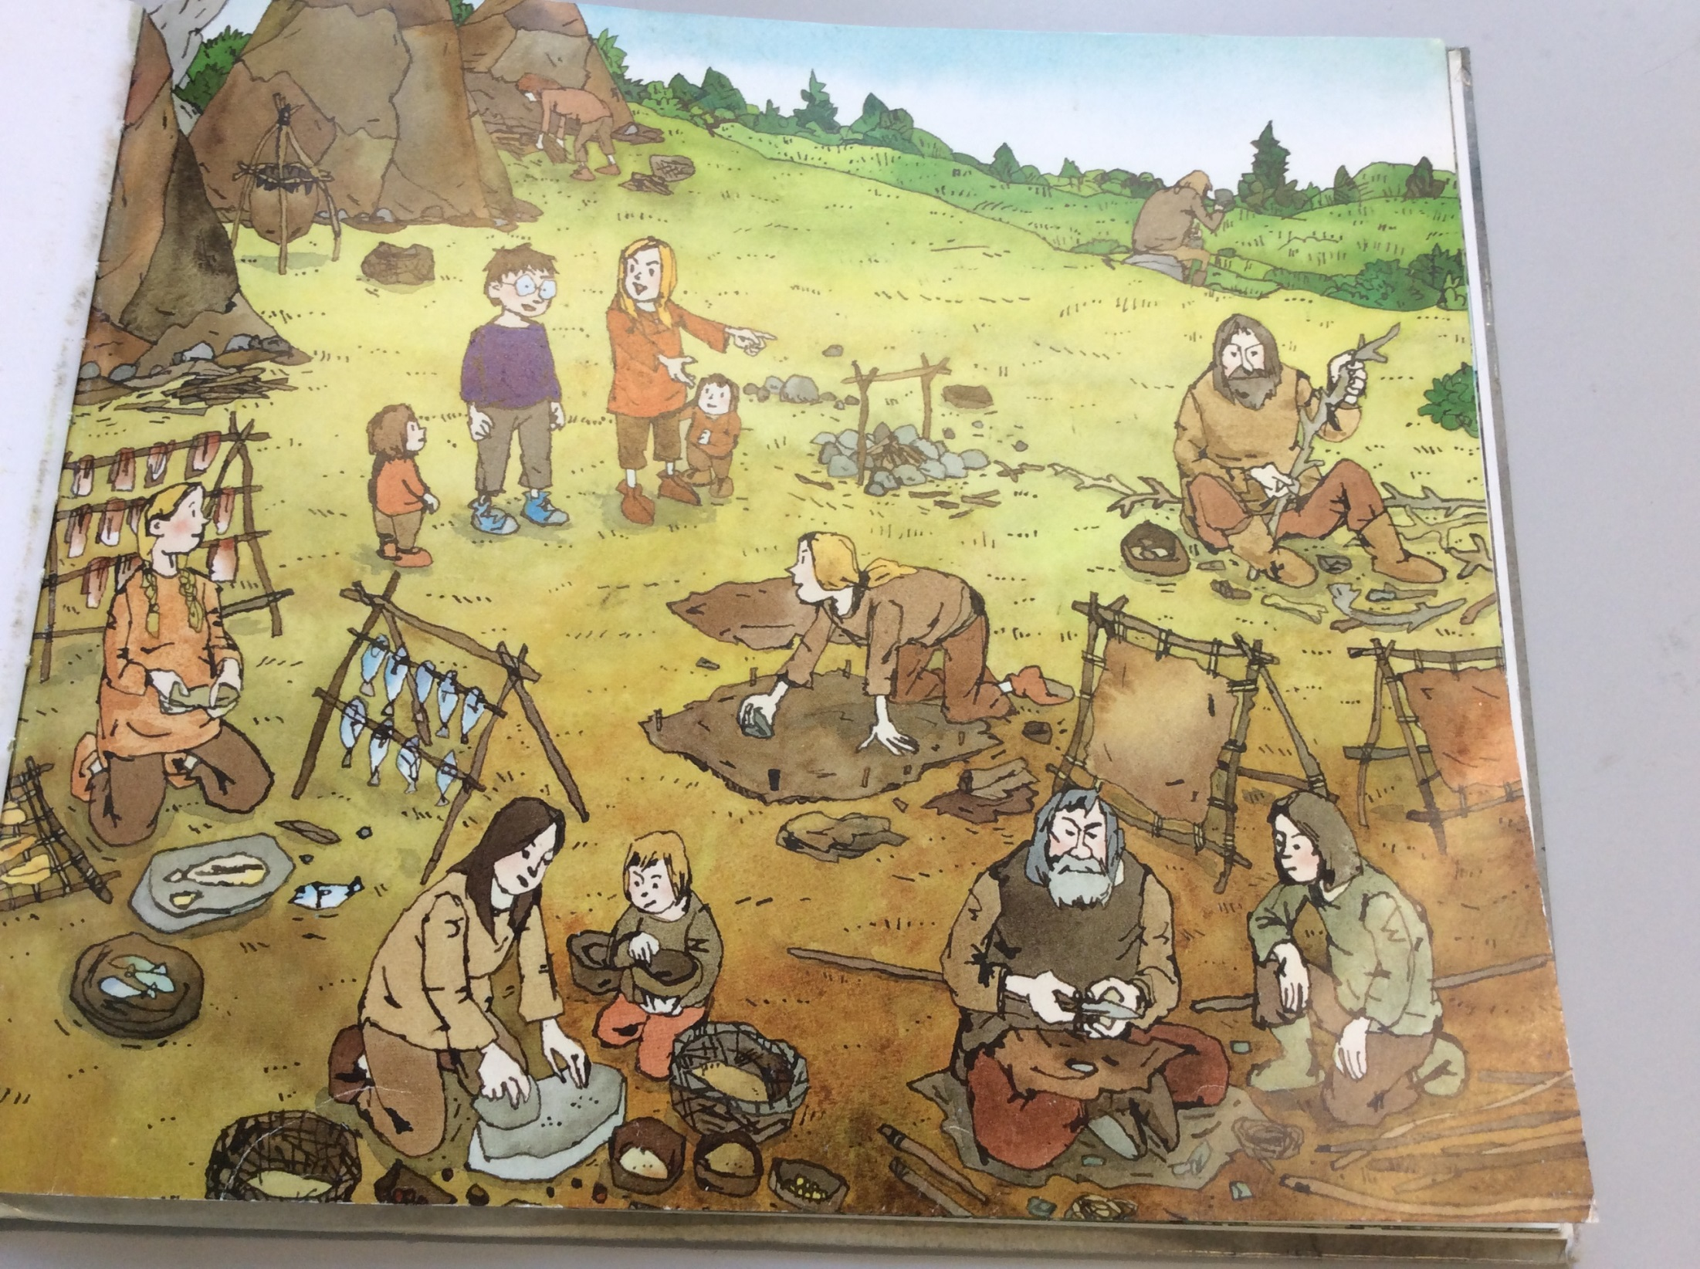
Next 2 pages of the story. You can read back the start of the book from Wednesday if you would like.

Slide 34
Have a think about what Om might be telling the Stone Age boy about her home.
You could use some of your knowledge of the Stone Age to help you (think of the comprehension on Monday’s lesson)
_______________________________________________________________________________________________________________________________________________________________________________________________________________

Slide 35
Here is the start of the conversation between Om and the Stone Age boy for you. Put the inverted commas in the right place.
Everybody is busy and has a job to do. If you look over there, you can see her taking the bones out of the fish and hanging them to dry, explained Om.
The boy replied, That is very interesting. We buy all of our food from a shop and it is just ready to eat.
What’s the fun in that? laughed Om.
The boy asked, What are the 2 men making over there?

Slide 36
Now have a go at finishing the conversation yourself.
Try both Speech 1 and Speech 2
Remember to start a new line when a new speaker starts.
______________________________________________________________________________________________________________________________________________________________________________________________________________________________________________________________________________________________________________________________________________________________________________________________________________
________________________________________________________________________________________________________________________

Slide 37

Well done everyone!
Keep up the super work!

