Slide 1



Date: Monday 22nd February 2021
LO: To be able to identify safety hazards in the kitchen.
Subject: Technology

Slide 2
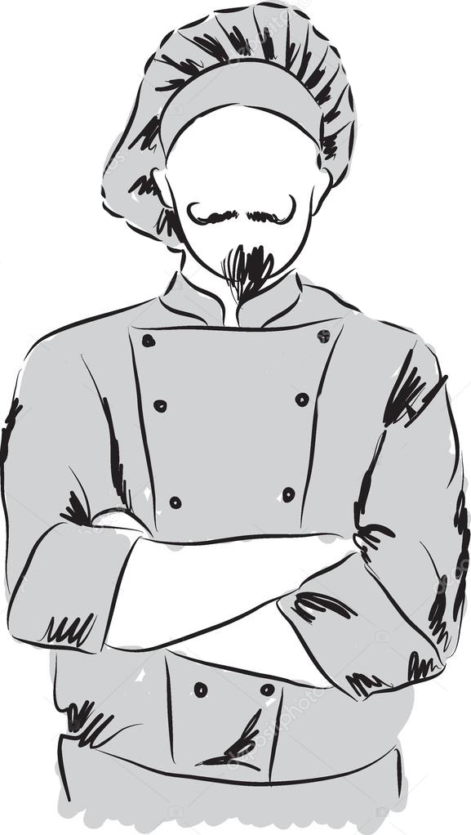
Kitchen safety awareness is crucial during food preparation and cooking, as well as during clean-up and daily living.
Understanding the hazards present in the kitchen can help you avoid causing an accident or subjecting your family to a bout of food poisoning.

Slide 3
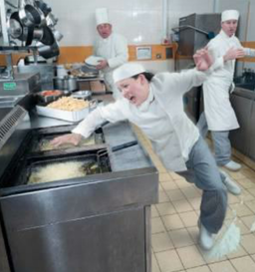
In order to stay safe in the kitchen, it's important to understand the dangers present in this area of your home.
From sharp knives to hot stoves, reading up on kitchen hazards can help you change your habits and protect your family.

Slide 4
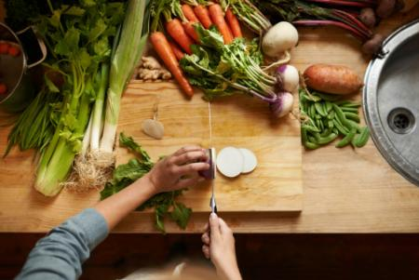
Knife Safety
Using a knife appropriately can help prevent serious injuries.
Always handle knives with caution.
When picking up a knife, make sure you aren't holding anything else or are distracted.
When chopping round objects, cut one side to make it flat and then lay the flat side down on your chopping block. This way, you can stabilise whatever item you are chopping.
Grasp the knife handle firmly and lay your other hand on top of the knife to prevent any blade contact.

Slide 5
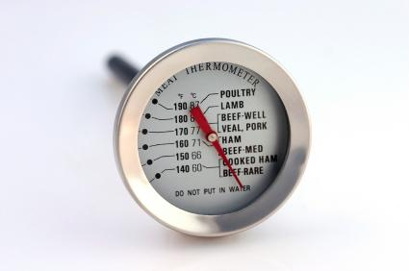
Handling Hot Dishes
Hot dishes can not only pose a risk to you, but others around you. To stay safe:
Do not leave stovetop dishes unattended while the burner is on. Use oven mitts
Turn pot handles inward or angled back so you don't accidentally bump them.
Never overfill your pot to prevent the water from overflowing.
Practice Proper Food Safety
In addition to the hazards from heat and sharp objects, the kitchen also presents safety concerns surrounding food preparation. Improper food preparation can lead to food poisoning like salmonella.

Slide 6

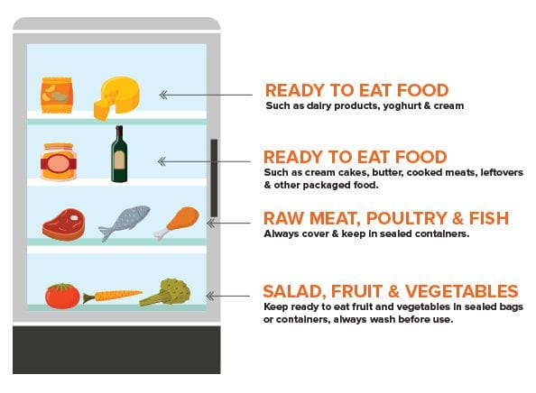
Shop Smart
Don't buy any food that is past the expiration date.
Do not buy meat in a torn or leaking package.
When buying meat, place it in an extra bag before putting it in your cart.
Do not buy dented or damaged cans.
Store Your Food Properly
Refrigerate food within one to two hours.
Keep your refrigerator temperature below 40 degrees Fahrenheit and the freezer below zero.
Wrap meat securely so it will not leak on other food and store it on a bottom shelf so it doesn't drip on other foods.

Slide 7
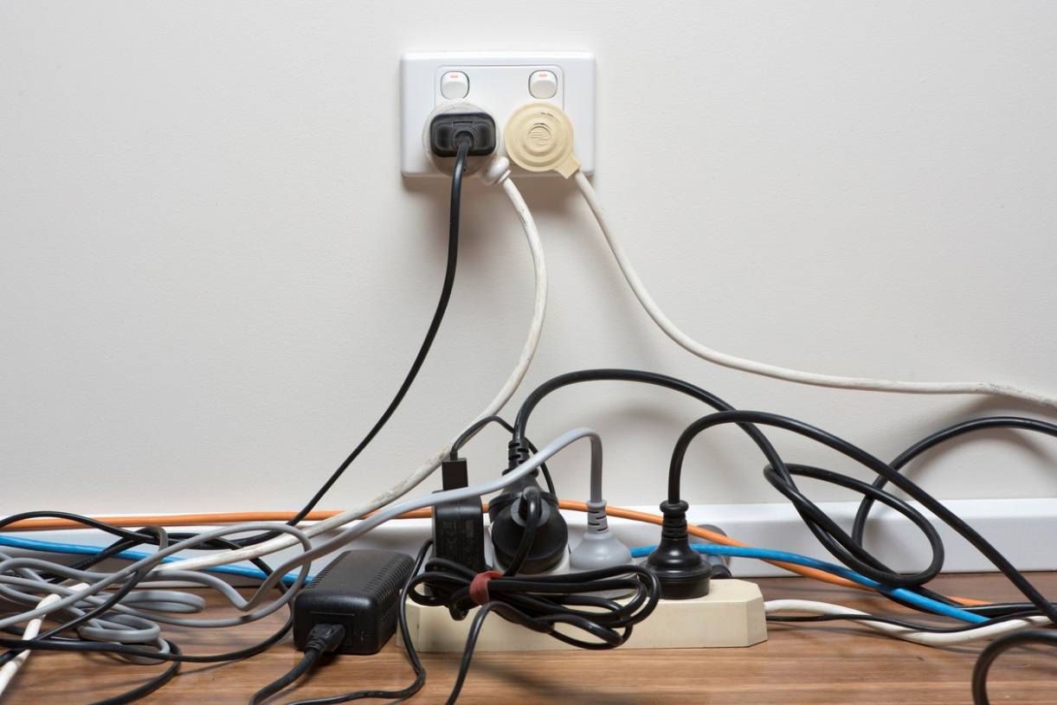
Small Kitchen Appliance Safety
Make sure you always unplug the appliance when you are done using it
Don’t overload sockets
Make sure the cord is untangled and out of the way to prevent tripping over it

Slide 8
Take a look at the kitchen to the left.
How many hazards can you identify?
Circle each and explain your choices!
(There are up to 13 to find)

Slide 10
End of Lesson

Slide 11

Date: Tuesday 23rd February 2021
LO: To be able to explain how to record and report online bullying on apps and platforms.
Subject: PSHE

Slide 12
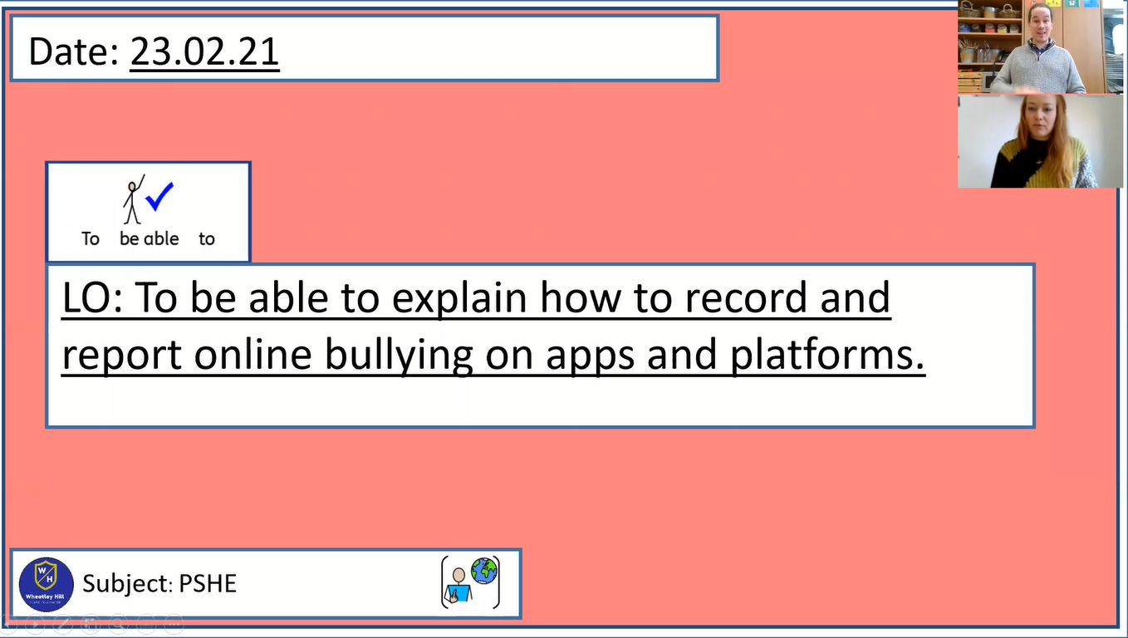
Pre-recorded Teaching
Mr. Herdman’s online teaching video is on our school website. It will support you to complete the work in this lesson. This video will act as a support but all of the work can still be successfully understood & completed using paper-based versions of this pack. If you need further support to understand / complete work then please contact school via e-mail or telephone.
You can also copy and paste this link if you would prefer:
https://www.whprimary.com/copy-4-of-covid19

Slide 13

Cyberbullying
What is cyberbullying?
In what ways do you think cyberbullying can happen?
What are the effects of cyberbullying?
How can we get help if cyberbullying happens to us or someone we know?

Slide 14
Cyberbullying
Watch this video to learn a little more about cyberbullying.
https://www.bbc.co.uk/cbbc/watch/what-is-cyberbullying

Slide 15
Cyberbullying
Unfortunately, some people choose to use technological devices to hurt people instead of helping them.
Bullying is when someone chooses to hurt someone else on purpose with their actions or with their words.
It is most often something that happens more than once but it can also happen just once.
Bullying can have serious and long-lasting effects.

Slide 16

Cyberbullying
Bullying or cyberbullying IS NOT OK. It is not acceptable.

Slide 17
Cyberbullying
Bullying can happen in person or using a technological device.
When someone chooses to hurt other people using a phone, computer, tablet or other online device, this is called cyberbullying.
Using technology in this way is unacceptable behaviour and can cause a lot of hurt and upset.
Let’s find more out about cyberbullying by taking part in a quiz.

Slide 18

Cyberbullying is any sort of bullying that happens through a technological device. For example, a phone, a computer, a tablet or a gaming device.
True
False

Slide 19
Cyberbullying is any sort of bullying that happens through a technological device. For example, a phone, a computer, a tablet or a gaming device.
True – Cyberbullying is when people choose to hurt others through a phone, computer, tablet or a gaming device.
True
False

Slide 20
Cyberbullying isn’t as bad as physical bullying.
True
False

Slide 21
False – All bullying behaviours are
wrong and unacceptable.
True
False

Slide 22
Cyberbullying isn’t very common.
True
False

Slide 23
False – Unfortunately, cyberbullying is becoming increasingly widespread.
True
False

Slide 24
Cyberbullying includes liking a nasty online post about someone else.
True
False

Slide 25
Cyberbullying is any sort of bullying that happens through a technological device. For example, a phone, a computer, a tablet or a gaming device.
True – Name calling, posting and commenting on or liking nasty online posts, videos and photos is cyberbullying. So is starting and spreading lies about someone online. Cyberbullying also includes sending unkind messages, pressuring others online to do something they don’t want to do and being unkind to someone in an online game.
True
False

Slide 26
Cyberbullying doesn’t hurt people as much as face-to-face bullying.
True
False

Slide 27
False – All bullying behaviours can have serious and long-lasting effects. For example, anxiety, depression, loneliness, becoming withdrawn from family and friends, loss of self-confidence and also feeling worthless.
True
False

Slide 28
We can help to stop cyberbullying.
True
False

Slide 29
True – We can choose to never hurt others online using a technological device and we can speak out if we see it happening to us or our friends.
True
False

Slide 30
Cyberbullying
It is important to remember that if you ever experience bullying, it is not your fault and there are people who can help make it stop.
If you see or experience cyberbullying, it is important to tell a trusted adult and ask for help.

Slide 31
Cyberbullying – getting help
So what are the strategies for tackling and getting help for cyberbullying?
Report it via the online site that you experience it on, then tell a trusted adult about it and ask for help.
Block or remove the account or person who is carrying out the bullying.
Contact the police if you experience bullying because of who you are, where you are from or a life choice you have made as these are ‘hate crimes’ and will be taken seriously.
Keep evidence to show a trusted adult or if necessary, the police.

Slide 32
Cyberbullying – getting help
Remember bullying is not your fault and there are people who can help.
Be kind online all of the time!
Say no to cyberbullying!
Remember, bullying in any form is wrong and that all people have the right to live safe, happy and healthy lives which are free from fear.

Slide 33

Cyberbullying
Watch this video about staying safe online in BSL
Don't like it? Block it, report it
Please feel free to take at the linked BSL Videos, if you wish.

Slide 34
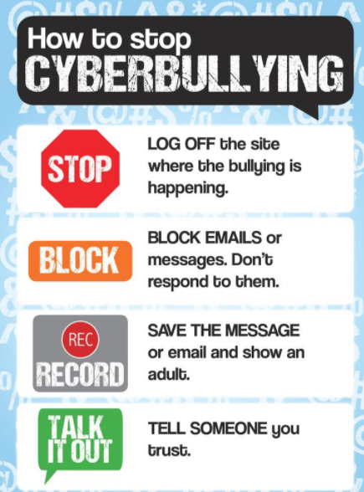

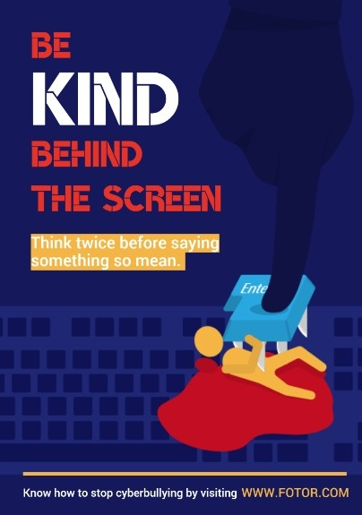
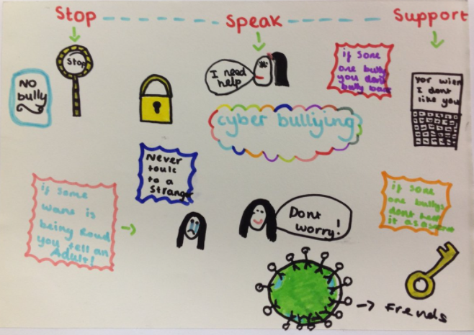
Cyberbullying
Create a poster or a leaflet about what you have learnt today about cyberbullying, how to stop cyberbullying and how to stay safe online.

Slide 35
End of Lesson

Slide 36
Date: 24.02.2021
LO: To be able to complete a circuit of exercises and beat my personal best.
Subject: P.E

Slide 37
Today, we are going to complete an at-home P.E lesson.
The aim of this lesson is to improve our fitness, our flexibility, coordination and most importantly… to have some fun.
The following slides show the whole workout and instructions on how to complete each exercise.
The exercises have advice on how to make them easier or harder and you can complete the circuit as many times as you wish. If possible, however, try and complete this circuit at least 3 times, between now and next Wednesday.
One circuit takes 15 minutes with 30 second breaks between each exercise (however you can lengthen or shorten your rest, depending on how you feel or shorten the exercise down to 30 seconds – remember you are competing against yourself and no one else).
You should be able to complete this workout with very little equipment. Something small for the last exercise, so you can touch your toe on it and a soft enough floor will be all you need.
Included at the end of this presentation is a table for you to record how many of each exercise you managed to do within the minute.
Have fun!

Slide 38
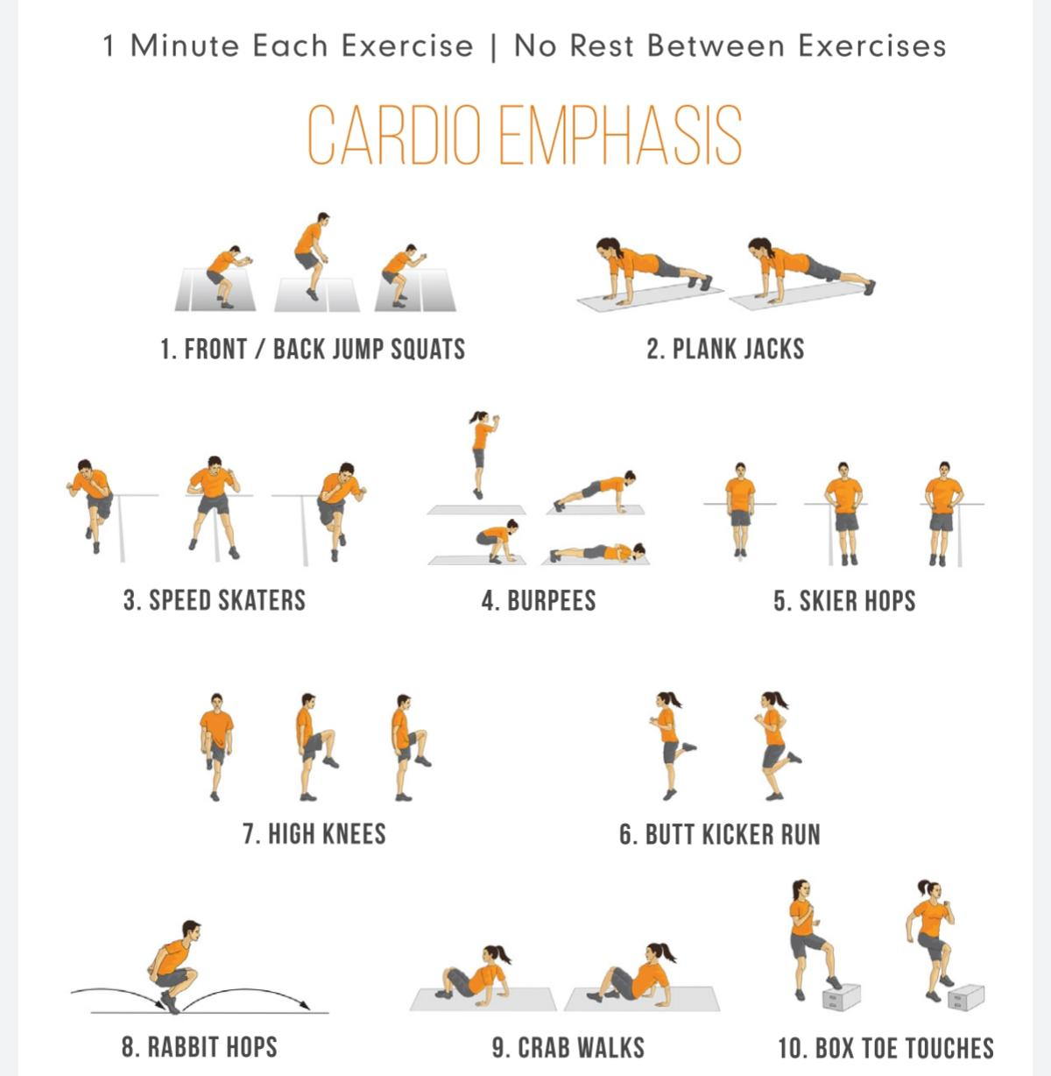

The workout
30secs rest between exercises

Slide 39
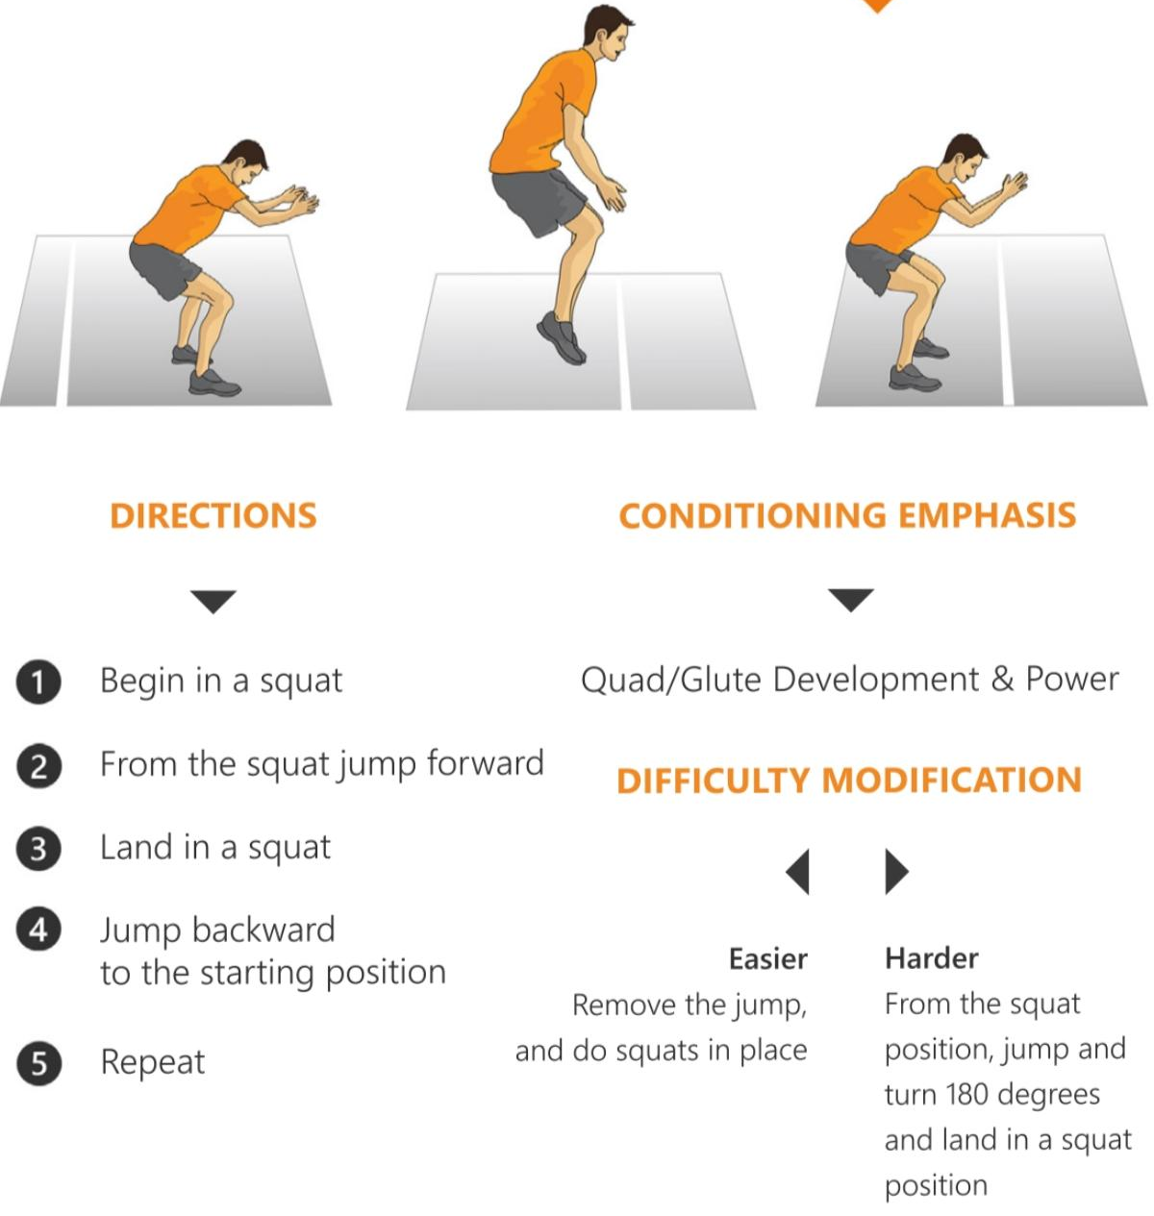
Front and Back Jump Squats

Slide 40
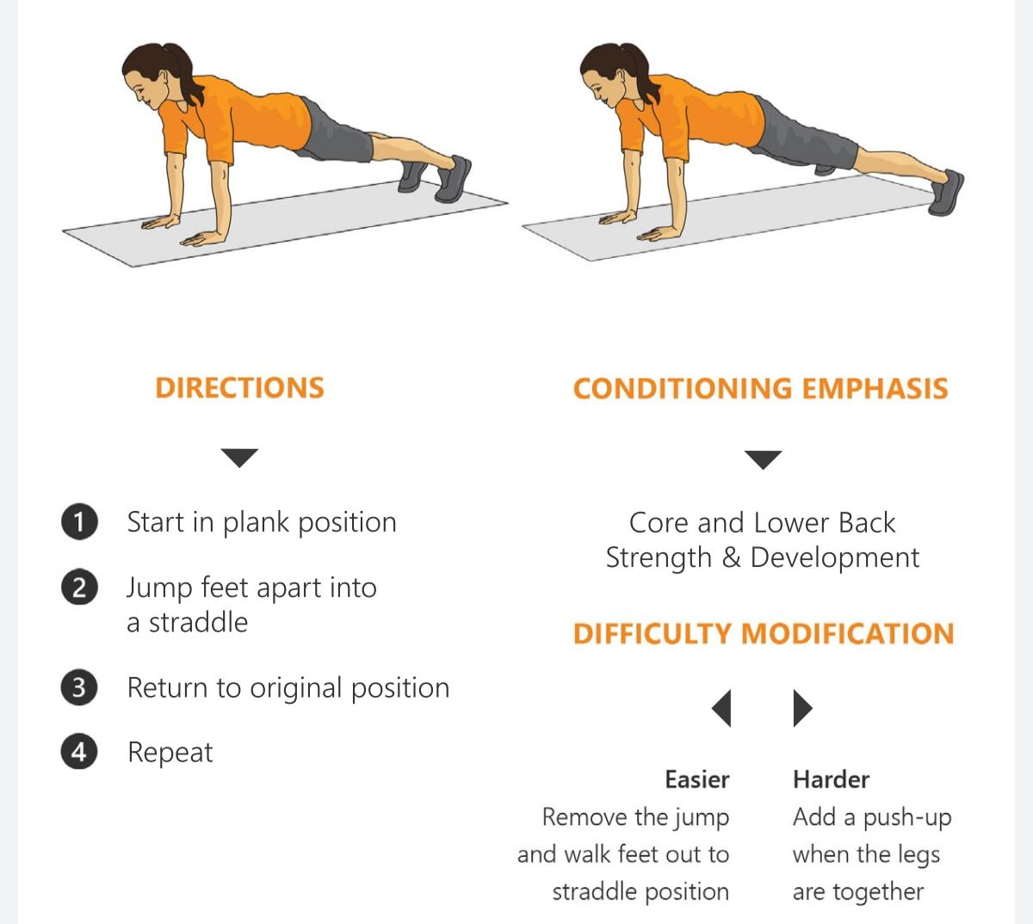
Plank Jacks

Slide 41
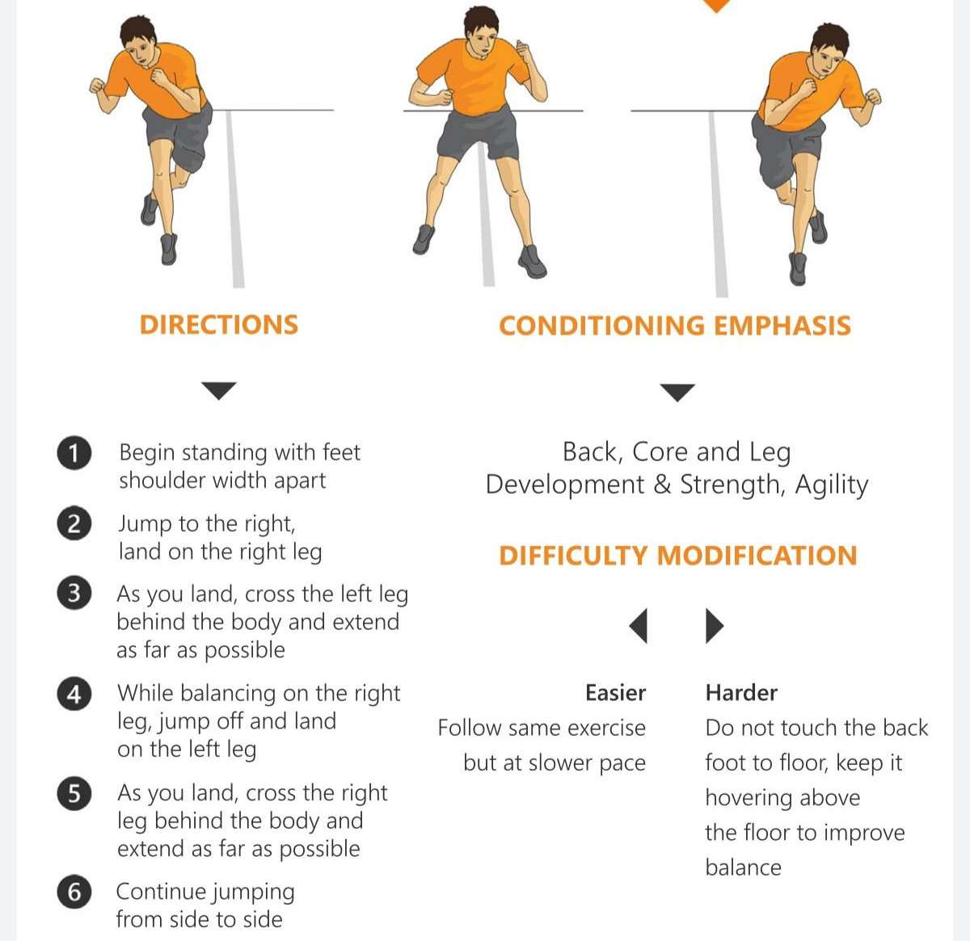
Speed Skaters

Slide 42
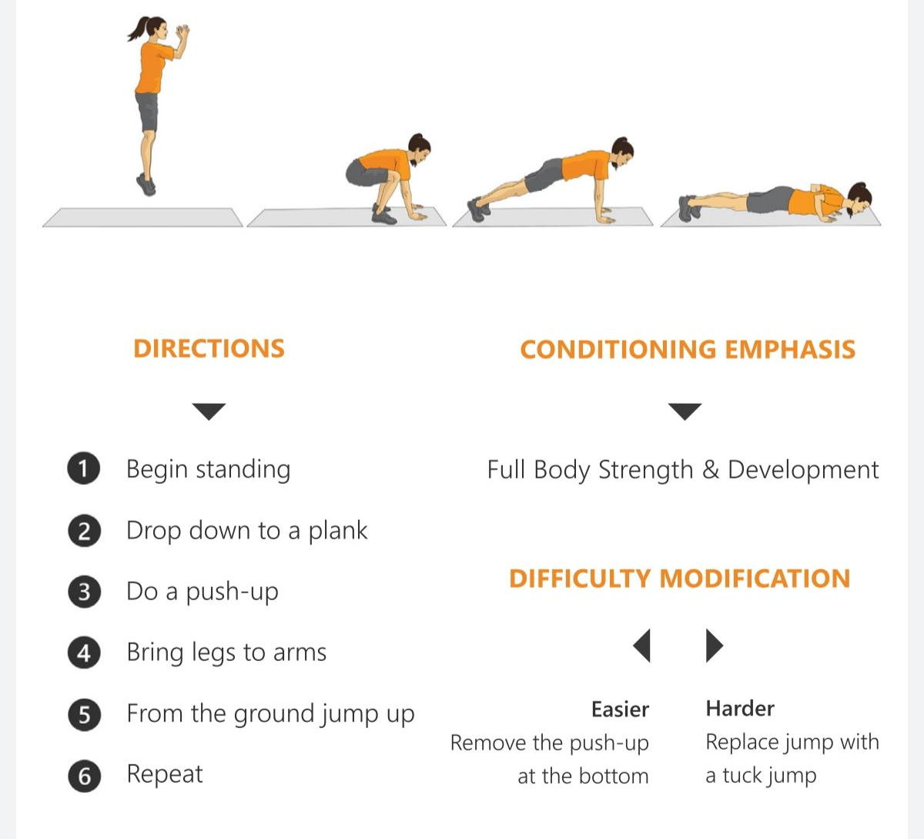
Burpees

Slide 43
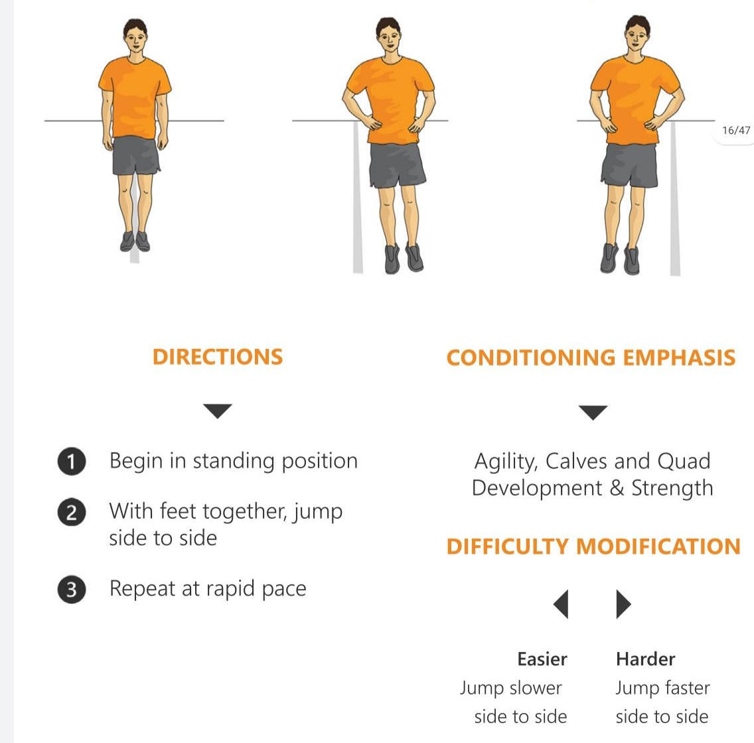
Skier Hops

Slide 44
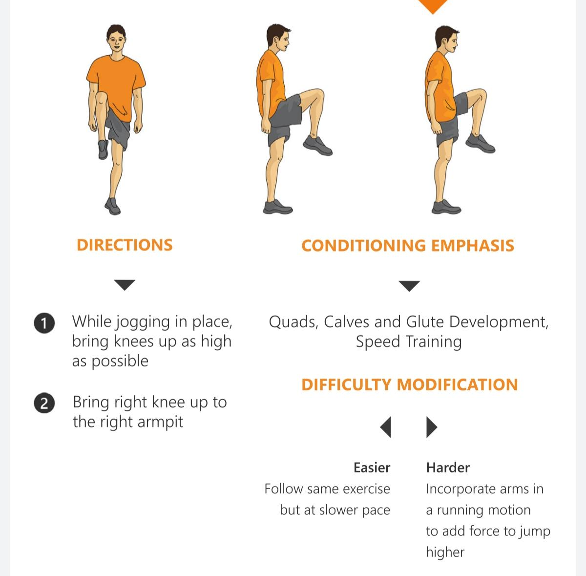
High Knees

Slide 45
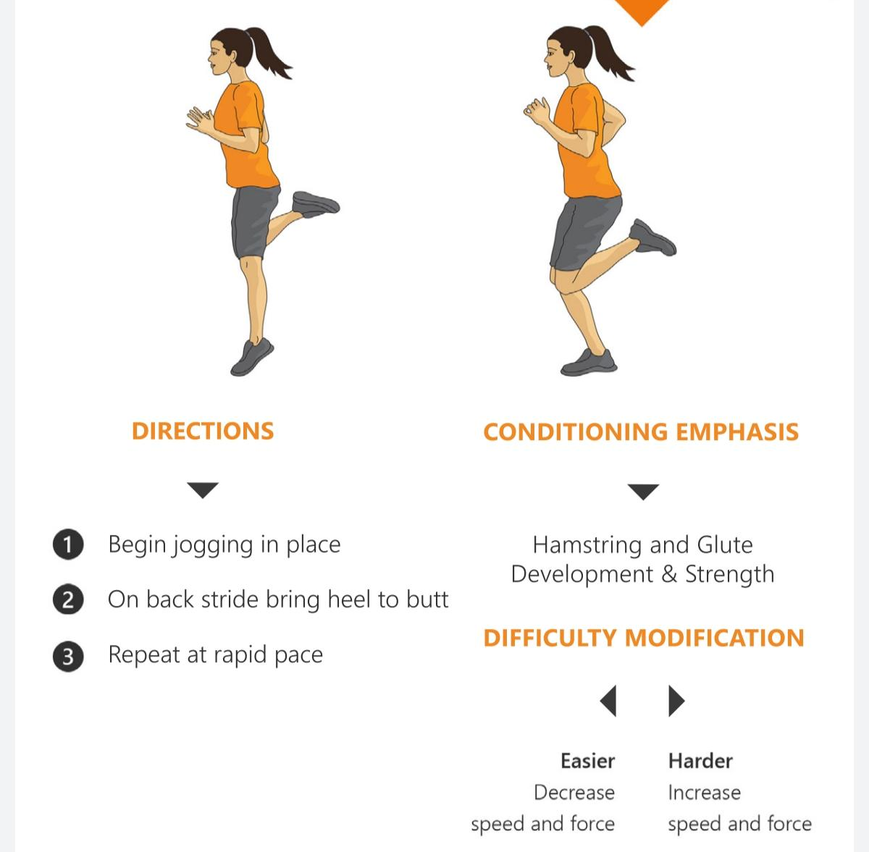
Butt Kicker Run

Slide 46
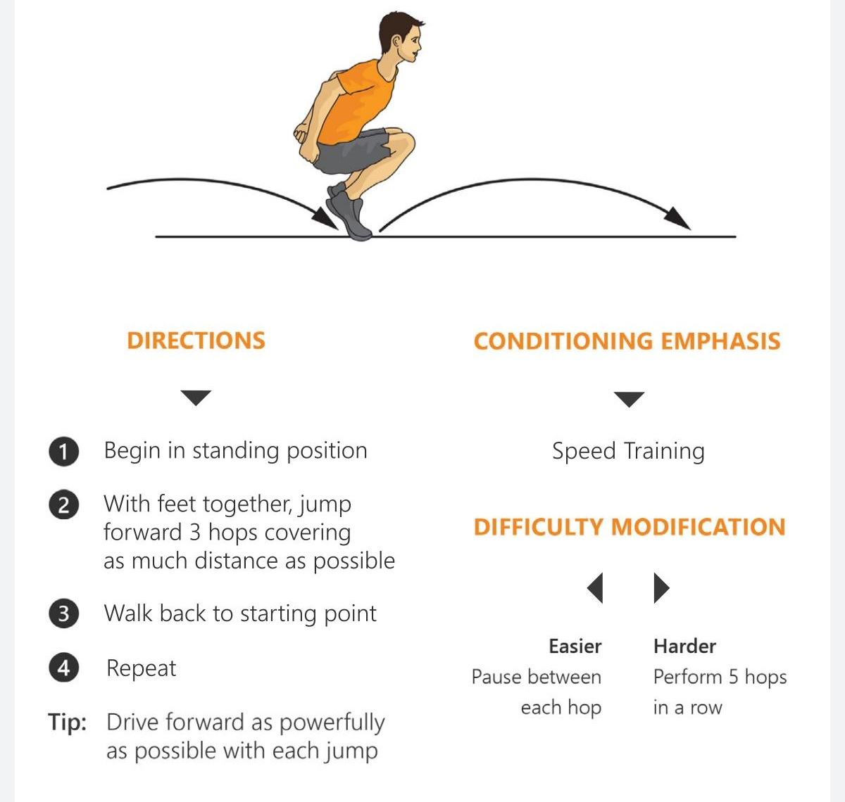
Rabbit Hops

Slide 47
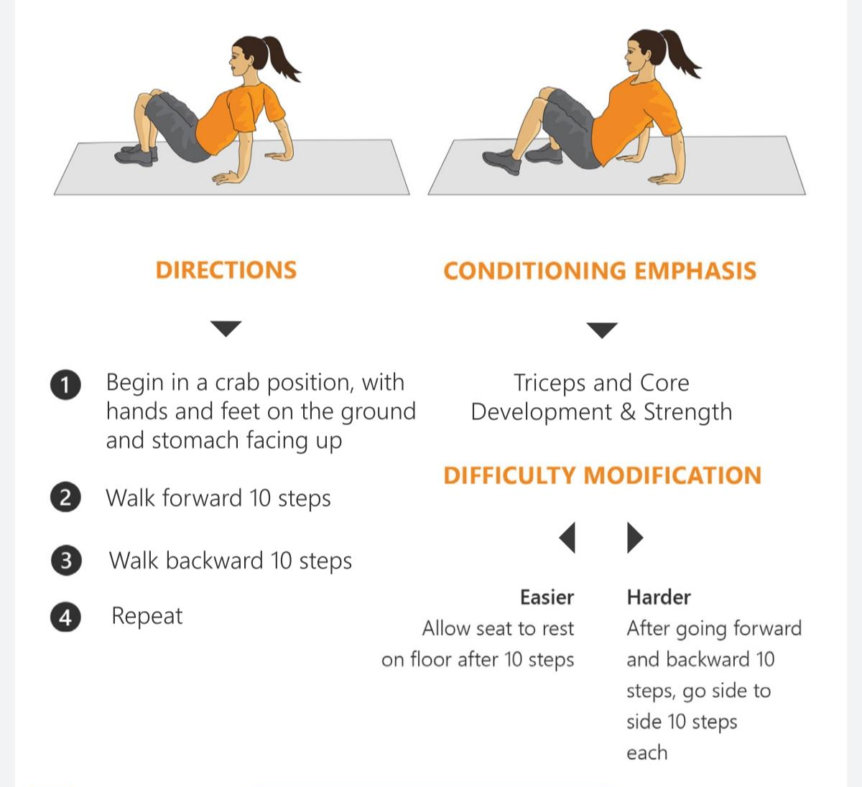
Crab Walks

Slide 48
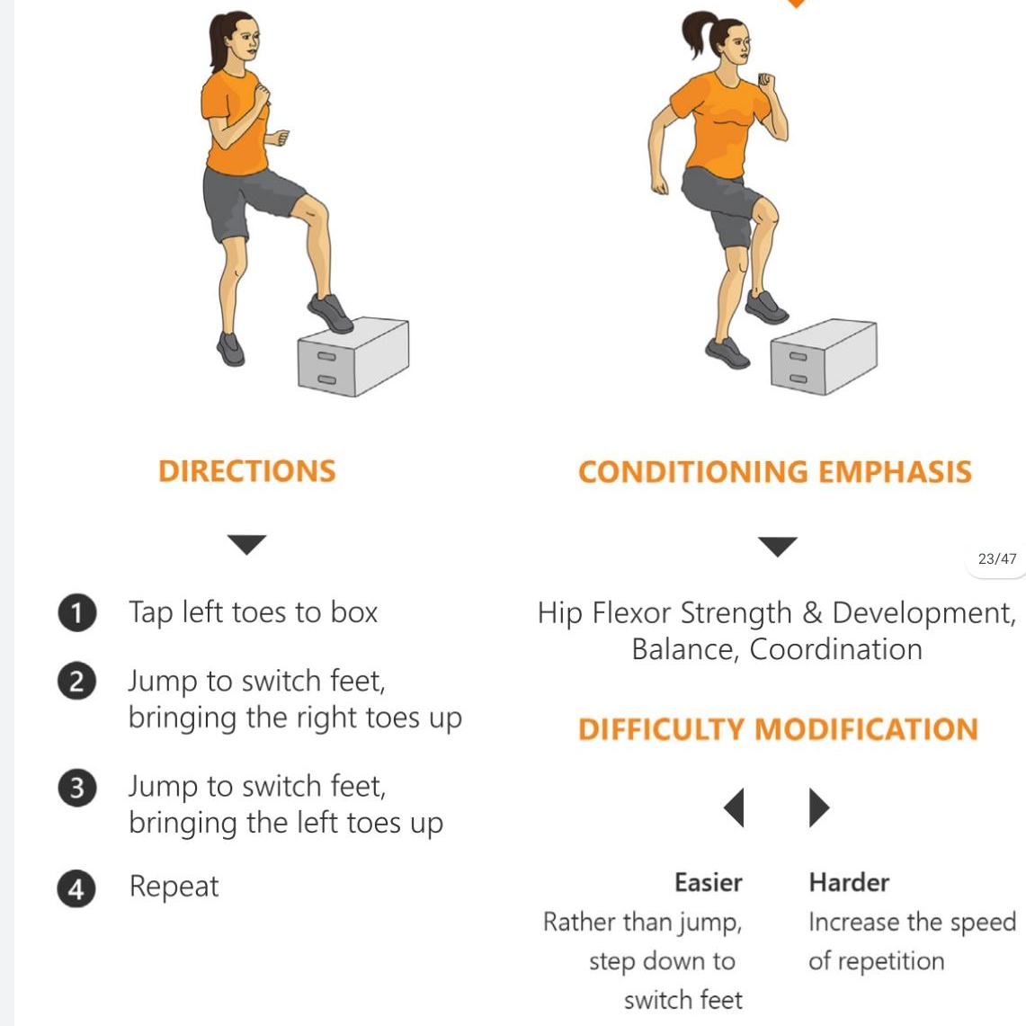
Box Toe Touches

Slide 49
Personal Best Chart
Name: ________________________________
Exercise | Example | Attempt 1 | Attempt 2 | Attempt 3
Front & Back Squats | 22
Plank Jacks | 35
Speed Skaters | 62
Burpees | 10
Skier Hops | 90
High Knees | 115
Butt Kicker Run | 92
Rabbit Hops | 6
Crab Walks
Box Toe Touches

Slide 50
End of Lesson

Slide 51

Date: jeudi 25 février 2021
LO: To be able to understand the French words for breakfast items.
Subject: French

Slide 52

We are going to learn about French breakfast items.

Slide 53
Que voudriez-vous pour le petit-déjeuner?
(What would you like for breakfast?)
Je voudrais…
(I would like…)

Slide 54

le pain
(bread)

Slide 55
le pain grillé
(toast)

Slide 56
le fruit
(fruit)

Slide 57
la confiture
(jam)

Slide 58
le sucre
(sugar)

Slide 59
le thé
(tea)

Slide 60
les céréales
(cereal)

Slide 61

le pain au chocolat
(chocolate bread)

Slide 62

le lait
(milk )

Slide 63
le croissant
(croissant)

Slide 64
le café
(coffee)

Slide 65

le jus d’orange
(orange juice)

Slide 66

le jus de pomme
(apple juice)

Slide 67

le fromage
(cheese)

Slide 68
le beurre
(butter)

Slide 69

l'œuf
(egg)

Slide 70
le chocolat chaud
(hot chocolate)

Slide 71
le miel
(honey)

Slide 72
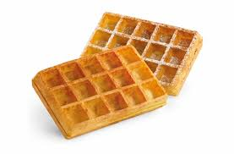
les gaufres
(waffles)

Slide 73

Le yaourt
(yoghurt)

Slide 74
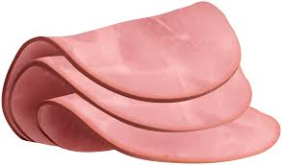
Le jambon
(ham)

Slide 75
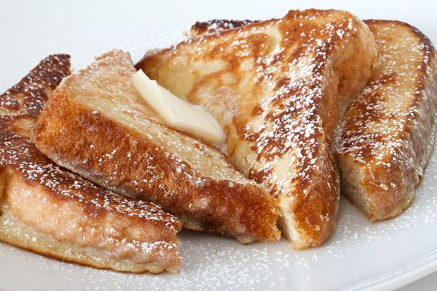
Le pain perdu
(French toast)

Slide 76


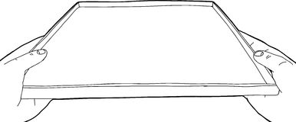


Can you work out what each child has ordered for their breakfast?
Je voudrais un croissant, du fromage et du jus d'orange?
Je voudrais un yaourt, du gaufres et du jus de pomme?
Je voudrais les céréales, du pain au chocolat
et du thé?
.
Je voudrais un pain grille, du beurre et du chocolat chaud?

Slide 77
Vocabulary
Breakfast le petit déjeuner
Egg l’oeuf
Bread le pain
Milk le lait
Fruit juice jus de fruit
Orange juice jus d’orange
Apple juice jus de pomme
Tea le thé
Waffles les gaufres
French toast le pain perdu
Butter le beurre
Cheese le fromage
Ham le jambon
Jam la confiture
Hot chocolate le chocolat chaud
Drinks les boissons
Yogurt le yaourt
Coffee le café
Sugar le sucre
Toast le pain grille
Fruit le fruit
Cereal les céréales
Croissant le croissant
Chocolate bread le pain au chocolat
Honey le miel
Je voudrais – I would like
and – et
with - avec

Slide 78
End of Lesson

Slide 79

Date: Friday 26th February 2021
LO: To understand the question, ‘Is this the world God created?’
Subject: Religious Education

Slide 80
Why should people with a religious faith care about the environment?
This half term, we are going to find out about how Christians, Buddhists and Muslims teach about the natural world.

Slide 81
What does it mean by harm no living thing?
Is this the world God created?
Questions we
will look at!
What does Islam teach about care for the natural world?
Why should people with a religious faith care about the environment?
How do Christians show Stewardship?

Slide 82
How do Christians show Stewardship?
What are we waiting for?
Many of us act like the disintegration of the natural world is going to resolve itself. Or rather, won’t somebody else take care of it for us? A Christian response to this would be ‘NO!’, this is our responsibility, all of humankind’s. God left us the Earth in good faith that we would take care of his creation for him.’
This concept is called stewardship. We are stewards for the Earth, our priority should be to ensure its safety, protect its beauty and always remember that it is JUST ON LOAN to us.

Slide 83
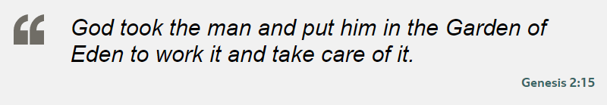
All religions respect the world around them and offer guidance on environmental issues. Christians believe that the Earth belongs to God and that humans are stewards in charge of its care.
What can this mean?
Humans have the role of protecting all created things, not abusing or destroying them.

Slide 84

Recap of the creation story

Slide 85


Slide 86
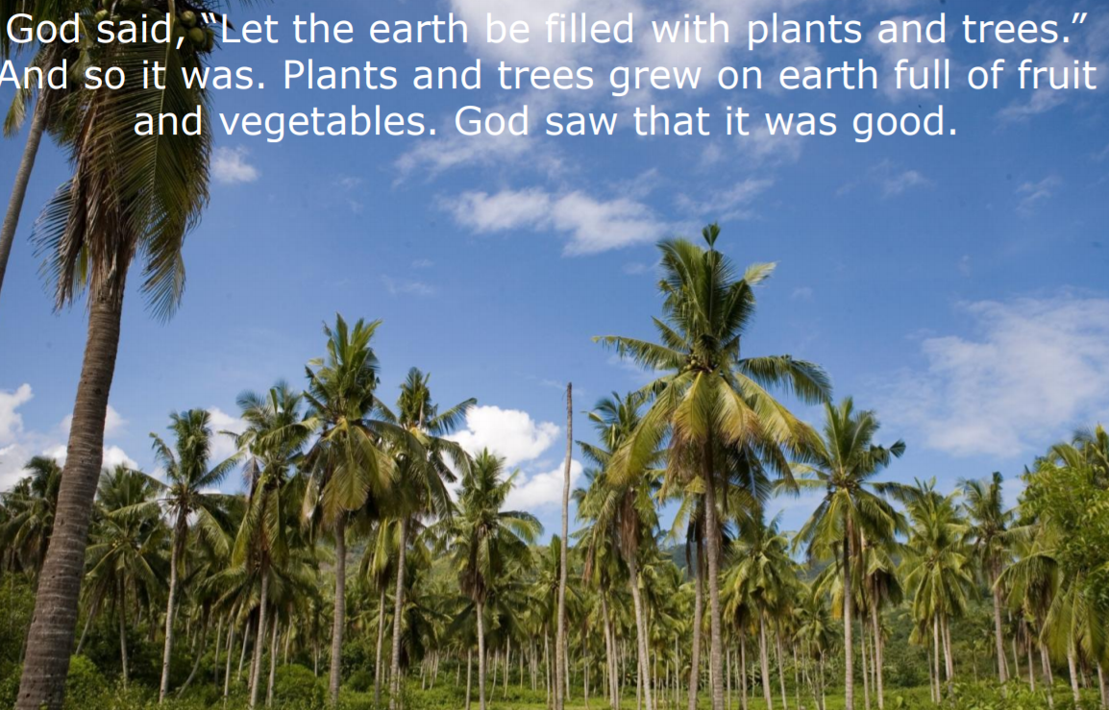

Slide 87


Slide 88
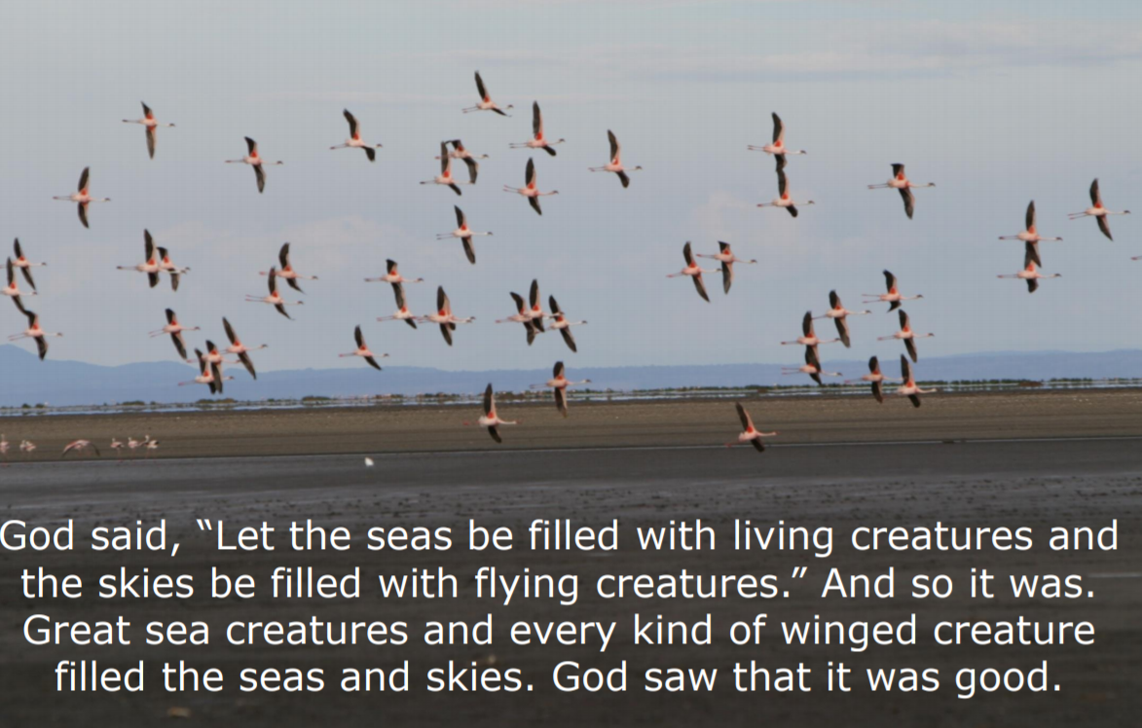

Slide 89
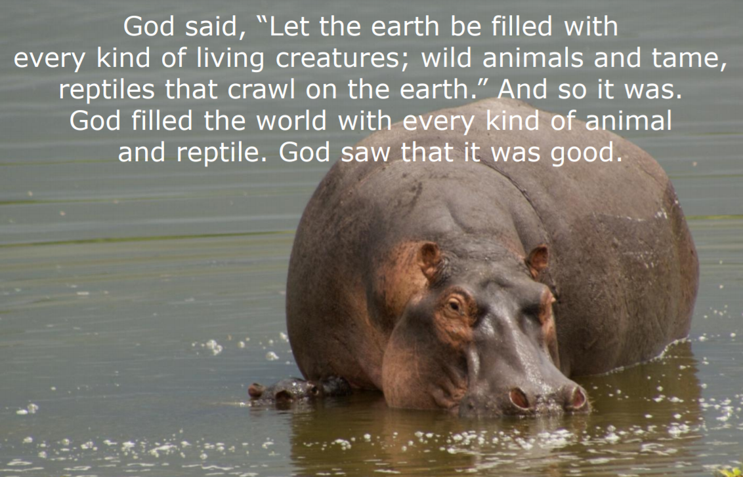

Slide 90
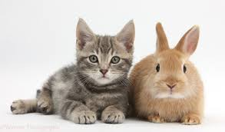





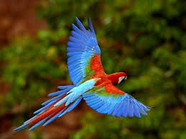
Is this the world that God made?
If possible, take a look at the following link.
https://www.bbc.co.uk/bitesize/clips/ztmpvcw

Slide 91

God created our wonderful world and then he made people to look after it. These are known as Stewards.

Slide 92
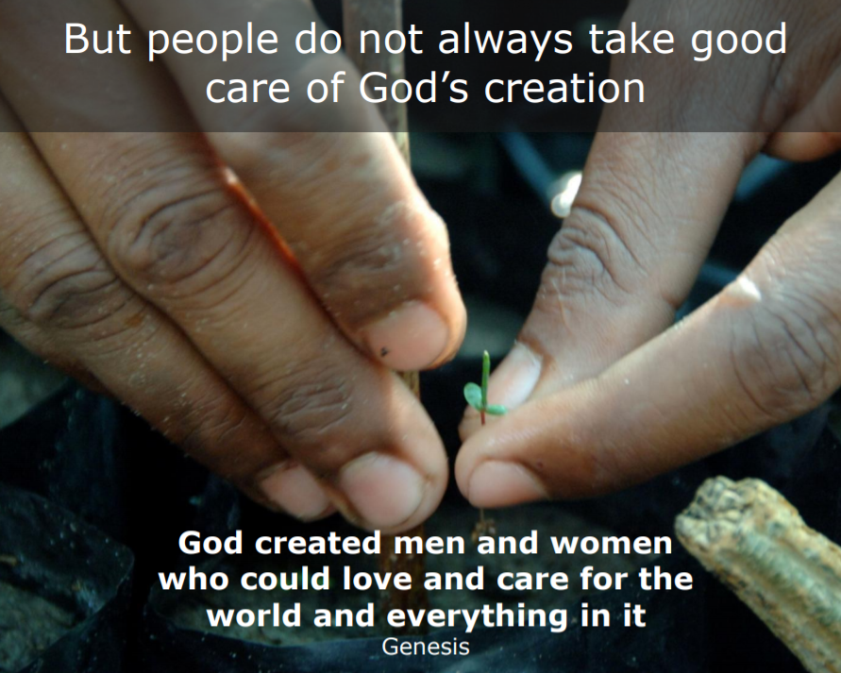

Slide 93
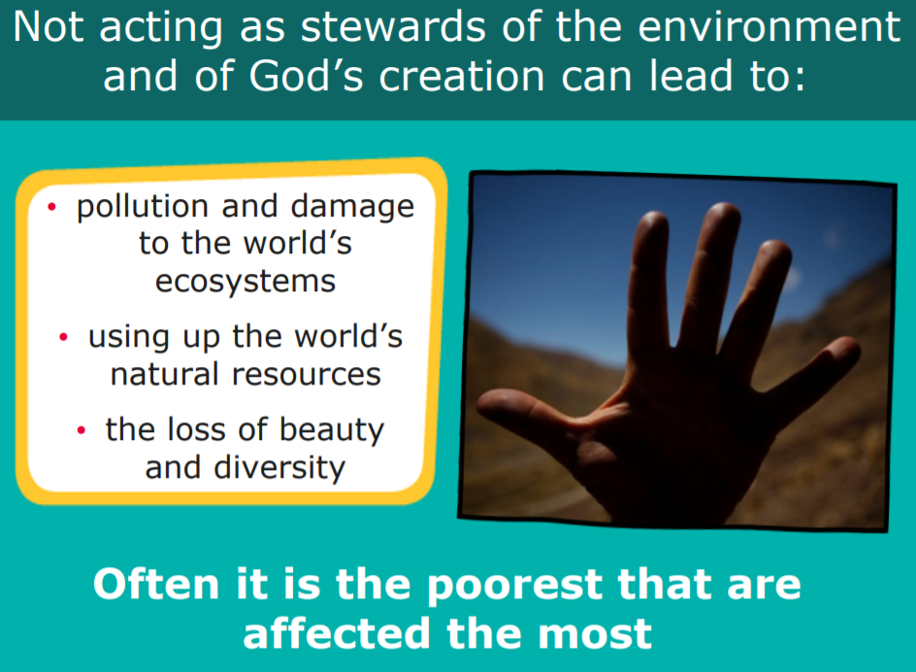
How do you think God’s world is being spoilt?.

Slide 94

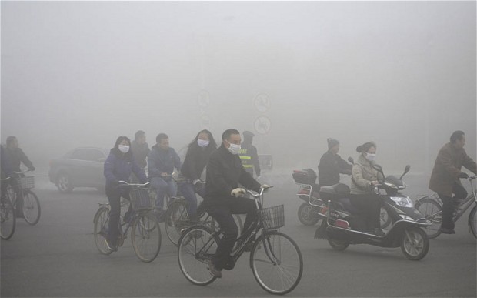
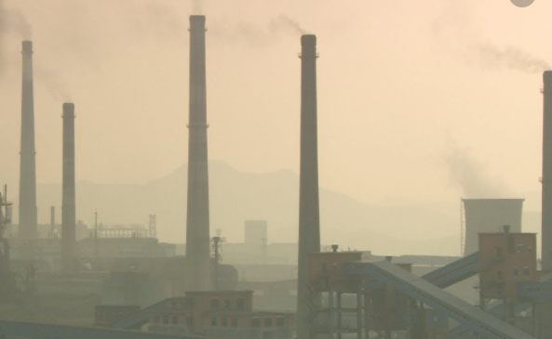
Let’s look back at the creation story!
Just look at the following images and think about what has happened to ‘God’s creations.’

Slide 95
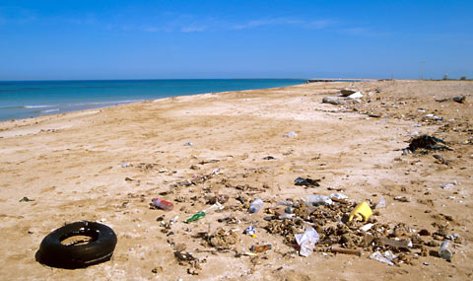
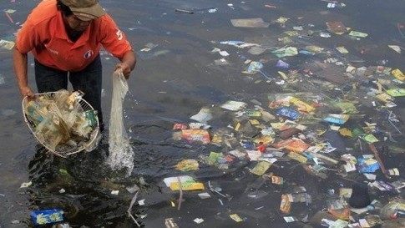
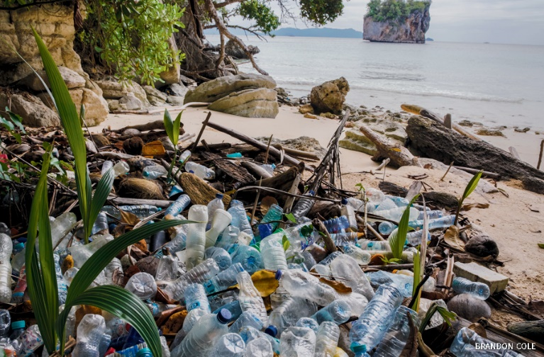

Slide 96
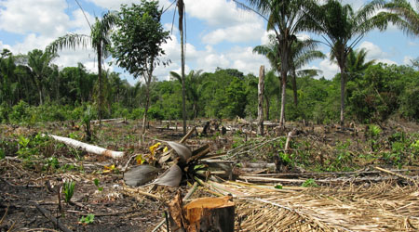
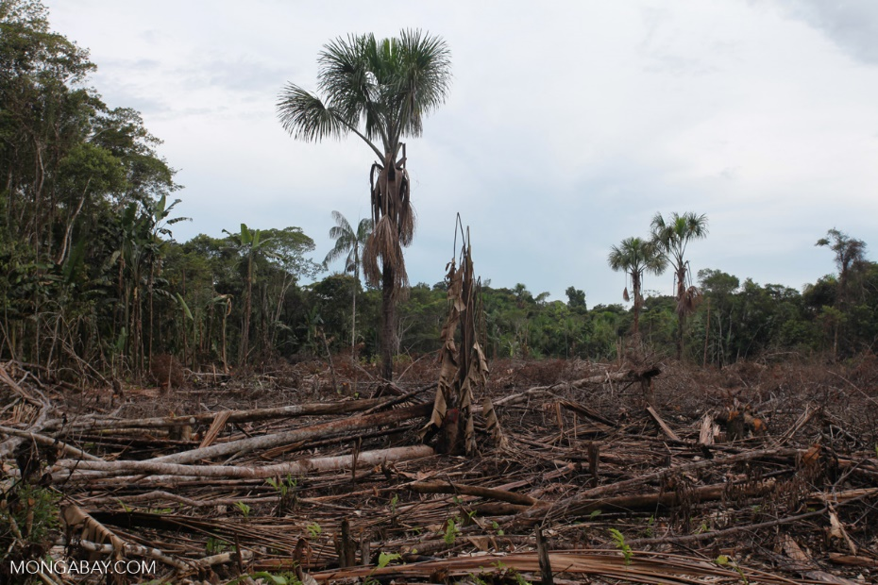

Slide 97
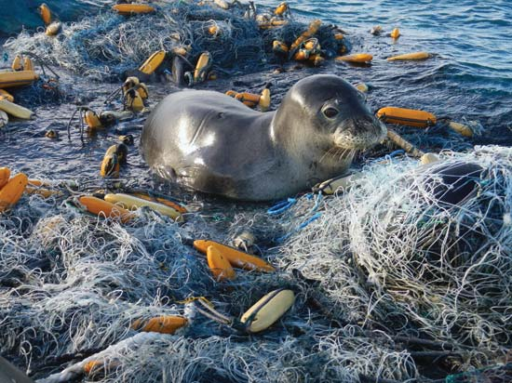
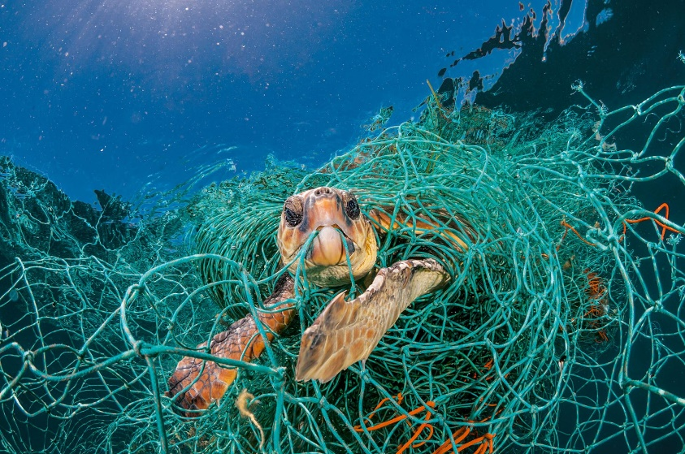
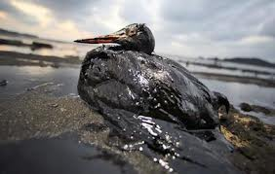

Slide 98
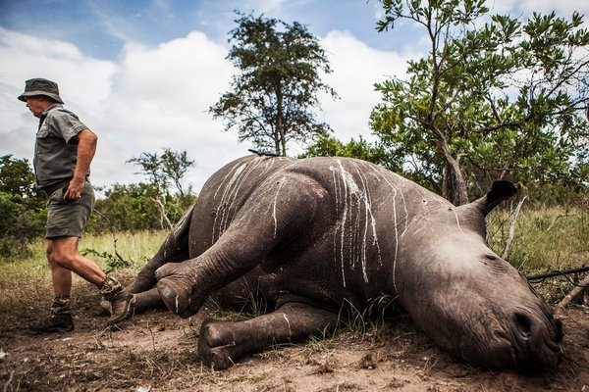
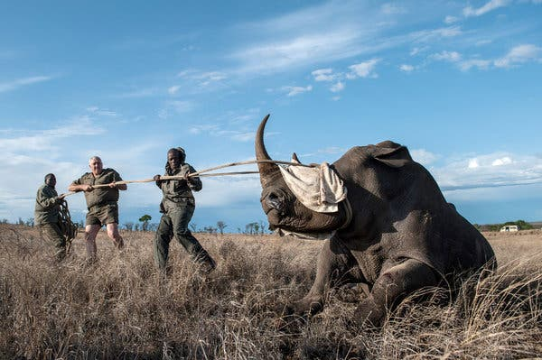
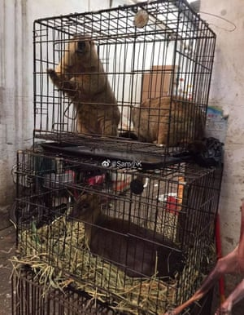
Did God make a mistake in giving
humans the responsibility of looking
after the world? Why?
How much pollution and damage to the environment is due to laziness?

Slide 99
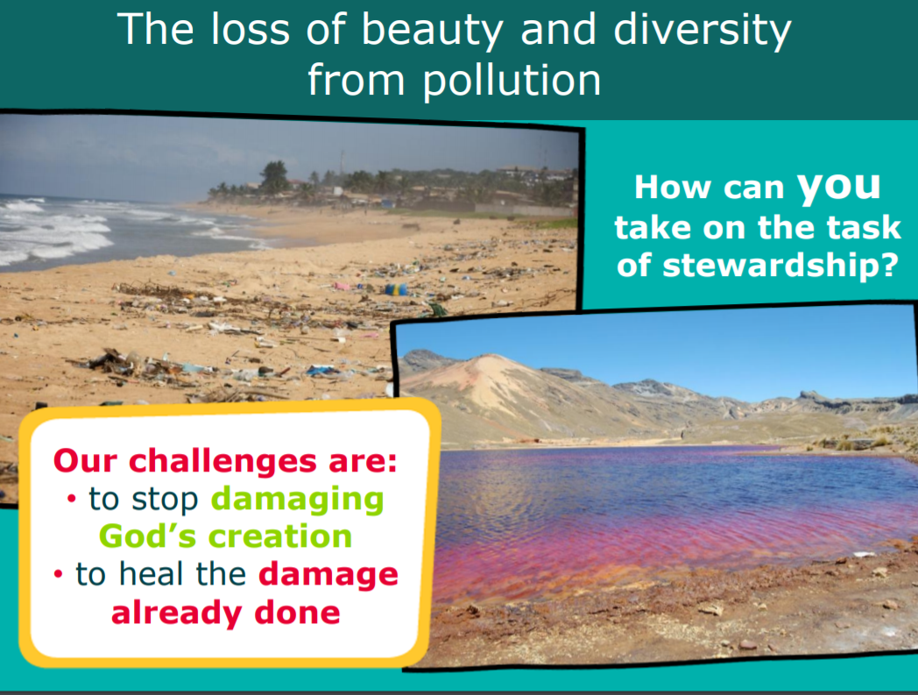
Jesus was saying that when people stand before God at the end of their lives, God will expect them to have worked hard as stewards of what He has put into their care. What does it mean to work hard as good stewards of the World, God's creation? What might that look like?

Slide 100
What does it mean to care for the environment?
The Earth has all the things we need to live, but we need to take care of the Earth so it can keep giving us what we need.
Caring for the environment means doing things that will keep the Earth healthy, like recycling your plastic bottles instead of throwing them in the bin, and turning off lights when you don’t need them on anymore.
It’s up to us to do what we can to care for the environment. There are plenty of ways to be green and make choices that help our planet, and you don’t have to be a grown-up to make eco-friendly choices!

Slide 101
True or False?
Every year half a million people in the world are poisoned by pesticides.
  True
10,000 people a year die prematurely in the UK as a result of air pollution.
  False – it is actually between 28,000-36,000
Every person in the UK throws away four times their own body weight in rubbish per year.
  False – it’s actually 7 times their bodyweight
Each person in the UK uses about 2 trees worth of paper every year.
  False - it’s actually 6!

Slide 102
Did you know?
Doing things that are good for the environment is also called being green.
The three main things to remember when it comes to caring for the environment are:
Reduce the amount of rubbish you throw away and the amount of water you use
Reuse things where you can, like water bottles
Recycle rubbish by sorting it out into bins for different materials like paper, plastic, tin and more.
How green are you?

Slide 103
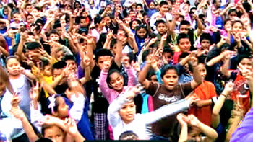
Who should look after the world?
All of us! We can all take responsibility for looking after God’s wonderful world and keeping it amazing.

Slide 104
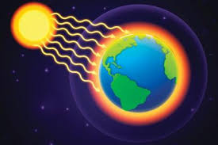


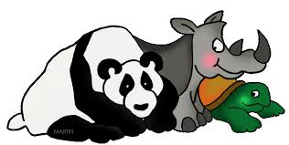


Different ways that people are destroying the earth.
Global Warming
Greenhouse effect
Extinction of animals.
Deforestation
Acid Rain
Pollution

Slide 105
Task 1
L.O.To recognise different ways how we can help with stewardship.
Draw a spider diagram and/or draw and list ways we can help look after the environment.
Ways we can look after
Our environment
Ideas on next slide!

Slide 106








Some ideas…
Different ways that Christians care for the environment.
Recycle
Car share/cycle
Save energy
Plant trees
Use ‘Bags for life’
for shopping
Reuse things where you can
Conserve water
Litter pick

Slide 107

An example of a completed one…
Litter pick
Re-use items
Save energy
Recycle
Cycle or car share
Save Water
Plant trees
Use ‘Bags for life’
for shopping

Slide 108
End of Lesson

