Slide 1
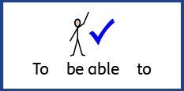
Date: Monday 28th June 2021
LO: To be able to explain why Salat is important to Muslims?
Subject: RE

Slide 2
What Are Ritual Prayers?
Can you remember the difference between a ritual and routine?
What is a ritual?
A ritual is similar to a ceremony. In a ritual, a series of things is done in a special order. Rituals are sometimes done every week, or every day, or at special times.
Can you think of any prayers you know or take part in that are the same every time?
Many religious people take part in special prayers. Often, these prayers are ritual prayers.
Is there anything you have seen people always do when they pray?
When people take part in some special prayers, they may use the same actions or the same words each time they pray.

Slide 3
Ritual Prayer
Prayer (Salat or Salah) is one of the Five Pillars of Islam. These are the ‘rules’ Muslims follow.
Salat should be performed five times a day. The times depend on the sun and so they change daily.
The five different times of day when Muslims must pray are:
1.
Salat al-fajr
Dawn, before sunrise.
2.
Salat al-zuhr
Midday, after the sun has passed its highest point.
3.
Salat al-’asr
Late in the afternoon.
4.
Salat al-maghrib
After the sun has finished setting.
5.
Salat al-’isha
In the dark of the night.

Slide 4
Ritual Prayer
Salat (prayer) is important to Muslims as it makes them feel connected to God (Allah).
Muslims usually go to a mosque to pray, but if they can’t go to the mosque, they can pray anywhere that is clean. Muslims may use a prayer mat when they pray in places other than the mosque, to be sure the floor is clean where they pray.
Prayer mats are quite often highly decorated with patterns and colours but they never have pictures of people or animals on them.
Muslims always face Mecca (a holy place)
when they pray.

Slide 5
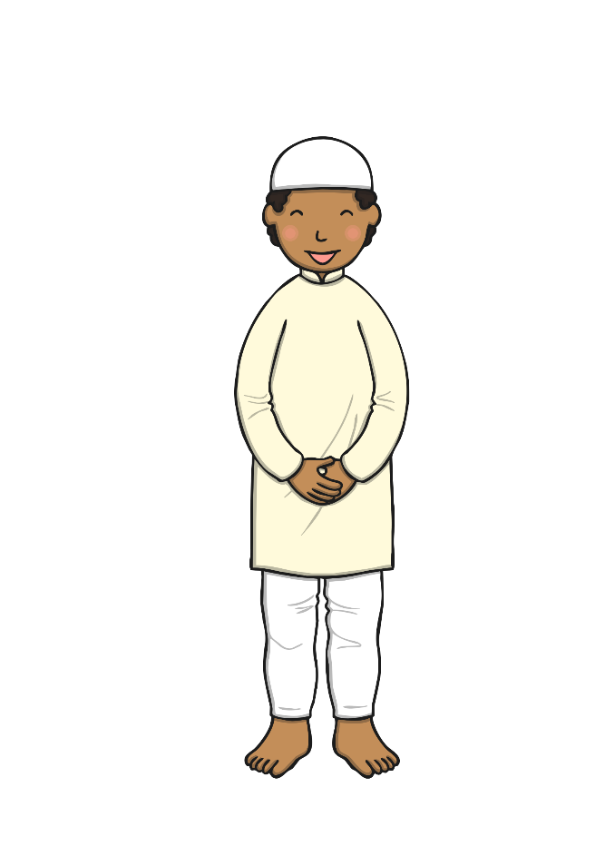
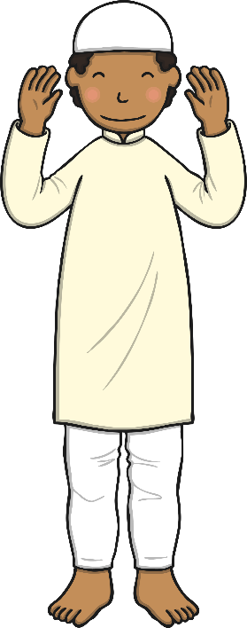
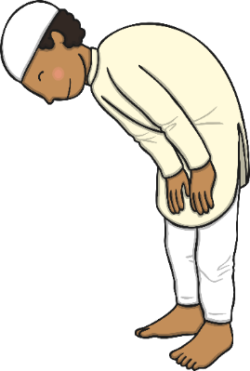
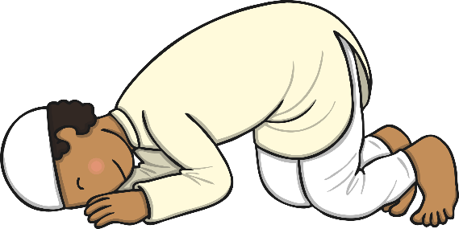
When Muslims pray, they perform sets of movements and gestures.
Niyyat
Qiyaam
Fatiha
To start the prayer, Muslims stand and say, “Allahu Akbar”, which means “God is great”. They raise they hands to their ears as they say this.
Muslims then place their right hand over their left, on their chest or navel. They say the opening supplication.
Muslims then say surah Al-Fatiha and one short surah from the Qur’an.
Ruku
Qauma
Sudjood
Muslims then drop into a prayer position with their hands on their knees, looking at their feet. They say the prayer words.
Muslims then go back to an upright position with their arms by their sides. They say the prayer words.
Muslims kneel again with their hands and face to the ground. They say the prayer words.

Slide 6
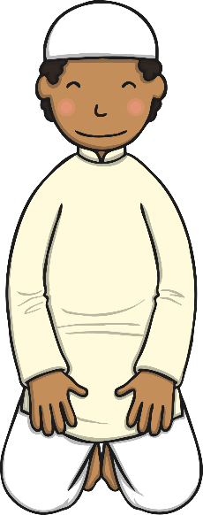
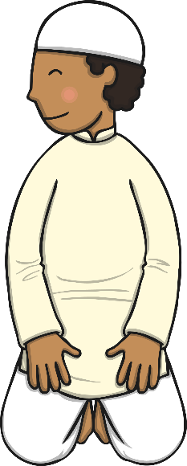
Qu’ud
Sudjood
Muslims kneel up again and look down at their lap. They say the prayer words.
Muslims then kneel with their hands and feet to the ground. They say the prayer words.
Qu’ud
Tasleem
Muslims then kneel up and look down at their lap. They say the prayer words.
Muslims then look over their left shoulder to the angel to record their bad deeds. They then say their personal prayers.

Slide 7
Task 1: Below are a list of times during the day when Muslims pray. They are all muddled up. Put them in order in on the powerpoint, or on paper and insert a picture or draw a diagram for each time.
Salat al-’asr
Late in the afternoon.
Salat al-zuhr
Midday, after the sun has passed its highest point.
Salat al-fajr
Dawn, before sunrise.
Salat al-’isha
In the dark of the night.
Salat al-maghrib
After the sun has finished setting.
You could write them out on a piece of paper, or you could number them on the slide.

Slide 8
Task 2: Design your own prayer mat
Draw patterns (or insert images) on your prayer mat to make your own design. Remember not to draw animals or people on your pray mat.
Once you have designed your prayer mat, write a sentence to explain why Salat is important to Muslims.

Slide 9
End of Lesson

Slide 10
Date: Tuesday 29th June 2021
LO: To be able to explain what happens during Holy Communion.
Subject: RE

Slide 11
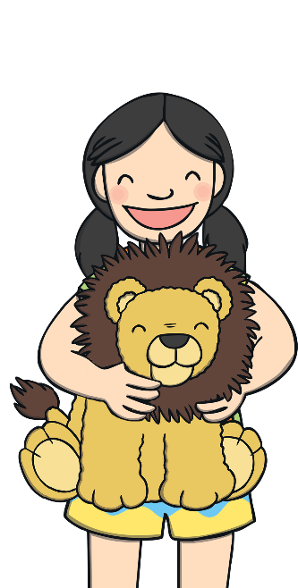
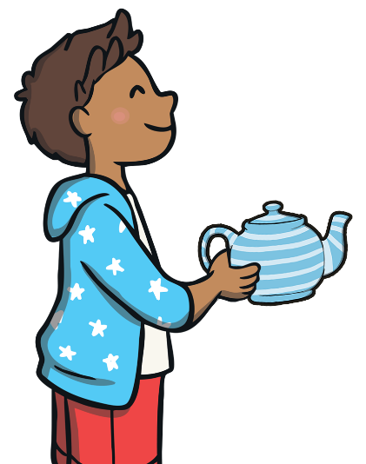
Objects and Memories
These children are talking about things that remind them of something.
We keep this teapot on the shelf at home. Every time I look at it, I remember my grandma. It belonged to her.
This boomerang
reminds me of
my amazing holiday
in Australia.
My dad bought me a toy lion to remind me that I am strong like a lion.

Slide 12
Can you think of an object which:
reminds you of something you have experienced?
reminds you of someone you know?
or reminds you of an important message?
Use these ideas to help you think of something.
places you have visited
people who are special to you
gifts you have been given
Draw the object you’re thinking about on a piece of paper or write down what that object is.

Slide 13
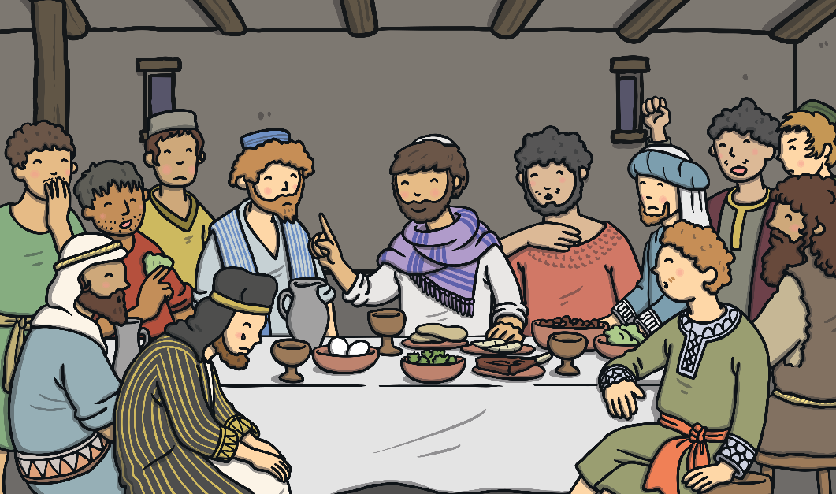
Christians believe that Jesus is the Son of God. They believe he came to Earth and lived as a real human being.
Christians believe that Jesus died on a cross. They believe that he knew he was going to die.
Before he died, he had a last meal with his closest friends, who were called his disciples.
Do you know what this last meal was called?
It was called the Last Supper.

Slide 14
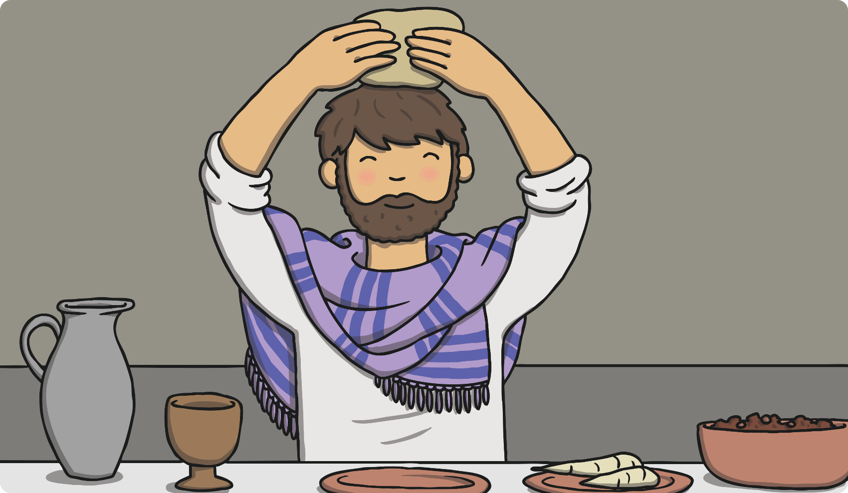
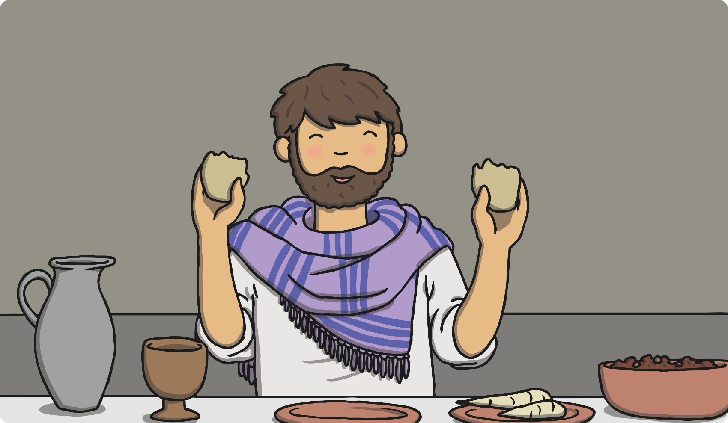
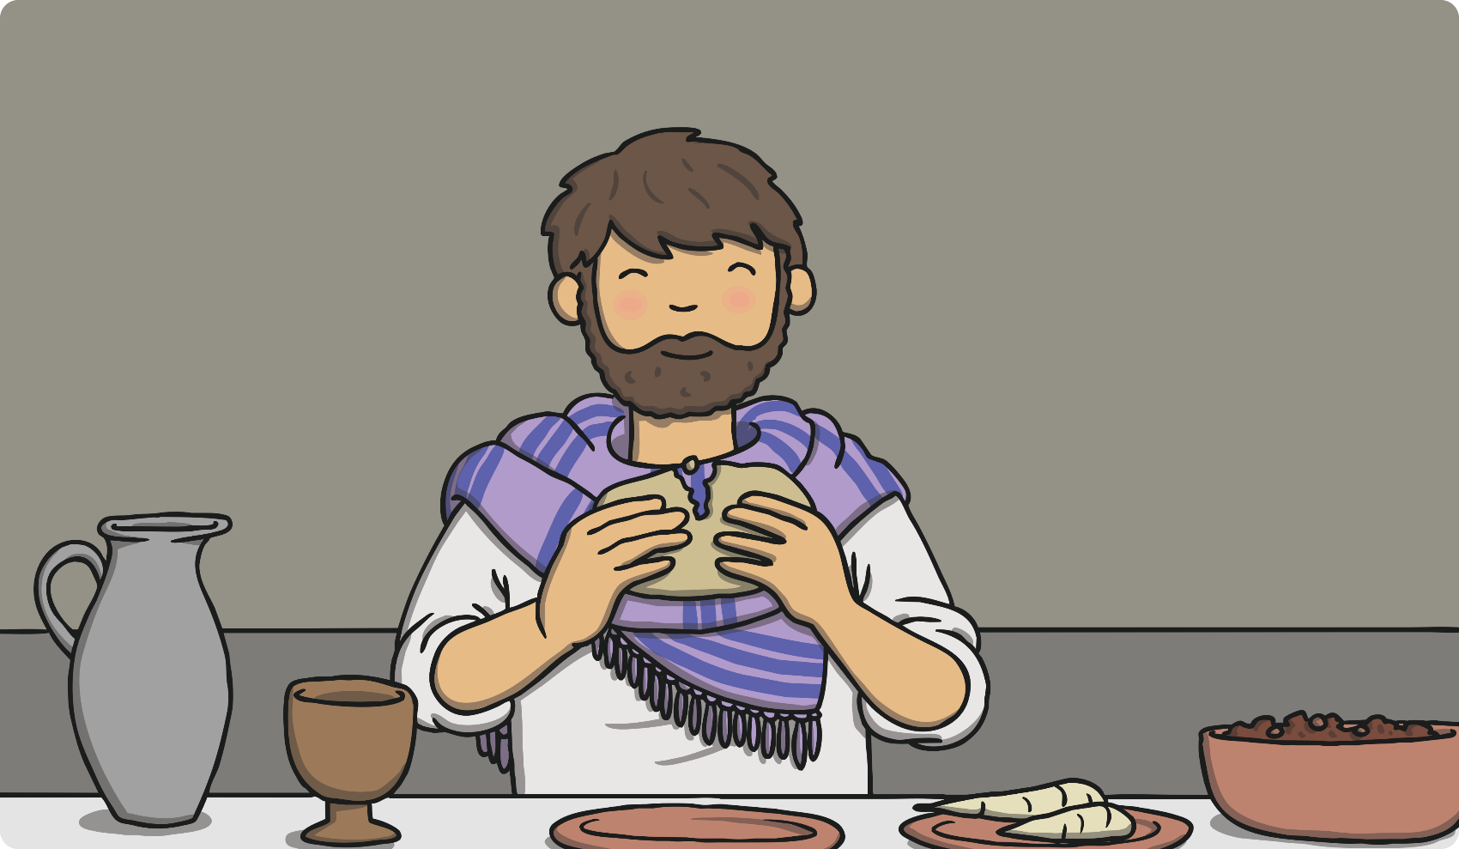
The Last Supper
At the last supper, Jesus thanked God for the bread.
He broke it apart to share with everyone.
Jesus said that the bread represented his body.
‘‘Take this and eat it. This is my body which is given for you,’’ he announced.

Slide 15
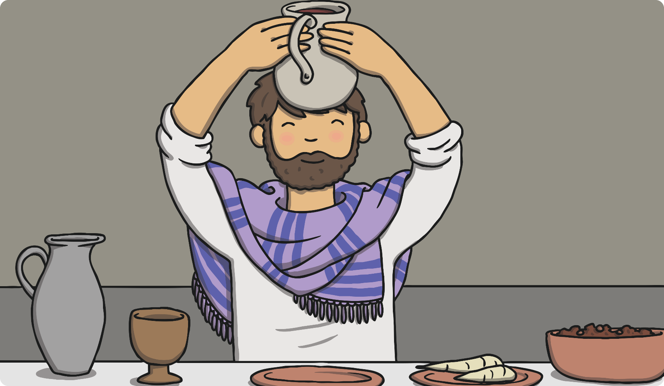
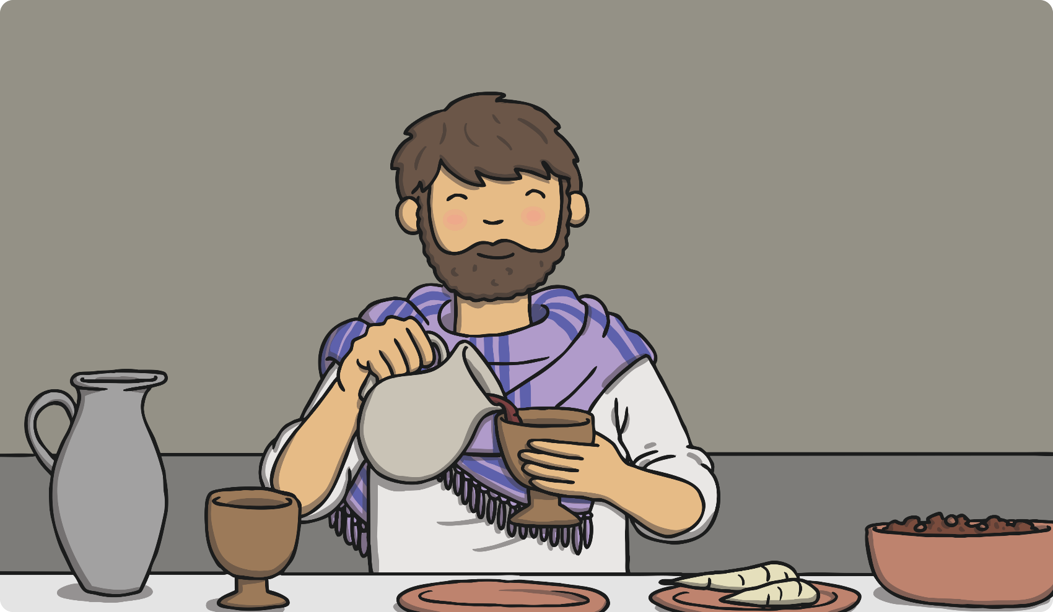
The Last Supper
‘‘This is my blood, which will be poured out for many
people so their sins may be forgiven,’’ Jesus said.
He then held a cup of red wine.
Jesus said the wine represented his blood.

Slide 16
Christians believe that when Jesus died on the cross, his death meant that the bad things (sins) that all human beings do could be forgiven.
Christians think about Jesus when they think about the bread and wine in Holy Communion.
The bread represents
the body of Jesus.
The wine represents
the blood of Jesus.
What do you think Jesus wanted the disciples to do after he had died?
He wanted them to think of him when eating bread and drinking wine during Communion, thinking about how the bread was like his body and the wine was like his blood.

Slide 17
Re-Enacting the Last Supper
Thousands of years after Jesus told his disciples to use bread and wine to remember him, Christians still re-enact the Last Supper regularly.
Do you know what the word ‘re-enact’ means?
It means to act out something that happened in the past.
During services in many different types of Christian places of worship, Christians take part in a ritual where they eat a small piece of bread and have a sip of wine (or grape juice) just as the disciples did with Jesus at the Last Supper.
This ritual can be known as:
Holy Communion;
the Lord’s Supper;
the Eucharist.

Slide 18
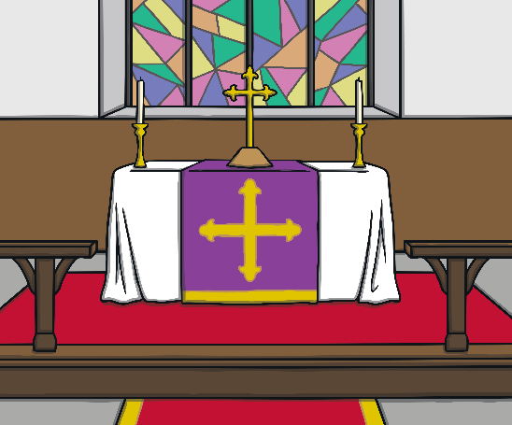
Different churches have different beliefs about what happens to the bread and wine after it is blessed.
Some churches believe that the bread and wine actually changes once it is blessed. Some churches believe they do not change but are symbols.
During Holy Communion, there are Bible readings, prayers and Christians come up to the altar to receive the bread and wine from the priest or vicar.
An altar is a holy table. In a Christian church, it is the table where the bread and wine are blessed.
Christians taking part in Holy Communion are given a small piece of bread to eat. Sometimes they might be given a small wafer in place of bread.
A sip of wine or grape juice is taken from a
special cup called a chalice.

Slide 19
Holy Communion Poem
Task: Use some of the words you thought of to create a poem that could be read out during a Holy Communion service.
Prayers are read out in a Holy Communion service in a church. The words often have special meaning. They remind Christians of Jesus and help them understand what each object and part of the ritual means.
What words could you use to talk about Holy Communion?
Here is a word bank to help you.
There is a template on the next side to help you. ☺

Slide 20
If you are struggling to come up with your own poem, use this template to help you. Use some words from the word bank on the previous page to complete each sentence.

Slide 21
End of Lesson

Slide 22
Date: Wednesday 30th June 2021
LO: To be able to explain the ritual of Puja.
Subject: RE

Slide 23
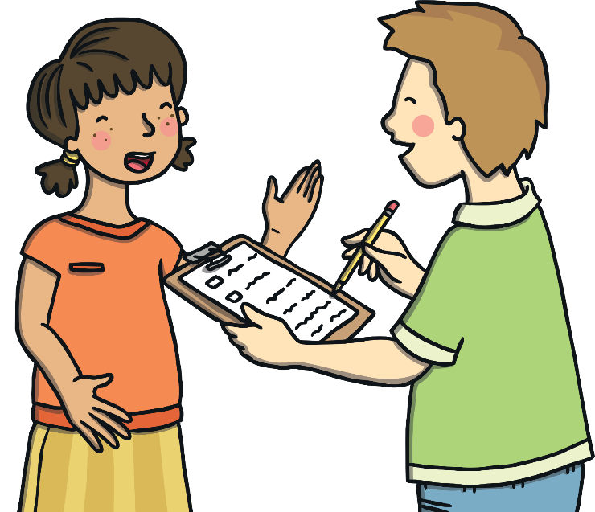
Nadia and Joseph are preparing for the arrival of their grandmother.
They are so excited that she is coming to stay!
Their father has gone to collect their grandmother from the airport and she will be arriving any minute.
When this very special visitor arrives at the house, what rituals do you think they might perform?
Think carefully about how you welcome visitors to your house.
Idea: Write down your ideas in a thought bubble.

Slide 24
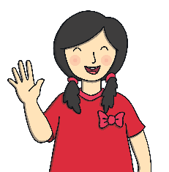
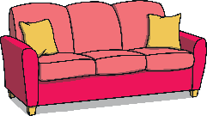
What ideas did you come up with? Here are my ideas.
offering a drink;
greeting and welcoming;
Welcoming a visitor
giving some flowers;
offering food;
offering somewhere to sit.

Slide 25
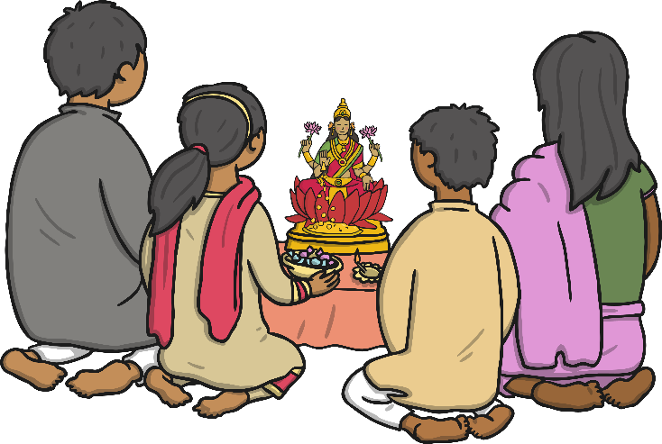
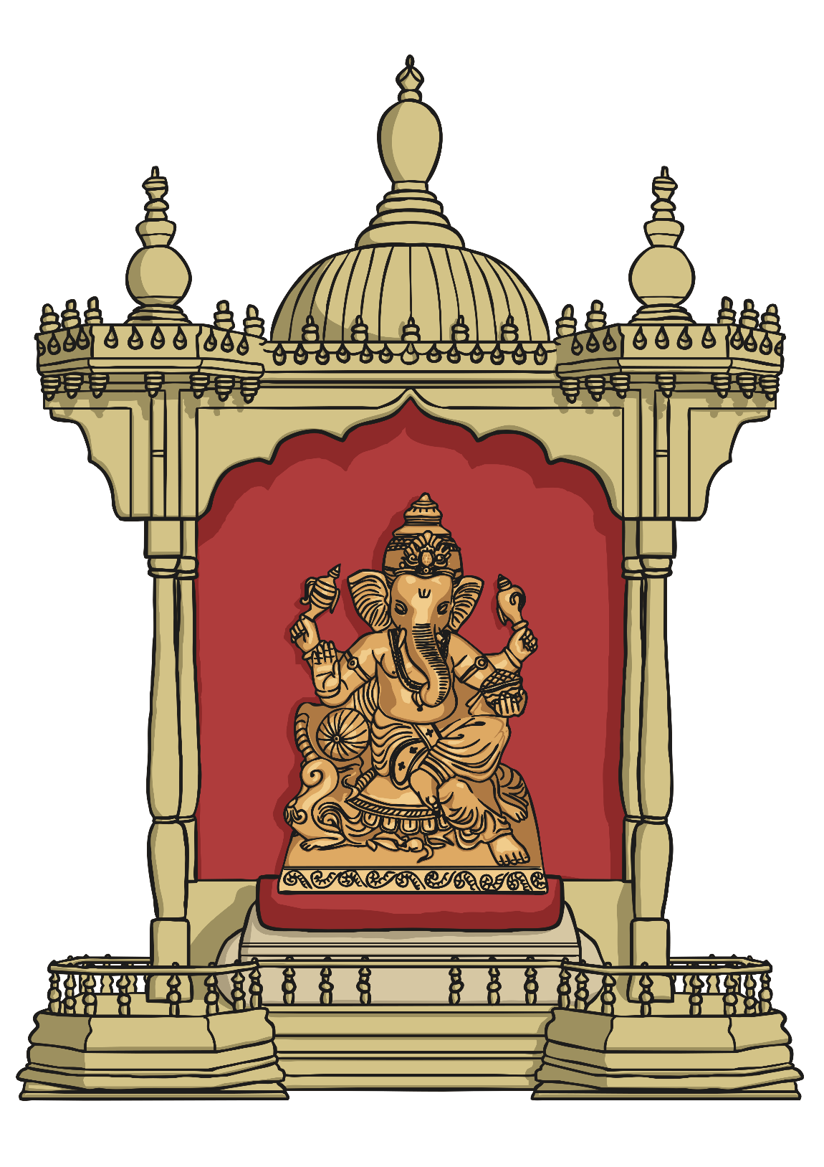
What Is Puja?
Did you know that when Hindus worship and pray to a god, they act just like they are welcoming a special visitor whom they love very much?
Hindu worship is called puja.
Hindus can perform puja at home or in a Hindu temple.
Many Hindus have shrines in their homes where they perform puja. A shrine is a holy space for worshipping. It often includes a picture of the thing being worshipped.
Shrines can be very simple and small or they can be large and richly decorated.

Slide 26
What Is Puja?
Before performing the ritual prayer of puja, Hindus remove their shoes.
Why do you think they do this?
Incense is a material which gives off a pleasant (and often strong) smell when burnt.
They do it to show respect for God.
They chant prayers (mantras) and they give offerings to the murtis such as fruit, incense , water and flowers.
Why do you think they give these gifts to the murtis?
They do this to show their respect and love for the gods, just as a host would want to offer food and drink to a visitor.
When the puja has finished, Hindus share and eat the food. They believe this food is blessed after it has been offered to the deities.
This blessed food is known as ‘prashad’.

Slide 27
What Is Puja?
‘Aum’ is chanted during puja.
This is the symbol for Aum.

Slide 28
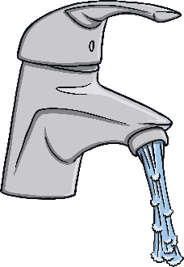
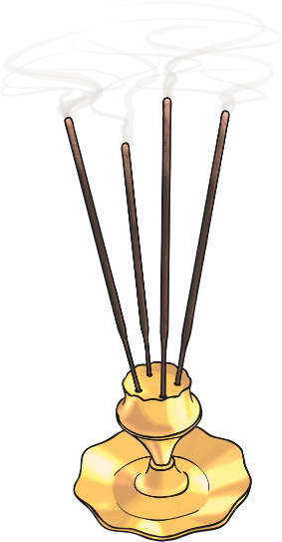
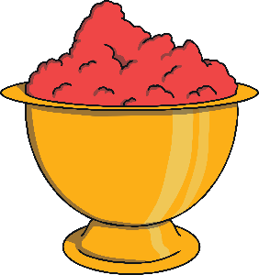
What Is Puja?
Each shrine contains a puja tray, which holds several important items:
The bell is rung to let God know the people are ready to worship.
To show love, care and respect for God, the murtis are offered a drink of water, given on a spoon.
The incense gives a lovely smell. It is a gift for the gods but also makes the air around the shrine pure.
Red kum kum powder is mixed with water to make a paste.
A red dot is placed on the foreheads of the
worshippers and of
the murtis.
The diva lamp is lit
to show that God is there.

Slide 29
Puja and the Senses
Hindus believe that they feel closer to their gods when they speak to them using all of their senses. All the senses are used during the ritual of puja.
What are your five senses?
Seeing
Hearing
Smelling
Feeling
Tasting

Slide 30
Look carefully at the things shown here which are a part of the ritual of Puja.
Give yourself thirty seconds to look at them and move onto the next slide. How many will you be able to remember?

Slide 31
Task: Sort the items and rituals listed below into the correct column in the table. You could also draw a picture to go with each one.
Murtis
Diva lamp
Flame
Flowers
Kum kum powder on forehead
Food
Sound of bell ringing
Blessed food (prashad)
Chanting, “Aum”
Incense
Chanting mantras
Sight | Smell | Sound | Taste | Touch
Tip: Some may go into more than one of the senses!

Slide 32
Did you get correct?
Murtis
Diva lamp
Flame
Flowers
Kum kum powder on forehead
Food
Sound of bell ringing
Blessed food (prashad)
Chanting, “Aum”
Incense
Chanting mantras
Sight | Smell | Sound | Taste | Touch
Murtis Diva lamp Flowers Flame Food | Flowers Incense | Sound of bell ringing Chanting ‘Aum’ Chanting mantras | Blessed food | Kum kum powder on forehead

Slide 33
End of Lesson

Slide 34
Date: Thursday 1st July 2021
LO: To be able to identify items in the classroom.
Subject: French

Slide 35
Items in the classroom
Look at the following list of vocabulary. You may have seen these words before or they may be completely new to you. They are all the names of items you might find in the classroom. Can you work out what they mean?
la porte
la table
la fenêtre
la chaise
l’armoire
L’ordinateur
la bibliothèque
l'évier
Use the information on the next slides to see if you got any correct.

Slide 36
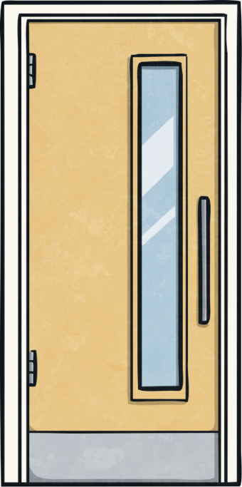
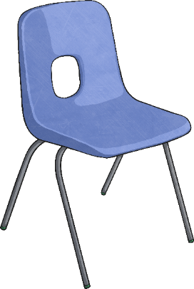
Voici …
(Here is)
Try to say the following words out loud.
La chaise = The chair
La porte = The door

Slide 37
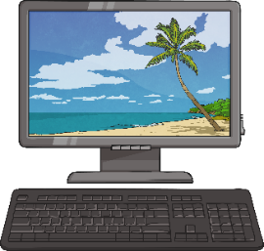
Voici …
(Here is)
L’ordinateur = The computer
La table = The table

Slide 38
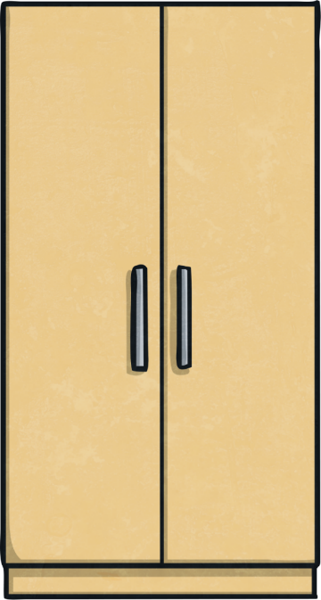
Voici …
(Here is)
La biblilotheque = The bookcase
La armoire = The cupboard

Slide 39
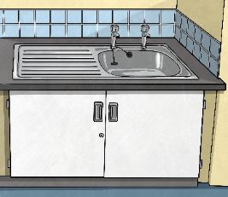
Voici …
(Here is)
La fenetre = The window
L’evier = The sink

Slide 40
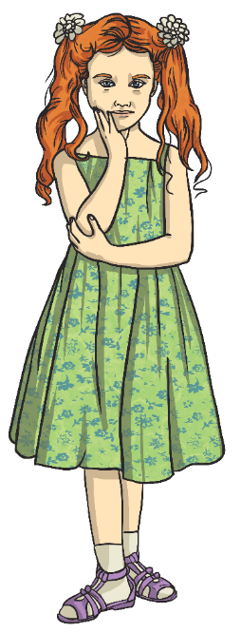
Now lets use the vocabulary we have learnt to write a sentence about where some children are standing in the classroom.
Lucie est à côté de l’armoire. =
Lucie is beside the cupboard.
Pierre est à côté de la chaise. =
Pierre is beside the chair.

Slide 41
Task: Use the images below to describe where the characters are standing.
Write a sentence for each one of the characters. Use the word bank and the sentence I have wrote to help you.
Example:
Pierre est à côté de la porte.
Lucie est à côté de __________.

Slide 42
End of Lesson

Slide 43
Date: Friday 2nd July 2021
LO: To be able to compare two school subjects.
Subject: French

Slide 44
Today we are going to look at school subjects.
Français
Have a look at the words in the list below. See if you can work out what the words mean in English. (some of them are very similar).
le français
le dessin
la géographie (la géo)
l’anglais
Press on the orange sound buttons to hear the words said aloud.
l'éducation physique (l’E.P.S.)
l'informatique
les mathématiques (les maths)
la musique
l'histoire
les sciences

Slide 45
Did you get any of them correct?
Français
English
le français
French
le dessin
Art
la géographie (la géo)
Geography
l’anglais
English
l'éducation physique (l’E.P.S.)
PE
l'informatique
IT
les mathématiques (les maths)
Maths
la musique
Music
l'histoire
History
les sciences
Science

Slide 46
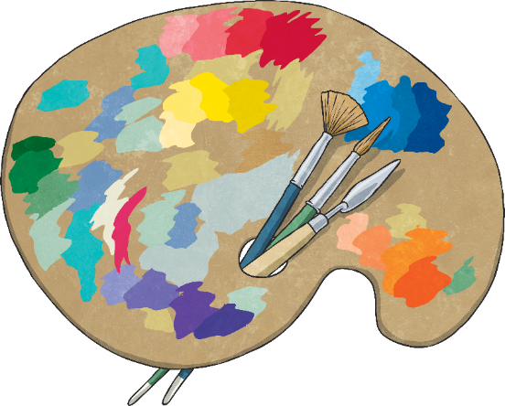
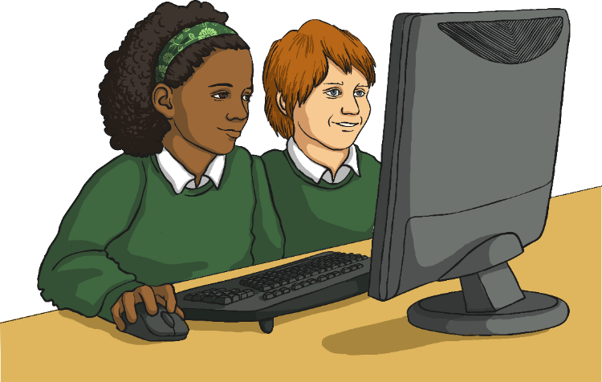
Let’s do a quick quiz.
What is the French name for art?
What is the French name for IT?
a) l’art
a) l’informatique
b) le dessin
b) le computer
c) la dessin
c) l’info
d) la dessiner
d) l’internet

Slide 47
Did you get them correct?
What is the French name for art?
What is the French name for IT?
a) l’art
a) l’informatique
b) le dessin
b) le computer
c) la dessin
c) l’info
d) la dessiner
d) l’internet

Slide 48
Unscramble these French words and say what the subject is in English.
al égaophiger
al iqmueus
le ranfaisç

Slide 49
Did you get them correct?
al égaophiger = la géographie
al iqmueus = la musique
le ranfaisç = le français

Slide 50
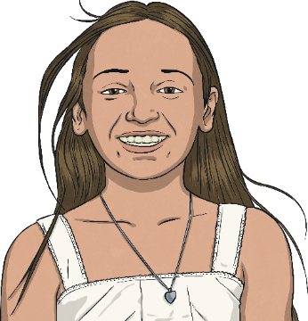
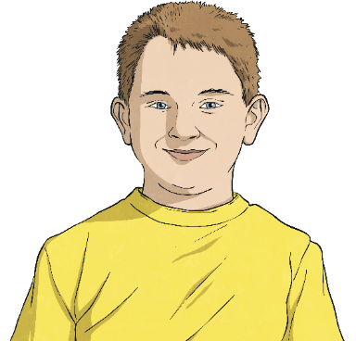
Now we are going to compare the subjects and say which one we prefer. First, lets work out what these characters are saying there favourite subject is.
Quelle est ta matière favorite ? Which is your favourite subject?
Ma matière favorite est = My favorite subject is.
Ma matière favorite est l’histoire..
Ma matière favorite est le dessin..

Slide 51
Did you get them correct?
Ma matière favorite est l’histoire..
Ma matière favorite est le dessin..
My favourite subject is history.
My favourite subject is art.

Slide 52
Quelle est ta matière favorite ? Which is your favourite subject?
Task: Write five sentences to say which subject you prefer.
1) Maths or English
2) Geography or history
3) Music or French
4) PE or computing
5) Science or art
le français
le dessin
la géographie (la géo)
l’anglais
Example:
Ma matière favorite est l’anglaise.
Ma matière favorite est ________.
l'éducation physique (l’E.P.S.)
l'informatique
les mathématiques (les maths)
la musique
l'histoire
les sciences

