Slide 1

Subject: English
Pack: B

Slide 2

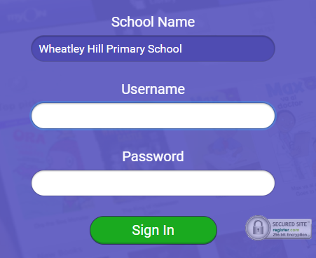
https://www.myon.co.uk/index.html
Remember to use myon for online reading
Example login -
Username
DavidW
Password
password1

Slide 3


Monday 22th February
L.O. To be able to answer questions based on a text.
Subject: English

Slide 4
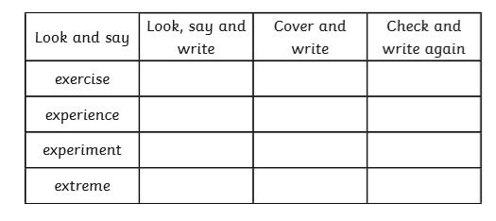
L.O To be able to spell words from the Y3/4 word list

Slide 5

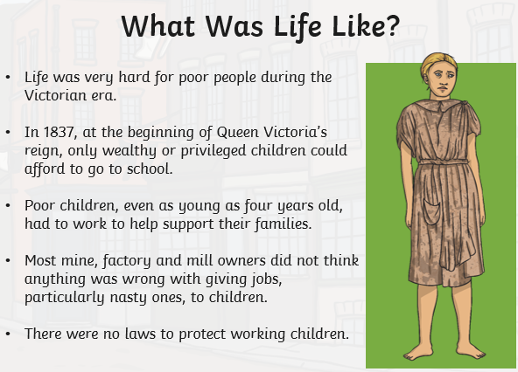
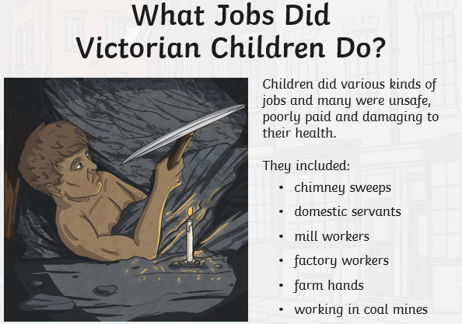
This week we are going to look at mining. Do you know anything about coal mines before we start?
Watch this video for more information on mining
https://www.bbc.co.uk/bitesize/clips/z73b4wx

Slide 6
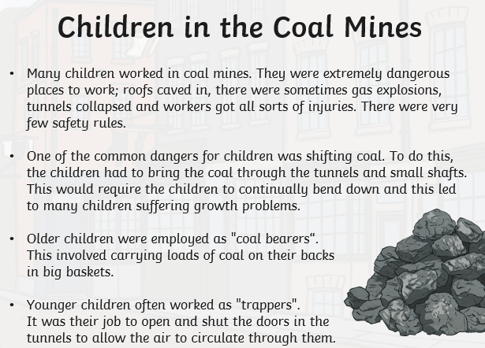

Slide 7
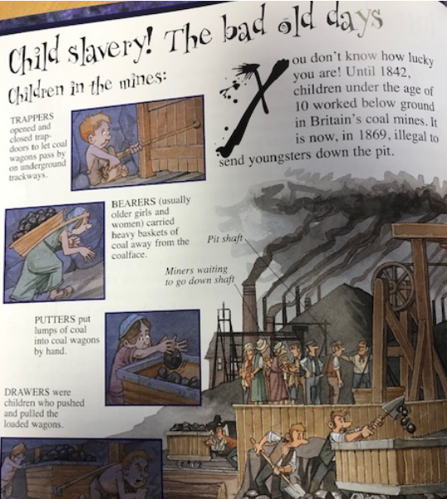
Here is the information from the page to make it easier to read ☺
Trappers opened and closed trap-doors to let coal wagons pass by on underground trackways.
Bearers (usually older girls and women) carried heavy baskets of coal away from the coalface.
Putters put lumps of coal into coal wagons by hand
Drawers were children who pushed and pulled loaded wagons.

Slide 8

Remember to answer in full sentences e.g. Children were given nasty jobs and they had no laws to protect them.
What sort of children were able to go to school in the Victorian period?
____________________________________________________________________________________________________________________________________________________________________________________
How old were children when they were expected to work and what jobs did they do?
________________________________________________________________________________________________________________________________________________________________________________________________________
3. Why were the mines so dangerous?
________________________________________________________________________________________________________________________________________________________________________________________________________
4. What were the common jobs that children were given?
____________________________________________________________________________________________________________________________________________________________________________________

Slide 9
5. What was the job of the Trapper?
____________________________________________________________________________________________________________________________________________________________________________________
6. What problems did the children face as a result of being down the mine?
________________________________________________________________________________________________________________________________________________________________________________________________________
How do you think the children feel about working down the mines and why?
_______________________________________________________________________________________________________________________________________________________________________________________________________

Slide 10
Tuesday 23rd February
L.O. To be able to write sentences in the past tense using expanded noun phrases.
Subject: English

Slide 11
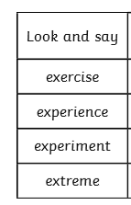
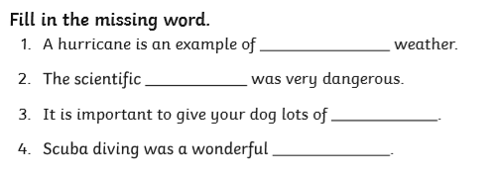
L.O. To be able to spell words from the Y3/4 word list.

Slide 12

We are going to build up to writing our own non-chronological report in English.
We have looked at these in school before.
Can you remember what we might find in them?
Title
Paragraphs

Slide 13
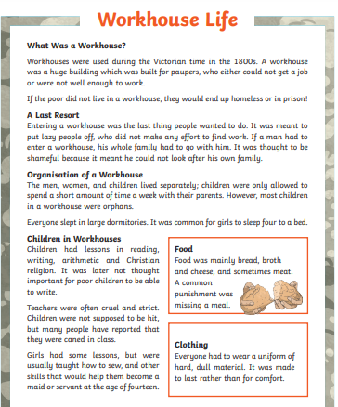
Title
Here is an example of a non-chronological report.
They can be presented in slightly different ways but they contain the same features.
Introduction
Paragraphs
Sub-headings
Factual
language
Pictures/photos
Third person
(e.g. she, he, they)

Slide 14
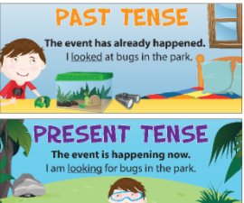

Non-chronological reports can be written in past or present tense.
For this non-chronological report work, we will be writing in past tense because we are looking at how mines were used in the past.
Underline the past tense words in the following sentences-
The boy worked down the mine since he was 6 years old.
The Trapper opened and closed the trap doors.

Slide 15
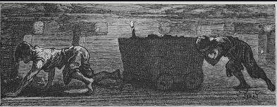
Here is a picture of some people working in the coal mines.
Write some adjectives (describing words) around the picture.
Add at least 8.
exhausted
dark
hardworking
tired
dangerous
depressing

Slide 16
Today we are going to write sentences that contain 2 adjectives (expanded noun phrase) and are in the past tense.
The coal mine was a dark , dangerous place to work.
Past tense
expanded noun phrase
The miners were all tired , hardworking people.

Slide 17
The _________________ , ___________________ children pushed the ________________, _______________ cart.
A ___________ , _____________ candle allowed the workers to see.
The ______________ , _______________ mines were a terrible to work.

Slide 18
Now continue with sentences on your own.
Remember to include adjectives and past tense.
4.______________________________________________________________________ ____________________________________________________________________
5.__________________________________________________________________________________________________________________________________________
6.__________________________________________________________________________________________________________________________________________

Slide 19
Wednesday 24th February
L.O. To be able to use conjunctions to extend sentences.
Subject: English

Slide 20
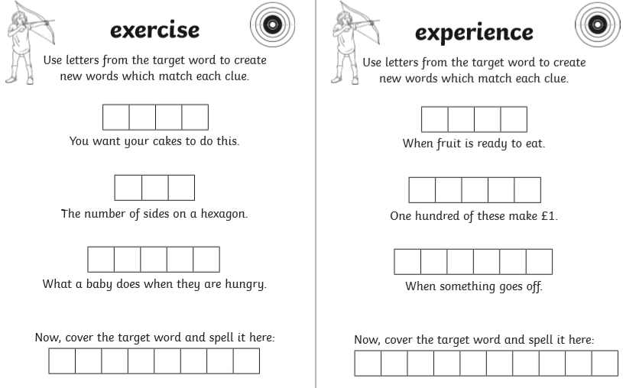
L.O. To be able to spell words from the Y3/4 word list.

Slide 21

Pre-recorded Teaching
Access the online teaching video below that will support you to complete the work in this lesson. This video will act as a support but all of the work can still be successfully understood & completed using paper-based versions of this pack. If you need further support to understand / complete work then please contact school via e-mail or telephone.
Play Video
You can also copy and paste this link if you would prefer: https://teachers.thenational.academy/lessons/to-explore-expanded-noun-phrases-ccwk8d

Slide 22
A conjunction is a joining word that links different parts of sentences.
We use 2 different types of conjunctions, co-ordinating conjunctions and subordinating conjunctions.
A subordinating conjunction adds additional information to the main clause (main part of the sentence) and does not make sense on its own.
because although however as
A co-ordinating conjunction joins two main clauses together.
but and so or

Slide 23
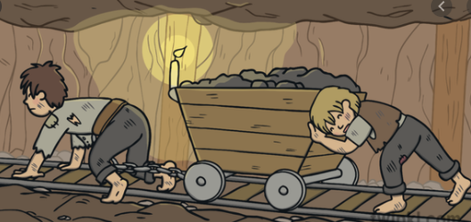
Here are some examples of sentences containing conjunctions. Decide if they are examples of subordinating or co-ordinating conjunctions.
Young children had to work long hours although it was very dangerous.
Wealthy children went to school but poor children were expected to work.
Children were given horrible jobs because there was no laws protecting them.

Slide 24
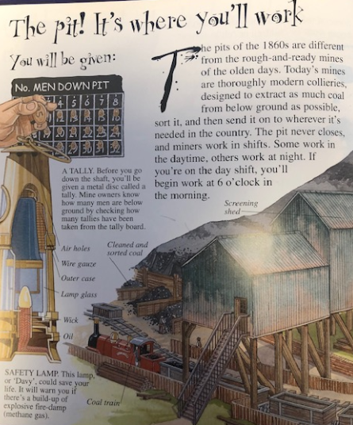
Have a think about what you know already about what it was like working in the coal mines. You could always read back Monday’s lesson to help you.
Here is some more information about the mines, which could help you write your own sentences with conjunctions.
Before you go down the shaft, you’ll be given a metal disc called tally. Mine owners know how many men are below ground by checking how many tallies have been taken from the tally board.
Safety lamp- This lamp or ‘Davy’, could save your life. It will warn you if there’s a build-up of explosive fire-damp.

Slide 25
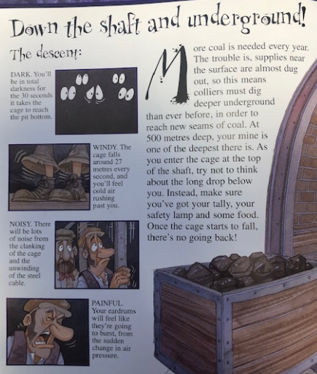
Here is some more information about the mines, which could help you write your own sentences with conjunctions.
Dark- You’ll be in total darkness for the 30 seconds it takes the cage to reach the pit bottom.
Windy- The cage galls around 27 meters every second and you’ll feel cold air rushing past you.
Noisy- There will be lots of noise from the clanking of the cage and the unwinding of the steel cable.
Painful- Your eardrums will feel like they’re going to burst, from the sudden change in air pressure.

Slide 26
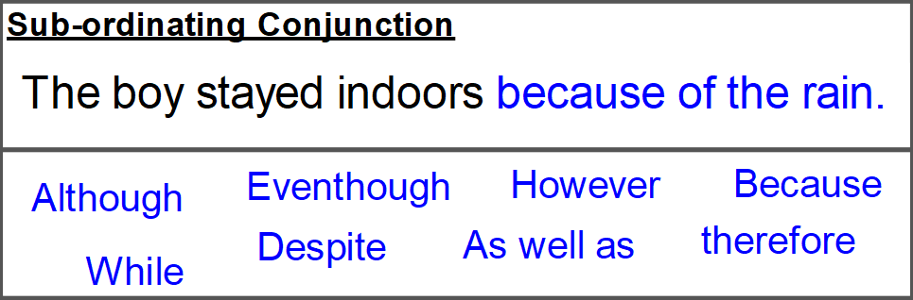
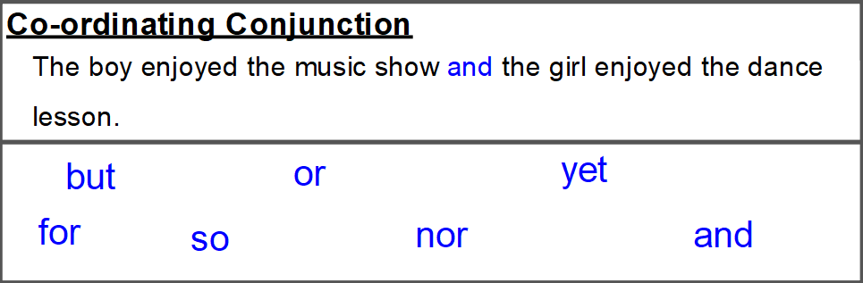
but so and or
Complete the sentences using a different conjunction each time.
A tally was taken in the mines so _________________________________________________________________________
The workers needed to travel in a cage to the bottom because _________________________________________________________________________
A lamp could save a miners life as
____________________________________________________________________

Slide 27
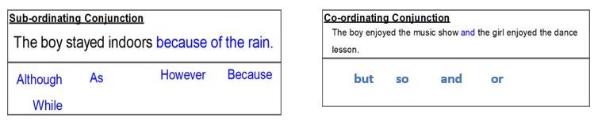
Now add 3 sentences of your own – try to use a mixture of different conjunctions.
4.______________________________________________________________________________________________________________________________________________________
5.__________________________________________________________________________________________________________________________________________________
6.___________________________________________________________________________________________________________________________________________________

Slide 28
Thursday 25th February
L.O. To be able to understand what a determiner is.
Subject: English

Slide 29
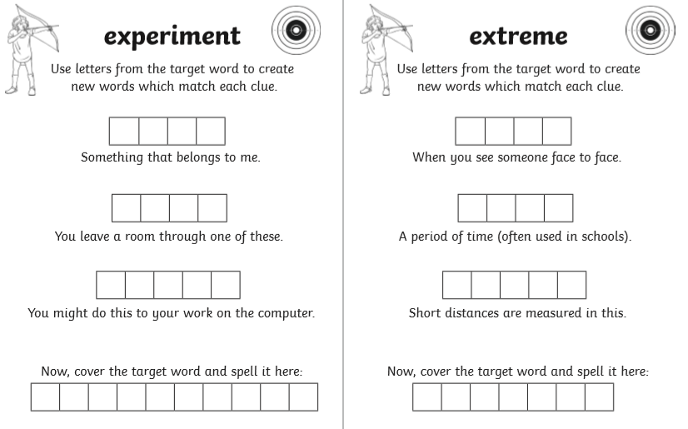
L.O. To be able to spell words from the Y3/4 word list.

Slide 30
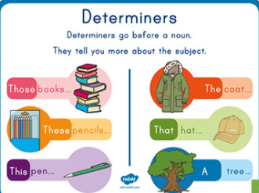

Slide 31

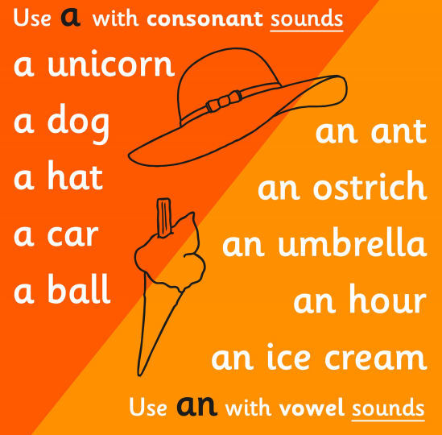
a and an are also examples of determiners.
A is use when the first letter of the following word begins with a consonant.
An is used when the first letter of the following word begins with a vowel.
(a, e, i, o, u)
In English there are always some exceptions to the rules.
e.g. an hour and a unicorn!
However, most of the time the consonant/vowel rule works!

Slide 32
Add the correct determiner in these nouns (a or an).
_____ engine
_____ cart
_____ job
_____ interesting machine
_____ loud bang
_____ lamp
_____ old horse

Slide 33
Add the correct determiner in these nouns (a or an).
1. ___ cart was used to travel down the mine.
2. ___ oil lamp would warn you if there was a build up of gas.
3. ___ tally was taken before the men entered the mines.

Slide 34
Now write 3 sentences of your own containing a or an.
4.________________________________________________________________________________________________________________________
5.___________________________________________________________________________________________________________________________
6.___________________________________________________________________________________________________________________________
Remember to use an before a vowel, and a before a consonant

Slide 35
Friday 26th February
L.O. To be able to write factual paragraphs about mining.
Subject: English

Slide 36
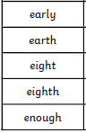
L.O. To be able to spell words from the Y3/4 word list.
Write your own sentences using these words.
________________________________________________________________________________________________________________________________________________________________________________________________________________________________________________________________________________________________________________________

Slide 37
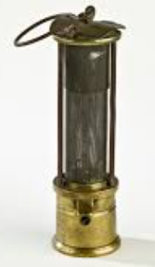
Today, we are going to write some fact paragraphs about mining.
Let’s recap what we have done this week and what we should include.
You could always look back at the previous slides to help.
Expanded noun phrase- the old, rickety cart
Past tense- was, has, worked, pulled
Conjunctions- because, but, so, although, and
Spot the determines that you have used.

Slide 38
Here is an opening paragraph about mining.
Underline or highlight the features were have worked on this week (past tense, expanded noun phrases, conjunctions, determiners).
During the Victorian times, coal mining was an important job to provide coal for industries. It was a dangerous, tiring job and some people worked 12 hour shifts, 6 days a week. Children from poor families were also expected to work, however wealthy children were able to attend school.

Slide 39
Paragraph 1: This has been started off for you.
In the mines, even the children were expected to work long shifts in ____________ , ________________ conditions. There were a few different jobs for the children to do and they were ______________ and _______________ . Children had to work because only the ______________,_____________ children could go to school. They would get different jobs depending on their age.
Finish this paragraph by discussing the roles of the children (look at Monday lesson for extra information).
____________________________________________________________________________________________________________________________________________________________________________________________________________________________________________________________

Slide 40
Paragraph 2: Finish this paragraph .
You could use other information we have looked at this week or even research
Coal mining yourself.
A tally was taken before entering ___________ the owner knows how many people were in the mine. The workers then entered a __________, __________ cart to travel down the mine which was extremely dark and _______________. The mines were ___________,___________ places so it was not a pleasant place to be.
Continue writing what it was like working in the mine (information in Wednesday’s lesson)
____________________________________________________________________________________________________________________________________________________________________________________________________________________________________________________________

Slide 41
My work is finished when:
One independent paragraph
Capital letters
Full stops
Commas
Conjunctions
Expanded noun phrase
Past tense
Challenge: identify the determiners you have used

Slide 42

Well done for all your hard work again this week!

