Slide 1


Monday 18th January 2021
LO To be able to order the events of the Stone Age
Subject: History

Slide 2
Chronology: the arrangement of events or dates in the order of their occurrence.
Put these events into chronological order.
Tip: Move the boxes on the PowerPoint or write the number of the boxes in the correct order on the sheet.
Romans invade Britain
Usain Bolt wins 100m gold at the Olympics
3
1
2
Dinosaurs lived on earth
Queen Elizabeth II is born
4

Slide 3
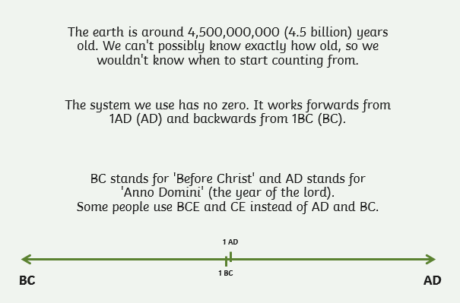
Did you know?

Slide 4
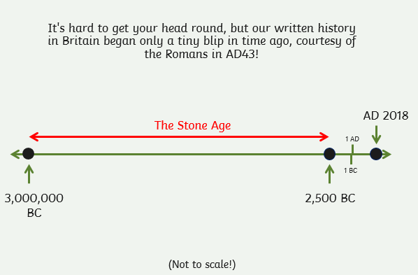

Slide 5
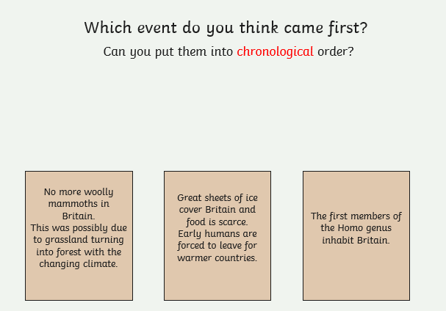
Write the number of the boxes in the correct order here _____________________
1 2 3

Slide 6
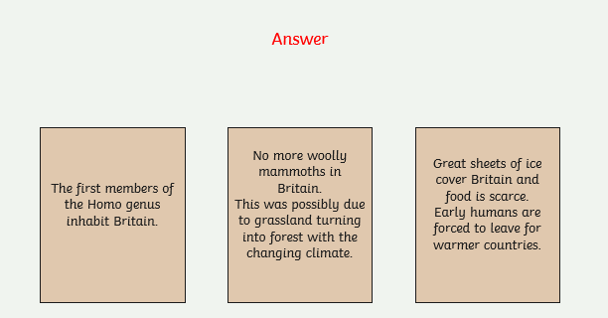
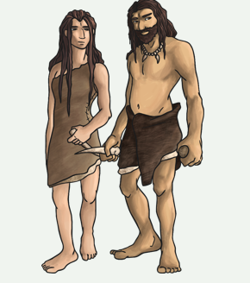
3. 1. 2.

Slide 7
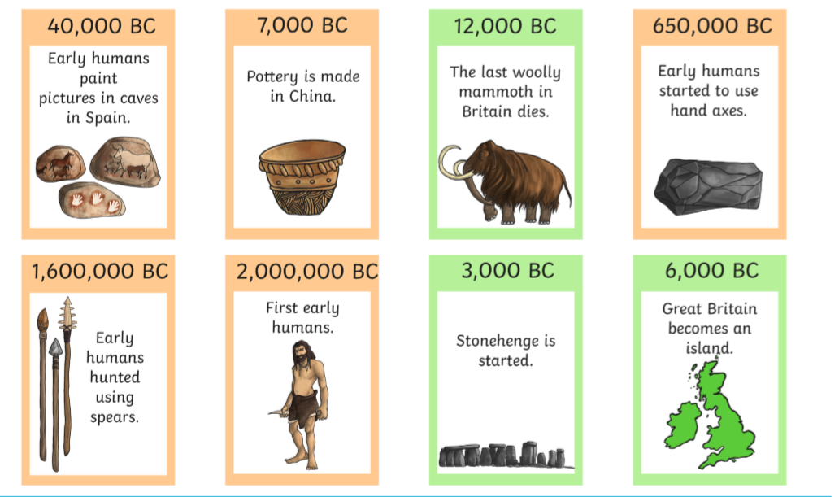
If you can’t cut and
stick the pictures,
write a list on the
next slide.
Start with the number
that is the greatest
(has the most numbers)
and write what
happened next to it.

Slide 8
Date | Event
Date | Event

Slide 9
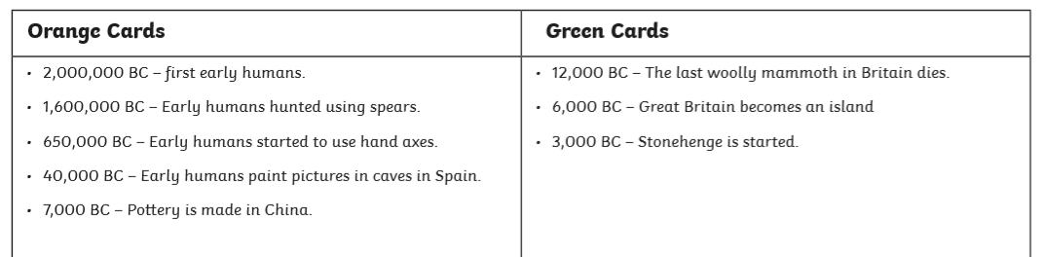
Answers

Slide 10
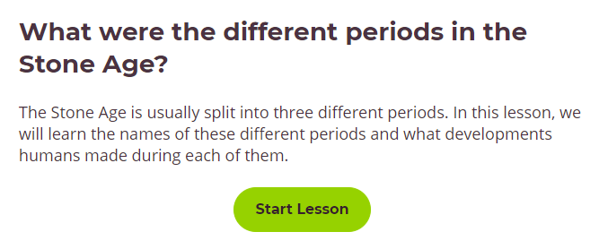
Click on the link to watch an online lesson about the Stone Age.
https://classroom.thenational.academy/lessons/what-were-the-different-periods-in-the-stone-age-crtkad

Slide 11
Tuesday 19th January 2021
LO To be able to compare life with the Stone Age.
Subject: History

Slide 12
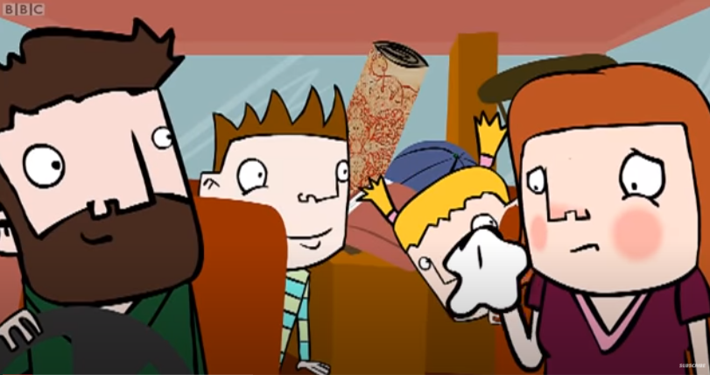
Watch this short video to see what life would have been like in the Stone Age.
As you are watching, compare life in the Stone Age to our life today.
https://www.youtube.com/watch?v=cE6OeRZB_Wc&list=PL4lsuC6DXedNs7U2_OoWR5efvMzU24hjW&index=9&t=0s

Slide 13
Sort the following statements on the next slide into
Stone Age or Modern Day.
If you are working on the computer drag them into the correct column on the next slide.
If you are working on paper you could colour the boxes two different colours. One for the Stone Age and a different colour for Modern Day.

Slide 14

Stone Age
Modern Day
Travel by car
Sleep on animal skins
Gather berries to eat
Buy clothes to wear
Sleep on a bed
Live in houses
Have a summer camp and a winter camp
Use electricity
Mainly travel by boat
Named after nature
Get food from shops
Use bow and arrows to kill animals for food
If you are colouring in the statements, colour the circle next to the heading to match the statements.
Make clothes from animal skins

Slide 15
Would you like to live in the Stone Age?
1.What would be the best part of living in the Stone Age?
__________________________________________________________
__________________________________________________________
2.What would be the hardest part of living in the Stone Age?
__________________________________________________________
__________________________________________________________
3.What would you miss the most from your modern day life?
____________________________________________________________________________________________________________________

Slide 16
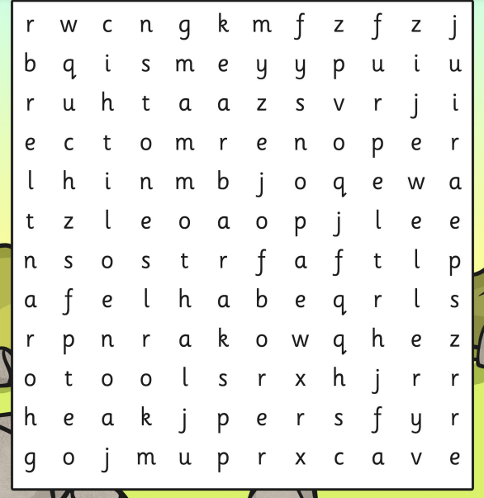
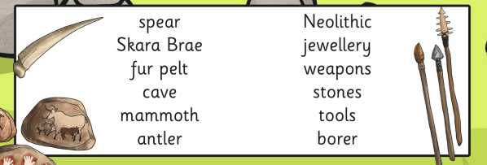
If you are working on the PowerPoint
on the computer, press the Insert button
then Shapes and pick a line to mark off
the words you find.

Slide 17
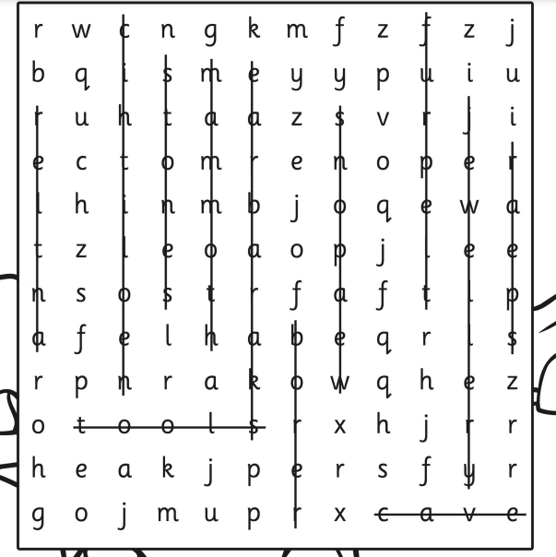
Answers

Slide 18
Tuesday 19th January 2021
LO To be able to make a 3D model
Subject: DT

Slide 19

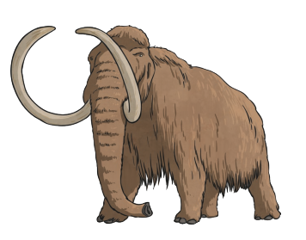
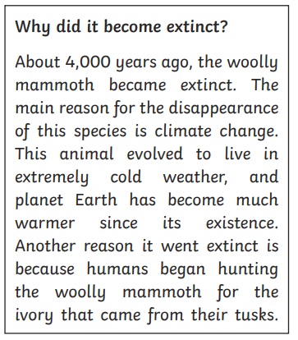
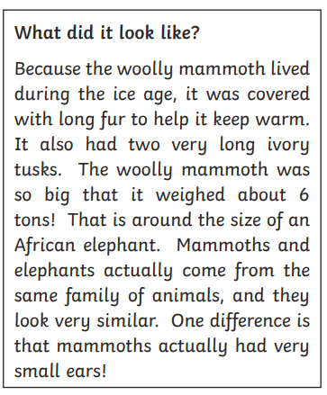
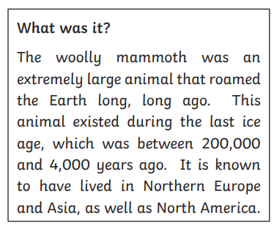

Slide 20
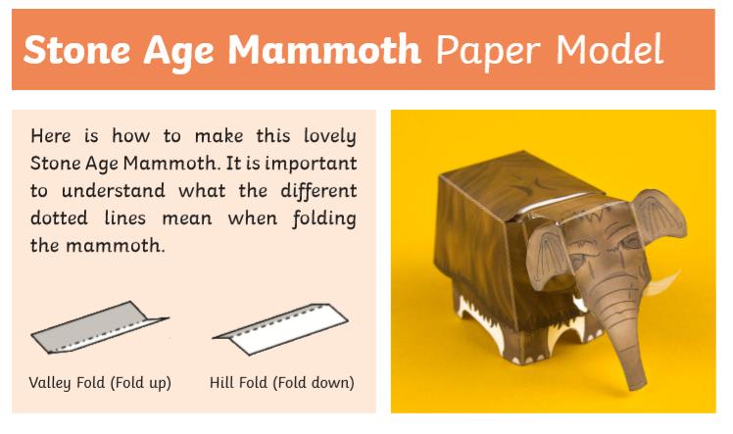
If you don’t have a paper copy to fold, why not make a junk model mammoth.
Look around the house to see what recycling you could use to make your own model. Or you might want to draw a mammoth instead.
Be creative!

Slide 21
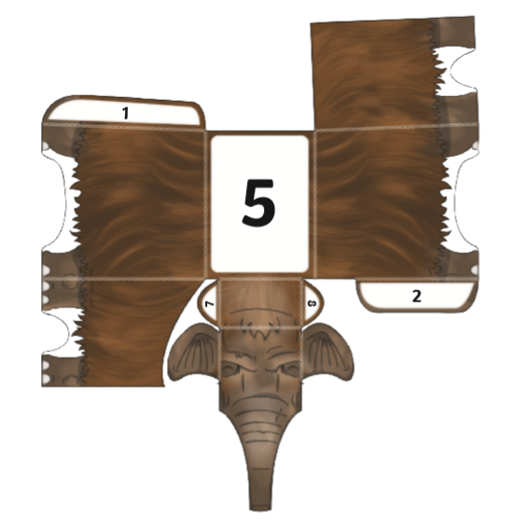
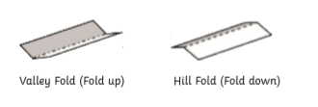

Slide 22
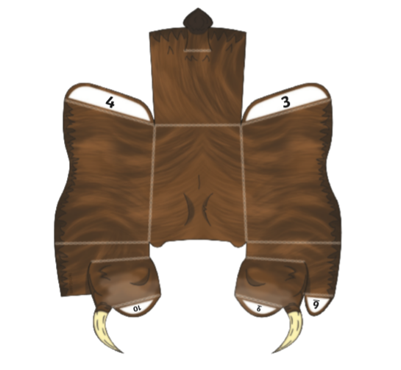
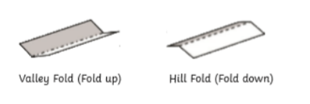

Slide 23
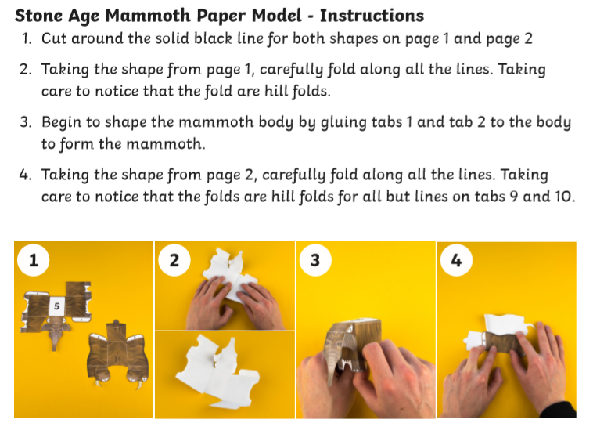

Slide 24
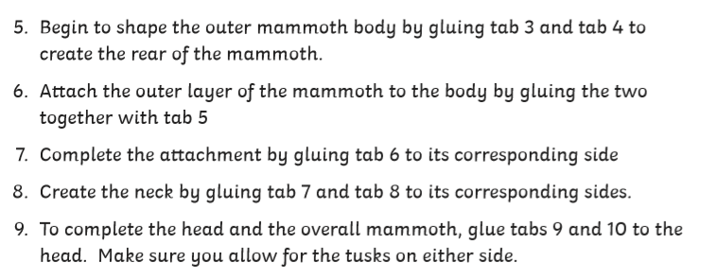
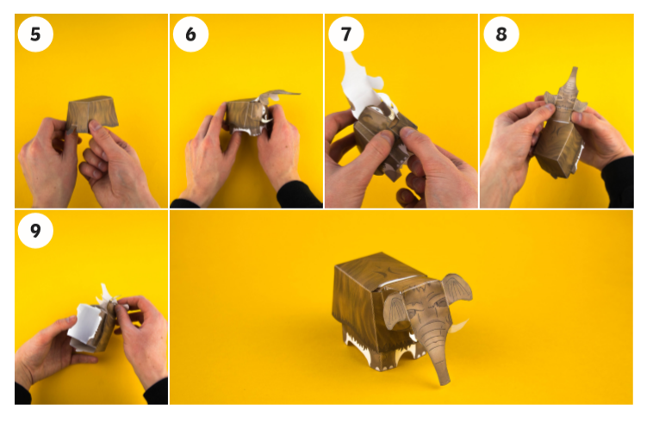

Slide 25

Mammoth Fact File
They lived… _________________________________________________________________________________________________________________________________________________________
They looked like …
__________________________________________________________________________________________________________________________________________________________________
They became extinct because..
__________________________________________________________________________________________________________________

Slide 26

Thursday 21st January 2021
LO To be able to identify the communities we belong to and how it makes us feel
Subject: PSHE

Slide 27
Starting point
Think about any groups you may be part of now or have been part of. Now complete the following steps.
Examples of groups: dancing, football, gymnastics, swimming, friendship, school class, family.
1. Write down the different groups you can think of that you are part of. They might include something in school or out of school. (dancing, football, friendships, class)
Friendships
Swimming
Swimming: Brother, sister
Friendships: Daniel, Ella
2. Can you write down who is in these groups with you? (Family, friends, teachers)
3. How does it make you feel to be part of these groups? (happy, excited, proud)
Excited, happy,

Slide 28



Did you know we all belong to a community?
What is a community?
A community is when a group of people come together because they share the same things for example: social interest (football, dance), job, where they live and school.

Slide 29

Listen to the following story using the link below.
If you are unable to watch online or prefer to read it, the story is provided on the next few slides (5-9).
https://www.youtube.com/watch?v=OaX_zGZO0Y8

Slide 30
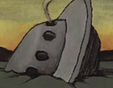
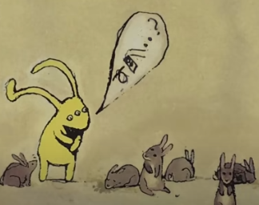
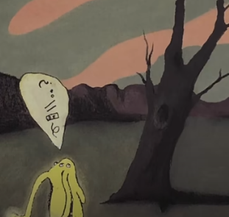
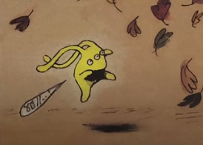
Beegu was not supposed to be here.
She was lost.
No one seemed to understand her.
Some wouldn’t even stay still to listen.

Slide 31
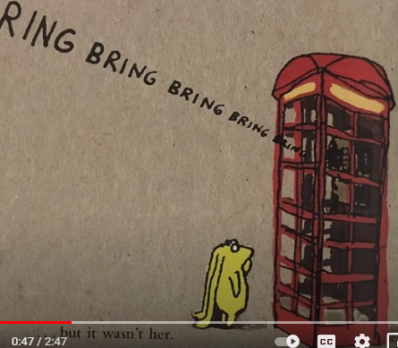
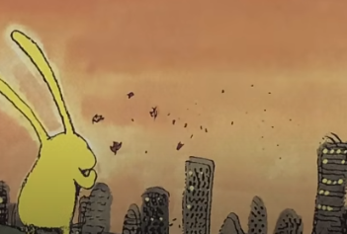
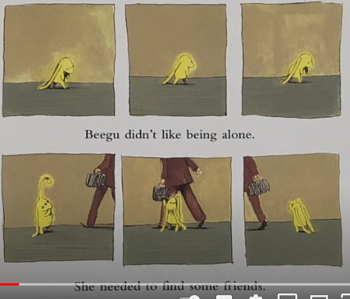
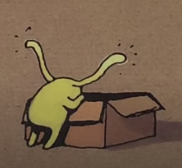
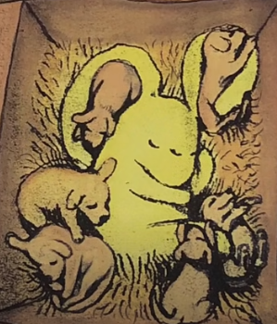
From far away ….. she thought she heard her mother calling but it wasn’t her.
Beegu didn’t like being alone. She needed to find some friends.
And she did at last..

Slide 32
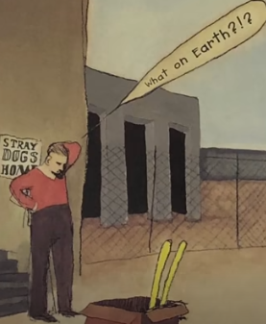
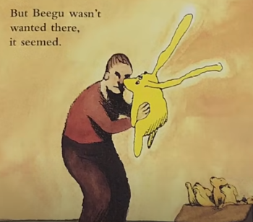
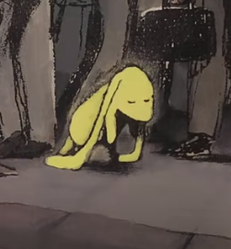
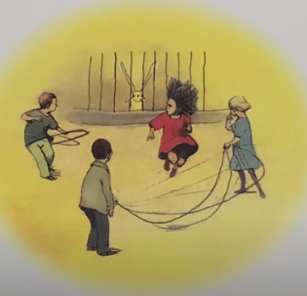
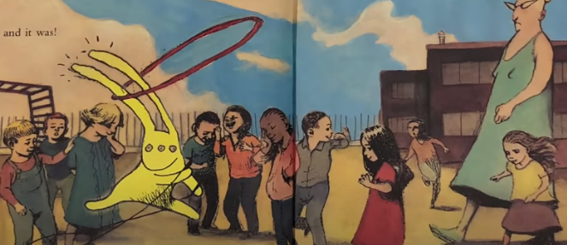
But Beegu wasn’t wanted there, it seemed.
Then she thought she’d found the perfect place… and it was!

Slide 33
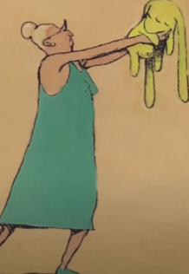
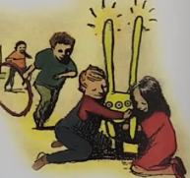
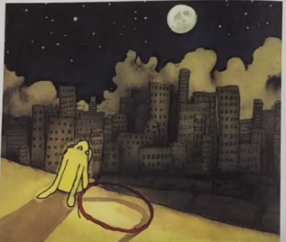
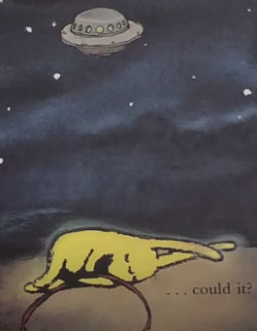
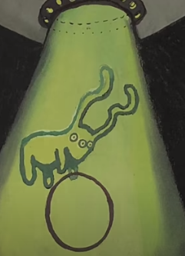
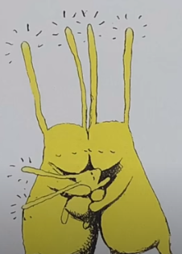
But not everyone thought so...
‘Wait!’
Her friends wanted to say goodbye.
Once again, from far away she thought she heard her mother calling. But she knew it couldn’t be…. could it?
But it was!

Slide 34
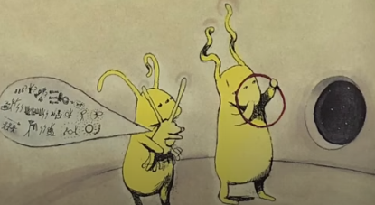
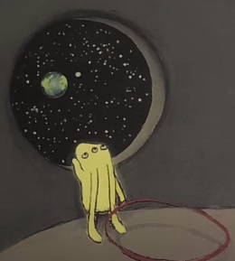
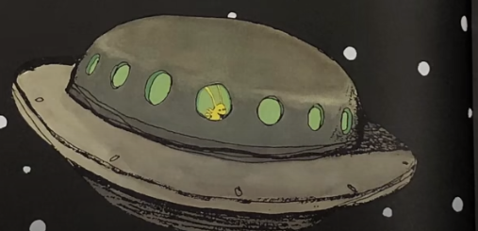
Beegu told her parents all about life on Earth. How earth creatures were mostly big and unfriendly, but there were some small ones who seemed hopeful.
Beegu would always remember those small ones.
She hoped they would remember her too.

Slide 35


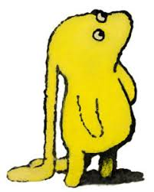
Now answer these questions
Wanting to belong
How did Beegu feel each time she was excluded from a group?
_______________________________________________________________________________________________________________________________________
What might Beegu have thought when this happened?
_______________________________________________________________________________________________________________________________________
Notes:
Teacher notes – 15 mins
Explain to the class that they are going to hear a story about someone who wanted to join different groups but was made to feel they didn’t belong. Read the story of Beegu by Alexis Deacon.
Teacher note: Beegu is an alien so remind the class that aliens aren’t real but in this case Beegu’s story helps us to talk about how we treat people who are new to our groups.
Ask pupils to think about all the things that happened to Beegu.
How was Beegu made to feel unwelcome by the different groups? Invite pupils to share and feedback their ideas on why they think Beegu was excluded.
• How do they think Beegu felt each time she was excluded from a group?
• What thoughts might have been going through Beegu’s mind each time?
• Which group did make Beegu feel welcome?
• How did they do this?
• What could the other groups have done instead so that Beegu felt welcome and included?
Record some of their ideas and opinions on the class flipchart or whiteboard.

Slide 36
Wanting to belong
Which group made Beegu feel welcome?
______________________________________________________________________________________
How did they do this?
_________________________________________________________________________________________________________________________________
What could the other groups have done instead to make Beegu feel welcome and included?
_________________________________________________________________________________________________________________________________
Notes:
Teacher notes – 15 mins
Explain to the class that they are going to hear a story about someone who wanted to join different groups but was made to feel they didn’t belong. Read the story of Beegu by Alexis Deacon.
Teacher note: Beegu is an alien so remind the class that aliens aren’t real but in this case Beegu’s story helps us to talk about how we treat people who are new to our groups.
Ask pupils to think about all the things that happened to Beegu.
How was Beegu made to feel unwelcome by the different groups? Invite pupils to share and feedback their ideas on why they think Beegu was excluded.
• How do they think Beegu felt each time she was excluded from a group?
• What thoughts might have been going through Beegu’s mind each time?
• Which group did make Beegu feel welcome?
• How did they do this?
• What could the other groups have done instead so that Beegu felt welcome and included?
Record some of their ideas and opinions on the class flipchart or whiteboard.

Slide 37


Slide 38

Friday 22nd January 2021
L.O To be able to recognise greetings.
Subject: French

Slide 39
Watch the video below to help you pronounce the greetings and introductions.
https://www.bbc.co.uk/teach/supermovers/ks1--ks2-mfl-french-greetings-with-ben-shires/zdpdvk7

Slide 40
Have a go at pronouncing each of the greetings on the next slide.

Slide 41
Greetings
English French
Hi
Salut
Hello / Good morning
Bonjour
Good afternoon
Bon après-midi
Good evening
Bonsoir
Good night
Bonne nuit
Goodbye
Au-revoir

Slide 42
Practice saying the greetings on the following slides.
Test yourself to see if you can remember what each of the greetings mean. Use the pictures to help you.
Make sure to check what each of the greetings mean if you have forgotten.

Slide 43

Salut

Slide 44


Bonjour

Slide 45
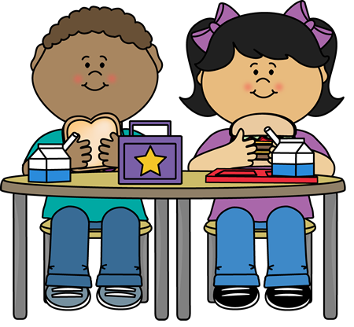
Bon après-midi

Slide 46

Bonsoir

Slide 47
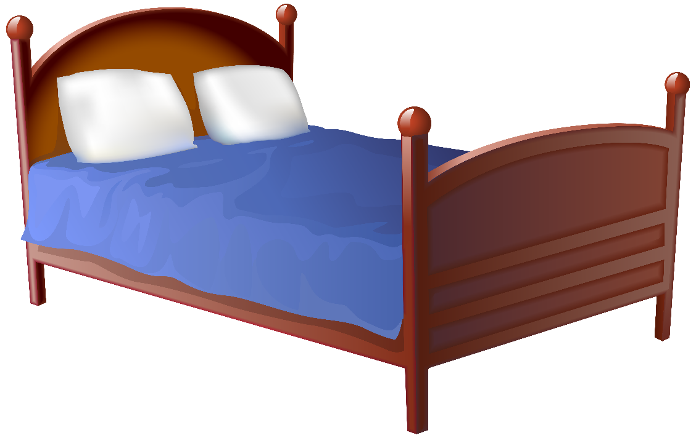
Bonne nuit

Slide 48

Au-revoir

Slide 49
Task
Copy out the words in English and French like they are shown on the next slide.
Using a ruler match the English greeting to the correct French greeting. The first one has been done for you.

Slide 50
Task
___________________________________________________________________________________________________________________________________________________________________________________________________________________________________________________________________________________________________________________________________________________________________________________________________________________________________________________________________________________________________________________________________________________________________________________________________________________________________________________________________________________________________________________________________________________________________________________________________________________________
Friday 22nd January 2021
L.O To be able to recognise greetings.
Good night
Salut
Good evening
Bonjour
Good afternoon
Bonsoir
Hi
Bon après-midi
Goodbye
Bonne nuit
Hello / Good morning
Au-revoir

Slide 51

Extend (1)
Practise recognising different French greetings by playing the game linked below.
https://www.lightbulblanguages.co.uk/estrellas-resources/FlingtheTeacher/fr-greetings.html

Slide 52
Extend (2)
Playing the matching game on the following slide.
Click on the cards to turn them over, turn over 2 cards.
If the French greeting matches with the English greeting leave them turned over.
If they do not match, click on the card again to turn them back over.
Try and find all of the matches!

Slide 53

Matching Game
Hello
Salut
Bonne nuit
Good evening
Goodbye
Au-revoir
Hi
Bonjour
Good night
Bonsoir

