Slide 1






Date: 28.06.2021
LO: To be able to calculate the perimeter of shapes.
Subject: Maths

Slide 2
Starting Video
To help you with this lesson, you can take a look at the first video (Measure Perimeter) to help you.
They will help you when you come to do your independent work.
https://whiterosemaths.com/homelearning/year-5/week-11-measurement-perimeter-area/

Slide 3
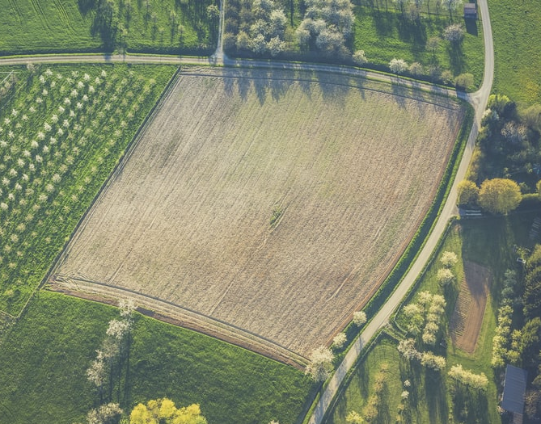
What is perimeter?
Perimeter is the path that is on the outside of a shape.
We add all the lengths and widths together to find the perimeter.
Farmers will measure the perimeter of their field to know how long their fence will be.

Slide 4
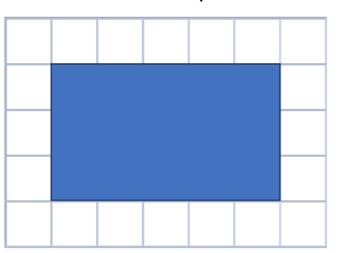
What is the perimeter?
Perimeter is calculating the distance around a whole shape.
Length
Perimeter is calculating the outside of a shape using the lengths and widths.
Look at the blue rectangle, the longer sides of the shapes are the ‘length’ and the shorter sides of the shape are the ‘width’.
Width
Width
Length
When calculating the perimeter, we simply need to add all of the lengths and the widths together.
5cm
Length + Length + width + width = Perimeter
5 cm + 5cm + 3cm + 3cm = 16cm
The perimeter of the Blue rectangle is 16cm.
3cm
3cm
Hint: Use the 1cm squares to help you.
5cm

Slide 5
Use the 1cm grid to help you count.
By counting using the 1cm grid, you can calculate the perimeter of the shape.
1
2
3
4
5
16
6
15
7
14
8
13
12
11
10
9

Slide 6
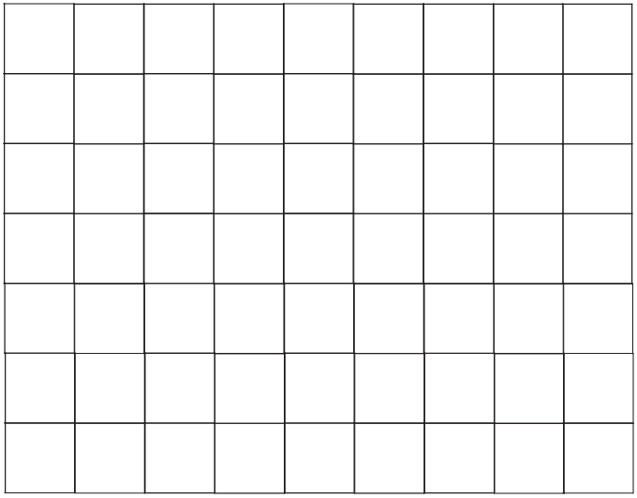
What is the perimeter of the this shape?
Using the grid squares, calculate the lengths and widths of the shape.
7cm
Remember, when calculating the perimeter, we simply need to add all of the lengths and the widths together.
2cm
2cm
Length + Length + width + width = Perimeter
7 cm + 7cm + 2cm + 2cm = 18cm
Perimeter = 18cm.
7cm

Slide 7
What is the perimeter of the this shape?
7cm
Using the grid squares, calculate the lengths and widths of the shape.
What is the perimeter if the rectangle?
3cm
Let’s check together.
7cm + 7cm + 2cm +2cm = 20cm
Perimeter = 20cm

Slide 8
Moving onto more complex shapes.
3cm
Can you calculate the perimeter of this shape using the 1cm grid?
2cm
4cm
3cm
3cm + 4cm + 6cm + 2cm + 3cm + 2cm = 20cm
Perimeter = 20cm
2cm
6cm

Slide 9
Checking our work…
I have used the squares to check if the perimeter of this shape is 20cm.
1
2
3
20
4
We were correct!
19
5
6
7
8
18
9
17
10
16
15
14
13
12
11

Slide 10
Your turn!
Use the grids to help you calculate the perimeter of each of the shapes.
Remember you are adding all of the sides together, the length and the width, to find the perimeter.
Each square = 1cm (they are not to scale on the PP)

Slide 11
What is the perimeter of this shape?
Perimeter = ____________

Slide 12
What is the perimeter of this shape?
Perimeter = ____________

Slide 13
What is the perimeter of this shape?
Perimeter = ____________

Slide 14
What is the perimeter of this shape?
Perimeter = ____________

Slide 15
What is the perimeter of this shape?
Perimeter = ____________

Slide 16
What is the perimeter of this shape?
Perimeter = ____________

Slide 17
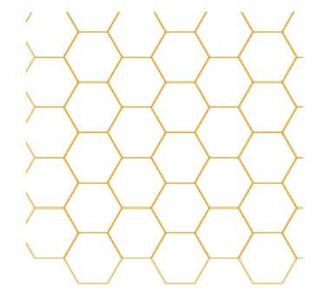
Each regular hexagon has a side length of 2cm.
Drag the red lines onto the grid to construct a shape, with a perimeter of 44cm.

Slide 18
End of Lesson

Slide 19
Date: 29.06.2021
LO: To be able to calculate the perimeter of a rectangle.
Subject: Maths

Slide 20
Video Introduction
To help you with this lesson, you can take a look at the first video (Perimeter of rectangles) to help you.
They will help you when you come to do your independent work.
https://whiterosemaths.com/homelearning/year-5/week-11-measurement-perimeter-area/

Slide 21
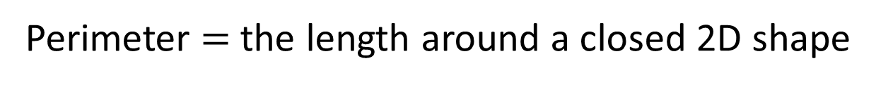
Perimeter $=$ the length around a closed 2D shape
1 cm
1 cm
5 cm
4 cm
4 cm
5 cm
5 cm
+ 4 cm
+ 5 cm
+ 4 cm
= 18 cm

Slide 22
Calculating the perimeter without the grid.
10cm
Here is as rectangle.
We know that all of the two lengths are 24cm and the widths are 10cm.
Remember, when calculating the perimeter, we simply need to add all of the lengths and the widths together.
24cm
Not drawn to scale
24cm
Length + Length + width + width = Perimeter
10 cm + 10cm + 24cm + 24cm = 68cm
Perimeter = 68cm.
10cm

Slide 23
Note down the features of a rectangle.
2 cm
2 cm
2D shape
4 sides
All sides are straight
6 cm
6 cm
2 pairs of equal sides
Perimeter =
16 cm
8 cm ?
6 cm
+ 2 cm
+ 6 cm
+ 2 cm
= 16 cm

Slide 24
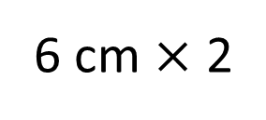
2 cm
6 cm
6 cm
+ 2 cm
+ 6 cm
+ 2 cm
= 16 cm
6 cm $×$ 2
+
2 cm × 2
= 16 cm
= 16 cm
8 cm
× 2

Slide 25
Let’s try one together.
We know that a rectangle has two equal lengths and two equal widths.
16cm
So, we can do:
16cm x 2 = 32cm
31cm x 2 = 62cm
32cm + 62cm = 94cm
Perimeter = 94 cm
Not drawn to scale
31cm
We can also do:
16cm + 31cm = 47cm
47cm x 2 = 94cm
Which method would you choose?

Slide 26
Try this one on your own, then click to find the answer.
We know that a rectangle has two equal lengths and two equal widths.
12cm
So, we can do:
12cm x 2 = 24cm
42cm x 2 = 84cm
24cm + 84cm = 108cm
Perimeter = 108 cm
Not drawn to scale
42cm
We can also do:
12cm + 42cm = 54cm
54cm x 2 = 108cm
Dis you get the answer right?

Slide 27
What is the perimeter of each of these squares?
2)
1)
6 cm
14 cm
9 cm
22 cm
2 cm
40 cm
7 cm
3)
4)
18 cm
Square
3 cm
6 cm
28 cm

Slide 28
Your turn!
On your questions use the grids to help you calculate the perimeter of each of the shapes.
Remember you are adding all of the sides together, the length and the width, to find the perimeter.

Slide 29
What is the perimeter of this shape?
12cm
Not drawn to scale
Perimeter = ____________
16cm

Slide 30
What is the perimeter of this shape?
5cm
Not drawn to scale.
Perimeter = ____________
21cm

Slide 31
What is the perimeter of this shape?
Not drawn to scale.
Perimeter = ____________
44cm
20cm

Slide 32
What is the perimeter of this shape?
Not drawn to scale.
Perimeter = ____________
20cm
20cm

Slide 33
Find the missing side - ?
The perimeter of this shape is 18cm
3cm
You have only been given one width of the shape and will need to tell me the length marked with a ? .
I know the the perimeter is the sum of all of the sides. All of the sides added up.
Also, this shape is a rectangle, and I know that the opposite sides of this shape are equal. Therefore, the bottom is also 3cm.
?
3cm x 2 = 6cm
18cm – 6cm = 12cm
3cm
Now I need to find the last two sides of the rectangle.
12cm ÷ 2 = 6 cm
? = 6cm
Perimeter = 18cm

Slide 34
What is the length of the side marked A?
Perimeter = 80cm
A = _______________
A
21cm

Slide 35
What is the length of the side marked A?
A
Perimeter = 82cm
A = __________
31cm

Slide 36
What is the length of the side marked A?
Perimeter = 100cm
A = __________
A
30cm

Slide 37
What is the length of the side marked A?
Perimeter = 20cm
A = __________
A
3cm

Slide 38
End of Lesson

Slide 39
Date: 30.06.2021
LO: To be able to calculate the perimeter of a rectilinear shape.
Subject: Maths

Slide 40
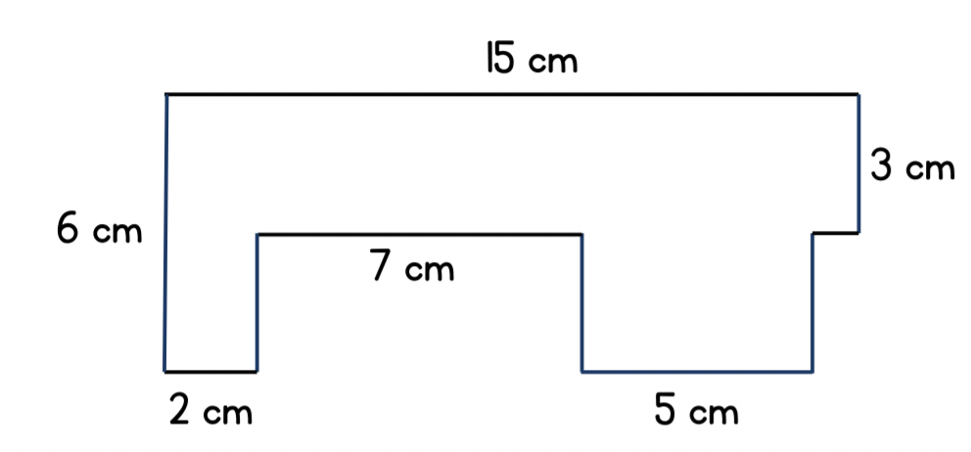
Starter
True or False: The perimeter of this shape is 38cm?

Slide 41
Video Introduction
To help you with this lesson, you can take a look at video, below.
It will help you when you come to do your independent work.
https://vimeo.com/477528259

Slide 42
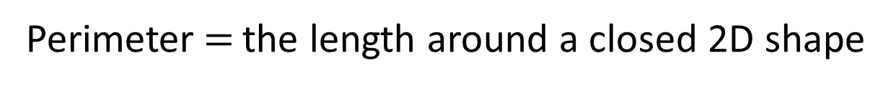
Perimeter $=$ the length around a closed 2D shape
1 cm
1 cm
2 cm
3 cm
5 cm
3 cm
2 cm
5 cm
2 cm
+ 3 cm
+ 3 cm
+ 2 cm
+ 5 cm
+ 5 cm
= 20 cm

Slide 43
We are going to look at how we can calculate the perimeter of rectilinear shapes.
We use the information we have available, to calculate any missing side lengths.
Here we know that one of the vertical sides is equal to 3cm.
We also know, that another of the vertical side lengths is 4cm.
If we add those together, we can calculate the missing length, on this shape.
Once we have all of our side lengths, we can add them together to calculate the perimeter.
6 cm
4 cm
4 cm
? cm
7 cm
5 cm
3 cm
3 cm
1 cm
= 26 cm
7 cm + 6 cm + 4 cm + 5 cm + 3 cm + 1 cm

Slide 44
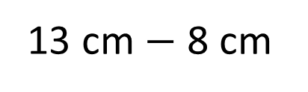
13 cm
13 cm
3 cm
Here, we do the same thing again.
We know that the missing vertical side is equal to 6cm add 3cm.
To find the missing horizontal side, we can take 13cm (fro the top) and minus 8cm.
Once we have all of our side lengths, we can add them together to calculate the perimeter.
8 cm
8 cm
9 cm
6 cm
13 cm $−$ 8 cm
= 5 cm
5 cm
3 cm + 13 cm + 9 cm + 5 cm + 6 cm + 8 cm
= 44 cm

Slide 45

2 m
1)
30 m
3 m
Let’s take a look at these together.
Can you work out the missing horizontal side on 1) by taking 5 away from 7?
Can you work out the missing vertical side by subtracting 5 from 8?
Using the missing sides, try and find the missing sides for 2 and 3, then add them together to find the perimeter.
5 m
8 m
2)
46 cm
5 m
14 cm
6 cm
7 m
9 cm
2 cm
10 cm
3)
3 cm
10 cm
10 cm
4 cm
7 cm
14 cm
4 cm
23 cm $=$ 7 cm $+$ cm $+$ 14 cm
4 cm
2
?
23 cm
74 cm

Slide 46
A photo frame is 15 cm long and 12 cm high.
The border around the photo window is 2 cm wide.
15 cm
12 cm
What is the perimeter of the photo window?

Slide 47
A photo frame is 15 cm long and 12 cm high.
The border around the photo window is 2 cm wide.
To find the perimeter of the photo window, we must subtract 2cm from either side of the vertical and horizontal sides.
Therefore, the horizontal length is 11 cm and the vertical sides are 8cm.
Now we can add these lengths together to find our perimeter.
15 cm
2 cm
11 cm
10 cm
12 cm
8 cm
2 cm
2 cm
What is the perimeter of the photo window?
38 cm

Slide 48
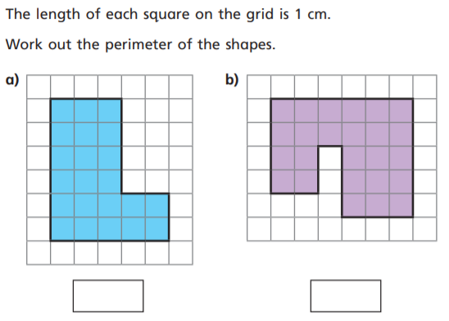
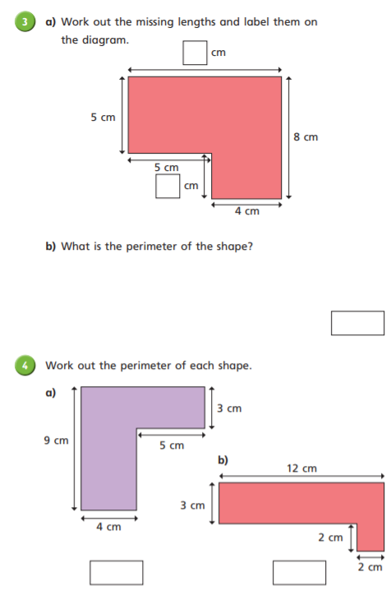
Answers
3)
1)
2)
9
3
22cm
26cm
4)
5)
34cm
6)
36cm
34cm

Slide 49
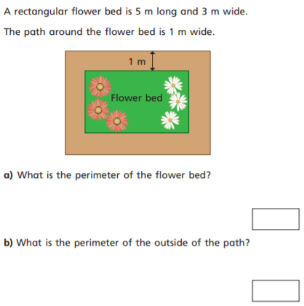
Extension : Can you calculate the perimeter of these rectilinear shapes?

Slide 50
Task: Can you calculate the perimeter of these rectilinear shapes?
3)
3)
1)
2)
1)
2)
4)
5)
5)
6)

Slide 51
Extension : Can you calculate the perimeter of these rectilinear shapes?
16cm
24cm

Slide 52
End of Lesson

Slide 53
Date: 01.07.2021
LO: To be able to calculate perimeter of different shapes.
Subject: Maths

Slide 54
Video Introduction
To help you with this lesson, you can take a look at the video, below.
It will help you when you come to do your independent work.
https://vimeo.com/477528979

Slide 55
2 m
= 200 cm
10 cm
Let’s take a look at these rectangles and find their perimeter.
However, we need to be very careful, as one of the side lengths is in metres and another is cm.
When this happens, we must put both sides into the same units.
So, let’s make both of these into cm.
There are 100cm in 1m, so 2m = 200cm.
12 cm
× 2
= 24 cm
210 cm
× 2
= 420 cm
80 cm
1 m
= 100 cm
180 cm
× 2
= 360 cm

Slide 56


The front of a garage is a rectangle 3 m high and 4 m wide.
The garage door is 70 cm shorter and 40 cm thinner on
each side than the garage.
This is similar to our photo window question, from yesterday.
However to find these missing sides, we are going to need to convert back into cm.
Remember, 1m=100cm.
Here we need to;
Subtract 70cm from 300cm
And
Subtract 80cm (40cm+40cm) from 400 cm.
Now we can calculate our perimeter.
400 cm
4 m
70 cm
320 cm
300 cm
3 m
230 cm
40 cm
40 cm
What is the perimeter of the garage door?
320 $+$ 230 $=$ 550 cm
550 $×$ 2 $=$ 1,100 cm

Slide 57
Ava is using squares with 5 cm sides.
5 cm
5 cm
5 cm
5 cm

Slide 58
Ava makes this shape using three of the squares.
10 cm
5 cm
5 cm
5 cm
5 cm
10 cm
Do we know all of the side lengths?
There may be two missing side lengths, but have a think. Can we calculate them?
5 cm
5 cm
5 cm
5 cm
Ava thinks that she cannot calculate this shape’s perimeter.
What do you think?

Slide 59
Ava makes this shape using three of the squares.
10 cm
5 cm
5 cm
5 cm
5 cm
As you can see, there are two missing side lengths.
However, if we think about this, we can work out that two of the squares sides are equal to 10cm. Attached to it is one 5cm side.
So 10cm, minus the 5cm side, will reveal the missing length.
10 cm
5 cm
5 cm
5 cm
5 cm
5 cm
Ava thinks that she cannot calculate this shape’s perimeter.
Explain why Ava is incorrect.
10 cm + 5 cm + 5 cm + 5 cm + 5 cm + 5 cm + 5 cm =
40 cm

Slide 60
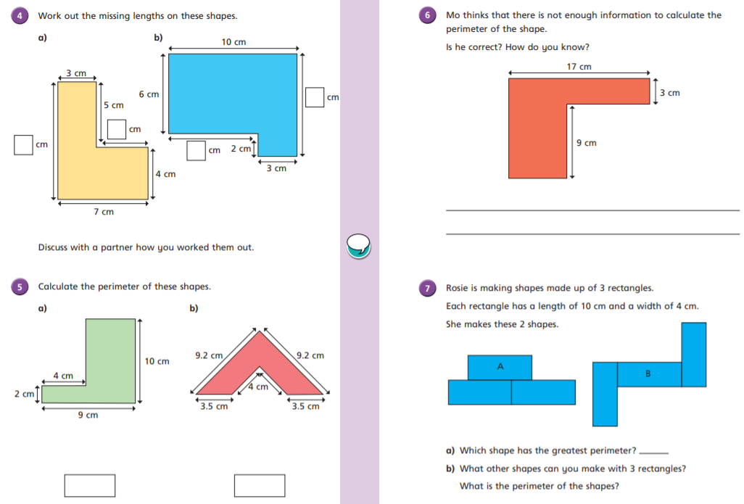
Task: Can you calculate the perimeter of these shapes?
5)
1)
2)
3)
4)
6)
7)

Slide 61

Answers: Can you calculate the perimeter of these shapes?
5)
1)
2)
3)
4)
6)
7)

Slide 62
End of Lesson

Slide 63
Date: 02.07.2021
LO: To be able to calculate area, by counting squares.
Subject: Maths

Slide 64
Video Introduction
To help you with this lesson, you can take a look at the video, below.
It will help you when you come to do your independent work.
https://vimeo.com/477528979

Slide 65
Today, we are going to learn about area.
Area is the space inside a 2D shape.

Slide 66
The third shape is not closed, so the are cannot be calculated.
Can you visualise the areas of these shapes?
Area is the space inside a 2D shape.
Area is the space inside a closed 2D shape.

Slide 67
Which shape would be the best to fill the rectangle?
Why?

Slide 68
Gaps
Which shape would be the best to fill the rectangle?
Why?
The area is 20 circles

Slide 69
Which shape would be the best to fill the rectangle?
Why?

Slide 70
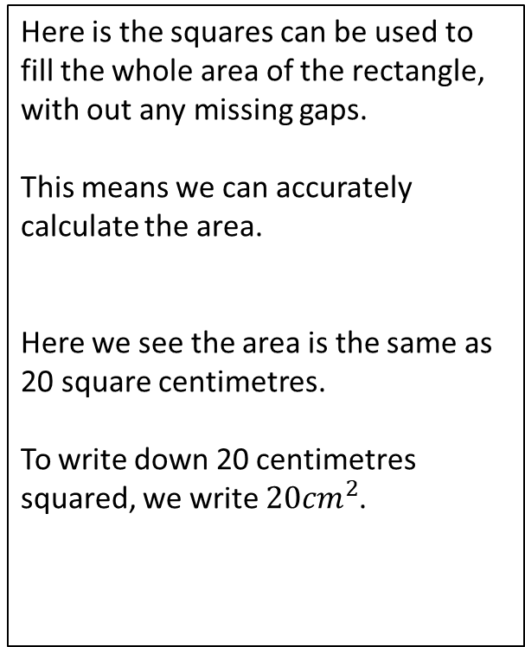
Here is the squares can be used to fill the whole area of the rectangle, with out any missing gaps.
This means we can accurately calculate the area.
Here we see the area is the same as 20 square centimetres.
To write down 20 centimetres squared, we write ${20cm}^{2}$.
The area of the rectangle is:
20 squares

Slide 71
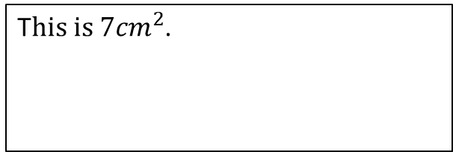
1
2
3
4
5
6
T$his is {7cm}^{2}$.
7
7
The area is ___ squares.

Slide 72



1)
9
The area is __ squares.
T$his is {9cm}^{2}$.
3)
2)
4
The area is __ squares.
4
The area is __ squares.
T$his is {4cm}^{2}$.
T$his is {4cm}^{2}$.

Slide 73
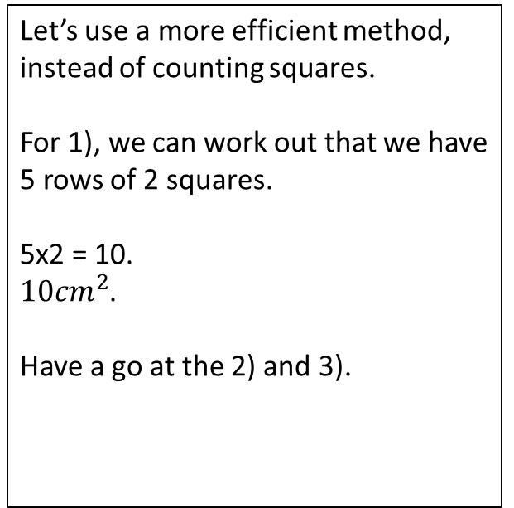
1)
5 × 2 =
10 squares
2)
Let’s use a more efficient method, instead of counting squares.
For 1), we can work out that we have 5 rows of 2 squares.
5x2 = 10.
${10cm}^{2}$.
Have a go at the 2) and 3).
1 × 6 =
6 squares
3)
4 × 4 =
16 squares

Slide 74

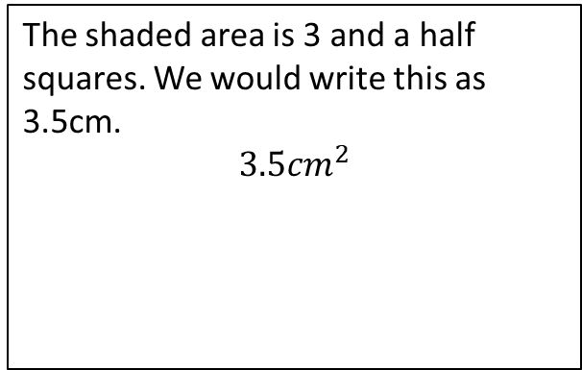

The shaded area is 3 and a half squares. We would write this as 3.5cm.
$${3.5cm}^{2}$$
$$\frac{\text{1}}{\text{2}}$$
1
2
3
$$\frac{\text{1}}{\text{2}}$$
3
The area is ____ squares.

Slide 75

1)
2)
Have a go at finding the areas of the shaded parts of these quadrilaterals.
Remember that 2 halves make a whole!
3
2
$$\frac{\text{1}}{\text{2}}$$
3)
3

Slide 76
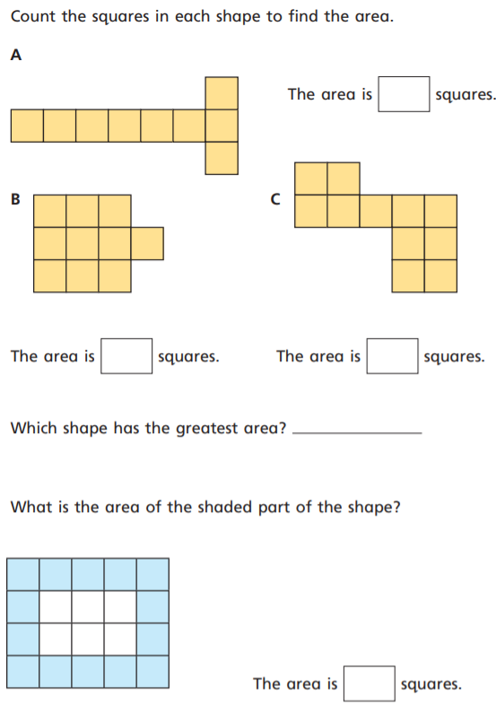
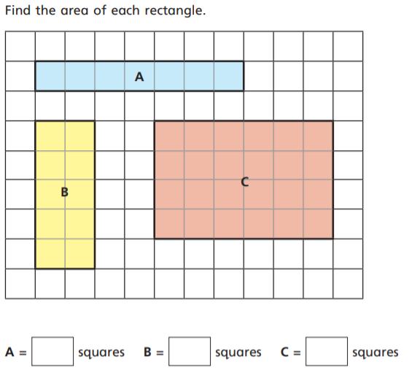



Task: Count the squares to help calculate the area.
1)
6)
2)
3)
4)
5)
$${cm}^{2}$$
$${cm}^{2}$$
$${cm}^{2}$$

Slide 77
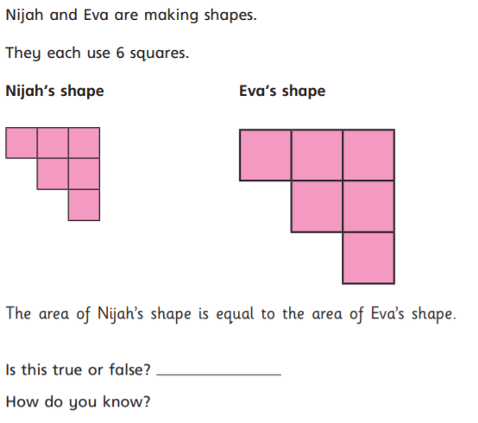
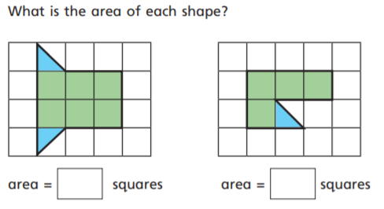


Task: Count the squares to help calculate the area.
7)
$${cm}^{2}$$
$${cm}^{2}$$
8)
9)

Slide 78
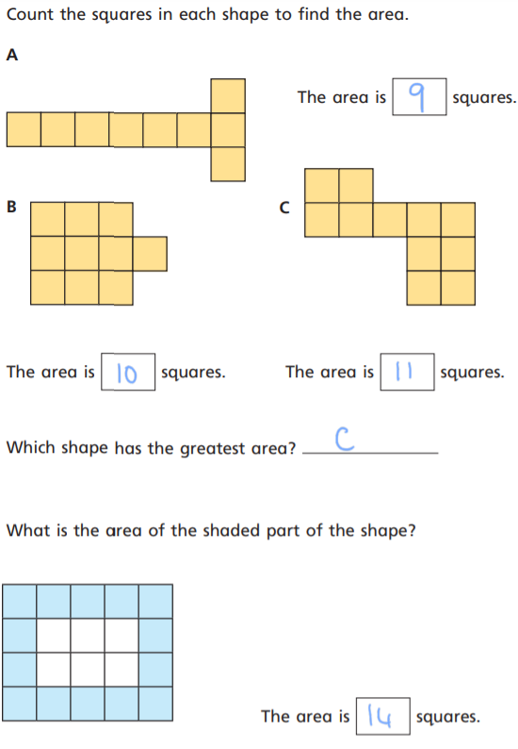

Answers
1)
6)
2)
3)
4)
5)
7)
$${cm}^{2}$$
10
$${cm}^{2}$$
24
$${cm}^{2}$$

Slide 79
Answers
7)
$${cm}^{2}$$
4.5
7
$${cm}^{2}$$
8)
False
9)
There are the same number of squares, however he size of the squares are not the same.

Slide 80
End of Lesson

