Slide 1
Date: Tuesday 9th February 2021
LO: To be able to understand the importance of using secure passwords.
Subject: Computing

Slide 2
Starter
In your own words, write down what a password is and what it is used for?

Slide 3
Starter
In your own words, can you tell me what a password is and what it is used for?
A password is a string of characters that allows access to a computer, social media account or any other type of secured system.
Passwords are like keys that keep our information and money safe.
Hackers can use computer programmes to crack our codes to gain access to our valuables and steal our identity.

Slide 4
What makes a password strong and secure?
Being unique and very difficult to guess or work out.
They contain a mix of at least 8 characters including upper- and lower-case letters, numbers and symbols.
They should not contain obvious information like your name, birthdate or other details that might be known by others.
Never use the word “password” or other obvious sequences such as 123456.
Secure passcodes and passwords are not re-used for other accounts and are not displayed anywhere.

Slide 5
What can help us remember a secure password?
You could use an acronym, an unusual phrase, or words of a song or poem that you know well and add in numbers or symbols for some of the letters.
Try to avoid obvious substitutions such as 1 for i or 3 for E – make your own unique code.
You should use strong and separate passwords for each different account, and this is especially important for your email account.

Slide 6
What ways can we protect ourselves online?
Two-factor authentication is a second level of security used in addition to your username and password. It is used for sites such as banking. Banks may send a text message to a customer’s phone with a number which must be entered on the computer before the payment can proceed.
Some websites increase security by only asking for certain bits of your password. For example the 3rd, 5th and 8th letters.

Slide 7
What other ways can we protect ourselves online?
Captcha checks that a user is human and not a robot. It might ask you to recognise letters or numbers written in non-standard ways. Or, you might have to identify features such as traffic lights, vehicles in a grid of photos.
Anti-virus software and installing security updates is also important.

Slide 8
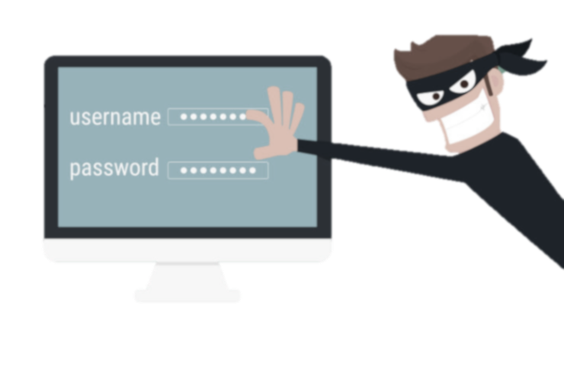
Why is it important to use different passwords for a range of online services?
Secure passcodes and passwords are not re-used for other accounts and are not displayed anywhere. Hackers can use computer programmes to crack our codes to gain access to our valuables and steal our identity. If you use the same password, they will have access to all of your accounts.

Slide 9
Its time to test your password knowledge!
You are going to be asked 6 multiple choice questions.
Answer them all correct, and you will win.

Slide 10
Question 1
You are creating a password for your email account. Do you:
A) Include personal information, for example, your name.
B) Use the word ‘password’.
C) Use a sequence of number, for example, 12345.
D) Include a mix of at least 8 characters including upper- and lower-case letters, numbers and symbols.

Slide 11
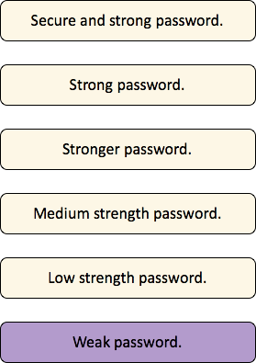
Question 1
You are creating a password for your email account. Do you:
A) Include personal information, for example, your name.
B) Use the word ‘password’.
C) Use a sequence of number, for example, 12345.
D) Include a mix of at least 8 characters including upper- and lower-case letters, numbers and symbols.

Slide 12
Question 2
You have created a password for your email account. Who do you tell this password too?
A) Your family.
B) Your friends.
C) No-one.
D) Your teacher.

Slide 13
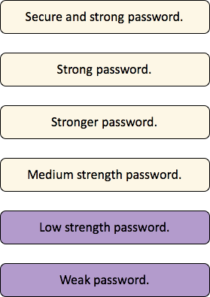
Question 2
You have created a password for your email account. Who do you tell this password too?
A) Your family.
B) Your friends.
C) No-one.
D) Your teacher.

Slide 14
Question 3
You need to create a password you will remember. Do you:
A) Use anacronym, an unusual phrase, or words of a song or poem that you know well and add in or substitute numbers or symbols for some of the letters.
B) Use substitutions such as 1 for i or 3 for E.
C) Use personal information that is easy to remember, for example, your birthday.
D) Make a secure password but tell a family member incase you forget.

Slide 15
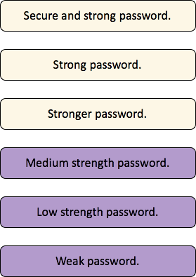
Question 3
You need to create a password you will remember. Do you:
A) Use anacronym, an unusual phrase, or words of a song or poem that you know well and add in or substitute numbers or symbols for some of the letters.
B) Use substitutions such as 1 for i or 3 for E.
C) Use personal information that is easy to remember, for example, your birthday.
D) Make a secure password but tell a family member incase you forget.

Slide 16
Question 4
You are creating a password for another account. Do you use the same password as your email account?
A) No, all passwords should be different. Especially important for your email account.
B) Yes, it will be easy to remember.

Slide 17
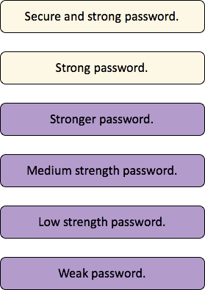
Question 4
You are creating a password for another account. Do you use the same password as your email account?
A) No, all passwords should be different. Especially important for your email account.
B) Yes, it will be easy to remember.

Slide 18
Question 5
Your friend finds out your password and logs into your phone. Do you:
A) Change your password immediately.
B) Do nothing.
C) Tell your friend not to log in again.

Slide 19
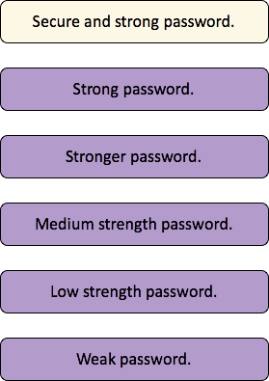
Question 5
Your friend finds out your password and logs into your phone. Do you:
A) Change your password immediately.
B) Do nothing.
C) Tell your friend not to log in again.

Slide 20
Question 6
You are typing your password and lots of people are around you. Do you:
A) Type it in normally.
B) Cover your password when entering it so others can’t see.
C) Type it in quickly.
D) Make sure no one is looking.

Slide 21
Question 6
You are typing your password and lots of people are around you. Do you:
A) Type it in normally.
B) Cover your password when entering it so others can’t see.
C) Type it in quickly.
D) Make sure no one is looking.

Slide 22
Secure and strong password.
Strong password.
Stronger password.
Medium strength password.
Low strength password.
Well done!
You have created a secure and strong password.
Weak password.

Slide 23
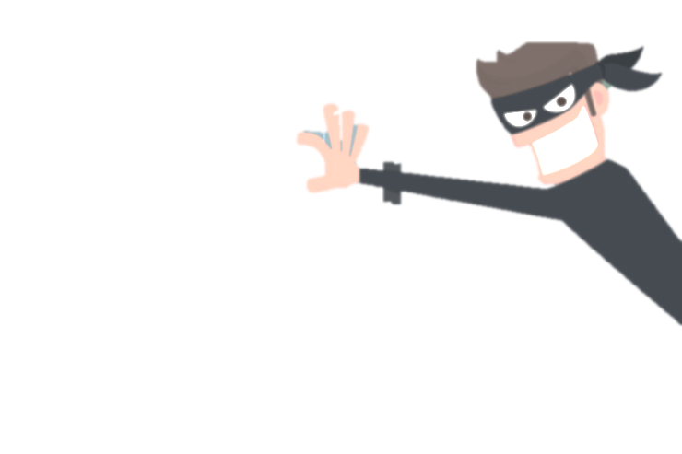
Task
Using what we have learnt today, create a poster with your top tips for secure ways to set up and protect passwords.

Slide 24
End of lesson.

