Slide 1
Monday 11th January
Weekly Spellings- ible sound
Please spend time practising these spellings daily. (Approx 10mins)
Rule: The suffix ‘ible’ does not leave a recognisable word when dropped (e.g. visible/vis)
audible
compatible
divisible
gullible
sensible
visible
possible
horrible
legible
terrible
Read each of the word out loud
Identify ible sound in each word
Break up each word to help with spelling it
Think of or discuss what each word means, can you use it in sentence?
Use a dictionary or the internet to find any words you are unsure of- or ask an adult!
Copy the words down
Cover and try to spell them
Check and correct any errors

Slide 2
Audible – to be heard
A singer uses a microphone to be audible over the loud crowd.
Compatible- two or more things that go together
The charger was not compatible with the mobile phone so it would not charge.
Gullible- to easily persuade someone of something
My little sister is extremely gullible therefore I tell her lots of things that are not true and she believes me.
Legible- clear enough to read
I must make sure my handwriting is neat and legible otherwise Miss Dobson will not be happy!

Slide 3



Date: Monday 11th January
L.O To be able to answer questions about a text
Subject: English

Slide 4
To support our learning in science, we will read about the different parts of a flower and their functions. Carefully read through the information below.
Reproduction is the process of making a copy of something. Human reproduction involves making a copy of a person. Plants also reproduce, but they do not reproduce in the same way as animals. When plants reproduce, the process begins with pollination and the result is fertilisation and new plants.
Only flowers from the same species of a plant can produce seeds. The seeds are produced within certain parts of a flower through pollination and fertilisation. Sometimes people confuse the two terms. Pollination is the process that leads to fertilization. Fertilisation occurs when the egg cells (female) of a flowering plant receive the pollen (male) from another flower. Pollination and fertilization are simple processes that take place wherever flowering plants exist.
Since plants cannot move from one place to another place, they must rely on the movement of bees, butterflies, birds, and other methods for reproduction. The steps of the pollination process begin when pollen, the male cells of a plant, is discharged from the male part of a flower, the stamen. It is a fine, yellow, powdery substance. When it is in the air, it can cause allergic reactions for many people.

Slide 5
Write down the answers to the questions below or discuss them with an adult.
What is the name of the first stage of the process of the reproduction plants?
Explain what the word ‘species’ means.
What does the plant produce after the process of pollination and fertilisation?
What do plants rely on for the process of pollination to happen? Why is this?
Explain why some words are wrote in bold. Write these words down along with their definition.

Slide 6
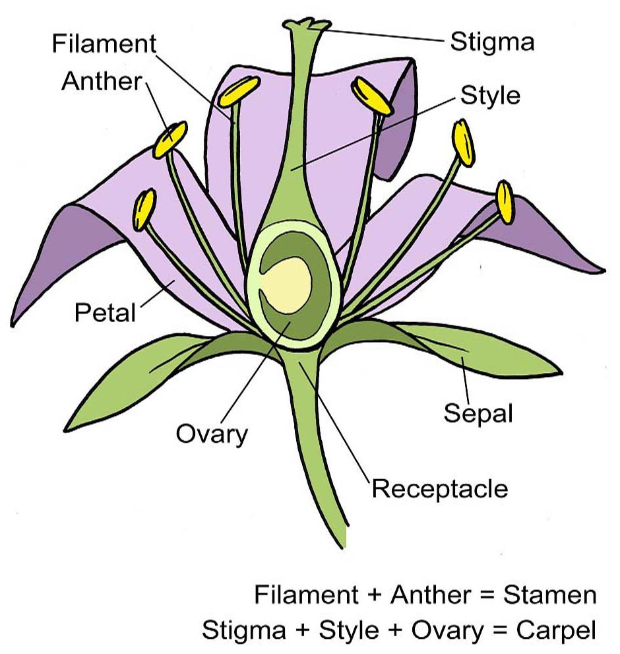
The first step of pollination begins when the colourful petals of a flower and the scent of the nectar attract insects such as bees and butterflies (called pollinators) to the flower.
Next, the bees or other insects accidentally land on the male part of the flower, the stamen.
Third, while on the stamen, tiny grains of pollen from the anthers of the flower stick to the insect's bodies. The insect's purpose is to feed on the nectar of the flower.
During the fourth step, the insect then travels to another flower (of the same species) and accidentally lands on the stigma, top of the pistil (the female part of the flower) where the pollen is released.
Following the release of the pollen, the ovules (eggs) in the ovary, the bottom of the style, wait to be fertilised by the pollen as it travels downward through the style to the ovary.
Finally, it is in the ovary where fertilisation takes place and a new seed is produced.
When the fertilised eggs turn into seeds, it is called seed production. Once the seeds are produced, they are scattered throughout the area through seed dispersal. The seeds can simply fall onto the ground and then carried by animals or water to another area.

Slide 7
6. How are insects attracted to the flowers. State two methods.
What are the purpose of the insects? Two answers can be given.
8. Where does fertilisation happen and what is produced?
9. How are seeds scattered? What is this process called?
10. Why is this process of pollination and fertilisation so important? Explain your answer.

Slide 8
What is the name of the first stage of the process of the reproduction plants? Pollination
Explain what the word ‘species’ means. A group of living things which are the same of similar
What does the plant produce after the process of pollination and fertilisation? Seeds are produced which means new plants can grow.
What do plants rely on for the process of pollination to happen? Why is this? Plants rely on insects for pollination because they can not move.
Explain why some words are wrote in bold. Write these words down along with their definition. Some words are wrote in bold so they stand out and because they are key words.
How are insects attracted to the flowers. State two methods. Through the bright coloured petals and the scent of nectar.
What are the purpose of the insects? Two answers can be given. The insects purpose is to feed on the nectar but they are needed to pollinate the flowers.
8. Where does fertilisation happen and what is produced? Fertilisation happens in the ovary and a seed is produced.
9. How are seeds scattered? What is this process called? Seeds are scattered throughout the area through seed dispersal. The seeds can simply fall onto the ground and then carried by animals or water to another area.
10. Why is this process important? Explain your answer. The process of pollination and fertilisation is important because it is the way flowers and plants reproduce to create new seeds which means new plants and flowers grow.

Slide 9

Reading time
Now that you have finished your main task, please enjoy some reading time.
You can read to yourself, an adult or sibling.
This can be done by logging on to your myON account, picking a book or magazine and enjoying at least 15 minutes reading time.
https://www.myon.co.uk/login/index.html
Remember that your login is your first name and first letter of your surname then password:
harryp
password1
Please email trailblazerspupils@gmail.com if you have any login issues.

Slide 10
Tuesday 12th February
Weekly Spellings- ible sound
Please spend time practising these spellings daily. (Approx 10mins)
Rule: The suffix ‘ible’ does not leave a recognisable word when dropped (e.g. visible/vis)
audible
compatible
divisible
gullible
sensible
visible
possible
horrible
legible
terrible
Read each of the word out loud
Identify ible sound in each word
Break up each word to help with spelling it
Copy the words down
Cover and try to spell them
Check and correct any errors

Slide 11
Date: Tuesday 12th January
L.O To be able to use fronted adverbials
Subject: English

Slide 12
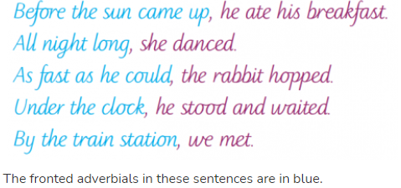
What do we mean by fronted adverbials?
An adverbial is a word or phrase that has been used like an adverb to add detail or further information to a verb. (An easy way to remember what an adverb is: it adds to the verb.)
Fronted' adverbials are 'fronted' because they have been moved to the front of the sentence, before the verb. In other words, fronted adverbials are words or phrases at the beginning of a sentence, used to describe the action that follows.
A comma is normally used after an adverbial (but there are plenty of exceptions to this rule).
Copy and paste the link into a web browser. Then watch the video and read the information below.
https://www.bbc.co.uk/bitesize/topics/zwwp8mn/articles/zp937p3

Slide 13
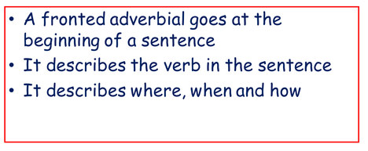
Here are some examples based upon pollination of plants.
When plants reproduce, the process begins with pollination and the result is fertilization and new plants.
Before fertilisation can occur, the process of pollination needs to happen.

Slide 14
Task: Using time fronted adverbials, write 6 sentences to explain the processes of pollination and fertilisation. Use the information you read last lesson to help you.
Decide upon a fronted adverbial to use in your sentence- make sure it as the start of your sentence!
Check you have used a comma correctly after the fronted adverbial or fronted adverbial phrase.
Time fronted adverbials examples:
Before long, Beforehand,
After a while, Again
Soon, Later,
Following on from…, Next,
Finally, Some time later,

Slide 15
Reading time
Now that you have finished your main task, please enjoy some reading time.
You can read to yourself, an adult or sibling.
This can be done by logging on to your myON account, picking a book or magazine and enjoying at least 15 minutes reading time.
https://www.myon.co.uk/login/index.html
Remember that your login is your first name and first letter of your surname then password:
harryp
password1
Please email trailblazerspupils@gmail.com if you have any login issues.

Slide 16
Wednesday 13th January
Weekly Spellings- ible sound
Please spend time practising these spellings daily. (Approx 10mins)
Rule: The suffix ‘ible’ does not leave a recognisable word when dropped (e.g. visible/vis)
audible
compatible
divisible
gullible
sensible
visible
possible
horrible
legible
terrible
Read each of the word out loud
Identify ible sound in each word
Break up each word to help with spelling it
Copy the words down
Cover and try to spell them
Check and correct any errors

Slide 17
Date: Wednesday 13th January
L.O To be able to use modal verbs to indicate a degree of possibility
Subject: English

Slide 18
What are model verbs?
These are verbs that indicate likelihood, ability, permission or obligation.
Words like: can/could, may/might, will/would, shall/should and must.
"The Sea Monster should go away"
'Should' is the modal verb here as it indicates the likelihood of the Sea Monster going away.
One of the main functions of a modal verb is to show the degree of possibility or likelihood of something happening.
The most common modal verbs that perform this function are will, would, should, could, may, can, shall, ought to, must and might. Many of these modal verbs have a negative form, e.g. couldn’t/could not, can’t/cannot
Copy and paste the link below into a browser, watch the video to support your understanding.
https://www.bbc.co.uk/bitesize/topics/zwwp8mn/articles/zps4pbk

Slide 19
Examples of sentences using modal verbs:
The petals of flowers are brightly coloured so they will attract insects to them.
Without insects, pollination and fertilisation of flowers would not happen.
When pollen is in air, it might cause problems for those who are allergic and have hay fever.

Slide 20
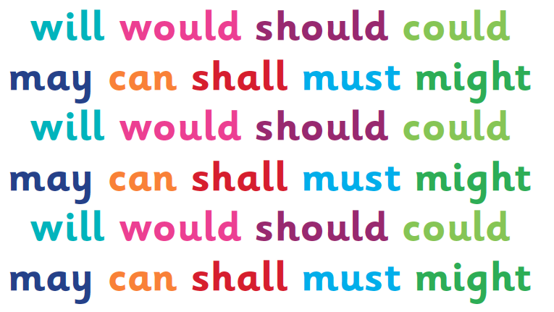
Task: Write 6 sentences of your own, which include modal verbs, that are focused on facts about life cycles of living things or the process of reproduction in plants.
Use the information from Monday’s lesson and last week to help remind you of different facts you could write about.
Remember to check your sentences are correctly punctuated!
CL , .

Slide 21
Reading time
Now that you have finished your main task, please enjoy some reading time.
You can read to yourself, an adult or sibling.
This can be done by logging on to your myON account, picking a book or magazine and enjoying at least 15 minutes reading time.
https://www.myon.co.uk/login/index.html
Remember that your login is your first name and first letter of your surname then password:
harryp
password1
Please email trailblazerspupils@gmail.com if you have any login issues.

Slide 22
Thursday 14th January
Weekly Spellings- ible sound
Please spend time practising these spellings daily. (Approx 10mins)
Rule: The suffix ‘ible’ does not leave a recognisable word when dropped (e.g. visible/vis)
audible
compatible
divisible
gullible
sensible
visible
possible
horrible
legible
terrible
Read each of the word out loud
Identify ible sound in each word
Break up each word to help with spelling it
Copy the words down
Cover and try to spell them
Check and correct any errors

Slide 23
Date: Thursday 14th January
L.O To be able to plan an explanation text
Subject: English

Slide 24
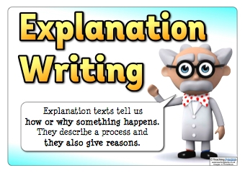
What do we mean by an explanation text?
An explanation text is a specific type of writing and includes some identifiable features.
It is a non-fiction text which describes a process, for example: the water cycle, how bees make honey or how a car is made.
We are going to write an explanation text about the process of reproduction for plants.

Slide 25
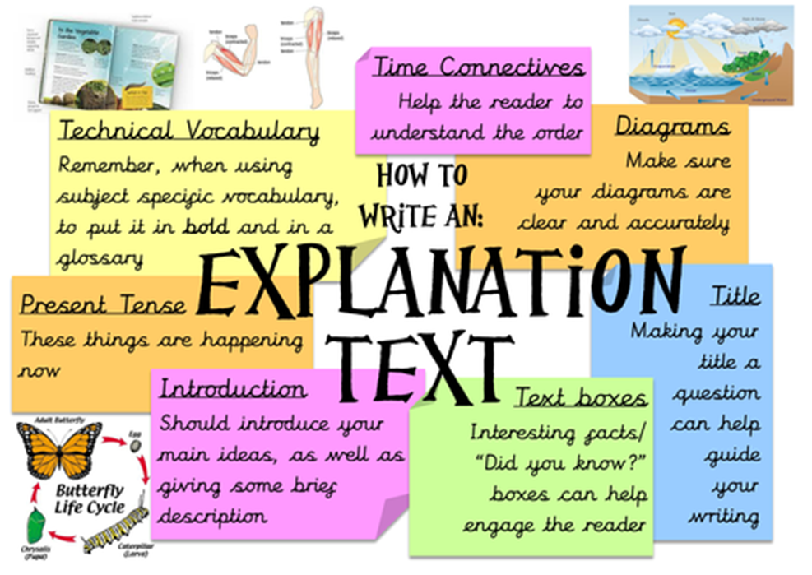
What are the features of an explanation text?
Explanation texts usually include these features:
Written in the present tense, in formal language
Text arranged into numbered points
Sub-headings to separate sections of text
Time connectives, such as: first, then, next, later, finally.
Technical vocabulary (sometimes in bold), for example: if the text is about how a car is made, it may include words such as 'ignition', 'engine' and 'bonnet'
Glossary to explain technical vocabulary
Diagrams with labels
Pictures with captions

Slide 26
Task: Plan a explanation text
Re-cap information about the process of reproduction in plants.
Decide and write down what the title will be- this needs to explain what the text is about eg. Reproduction in plants.
Decide and write down headings you will use for the different sections- eg. Parts of a plant, Pollination, Fertilisation etc.
Create a bank of vocabulary you can use – eg. Technical words, fronted adverbials (time openers), modal verbs, conjunctions, present tense etc.
Plan out how you will set out your information.
Draw or print any diagrams or pictures
you will use then annotate or write a caption
for them.
You can decide upon your own topic to write an explanation text about. Such as, your favourite game- how to play, characters etc.

Slide 27
You can use this to plan your explanation text or write out your plan onto paper using the same headings.
Title:
Vocabulary to use:
Technical words:
Fronted adverbials (time openers):
Modal verbs:
Conjunctions:
Present tense verbs:
Sub- headings or sections:
Diagrams:

Slide 28
Reading time
Now that you have finished your main task, please enjoy some reading time.
You can read to yourself, an adult or sibling.
This can be done by logging on to your myON account, picking a book or magazine and enjoying at least 15 minutes reading time.
https://www.myon.co.uk/login/index.html
Remember that your login is your first name and first letter of your surname then password:
harryp
password1
Please email trailblazerspupils@gmail.com if you have any login issues.

Slide 29
Friday 15th January
Weekly Spellings- ible sound
Use today to test yourself on the spelling words. How many can you spell correctly from memory?
audible
compatible
divisible
gullible
sensible
visible
possible
horrible
legible
terrible
Break up each word to help with spelling it
Cover and try to spell them
Write the words down
Check and correct any errors

Slide 30
Date: Friday 15th January
L.O To be able to write an explanation text
Subject: English

Slide 31
Today you will be writing your own explanation text using your plan from yesterday.
Remember to include the features we have worked on over the last two weeks:
Present tense
Brackets for parenthesis
Fronted adverbials
Modal verbs
As well as the features mentioned
here:

Slide 32
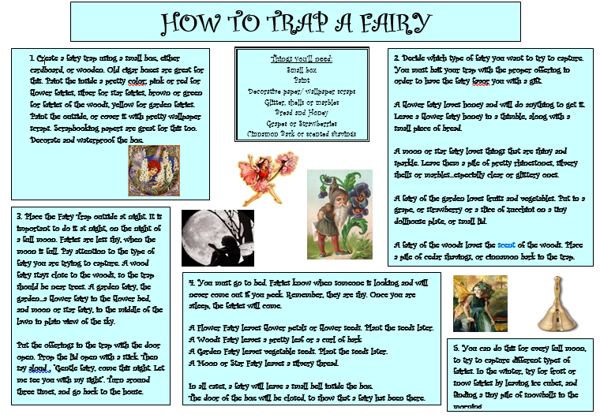
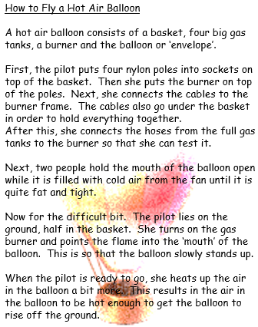
Here are some examples of explanation texts:

Slide 33
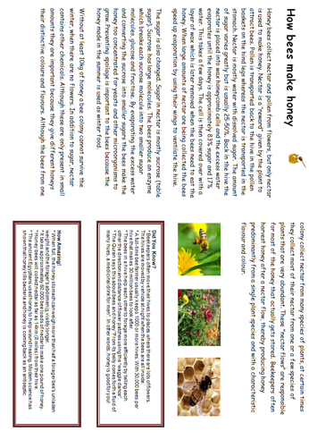
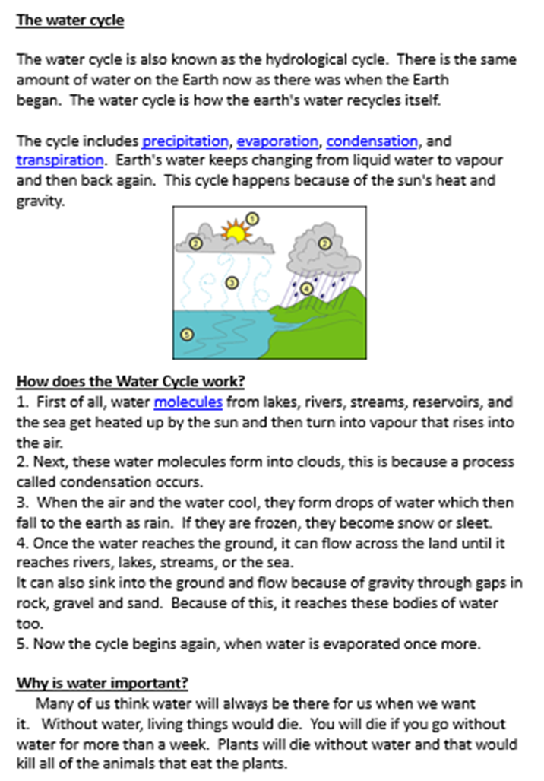
Copy and paste the link into a web browser. Watch the video as it may support you with writing your own text.
https://www.bbc.co.uk/teach/class-clips-video/english-ks1-ks2-how-to-write-an-explanation/zh2kjhv

Slide 34
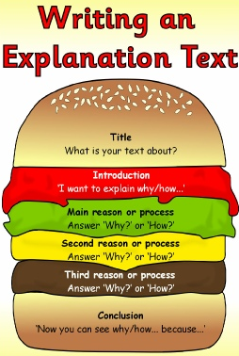
Writing an explanation text
Use this structure to help with writing your explanation text along with the plan you created for the different sections.
You can write or type up your explanation text using MS Word.

Slide 35
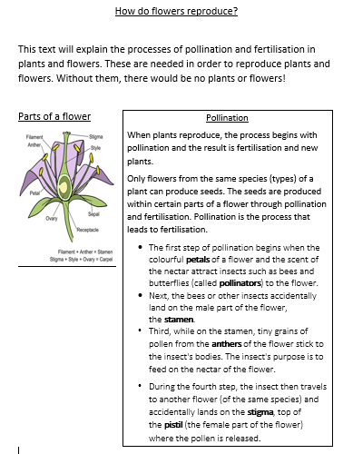
Example about reproduction in plants
Remember to check your work through and make sure sentences are punctuated correctly!

Slide 36
Reading time
Now that you have finished your main task, please enjoy some reading time.
You can read to yourself, an adult or sibling.
This can be done by logging on to your myON account, picking a book or magazine and enjoying at least 15 minutes reading time.
https://www.myon.co.uk/login/index.html
Remember that your login is your first name and first letter of your surname then password:
harryp
password1
Please email trailblazerspupils@gmail.com if you have any login issues.

