Slide 1


Subject: English
Pack: A

Slide 2
Text type: Non-chronological Report
Trailblazers
Monday | Tuesday | Wednesday | Thursday | Friday
L.O. To be able to create a planet fact file. | L.O. To be able to write in the present tense. | L.O. To be able to develop vocabulary. | L.O. To be able to write a non-chronological report. | L.O. To be able to read aloud with intonation.

Slide 3
Read, copy, cover, spell this week’s spellings.
Date: Monday 8th February 2021
co-operate
re-enter
co-owner
sugar-free
forty-second
twenty-seventh
re-sign
re-treat

Slide 4


Date: Monday 8th February 2021
LO: To be able to create a planet fact file.
Subject: English

Slide 5

Here is some key vocabulary that we will be using today. Read through the explanations to help you get a better understanding of what they mean.
Solar System Eight planets and their moons that orbit round the sun | Obit An orbit is a regular, repeating path that one object in space takes around another one.
Atmosphere The gases surrounding a planet | Surface The outside part of a planet.

Slide 6
Our non-chronological report is going to be about a planet that you create.
In this lesson, we will be making notes about real planets that you can use to write about the planet that you create later in the week.

Slide 7
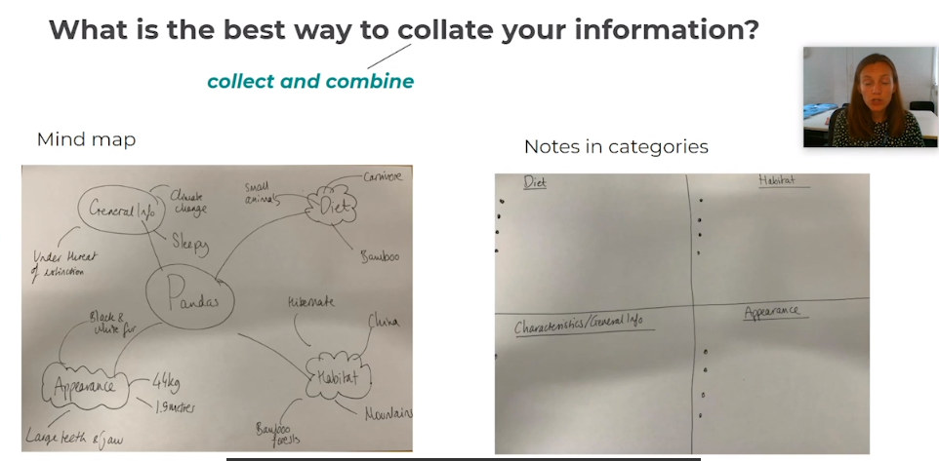

Slide 8
Your categories are:
Venus | Mars
Saturn | Neptune

Slide 9

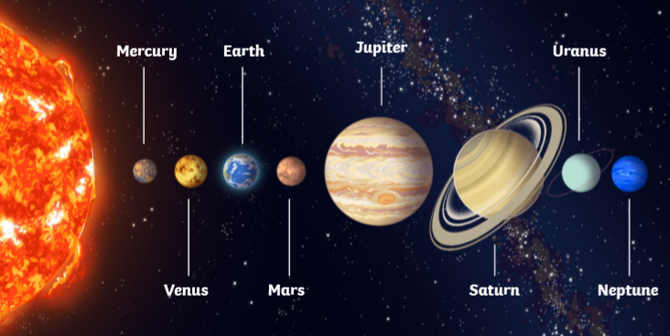
Click on the link to watch a video and learn more about our solar system.
What information can you collect from this diagram about our four planets?
https://www.youtube.com/watch?v=libKVRa01L8

Slide 10
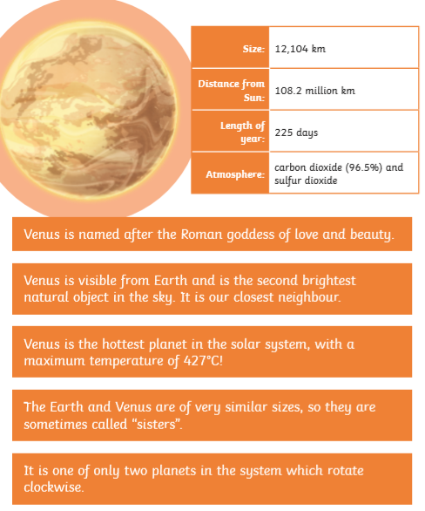
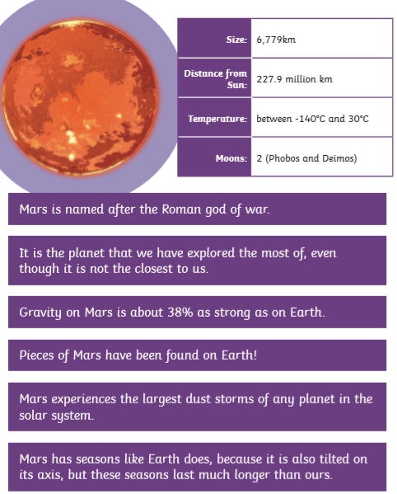
Venus
Mars

Slide 11
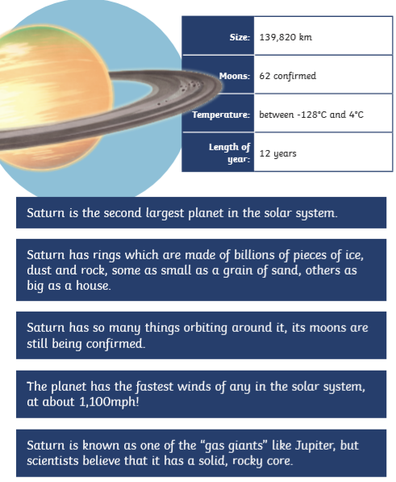
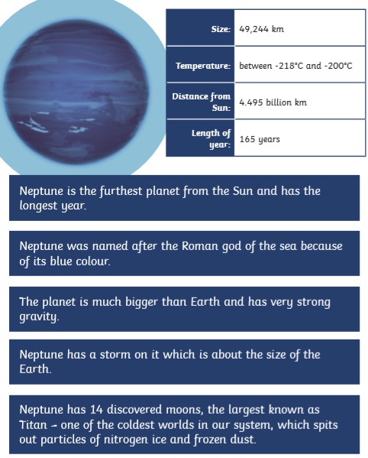
Saturn
Neptune

Slide 12
The notes that you have made today MUST be kept to help you with the rest of your non-chronological report lessons.
See you tomorrow.

Slide 13

Reading time
Now that you have finished your main task, please enjoy some reading time.
You can read to yourself, an adult or sibling.
This can be done by logging on to your myON account, picking a book or magazine and enjoying at least 15 minutes reading time.
https://www.myon.co.uk/login/index.html
Remember that your login is your first name and first letter of your surname then password:
harryp
password1
Please email trailblazerspupils@gmail.com if you have any login issues.

Slide 14
End of lesson.

Slide 15
Read, copy, cover, spell this week’s spellings.
Date: Tuesday 9th February 2021
co-operate
re-enter
co-owner
sugar-free
forty-second
twenty-seventh
re-sign
re-treat

Slide 16
Date: Tuesday 9th February 2021
LO: To be able to write in the present progressive tense.
Subject: English

Slide 17
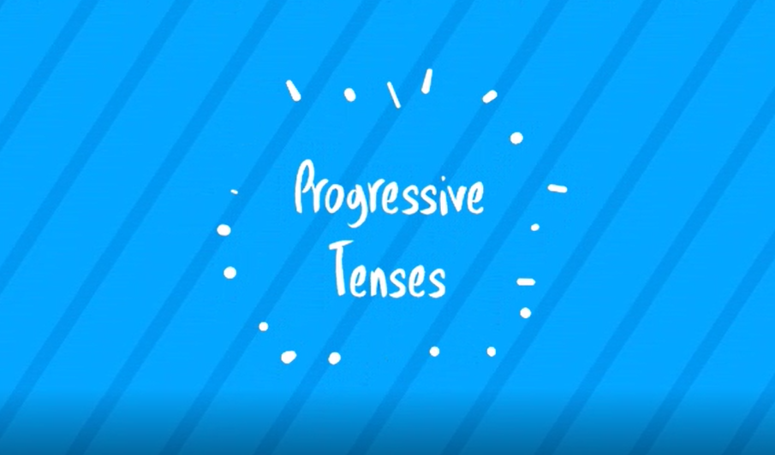
Pre-recorded Teaching
Mr. Gingell’s online teaching video is on our school website. It will support you to complete the work in this lesson. This video will act as a support but all of the work can still be successfully understood & completed using paper-based versions of this pack. If you need further support to understand / complete work then please contact school via e-mail or telephone.
You can also copy and paste this link if you would prefer:
https://www.whprimary.com/copy-4-of-covid19

Slide 18
Write the verbs that are written in the present tense.
Starter
Eat
Ate
Play
Played
Lived
Live
Liked
Like
Help
Helped

Slide 19
Write the verbs that are written in the present tense.
Starter
Eat
Ate
Play
Played
Lived
Live
Liked
Like
Help
Helped

Slide 20
What is present progressive?
We use present tense to talk about things that are happening now.
The present progressive tense is used for an ongoing activity in the present.

Slide 21
The present progressive tense is used for an ongoing activity in the present.
Example:
I am going to school.
In this sentence the action is happening right now. When we write in the present progressive tense, the action is happening right now.

Slide 22
Here are examples of sentences using the present progressive tense. Do you notice anything about the sentences?
I am going to school.
She is learning the piano.
They are playing football.

Slide 23
Here are examples of sentences using the present progressive tense. Do you notice anything about the sentences?
I am going to school.
She is learning the piano.
They are playing football.
You use the present tense verb ‘to be’ every time you use the present progressive.

Slide 24
The sentences include:
am + present participle
is + present participle
are + present participle
-ing verb (walking, running, dancing, going)
We use am or is for singular nouns.
We use are for plural nouns.

Slide 25

Write the verb in the present progressive tense.
To play
I __ _____.
He __ _______.
They ___ ______.

Slide 26
Write the verb in the present progressive tense.
To play
I am playing.
He is playing.
They are playing.
We use am or is for singular nouns.
-ing verb
We use are for plural nouns.

Slide 27
Write the verb in the present progressive tense.
To listen
I __ _____.
He __ _______.
They ___ ______.

Slide 28
Write the verb in the present progressive tense.
To listen
I am listening.
He is listening.
They are listening.
We use am or is for singular nouns.
-ing verb
We use are for plural nouns.

Slide 29
Write the verb in the present progressive tense.
To sit
I __ _____.
He __ _______.
They ___ ______.

Slide 30
Write the verb in the present progressive tense.
To sit
I am sitting.
He is sitting.
They are sitting.
We use am or is for singular nouns.
-ing verb
We use are for plural nouns.

Slide 31
Can you write the correct verb in these sentences for present progressive tense?
She __ playing football.
He __ walking to school.
The children ___ dancing to music.
I __ working today.
am/is/are
am/is/are
am/is/are
am/is/are

Slide 32
Can you write the correct verb in these sentences for present progressive tense?
She is playing football.
He is walking to school.
The children are dancing to music.
I am working today.
am/is/are
am/is/are
am/is/are
am/is/are

Slide 33
Can you write the correct ‘–ing’ verb in the sentences below?
She is ____ a movie.
He is ____ football.
The children are ____ cupcakes.
I am _____.
To watch
To play
To bake
To teach

Slide 34
Can you write the correct –ing verb in these sentences?
She is watching a movie.
He is playing football.
The children are baking cupcakes.
I am teaching.
To watch
To play
To bake
To teach

Slide 35
Task
Write 5 sentences in the present progressive tense. You can use examples we have been through this lesson to help you.
Ideas to think about:
Do you play anything?
Do you go anywhere? E.g. School, shopping, cinema etc.
What do you learn?
Do you read anything?
Do you watch anything on the television?

Slide 36
Reading time
Now that you have finished your main task, please enjoy some reading time.
You can read to yourself, an adult or sibling.
This can be done by logging on to your myON account, picking a book or magazine and enjoying at least 15 minutes reading time.
https://www.myon.co.uk/login/index.html
Remember that your login is your first name and first letter of your surname then password:
harryp
password1
Please email trailblazerspupils@gmail.com if you have any login issues.

Slide 37
End of lesson.

Slide 38
Read, copy, cover, spell this week’s spellings.
Date: Wednesday 10th February 2021
co-operate
re-enter
co-owner
sugar-free
forty-second
twenty-seventh
re-sign
re-treat

Slide 39
Date: Wednesday 10th February 2021
LO: To be able to write factual descriptions.
Subject: English

Slide 40
Fact or Opinion?
Looking at these examples, come up with a definition for what you think a fact is and what an opinion is.
Facts | Opinions
France is in Europe. | There is no better place to eat a picnic than on the beach.
In a leap year there are 366 days rather than 365 days. | Beef is the tastiest meat to eat.
Tomatoes grow on vines. | Watching the sun set is a magical experience.
A fact is _______________________.
An opinion is ____________________.

Slide 41
Definitions
Fact
A fact is something that can be shown to be true. It can be proved.
Opinion
An opinion is a view or judgement that someone has formed but it cannot be proved to be true.

Slide 42
Fact or Opinion?
Decide which of these statements are facts or opinions.
Inverness is the most beautiful city in Scotland.
Kangaroos are native to Australia.
The Sun is 149.6million kilometres away
from Earth.

Slide 43
Fact or Opinion?
Decide which of these statements are facts or opinions.
Inverness is the most beautiful city in Scotland.
opinion
Kangaroos are native to Australia.
fact
The Sun is 149.6million kilometres away
from Earth.
fact

Slide 44
Identify facts and opinions in this paragraph.
Sheep are one of the most interesting animals in nature. There is thought to be around 1 billion sheep in the world. The UK is home to over 33 million sheep.
When sheep are under one year old, they are called lambs. They are the cutest of all spring animals. The sight of them in the fields of Britain are the clearest sign that spring has come.
Humans breed sheep for food and clothing.
Their wool provides the best material for
making high quality garments.
Facts
Opinions
Choose a colour for facts and a colour for opinions that you have available at home.
Colour the facts and opinions in the colours that you have chosen.

Slide 45
Can You Identify Facts and
Opinions in This Paragraph?
Sheep are one of the most interesting animals in nature. There is thought to be around 1 billion sheep in the world. The UK is home to over 33 million sheep.
When sheep are under one year old, they are called lambs. They are the cutest of all spring animals. The sight of them in the fields of Britain are the clearest sign that spring has come.
Humans breed sheep for food and clothing.
Their wool provides the best material for
making high quality garments.
Sheep are one of the most interesting animals in nature. There is thought to be around 1 billion sheep in the world. The UK is home to over 33 million sheep.
When sheep are under one year old, they are called lambs. They are the cutest of all spring animals. The sight of them in the fields of Britain are the clearest sign that spring has come.
Humans breed sheep for food and clothing.
Their wool provides the best material for
making high quality garments.
Blue - facts
Orange - opinions
Answers

Slide 46
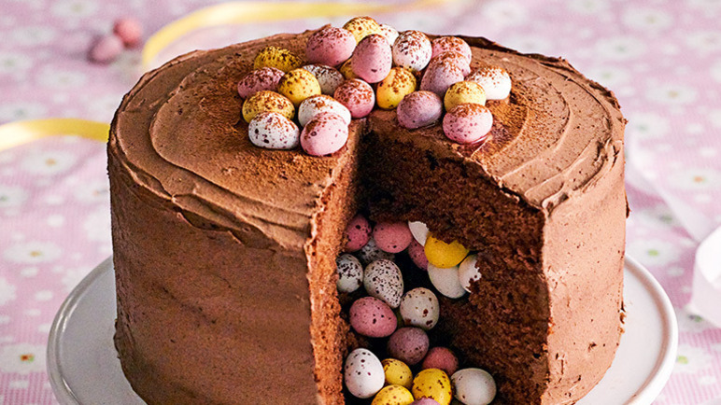
Today, we are going to use our knowledge of facts to create factual descriptions.
What does that mean?
We already know how to write a description using adjectives.
The cake was delicious.
However, this description includes an opinion – delicious.

Slide 47
When we are writing a factual report, we don’t include opinions only facts.
Let’s have a look at a factual description.
The cake has mini eggs on the top of it.

Slide 48
Opinion
The cake was delicious.
The cake has mini eggs on the top of it.
Fact
A fact is something that can be shown to be true. It can be proved.
Fact
Opinion
An opinion is a view or judgement that someone has formed but it cannot be proved to be true.

Slide 49
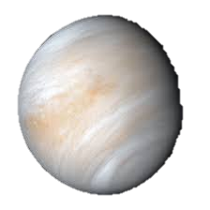
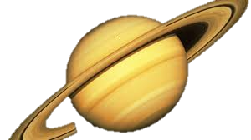
Which one of these sentences is a factual description?
Venus is the hottest planet in the solar system.
Saturn is a fascinating planet because it has an asteroid belt.
Fact
A fact is something that can be shown to be true. It can be proved.
Opinion
An opinion is a view or judgement that someone has formed but it cannot be proved to be true.

Slide 50
Fact
Venus is the hottest planet in the solar system.
Saturn is a fascinating planet because it has an asteroid belt.
Fact
A fact is something that can be shown to be true. It can be proved.
Opinion
Opinion
An opinion is a view or judgement that someone has formed but it cannot be proved to be true.

Slide 51
Vocabulary we can use in our factual descriptions.
If there are any words that you do not know the meaning of, use a dictionary to check.
https://www.oxfordlearnersdictionaries.com/
Tier 3
atmosphere
solar system
carbon dioxide
sulphur dioxide gravity orbit
nitrogen Milky Way galaxy
terrestrial Jovian helium hydrogen
This is vocabulary that is specific to space an we wouldn’t use it every day.
Tier 1 & 2
gassy gaseous visible bright brightest natural
hot hottest rotate fastest revolve sustain
scorching blistering searing quickest
This is a mixture of vocabulary that we may use every day (tier 1) and more advanced vocabulary we might read (tier 2).

Slide 52
Use the word bank to complete the factual descriptions.
Earth is the only planet in the ___________ that has an ___________ that can ___________ life.
Saturn is a ___________ planet, which means it is a ___________ planet made up of mostly ___________ and ___________ .
Tier 3
atmosphere solar system carbon dioxide
sulphur dioxide gravity orbit
nitrogen Milky Way galaxy
terrestrial Jovian helium hydrogen
Tier 1 & 2
gassy gaseous visible bright brightest natural hot hottest rotate fastest revolve sustain
scorching blistering searing quickest

Slide 53
Use the word bank to complete the factual descriptions.
Earth is the only planet in the solar system that has an atmosphere that can sustain life.
Saturn is a Jovian planet, which means it is a gaseous planet made up of mostly helium and hydrogen .
Tier 3
atmosphere solar system carbon dioxide
sulphur dioxide gravity orbit
nitrogen Milky Way galaxy
terrestrial Jovian helium hydrogen
Tier 1 & 2
gassy gaseous visible bright brightest natural hot hottest rotate fastest revolve sustain
scorching blistering searing quickest

Slide 54
Task:
Write 5 factual descriptions about the planets of our solar system using your notes from Monday and today’s vocabulary.
Tier 3
atmosphere solar system carbon dioxide
sulphur dioxide gravity orbit
nitrogen Milky Way galaxy
terrestrial Jovian helium hydrogen
Tier 1 & 2
gassy gaseous visible bright brightest natural hot hottest rotate fastest revolve sustain
scorching blistering searing quickest

Slide 55
Reading time
Now that you have finished your main task, please enjoy some reading time.
You can read to yourself, an adult or sibling.
This can be done by logging on to your myON account, picking a book or magazine and enjoying at least 15 minutes reading time.
https://www.myon.co.uk/login/index.html
Remember that your login is your first name and first letter of your surname then password:
harryp
password1
Please email trailblazerspupils@gmail.com if you have any login issues.

Slide 56
End of lesson.

Slide 57
Read, copy, cover, spell this week’s spellings.
Date: Thursday 11th February 2021
co-operate
re-enter
co-owner
sugar-free
forty-second
twenty-seventh
re-sign
re-treat

Slide 58
Date: Thursday 11th February 2021
LO: To be able to write a non-chronological report.
Subject: English

Slide 59
Writing warm-up
Write a sentence in the present progressive tense that you could use in your non-chronological.

Slide 60
Writing warm-up
Write a sentence in the present progressive tense that you could use in your non-chronological.
Saturn is orbiting the sun at a speed of 12 Earth years.

Slide 61
Today, you will be writing an introduction and one other category about a planet that you are going to create.
Think about your planet.
What is it called?
Is it like any planets you have learned about?
Could you steel any of the features of other planet?
How far is it away from the sun? (5th, 6th planet etc.)
Does any thing live their?
Is it a terrestrial or Jovian planet?

Slide 62
Writing an introduction.
Introductions are general, which means you talk about lots of different things and do not write about specific details like what the surface is like or which creatures live there.
You could write about:
Which planet it is form the sun (5th, 6th planet etc.)
If it is terrestrial or Jovian
Which Roman god it is named after
The temperature
How much gravity there is
If it has moons or a asteroid belt

Slide 63
What a good one looks like.
Chestus
Chestus is the largest terrestrial planet in the solar system. Although it is the second planet from the sun, it is the coldest planet discovered in the Milky Way. Temperatures have been measured as cold as -470º. This is due to its immensely thick atmosphere of helium, which prevents the heat of the sun reaching the icy surface. Named after the Roman god of animals, scientists believe that it was once inhabited by a wide range of sea creatures. Satellite pictures have shown that some creatures have evolved to thrive on this icy world. Uniquely, Chestus has two rings rotating in opposite directions.

Slide 64
Task
The name of your planet will be the title.
Write 2 paragraphs.
Paragraph 1 is your introduction.
Paragraph 2 choose between writing about:
Life on your planet. What creature live there?
or
The surface of your planet. Is made of an imaginary substance? Are there, mountains, water, lava or ice?
My work is finished when?
Two paragraphs
Tier 3 vocabulary
Third person
Present progressive tense
Embedded reporting clause
Subordinate conjunctions
Hyphenated words

Slide 65
Reading time
Now that you have finished your main task, please enjoy some reading time.
You can read to yourself, an adult or sibling.
This can be done by logging on to your myON account, picking a book or magazine and enjoying at least 15 minutes reading time.
https://www.myon.co.uk/login/index.html
Remember that your login is your first name and first letter of your surname then password:
harryp
password1
Please email trailblazerspupils@gmail.com if you have any login issues.

Slide 66
Read, copy, cover, spell this week’s spellings.
Date: Friday 12th February 2021
co-operate
re-enter
co-owner
sugar-free
forty-second
twenty-seventh
re-sign
re-treat

Slide 67
Date: Friday 12th February 2021
LO: To be able to read aloud with intonation.
Subject: English

Slide 68
Friday fun task.
Yesterday, you wrote about a new planet. Today, to practise your reading skills, you are going to read out loud your new discovery.
An important skills when reading out loud is using intonation for effect.
Someone who does this very well is David Attenborough when he talks about animals and places.
Here is an example David Attenborough talking about a bird.
https://www.youtube.com/watch?v=mSB71jNq-yQ
You could:
Read to a familyy member using intonation
Create an iMovie if you have an iPad
Record an audio clip on PowerPoint
Intonation is changing the pitch and volume of your voice or adding emphasis to words.

