Slide 1



Date: Monday 8th February
L.O To be able to describe the movement of the Moon in relation to Earth.
Subject: Science

Slide 2

Pre-recorded Teaching
Here is access to a online teaching video that will support you to complete the work in science this week. This video will act as a support but all of the work can still be successfully understood & completed using paper-based versions of this pack. If you need further support to understand / complete work then please contact school via e-mail or telephone.
Play video
You can also copy and paste this link if you would prefer:
https://teachers.thenational.academy/lessons/what-are-solar-and-lunar-eclipses-6nh3et

Slide 3

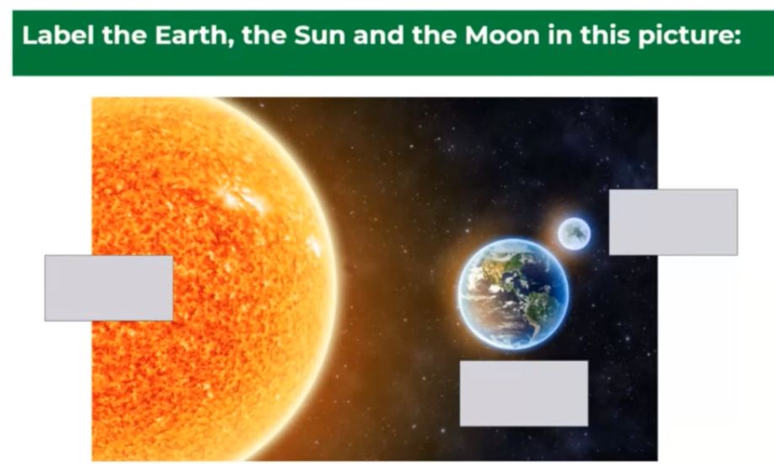
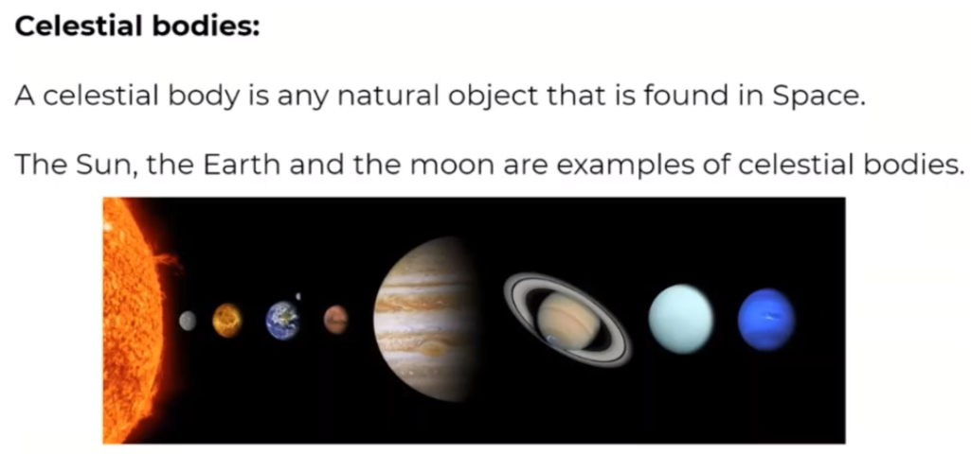
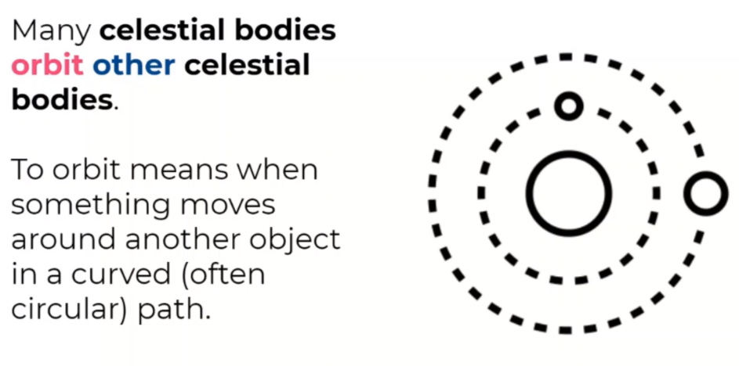

Slide 4
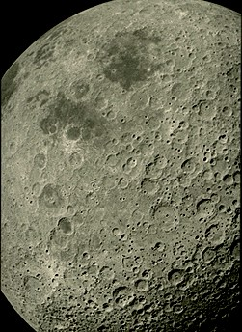
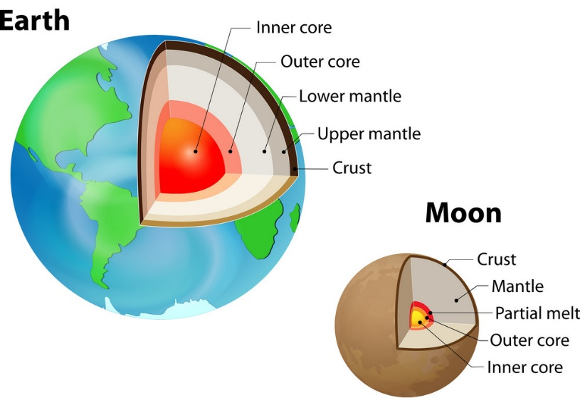
Facts about the moon
The Moon is a huge ball of rock in space which orbits the Earth. The Moon is made of rock and metal—just like the Earth and the other rocky planets (Mercury, Venus and Mars).
On the Moon there are mountains and flat areas called 'seas', although there is no water on the Moon.
The Moon's surface is covered in craters made by meteorites. There is no atmosphere around the moon and so rocks flying through space hit the moon hard and make craters.
The crust, the Moon’s outer shell, is covered by lunar soil, also called regolith: a blanket of fine rock particles, varying between three and 20 metres (10–65 feet) deep.
The moon’s diameter is 27% that of the Earth.
Temperature on the moon goes from 130C in the light to -130C in the dark.
The moon’s gravity causes the tides.
The Moon does not have any light of its own, it reflects the light of the sun.

Slide 5
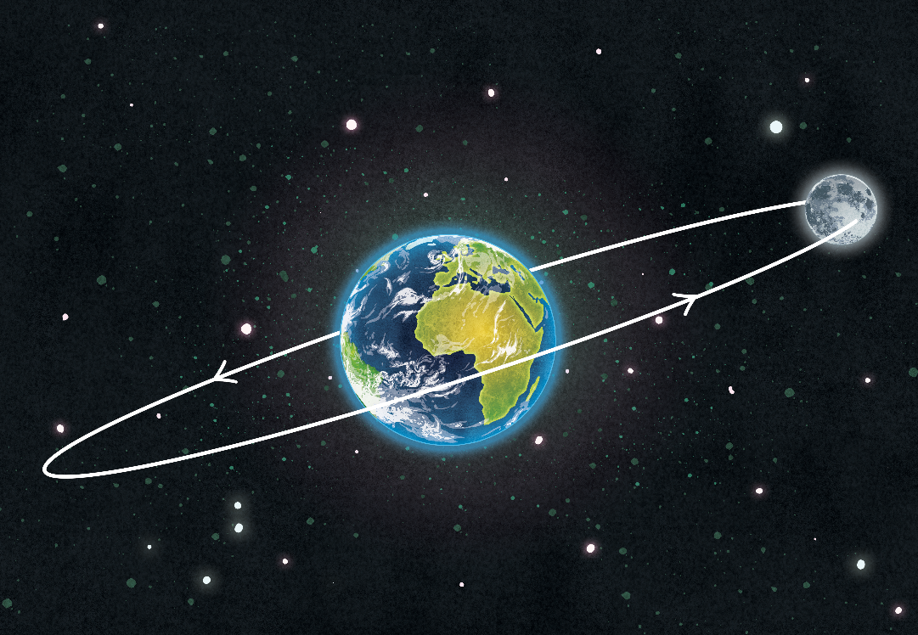
How does the Moon travel around Earth?
The Moon travels around Earth in a circle known as an orbit.
The Moon orbits the Earth in an oval-shaped path called an ellipse. Because of this shape, the Moon is sometimes nearer and sometimes further away from Earth. The range of distance is from 364,397 km to 406,731 km.
The Moon takes about 27 days (27 days, 7 hours, 43 minutes, 11.6 seconds) to go all the way around the Earth and return to its starting position.
The Moon's orbit around the Earth is a slightly squashed circle called an ellipse.

Slide 6
The movement of the Moon- Rotation
Just like the Earth, the Moon rotates on its axis. This rotation is anticlockwise, just like the Earth’s.
It takes 28 days for the Moon to rotate once.
Because the Moon spins and orbits at the same rate of time, it appears to be still from Earth. Scientists call this
‘synchronous rotation’. The word ‘synchronise’ means that things happen at the same time.
We will learn more about this in our lesson about ‘Phases of the Moon’.

Slide 7
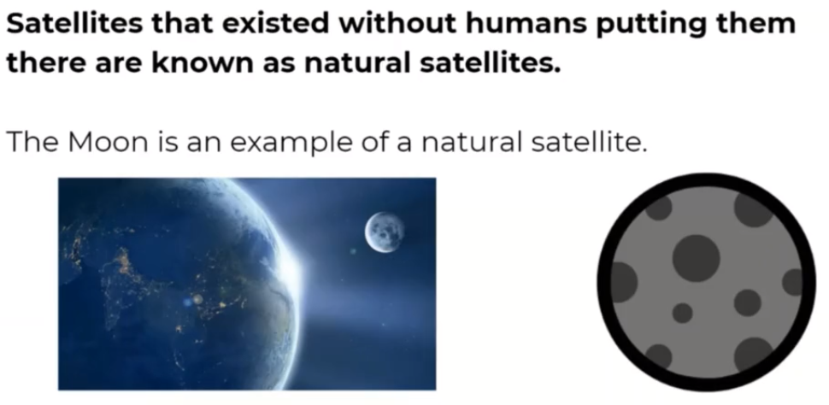
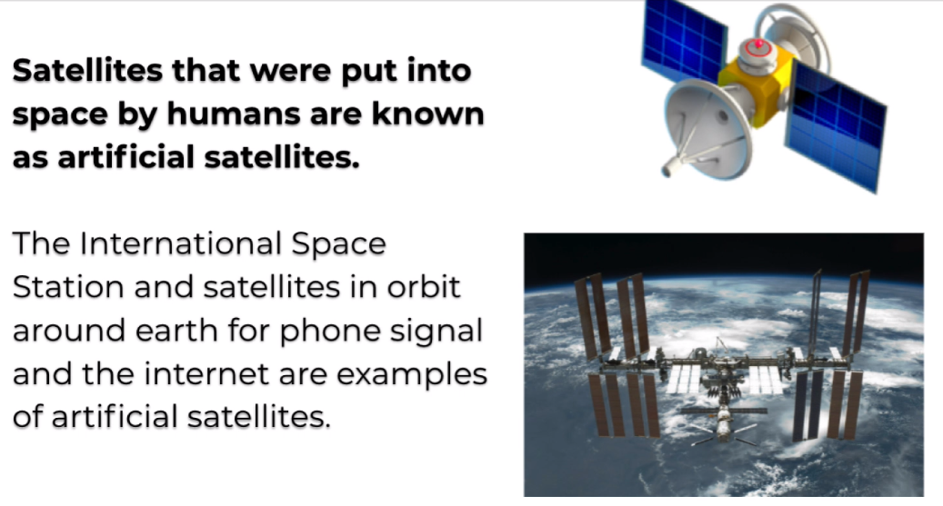
What are the uses of satellites?
Have you ever seen a satellite in the sky?

Slide 8
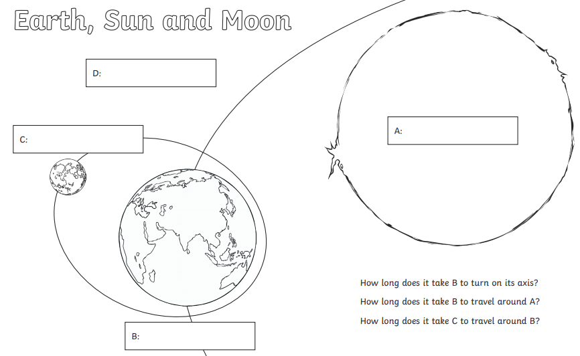
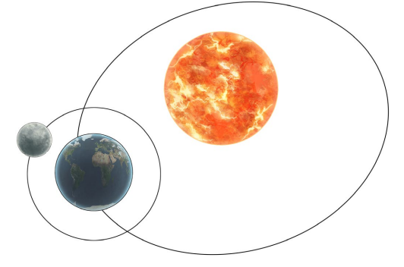
L.O To be able to describe the movement of the Moon in relation to Earth
Task 1
Create your own diagram to explain the movement of the Moon and write a paragraph to explain what is happening.
Use the information covered on the previous pages.
Task 2
Create a fact file, poster or write down at least 6 facts about the Moon.

Slide 9
Date: Tuesday 9th February
L.O To be able identify the phases of the moon and explain why these happen.
Subject: Science

Slide 10
Pre-recorded Teaching
Here is access to a online teaching video that you might have watched yesterday. Re-watch the part (around the middle) of the video which talks about the different phases of the moon.
This video will act as a support but all of the work can still be successfully understood & completed using paper-based versions of this pack. If you need further support to understand / complete work then please contact school via e-mail or telephone.
Play video
You can also copy and paste this link if you would prefer:
https://teachers.thenational.academy/lessons/what-are-solar-and-lunar-eclipses-6nh3et

Slide 11
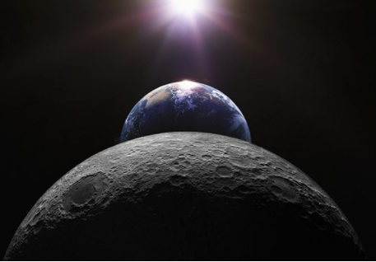
The Moon
The Moon doesn’t emit (give off) light itself, the ‘moonlight’ we see is actually the Sun’s light reflected off the lunar surface.
So, as the Moon orbits the Earth, the Sun lights up different parts of it, making it seem as if the Moon is changing shape. In actual fact, it’s just our view of it that’s altering…
The Earth and the Moon both rotate for the same length of time. This is called tidal locking. Because of this tidal locking, we only ever see one side of the Moon from Earth.
The side of the Moon we can see is called the near side. The other side of the Moon, the side we can’t see, is called the far side (although people often refer to it as the dark side of the moon, this is not accurate as there is no side of the Moon which is constantly in darkness). In 1959, the Russian spacecraft Luna 3 took the first photographs of the far side of the Moon. Until that time, no one knew what it looked like.
The far side of the Moon is very different to the near side. It is covered in craters from meteors that have crashed into it.

Slide 12
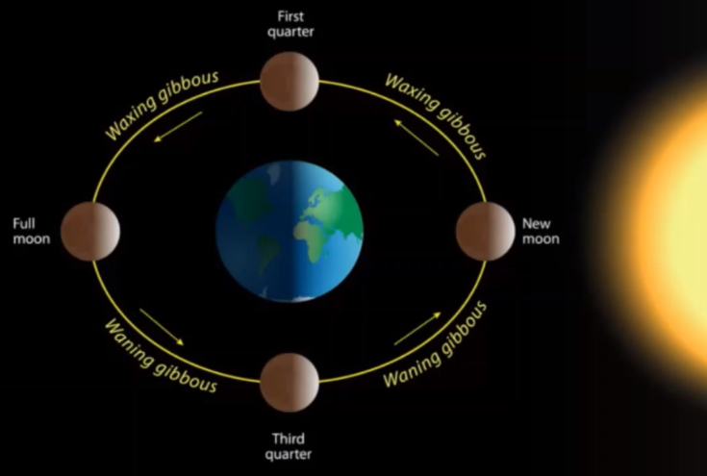
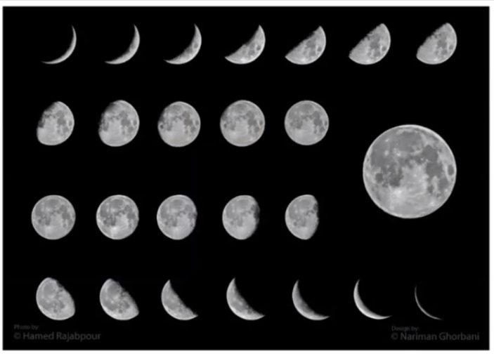
Shapes of the Moon- Lunar Phases
At various times in a month, the Moon looks different. This is because as the Moon rotates round the Earth, the Sun lights up different parts of it.
The Moon can also be described as a new moon (when none of it is visible from the Earth), half-moon and full moon.

Slide 13


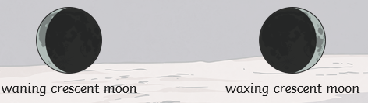
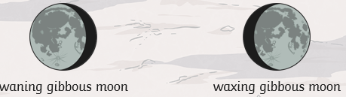
Waxing and Waning
The Moon can be described as either waxing or waning. This refers to the amount of Moon we see on sequential days.
When we are gradually seeing more of the Moon over a number of days, this is called waxing.
When we are gradually seeing less of the Moon over a number of days, this is called waning.
Crescent and Gibbous
A crescent moon is when we can only see a crescent-shaped area of the Moon.
A gibbous moon is when a crescent-shaped area of the Moon cannot be seen.

Slide 14
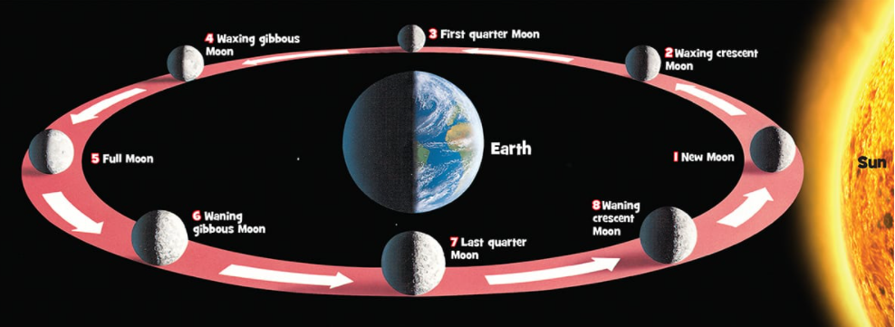
When the Moon appears to be getting bigger, it’s ‘waxing’ and when it looks like it’s getting smaller, it’s ‘waning’. Once the face of the Moon is fully turned towards the Sun, it’s a Full Moon, and we see it all. But, as the Moon moves around the Earth, the face pointing towards us gradually becomes hidden from the Sun until we can hardly see it at all – this is a New Moon. Cosmic!

Slide 15
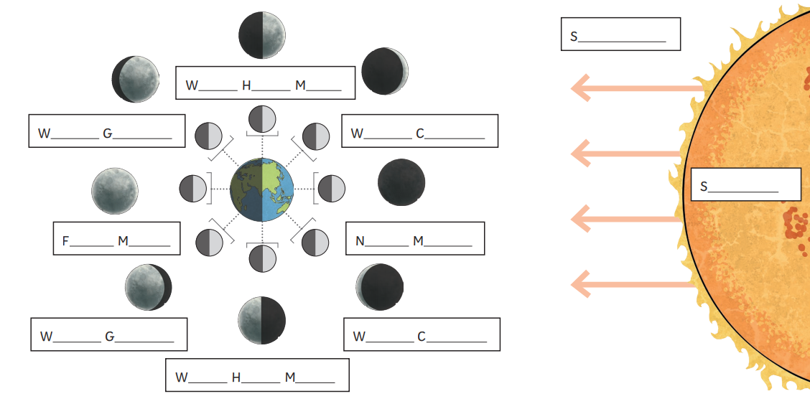
L.O To be able identify the phases of the moon and explain why these happen.
Task:
Copy or complete the diagram, label with the different phases and shade how the moon would look
at each phase.

Slide 16
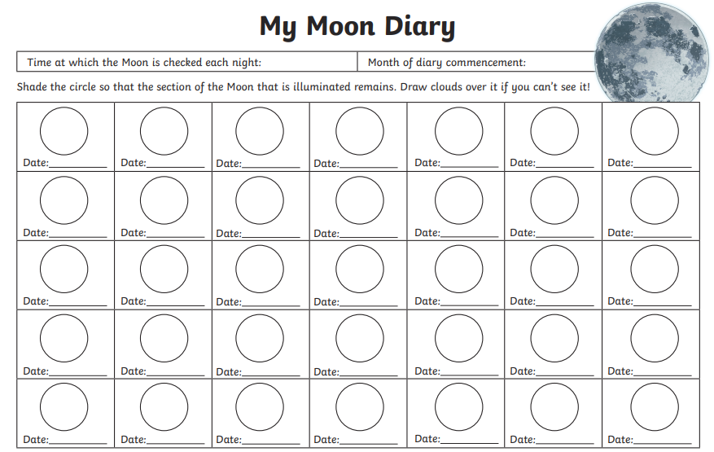
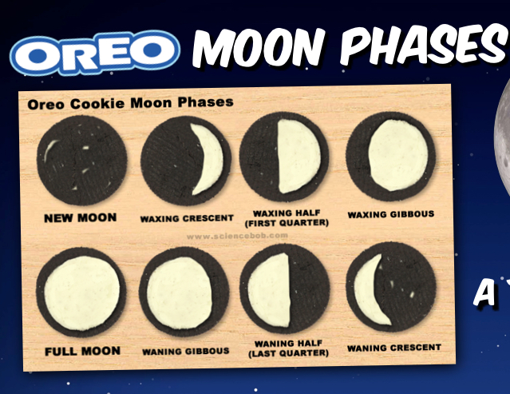
Task ideas:
If you have any biscuits like these, give this a try!
Or what about keeping a ‘Moon Diary’ for a month?

Slide 17
Date: Wednesday 10th February
L.O To be able to explain different types of eclipse and how they occur
Subject: Science

Slide 18
Pre-recorded Teaching
Here is access to a online teaching video that you might have watched. Re-watch the part (towards the end) of the video which talks about eclipses.
This video will act as a support but all of the work can still be successfully understood & completed using paper-based versions of this pack. If you need further support to understand / complete work then please contact school via e-mail or telephone.
Play video
You can also copy and paste this link if you would prefer:
https://teachers.thenational.academy/lessons/what-are-solar-and-lunar-eclipses-6nh3et

Slide 19
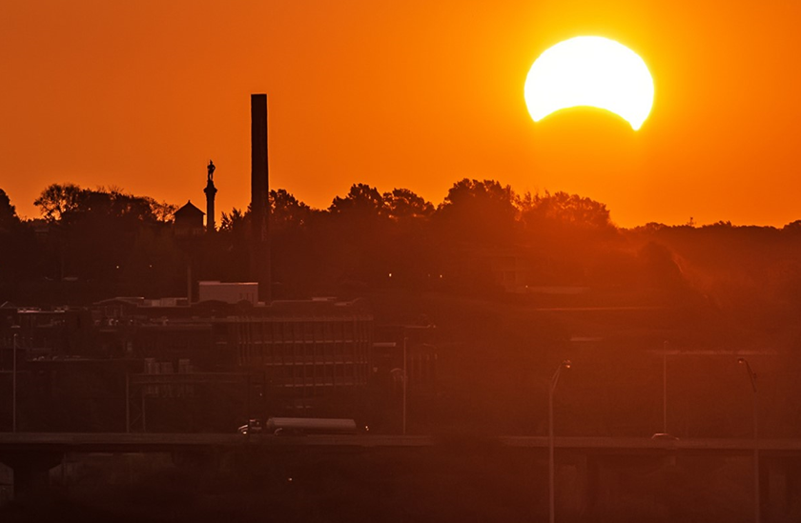
Here is a picture showing an eclipse which is about the happen.
What do you think we mean by a solar eclipse?
What is about to happen to the sun?
What do you think is causing this to happen?

Slide 20
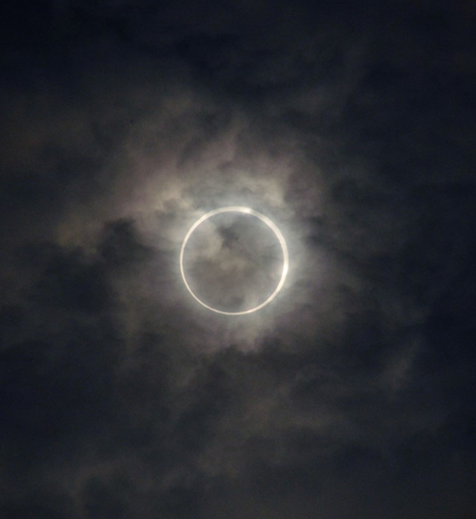
What Is A Solar Eclipse?
A solar eclipse happens when the light of the Sun is blocked by the Moon.
This makes the sky dark and can mean that you can see stars in the sky like you can at night time.
Copy and paste the web address (below) into a browser. Watch the video and read through the information to find out more.
https://spaceplace.nasa.gov/eclipse-snap/en/

Slide 21
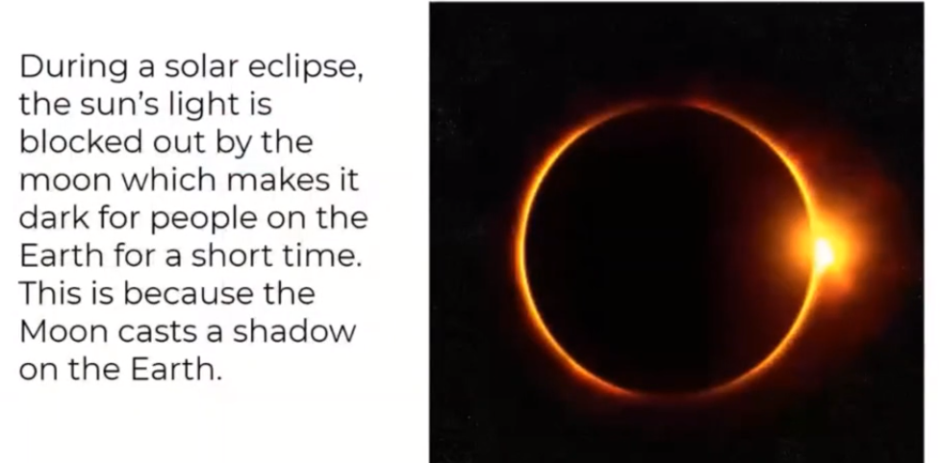

Slide 22
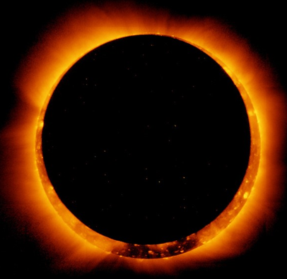
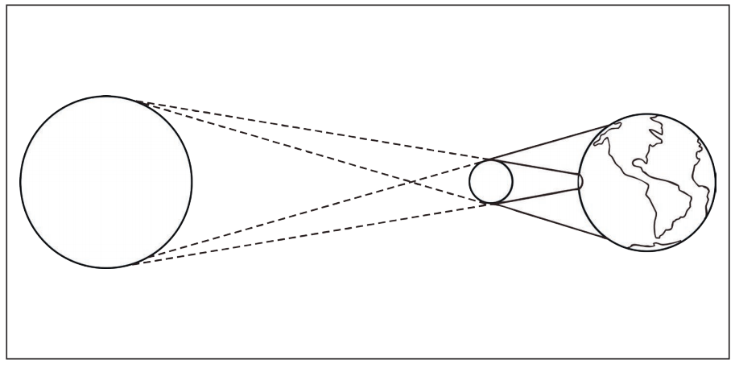
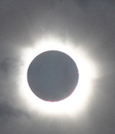
When an eclipse happens people can see the outer parts of the sun in more detail then they normally can.
Why Do Solar Eclipses Happen?
When we look up from Earth, the Moon looks about the same size as the Sun.
This means that, at specific times, the Moon can come in between the Earth and the Sun, in a certain way, which means that it blocks out the light of the Sun.
This can last for as long as 7 minutes or as little as 31 seconds.

Slide 23
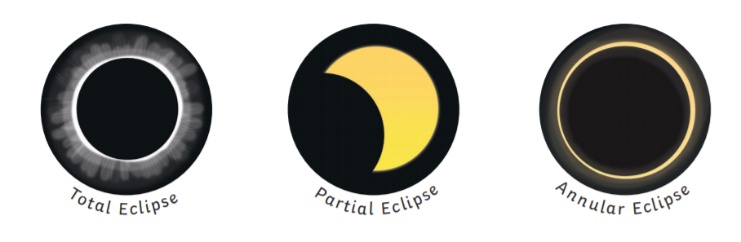
Types of Solar Eclipses
There are three types of eclipses:
Total - A total eclipse is where the Sun is covered completely by the Moon.
Annular - An annular eclipse is when the Moon covers the Sun, but the Sun can be seen around the edges of the Moon.
Partial - A partial eclipse is when only a portion of the Sun is blocked by the Moon.

Slide 24
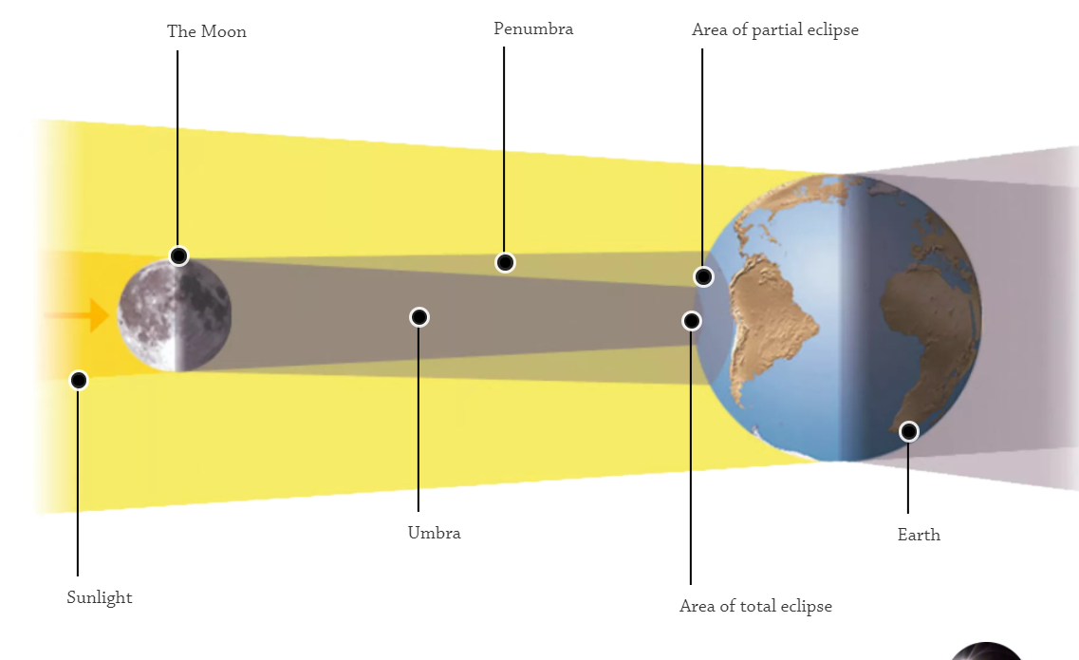
Diagram to show what happens during an eclipse

Slide 25
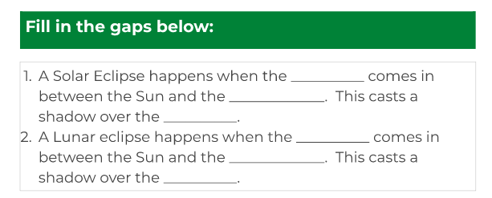
Alternatively, you can write down the missing words.

Slide 26
L.O To be able to explain different types of eclipse and how they occur
Task 1: Copy and complete the sentence below:
An eclipse of ________________ happens when the ____________come between the __________and the Sun.
Using the information on previous slides:
Task2: Draw a diagram of the Sun, Earth and Moon’s location during a solar eclipse.
Task 3: Draw and describe the three different types of eclipse:
Total:
Partial:
Annular:

Slide 27
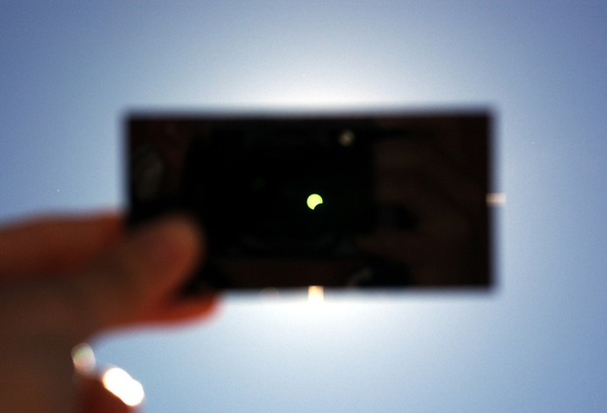
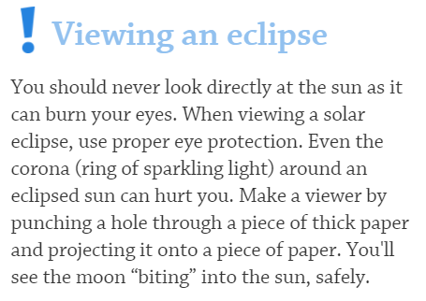

Slide 28

Date: Thursday 11th February
L.O. To be able to write short sentences to describe your own planet.
Subject: French

Slide 29
Les adjectifs
Vocabulary
grand - big
petit - small
Les planètes
bleu - blue
rouge - red
brun -brown
violet - purple
blanc - white
vert - green
noir - black
rose – pink
jaune - yellow
chaude - hot
froide - cold
Mercure
Vénus
la Terre
Mars
Jupiter
Saturne
Uranus
Neptune
assez grand – fairly big
assez petit – fairly small
très grand – very big
très petit – very small
très chaude – very hot
très froide – very cold

Slide 30
Try to work out the information about the planets.
Remember the adjectives come after the noun.
Mercure
Mercure est une très petite planète.
Mercury is a very small planet.
Il est une planète bleu.
It is a blue planet.

Slide 31
Vénus
La Terre
Vénus est une assez grande planète.
La Terre est une petite planète bleu et vert.
Venus is a fairly big planet.
The Earth is a small, blue and green planet.

Slide 32
Jupiter
Mars
Jupiter est une très grande planète.
Mars est une petite planète rouge.
Mars is a small red planet.
Jupiter is a very big planet.

Slide 33
Saturne
Uranus
Saturne est une assez grande planète.
Il est une planète très froide.
Saturn is a fairly big planet.
It is a very cold planet.
Il est une planète orange et jaune.
It is a orange and yellow planet.

Slide 34
Neptune
Neptune est une grande planète bleu.
Neptune is a big, blue planet.
Il est une planète froide.
It is a cold planet.

Slide 35
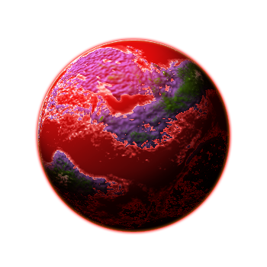
L.O. To write short sentences to describe your own planet.
My planet
Lethaura est une grande planète violet, rouge et vert.
Lethaura is a big, purple, red and green planet.
Il est une planète chaud.
It is a hot planet.
Lethaura

Slide 36

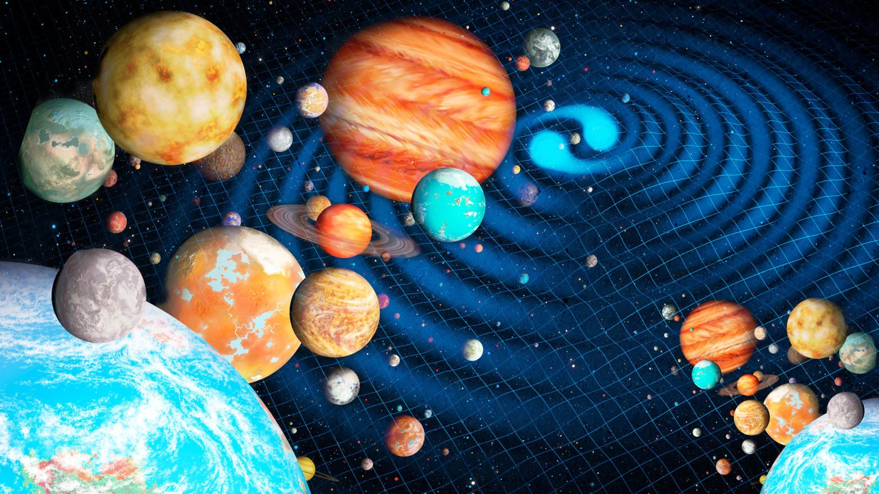
L.O. To write short sentences to describe your own planet.
Design your own planet choosing your own colours, and give it a name.
Task:
Draw your planet.
Write two sentences to describe your planet.
What’s your planet
going to look like?
Remember! Size before noun.
Look back through slides to help set out your sentences.

Slide 37

Date: Friday 12th February
LO. To be able to understand the potential risks of being online.
Subject: PSHE

Slide 38
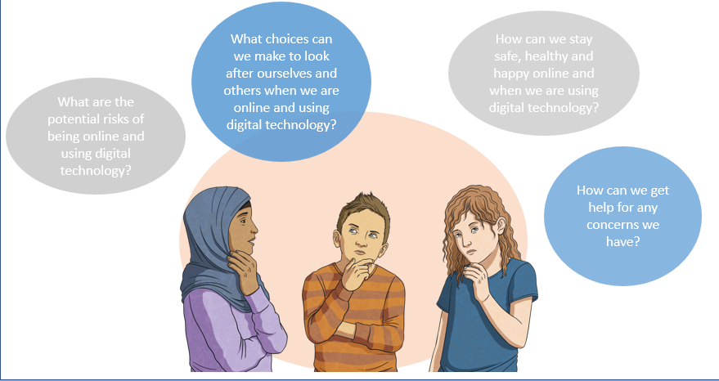
Task:
Write down a list of your ideas in response to these questions.

Slide 39
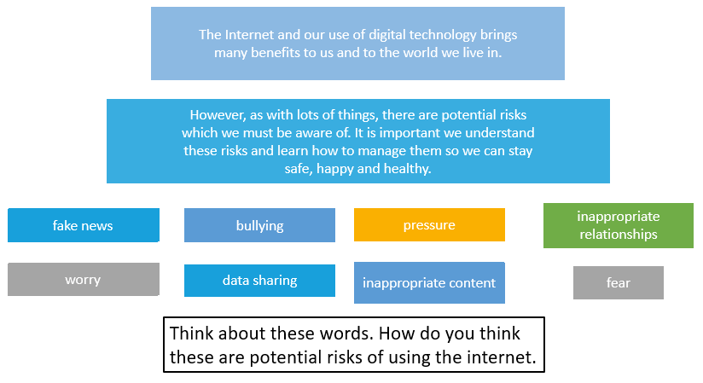

Slide 40
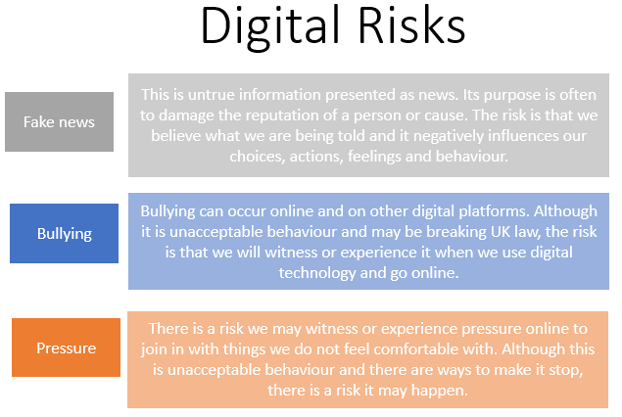
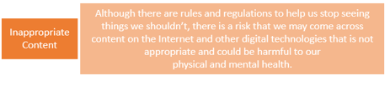
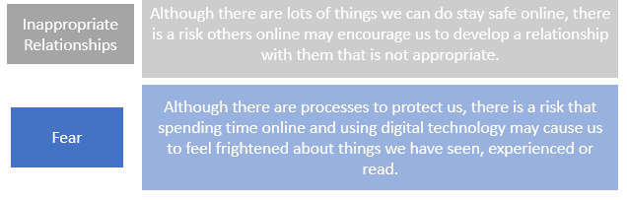
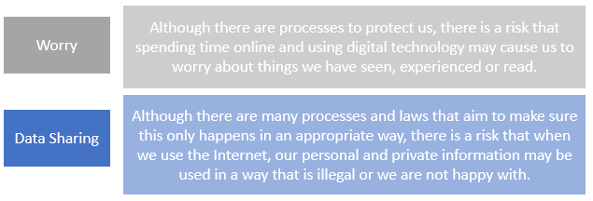

Slide 41
Although we take steps to stay safe online, something may go wrong. If this
happens, we may feel embarrassed or that we are going to get into trouble
but it is important to remember that we can find ourselves in situations
through no fault of our own. Even if we have made a mistake or error of
judgement, this is OK and we should not feel any blame.
It is vital we all feel comfortable and confident in asking for help whatever the situation we might find ourselves in.
I need help
If we see or experience anything when we use the Internet
or other digital technology that worries, concerns
or frightens us, it is really important we get help.

Slide 42
