Slide 1

Subject: Topic
Pack: A and B

Slide 2

Date: Monday 1st February 2021
LO To be able to explain the way farming has changed the way humans live
Subject: History

Slide 3


Pre-recorded Teaching
Access the online teaching video below that will support you to complete the work in this lesson. This video will act as a support but all of the work can still be successfully understood & completed using paper-based versions of this pack. If you need further support to understand / complete work then please contact school via e-mail or telephone.
Play Video
You can also copy and paste this link if you would prefer:
https://classroom.thenational.academy/lessons/how-did-farming-change-how-humans-lived-69gkce?step=2&activity=video

Slide 4
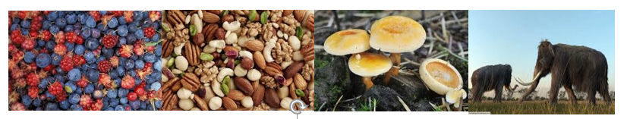

Before farming, people had to constantly be on the move in search for food. Can you remember what they gathered and caught?
Ask an adult to help you read this information if you are finding it a little tricky.
This food made a great diet for the people. They got all the nutrients they needed from a mix of fruit, vegetables and meat.
However it was hard having to keep gathering and hunting food and if they couldn’t find any food they would start to starve. Imagine not eating for days!

Slide 5
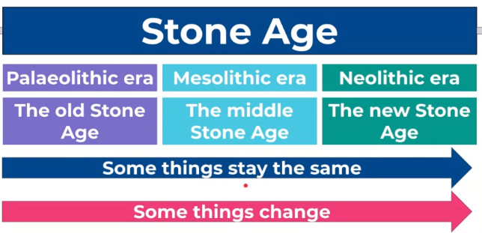
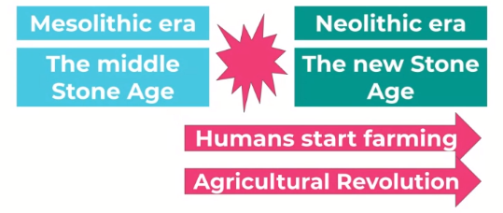
In history, some things change and some things stay the same.
Remember, there were three different periods to the Stone age.
A big change happened
in-between these two periods.
Agricultural is another word for farming.

Slide 6
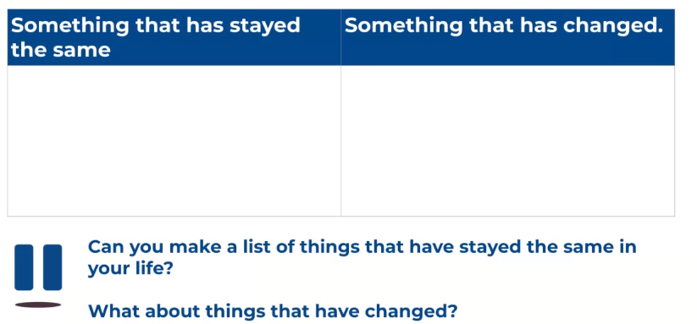
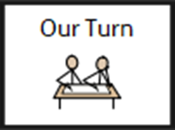
Talk to someone about what has changed and what has stayed the same.

Slide 7
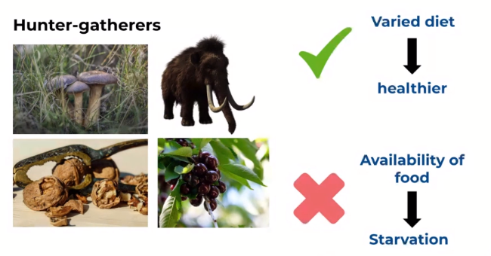
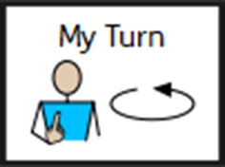
On thing that changed was human's diet.
Palaeolithic humans were hunter –gatherers.
The varied diet meant they were getting lots of nutrients and vitamins so they were healthy.
They were always at risk of being hungry because they didn’t have easy access to food.

Slide 8
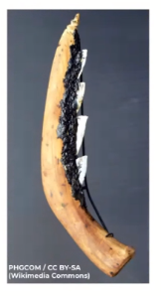
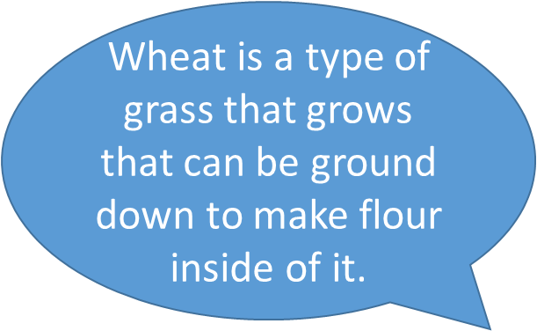
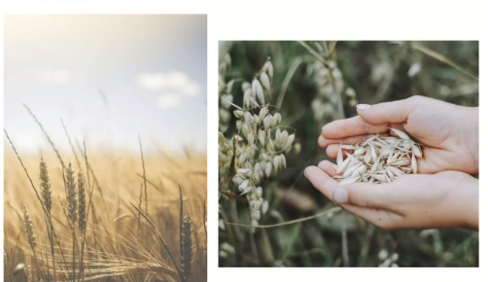
During the agricultural revelation the sickle was invented to cut down wheat.
The grass can be cut down and then stored away.
There will be plenty of food for people.
Settlements will grow because people will stay as they enough food to eat.

Slide 9
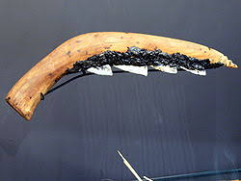
When stone age people invented the sickle, they used it to farm by collecting and storing wheat and barley.
Complete these three reasons why farming was good for people: People could _____________ gather their own _______________. There was ______________ of food to ________________. Settlements got bigger because _______________________________________________
Use the information on the slide before to help.

Slide 10
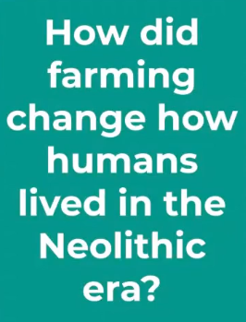
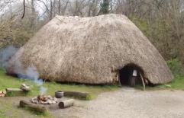
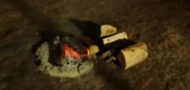
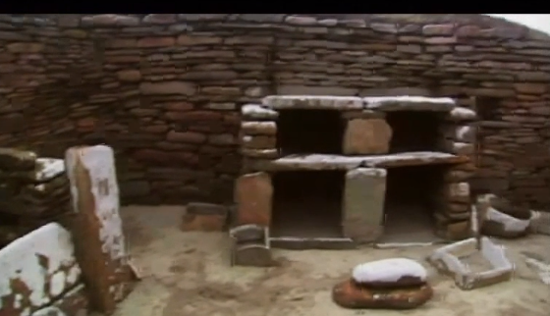

People began to settle in one place.
They brought animals from Europe like goats and sheep and
started to clear trees from the forest to create areas to grow
wheat and barely.
Some were even made out of stone.
This means the new period.
Stone people learnt how to start a fire which they used to keep warm and to cook on.
As people were now staying in one place
they built houses
like this one.

Slide 11
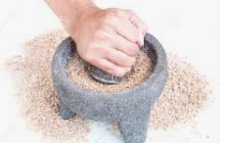
Now everyone was settled in one place, they had more time to talk as they did not have to hunt, build new houses or travel far for food.
While they were grinding the wheat, they would be describing what they were doing. They would be talking more and finding out a lot more about each other.
This led to a big change as language developed more in this time.

Slide 12

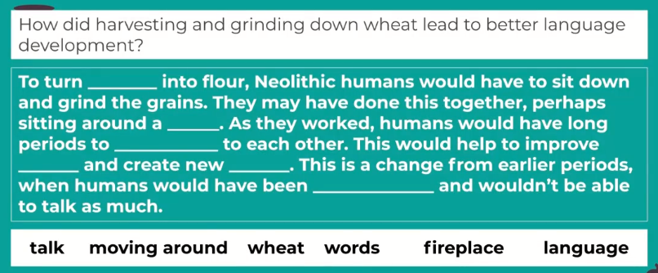

Slide 13

If you are working online you could google images and cut and paste them onto your farm.
Design your own Neolithic farm.
Sheep, goats, pigs and cows.
Storage - cupboards
Crops- grasses

Slide 14
End of lesson

Slide 15
Date: Tuesday 2nd February 2021
LO To be able to classify light as natural or artificial
Subject: Science

Slide 16
Pre-recorded Teaching
Access the online teaching video below that will support you to complete the work in this lesson. This video will act as a support but all of the work can still be successfully understood & completed using paper-based versions of this pack. If you need further support to understand / complete work then please contact school via e-mail or telephone.
Play Video
You can also copy and paste this link if you would prefer:
https://teachers.thenational.academy/lessons/what-is-light-c4w30d?from_query=light

Slide 17
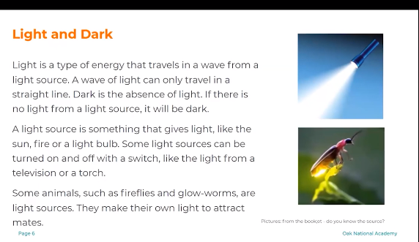
Ask an adult to help you read this information if you are finding it a little tricky.

Slide 18

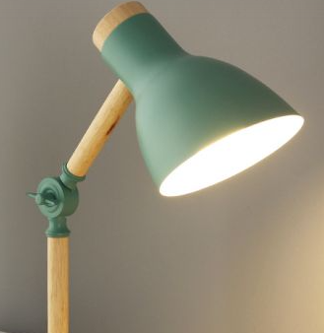

A light source gives out light.
A scientific word we can use to describe this is emit.
Lets use this word in a sentence. ‘ A light source emits light.’
Here are some examples of light sources.

Slide 19

Think of an answer for these two questions. You can use the sentence starters to help. What is light? Light is a type of __________ that comes from a light _________. 2. What is dark? Dark is when there is ___ __________ . no light source energy

Slide 20
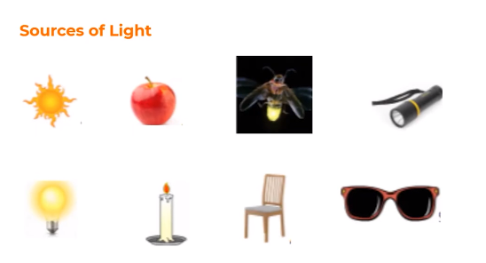
Tick the pictures if they are a light source.
Remember a light source emits (gives out) light.

Slide 21
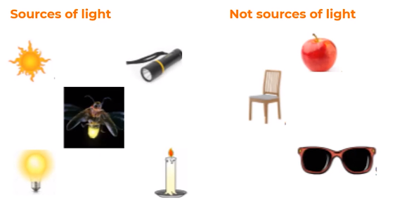
Check your answers.
Remember a light source emits (gives out) light.

Slide 22
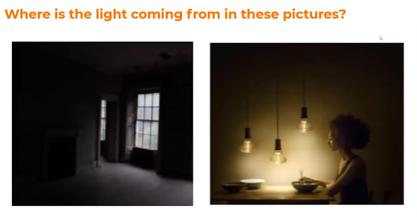
Where does light come from?
The window does not give us light so where is the light coming from?
The light is coming from
___________________________.
The light is coming from
___________________________.

Slide 23

There are different types of light sources.
Natural
Artificial
Natural light sources include the Sun and stars.
Artificial light sources include light bulbs and televisions.
Natural light, which produces heat and
colour, comes from the radiation given off
by the sun.
Artificial light sources can consist of a filament that
uses electricity or halogen gas to glow, or an electronic device that emits light.

Slide 24

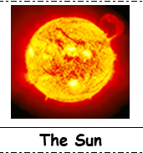

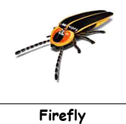


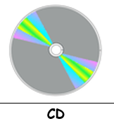



Sort these pictures into natural or artificial light sources.
Natural
Artificial
If you are working on the paper copy, draw a line from each picture to the heading.

Slide 25
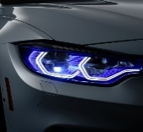
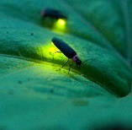


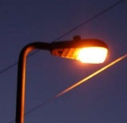
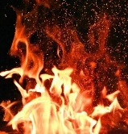
Natural light sources can be caused by three different things.
Match the pictures to the correct source.
Burning
Electricity
Chemical
Reactions

Slide 26
End of lesson

Slide 27
Wednesday 3rd February 2021
LO To be able to explore what Christians believe about Jesus
Subject: RE

Slide 28
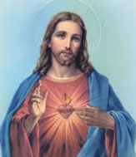

Write down anything you know about Jesus
Who was Jesus?

Slide 29
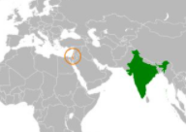
Who was Jesus?
Jesus was a Jew who lived over 2,000 years ago in a small country which is now called Israel. At the time it was ruled over by the Romans.
Christians, whatever race or country they are from, believe that Jesus is the Son of God and died to save them. He is called the Messiah which is a title to show the importance of Jesus as the saviour.
UK
Israel

Slide 30
Who was Jesus?
https://www.youtube.com/watch?v=8u-ICIHAmKk
On the next slide, is a scribed version of the video clip if you are unable to access it online.

Slide 31
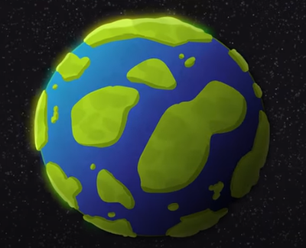
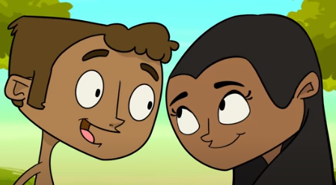
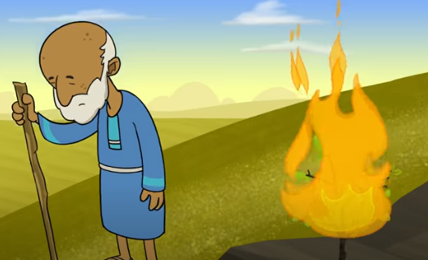
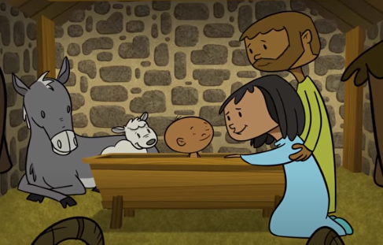
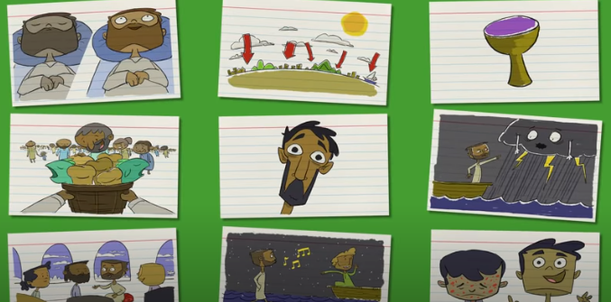
God created Earth, a perfect vision of how he wanted it to be. He created animals and the first people, Adam and Eve. There was nothing bad and the world was filled with love and peace.
Sadly, people began to do bad things but God still chose to love them. He eventually sent his son, Jesus, to help guide people through all the bad things and back onto the right path.
Jesus helped the sick and blind by performing miracles allowing them to become well again. He fed many and turned water into wine. Everyone was amazed by the good he could do.

Slide 32
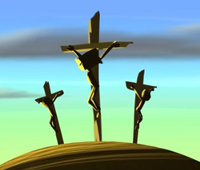
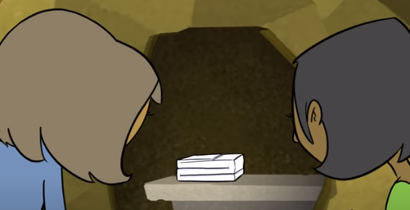
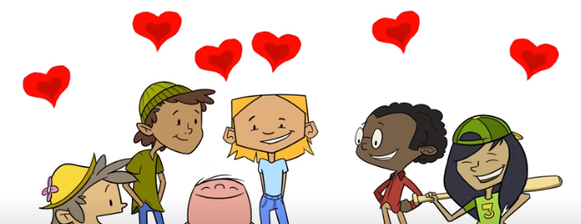
Although he was loved by many, there were some who wanted him dead as they didn’t believe he was the son of God. He was placed upon a cross and left to die. Shortly after, something incredible happened and Jesus resurrected and came back to life. He died on the cross for our sins so that we didn’t have to.
So even after all the bad people did, God’s love never changed.
No matter where we are and what we do, his love is never ending.

Slide 33
On the next slide, look carefully at the picture.
Write down any questions you could ask about the picture?

Slide 34
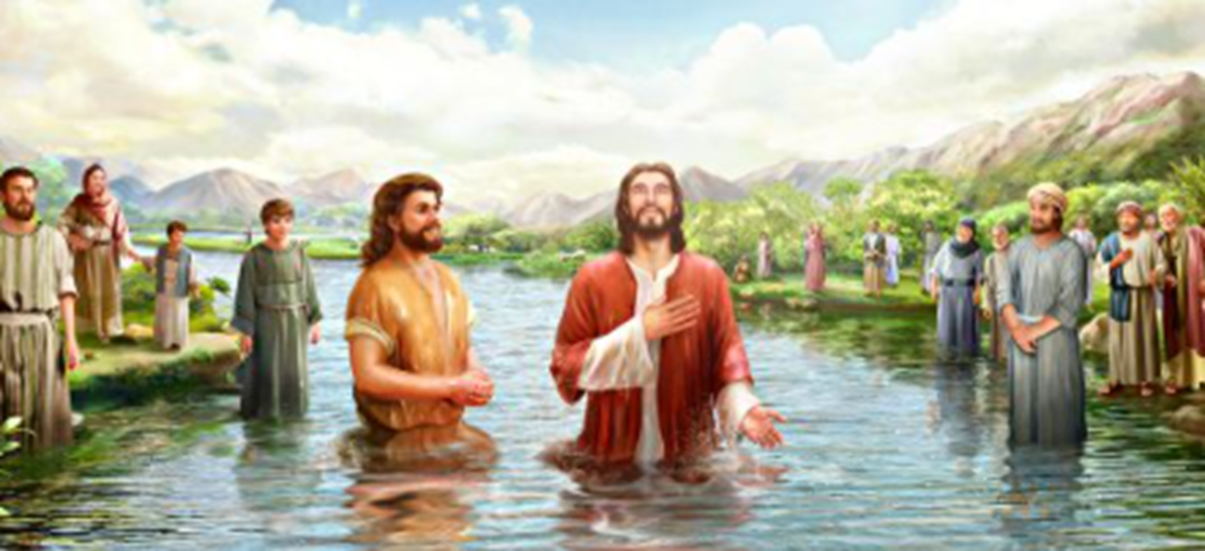
This is called a question matrix and will help us ask better questions.
Pick a question starter from the side to help generate questions about the picture.
What is happening?
Notes:
Deeper questioning and anticipated deeper response is developed from top left to bottom right.
Get pupils to describe a variety of aspects of the clip / photo through developing and asking quality questions and encouraging quality dialogue.
Come up with questions by choosing a word from the left-most column followed by a word from the top row.
Eg.
What Is…
How Could…
How Will…
Why might…
How Might…
ActiveX stuff and design by Jon Haines @mr_haines
Inspired by and thanks to @johnsayers

Slide 35
This is called a question matrix and will help us ask better questions.
Pick a question starter from the side to help generate questions about the picture.
What is happening?
Why are they in the water?
Where are they?
Why are they gathered around the river?
When did this happen?
Is it safe in the water?
What is going to happen to the man?
Who are they?
Why is everyone looking at the man in the water?
Notes:
Deeper questioning and anticipated deeper response is developed from top left to bottom right.
Get pupils to describe a variety of aspects of the clip / photo through developing and asking quality questions and encouraging quality dialogue.
Come up with questions by choosing a word from the left-most column followed by a word from the top row.
Eg.
What Is…
How Could…
How Will…
Why might…
How Might…
ActiveX stuff and design by Jon Haines @mr_haines
Inspired by and thanks to @johnsayers

Slide 36

This picture is taken from the story about Jesus’ baptism
Watch the short video clip about Jesus’ baptism or read it on the next 3 slides.
https://www.youtube.com/watch?v=88JYcN2-FiQ

Slide 37

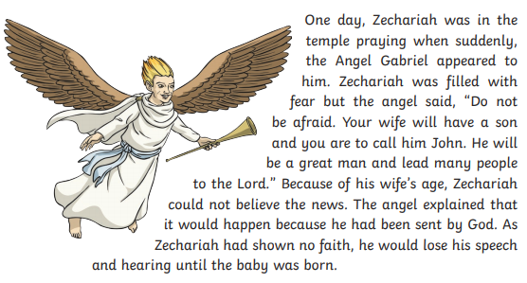

Slide 38
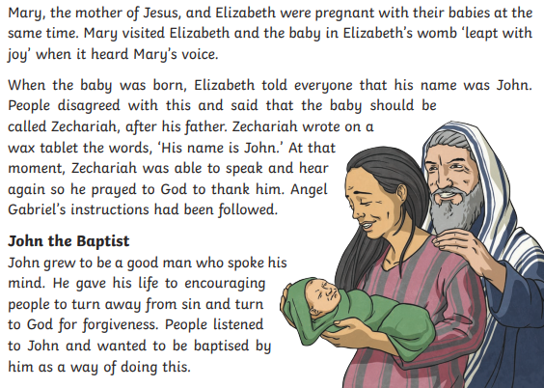

Slide 39
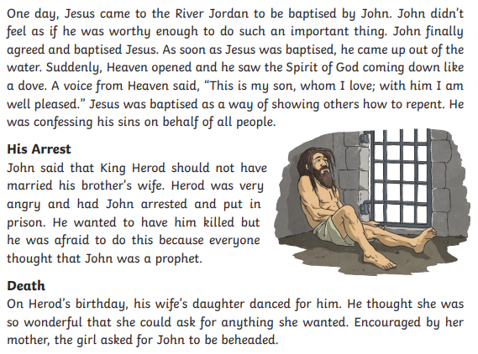

Slide 40
Jesus being baptised by John was his first adult event to be recorded.
Think about the story and answer the following questions.
Who was John?
______________________________________________________________________________________________________________________________
What was Jesus doing in the river? ______________________________________________________________________________________________________________________________
What is baptism? ______________________________________________________________________________________________________________________________

Slide 41
Who told Jesus to get baptised? ______________________________________________________________________________________________________________________________
Who did the dove represent and what did it say? _____________________________________________________________________________________________________________________________________________________________________________________________
Jesus was baptised as a sign of starting again, washing away any sins and having a new start. It also showed Christians that Jesus was one of them and confirming he was the son of God.

Slide 42
End of lesson

Slide 43

Thursday 4th February 2021
L.O To be able to ask someone their age.
Subject: French

Slide 44










Watch and listen to the song linked below to practise counting to 10.
Make sure you follow along and join in to make sure you are pronouncing each number correctly.
Copy and paste the following link:
https://www.youtube.com/watch?v=lsc3qLMaCu8

Slide 45
Sometimes words in French don’t always sound exactly like how they are written down.
Use the table to help you pronounce each number to 10. Make sure you say them all out loud.
Number | French Word | Phonetic Pronunciation
1 | un | ahn
2 | deux | duhr
3 | trois | twah
4 | quatre | katr
5 | cinq | sank
6 | six | seese
7 | sept | set
8 | huit | wheet
9 | neuf | nurf
10 | dix | deese
This column shows you how to pronounce the French word correctly.
This column shows the correct French spelling of each number to 10.

Slide 46


Counting 0-10 Quiz
Work with a partner or an adult at home to answer the following questions.
Write down your answer on the slide and check your answers at the end of the quiz.

Slide 47

Which number is huit?
1.
A) 3
B) 9
C) 8
D) 2
Answer:

Slide 48
Which of these is the answer to 8 - 4?
2.
A) zéro
B) quatre
C) trois
D) neuf
Answer:

Slide 49
Which number is cinq?
3.
A) two
B) eight
C) five
D) three
Answer:

Slide 50
10 – 1 = …?
4.
A) neuf
B) quatre
C) un
D) dix
Answer:

Slide 51
Which number is seven?
5.
A) deux
B) dix
C) six
D) sept
Answer:

Slide 52
How many Eiffel Towers did you spot on each of the previous question pages?
Write your answer below in French.
Answer:

Slide 53
Answers
C) 8
B) quatre
C) five
A) neuf
D) sept
A) six
B) trois
A) dix
C) deux
B) un
Number of Eiffel Towers…
quatre

Slide 54
Now, watch and listen to the song linked below to practise asking someone how old they are and telling somebody how old you are.
Make sure you follow along and join in.
Copy and paste the following link:
https://www.youtube.com/watch?v=6dtoYs-2TDs

Slide 55
Quel âge as-tu?
To ask somebody their age in French, you say…
Phonetic pronunciation: kel ahj ah too
This directly translates as…
What age do you have?
…but we would ask, “How old are you?”

Slide 56
J’ai ___ ans.
To tell somebody your age in French, you say…
This directly translates as…
I have ____ years.
…but we would say, “I am ____ years old.”
So, if you were 8 years old, you would say…
J’ai huit ans.

Slide 57
Quel _ _ _ as-_ _?
To ask somebody their age in French, you say…
What are the missing letters? Discuss with a partner or adult at home.
To tell somebody your age in French, you say…
J’ai ___ ans.
Fill in the missing numbers in French. Discuss this with a partner or adult at home.
I am three years old > J’ai ______ ans.
I am five years old > J’ai ______ ans.
I am nine years old > J’ai ______ ans.

Slide 58

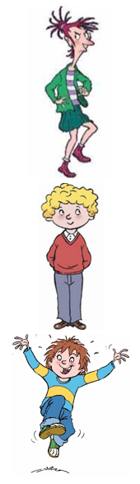
Task
Quel âge as-tu?
Answer the question ‘How old are you?’ like shown on the previous slides for each character.
J’ai _________ ans.
10
Write your answer next to the picture.
J’ai _________ ans.
4
The first one has been part completed for you.
6

Slide 59
Challenge
Peter: Hello
Henry: Hi!
Translate the conversation from English into French.
Write your answer underneath.
Use what you have learned from today’s and previous lessons.
Peter: How old are you?
Henry: I am 8 years old.
Peter:
Henry:
Peter:
Henry:

Slide 60
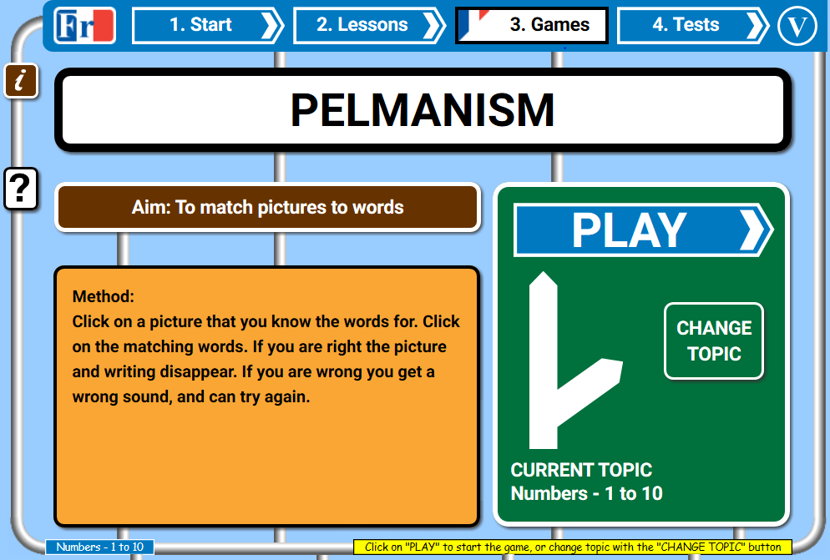
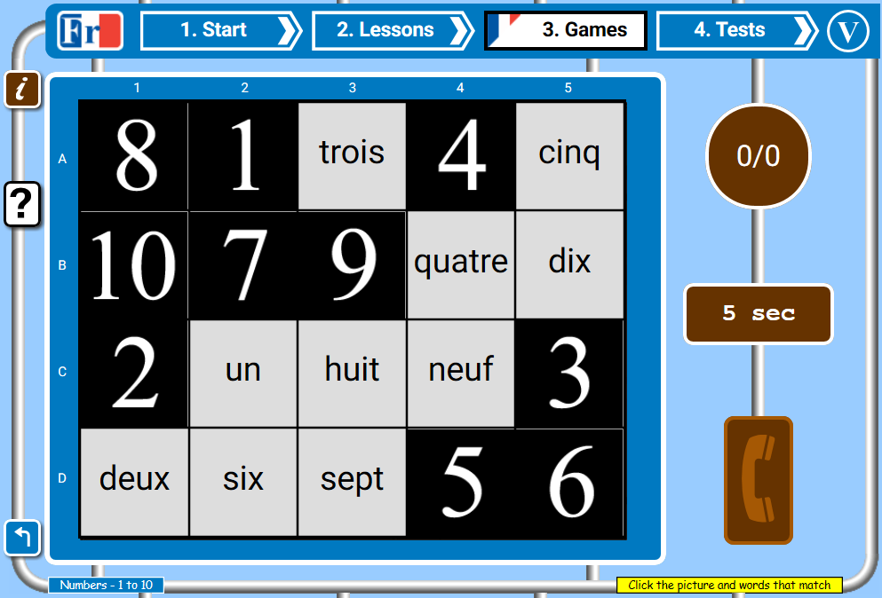
https://www.french-games.net/frenchgames/pelmanism?topic=Numbers%20-%201%20to%2010&level=primary
Play the matching game linked below to practise speaking and reading numbers 1-10.
If you are unable to access this game, cut out the squares on the following slides to create your own pairs game.
Copy and paste the following link:

Slide 61
un | deux | trois | quatre | cinq
six | sept | huit | neuf | dix

Slide 62
1 | 2 | 3 | 4 | 5
6 | 7 | 8 | 9 | 10

Slide 63
End of lesson

Slide 64
Date: Friday 5th February 2021
L.O To be able to understand that light is reflected
from surfaces.
Subject: Science

Slide 65
Pre-recorded Teaching
Access the online teaching video below that will support you to complete the work in this lesson. This video will act as a support but all of the work can still be successfully understood & completed using paper-based versions of this pack. If you need further support to understand / complete work then please contact school via e-mail or telephone.
Play Video
You can also copy and paste this link if you would prefer:
https://teachers.thenational.academy/lessons/which-materials-are-reflective-6cu6cc

Slide 66
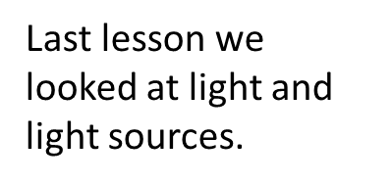
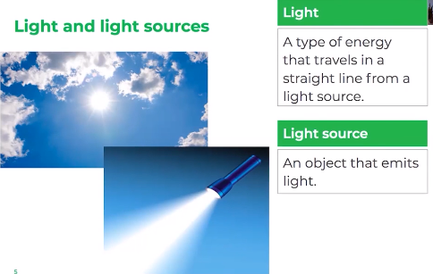
Read the two sentences above to remind yourself what light and a light source is.
How many light sources can you remember?

Slide 67
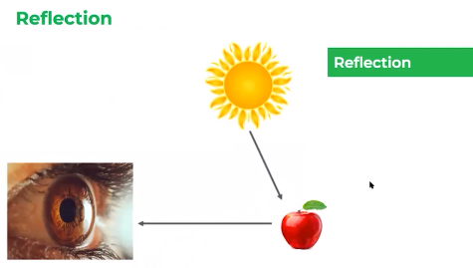
Today we are going to be learning about reflective and non-reflective materials.
When a light source emits light, that light travels in a straight line to the object.
So reflection means light bounces off an object.
When it reaches the object,
it is reflected off the object.

Slide 68
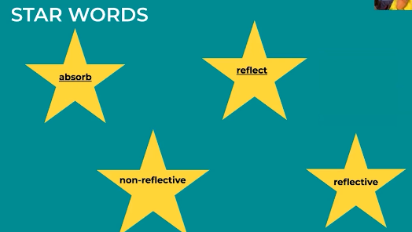
Means to bounce off
Means to take in
Not able to reflect light
Able to reflect light

Slide 69
Absorb means to __________________________.
Reflect means to
_____________________________.
Use the stars to complete the sentence below.
Materials can be ______________ and __________________.

Slide 70

When light hits a dark surface, lots of the light is absorbed. Not very much of the light bounces back off and is reflected.
When a material is reflective, it appears to be smooth and shiny. The light comes to the surface in a straight line and all of the light bounces off it.
That’s what makes the object seem smooth and shiny.
That’s what makes the object seem dark and dull.

Slide 71




Reflective and Non-reflective materials
cardboard
mirror
fabric
spoon
Two examples of a reflective material are:
______________ and ________________
Two examples of a non- reflective material are:
______________ and ________________

Slide 72


1.
2.

Slide 73
Time to investigate.
Look around the room to find reflective and non-reflective
materials/objects. Record your finding in the table below.
Reflective | Non-Reflective
Shine a light at an object, if it bounces off it is reflective.
If you don’t have a torch use the torch on a phone.

Slide 74

Time to apply what you have learnt.
From the objects below, tick the ones that will be reflective.
Remember, reflective materials appear smooth and shiny.
What happens to the light when it hits
the cardboard?
__________________________________
__________________________________

Slide 75


Slide 76
End of lesson
End of lesson

