Slide 1


Subject: Maths
Pack: B

Slide 2


Date: 08.02.2021
LO: To be able to represent the position of a shape, after a reflection.
Subject: Maths

Slide 3

Times-table practise
Spend at least 15mins practising your times-tables.
This can be done on TTRS, hit the button or any other times-table website.
Use the Times-Tables Rock Stars app or website.
Alternatively, copy and paste the following link into a web browser:
https://www.topmarks.co.uk/maths-games/7-11-years/times-tables

Slide 4

Pre-recorded Teaching
Access the online teaching video below that will support you to complete the work in this lesson. This video will act as a support but all of the work can still be successfully understood & completed using paper-based versions of this pack. If you need further support to understand / complete work then please contact school via e-mail or telephone.
Play Video
You can also copy and paste this link if you would prefer:
https://classroom.thenational.academy/lessons/reflecting-simple-shapes-6mu3ec?step=2&activity=video

Slide 5
Recap
x
y
( , )
Remember when we write in coordinates. We always write the number on the x-axis first and then the number on the y-axis.

Slide 6

The four quadrants.
y
2nd quadrant
1st quadrant
3rd quadrant
4th quadrant

Slide 7
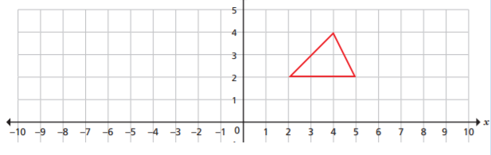

Recap
Reflect the triangle in the y-axis
X-AXIS
Y-AXIS

Slide 8
Recap answer
Reflect the triangle in the y-axis
A
A
C
B
B
C
X-AXIS
Y-AXIS
Vertex A is (4, 4). From the y-axis it is four spaces to Vertex A.
Starting from y-axis, go four spaces left into the second quadrant. The new coordinate for Vertex A is (-4, 4).
Vertex B is (2, 2). From the y-axis it is two spaces to Vertex B.
Starting from y-axis, go two spaces left into the second quadrant. The new coordinate for Vertex B is (-2, 2).
Vertex C is (5, 2). From the y-axis it is five spaces to Vertex C.
Starting from y-axis, go five spaces left into the second quadrant. The new coordinate for Vertex C is (-5, 2).

Slide 9
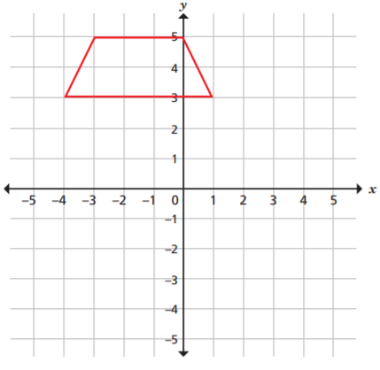
Recap
Reflect the shape in the x-axis

Slide 10
Recap answer
Reflect the shape in the x-axis
A
D
Vertex A is (-3, 5) in the second quadrant.
From the x-axis it is four spaces up to Vertex A.
Starting from x-axis, go four spaces down into the third quadrant. The new coordinate for Vertex A is (-5, 3).
Vertex B is (-4, 3) in the second quadrant.
From the x-axis it is three spaces up to Vertex B.
Starting from x-axis, go three spaces down into the third quadrant. The new coordinate for Vertex B is (-4, -3).
Vertex C is (1, 3) in the first quadrant.
From the x-axis it is three spaces up to Vertex C.
Starting from x-axis, go three spaces down into the fourth quadrant. The new coordinate for Vertex C is (-3, 1).
Vertex D is (0, 5) on the y-axis with positive coordinates.
From the x-axis it is five spaces up to Vertex D.
Starting from x-axis, go five spaces down into the y-axis with negative coordinates. The new coordinate for Vertex D is (0, -5).
B
C
X-AXIS
B
C
D
A
Y-AXIS

Slide 11
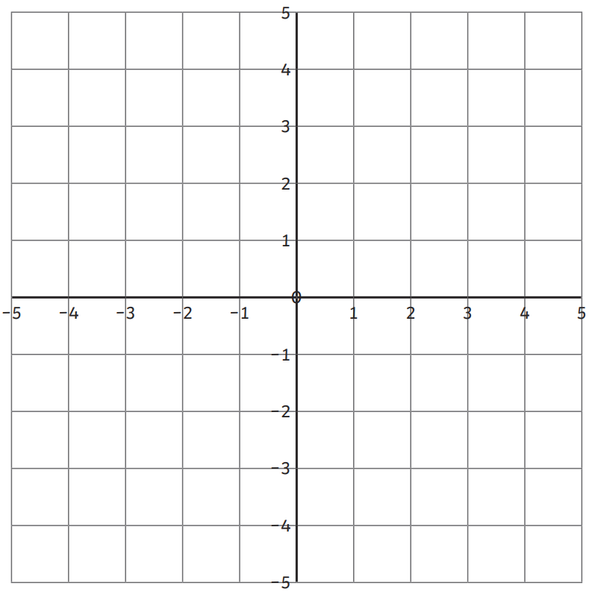
We are going to focus on the horizontal line reflection.
A rectangle is located in the first quadrant.
I am going to reflect the square using the x-axis by placing the reflected square on the fourth quadrant.
B
D
X-AXIS
The coordinates for all vertices of the rectangle in the first quadrant are;
Vertex A: ( , ) Vertex C: ( , )
Vertex B: ( , ) Vertex D: ( , )
A
C
1
1
5
1
1
4
5
4

Slide 12
Vertex A is one space up from the x-axis.
The new position for Vertex A is one space down from x-axis.
Vertex B is four spaces up from the x-axis.
The new position for Vertex B is four spaces down from x-axis.
Vertex C is one space up from the x-axis.
The new position for Vertex C is one space down from x-axis.
Vertex D is four spaces up from the x-axis.
The new position for Vertex D is four spaces down from x-axis.
B
D
X-AXIS
A
C
A
C
B
D

Slide 13
B
D
X-AXIS
The coordinates for all vertices of the rectangle in the fourth quadrant are;
Vertex A: ( , ) Vertex C: ( , )
Vertex B: ( , ) Vertex D: ( , )
A
C
1
-1
5
-1
A
C
1
-4
5
-4
B
D

Slide 14
We are going to focus on the horizontal line reflection.
A square is located in the third quadrant.
I am going to reflect the square using the x-axis by placing the reflected square on the second quadrant.
X-AXIS
B
D
The coordinates for all vertices of the square in the third quadrant are;
Vertex A: ( , ) Vertex C: ( , )
Vertex B: ( , ) Vertex D: ( , )
-4
-3
-2
-3
A
C
-4
-1
-2
-1

Slide 15
A
C
Vertex A is three spaces down from the x-axis.
The new position for Vertex A is three spaces up from the x-axis.
Vertex B is one space down from the x-axis.
The new position for Vertex B is one space up from x-axis.
Vertex C is three spaces down from the x-axis.
The new position for Vertex C is three spaces up from x-axis.
Vertex D is one space down from the x-axis.
The new position for Vertex D is one space up from x-axis.
X-AXIS
B
D
B
D
A
C

Slide 16
A
C
X-AXIS
B
D
B
D
The coordinates for all vertices of the square in the second quadrant are;
Vertex A: ( , ) Vertex C: ( , )
Vertex B: ( , ) Vertex D: ( , )
-4
3
-2
3
A
C
-4
1
-2
1

Slide 17
Let’s work together to reflect the square from its original position in the third quadrant to its new representation on the second quadrant.
Remember that we always start working out the coordinates of the vertices using the x-axis first.
What are the coordinates for all vertices of the square in the second quadrant?
Vertex A: ( , ) Vertex C: ( , )
Vertex B: ( , ) Vertex D: ( , )
X-AXIS
B
D
A
C

Slide 18
Answered
Let’s work together to reflect the square from its original position in the third quadrant to its new representation on the second quadrant.
Remember that we always start working out the coordinates of the vertices using the x-axis first.
A
C
What are the coordinates for all vertices of the square in the second quadrant?
Vertex A: ( , ) Vertex C: ( , )
Vertex B: ( , ) Vertex D: ( , )
B
D
-3
3
-1
3
X-AXIS
B
D
-3
1
-1
1
A
C

Slide 19
Let’s work together to reflect the rectangle from its original position in the first quadrant to its new representation on the fourth quadrant.
A
C
Remember that we always start working out the coordinates of the vertices using the x-axis first.
B
D
What are the coordinates for all vertices of the rectangle in the fourth quadrant?
Vertex A: ( , ) Vertex C: ( , )
Vertex B: ( , ) Vertex D: ( , )
X-AXIS

Slide 20
Answered
Let’s work together to reflect the rectangle from its original position in the first quadrant to its new representation on the fourth quadrant.
A
C
Remember that we always start working out the coordinates of the vertices using the x-axis first.
B
D
What are the coordinates for all vertices of the rectangle in the fourth quadrant?
Vertex A: ( , ) Vertex C: ( , )
Vertex B: ( , ) Vertex D: ( , )
2
-3
5
-3
X-AXIS
2
-5
5
-5
A
C
B
D

Slide 21
We are going to focus on vertical line reflection.
A square is located in the fourth quadrant.
I am going to reflect the square using the y-axis placing the reflected square on the third quadrant.
Y-AXIS
The coordinates for all vertices of the square in the fourth quadrant are;
Vertex A: ( , ) Vertex C: ( , )
Vertex B: ( , ) Vertex D: ( , )
5
-1
2
-1
C
A
5
-4
2
-4
D
B

Slide 22
Vertex A is five spaces right from the y-axis.
The new position for Vertex A is four spaces right from the y-axis.
Vertex B is five spaces right from the y-axis.
The new position for Vertex B is five spaces left from the y-axis.
Vertex C is two spaces right from the y-axis.
The new position for Vertex C is two spaces left from the y-axis.
Vertex D is two spaces right from the y-axis.
The new position for Vertex D is two spaces left from the y-axis.
Y-AXIS
A
C
C
A
D
B
B
D

Slide 23
Y-AXIS
The coordinates for all vertices of the square in the third quadrant are;
Vertex A: ( , ) Vertex C: ( , )
Vertex B: ( , ) Vertex D: ( , )
-5
-1
-2
-1
A
C
C
A
-5
-4
-2
-4
D
B
B
D

Slide 24
C
A
We are going to focus on the vertical line reflection.
A trapezium is located in the second quadrant.
I am going to reflect the trapezium using the y-axis by placing the reflected trapezium on the first quadrant.
D
B
The coordinates for all vertices of the trapezium in the second quadrant are;
Vertex A: ( , ) Vertex C: ( , )
Vertex B: ( , ) Vertex D: ( , )
-2
5
-3
5
Y-AXIS
-1
3
-4
3

Slide 25
C
A
A
C
Vertex A is two spaces left from the y-axis.
The new position for Vertex A is two spaces right from the y-axis.
Vertex B is one space left from the y-axis.
The new position for Vertex B is one space right from the y-axis.
Vertex C is three spaces left from the y-axis.
The new position for Vertex C is three spaces right from the y-axis.
Vertex D is four spaces left from the y-axis.
The new position for Vertex D is four spaces right from the y-axis.
D
B
B
D
Y-AXIS

Slide 26
A
C
B
D
The coordinates for all vertices of the trapezium in the first quadrant are;
Vertex A: ( , ) Vertex C: ( , )
Vertex B: ( , ) Vertex D: ( , )
2
5
3
5
Y-AXIS
1
3
4
3

Slide 27
Let’s work together to reflect the rectangle from its original position in the first quadrant to its new representation in the second quadrant.
Y-AXIS
C
A
Remember that we always start working out the coordinates of the vertices using the x-axis first.
What are the coordinates for all vertices of the rectangle in the second quadrant?
Vertex A: ( , ) Vertex C: ( , )
Vertex B: ( , ) Vertex D: ( , )
D
B
5
4
2
4
5
2
2
2

Slide 28
Answered
Let’s work together to reflect the rectangle from its original position in the first quadrant to its new representation in the second quadrant.
Y-AXIS
A
C
C
A
Remember that we always start working out the coordinates of the vertices using the x-axis first.
What are the coordinates for all vertices of the rectangle in the second quadrant?
Vertex A: ( , ) Vertex C: ( , )
Vertex B: ( , ) Vertex D: ( , )
B
D
D
B
5
4
2
4
5
2
2
2

Slide 29
Let’s work together to reflect the rhombus from its original position in the third quadrant to its new representation in the fourth quadrant.
Y-AXIS
Remember that we always start working out the coordinates of the vertices using the x-axis first.
What are the coordinates for all vertices of the rhombus in the fourth quadrant?
Vertex A: ( , ) Vertex C: ( , )
Vertex B: ( , ) Vertex D: ( , )
A
B
D
C

Slide 30
Answered
Let’s work together to reflect the rhombus from its original position in the third quadrant to its new representation in the fourth quadrant.
Y-AXIS
Remember that we always start working out the coordinates of the vertices using the x-axis first.
What are the coordinates for all vertices of the rhombus in the fourth quadrant?
Vertex A: ( , ) Vertex C: ( , )
Vertex B: ( , ) Vertex D: ( , )
2
-1
2
-3
A
A
B
B
1
-2
3
-2
D
D
C
C

Slide 31
Mr Herdman has drawn Shape A onto this coordinate grid. He has labelled one of the vertices as 1.
He reflects this shape in the y-axis. Give the coordinates of vertex 1 after the reflection.
Vertex 1: ( , )
1
1
Y-AXIS

Slide 32
Mr Herdman has drawn Shape A onto this coordinate grid. He has labelled one of the vertices as 1.
He reflects this shape in the y-axis. Give the coordinates of vertex 1 after the reflection.
Vertex 1: ( , )
1
1
X-AXIS
Mr Herdman reflects the original shape in the x-axis. Give the coordinates of vertex 1 after the reflection.
Vertex 1: ( , )
1
Y-AXIS

Slide 33
Mr Herdman has drawn Shape A onto this coordinate grid. He has labelled one of the vertices as 1.
He reflects this shape in the y-axis. Give the coordinates of vertex 1 after the reflection.
Vertex 1: ( , )
1
1
-1
3
X-AXIS
Mr Herdman reflects the original shape in the x-axis. Give the coordinates of vertex 1 after the reflection.
Vertex 1: ( , )
1
-3
1
Y-AXIS

Slide 34

Task 1
Mr Herdman has drawn Shape A onto this coordinate grid. Shape A is reflected in the y-axis.
Can you draw the reflection of the shape?
Can you give the coordinates of the reflected shape?
Coordinates:
( , ) ( , )
( , )
X-AXIS
Y-AXIS

Slide 35
Task 2
Mr Herdman has drawn a shape in the second quadrant with Vertex A.
He reflects his shape in the x-axis. He then reflects again the new shape in the y-axis and draws vertex A in its final position.
Mr Herdman predicts after both reflections, vertex A has now moved to (5, -3).
Is Mr Herdman correct? Explain your answer.
A
X-AXIS
Y-AXIS

Slide 36
Task 3
A
Mr Herdman has reflected Shape A in the y-axis and again in the x-axis. He has drawn the new position of the shape and labelled the shape with a B.
Can you explain whether Mr Herdman is correct or incorrect?
X-AXIS
B
Y-AXIS

Slide 37
Task 4
This shape is reflected in the y-axis.
Can you draw the reflection of the shape?
Can you also give the coordinates of the reflected shape?
Vertex A: Vertex D:
Vertex B: Vertex E:
Vertex C: Vertex F:
A
F
E
D
C
B
X-AXIS
The original shape is now reflected in the x-axis.
Can you draw the reflection of the shape?
Can you also give the coordinates of the reflected shape?
Vertex A: Vertex D:
Vertex B: Vertex E:
Vertex C: Vertex F:
Y-AXIS

Slide 38
Answers for all of the tasks.

Slide 39
Task 1
Mr Herdman has drawn Shape A onto this coordinate grid. Shape A is reflected in the y-axis.
Can you draw the reflection of the shape?
Can you give the coordinates of the reflected shape?
Coordinates:
( , ) ( , )
( , )
1
2
3
2
2
4

Slide 40
Task 2
Mr Herdman has reflected his shape in the x-axis and draws vertex A in its new position.
He then reflects the new shape in the y-axis and draws vertex A in its final position.
Mr Herdman predicts after both reflections, vertex A has now moved to (5, -3).
Is Mr Herdman correct? Explain your answer.
A
A
Mr Herdman is incorrect. He has given the incorrect coordinate for vertex A. Vertex A is now at (2, -3) after both reflections.

Slide 41
Task 3
Mr Herdman has reflected Shape A in the y-axis and again in the x-axis. He has drawn the new position of the shape and labelled the shape with a B.
Can you explain whether Mr Herdman is correct or incorrect?
A
Mr Herdman is incorrect. The shape should be upside down when it is reflected.

Slide 42
Task 4
This shape is reflected in the y-axis.
Can you draw the reflection of the shape?
Can you also give the coordinates of the reflected shape?
Vertex A: (4, 4) Vertex D: (3, 3)
Vertex B: (4, 1) Vertex E: (2, 3)
Vertex C: (3, 2) Vertex F: (1, 4)
A
F
E
D
C
B
The original shape is now reflected in the x-axis.
Can you draw the reflection of the shape?
Can you also give the coordinates of the reflected shape?
Vertex A: (-4, -4) Vertex D: (-3, -3)
Vertex B: (-4, -1) Vertex E: (-2, -3)
Vertex C: (-3, -2) Vertex F: (-1, -4)

Slide 43
End of Lesson

Slide 44
Date: 09.02.2021
LO: To be able to calculate angles on a straight line.
Subject: Maths

Slide 45
Times table practise
Spend at least 15mins practising your times tables.
This can be done on TTRS, hit the button or any other times table website.
Use the Times Tables Rock Stars app or website.
Alternatively, copy and paste the following link into a web browser:
https://www.topmarks.co.uk/maths-games/7-11-years/times-tables

Slide 46
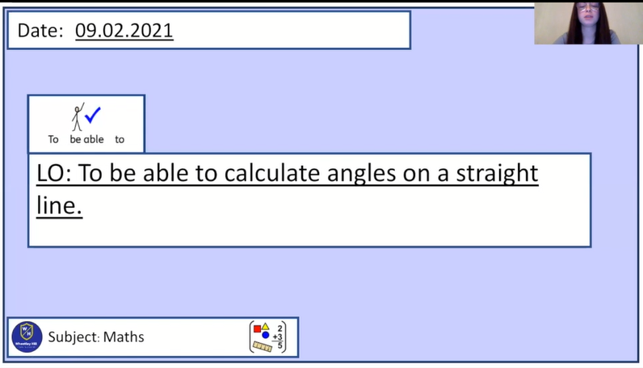
Pre-recorded Teaching
Miss Umpleby’s online teaching video is on our school website. It will support you to complete the work in this lesson. This video will act as a support but all of the work can still be successfully understood & completed using paper-based versions of this pack. If you need further support to understand / complete work then please contact school via e-mail or telephone.
You can also copy and paste this link if you would prefer:
https://www.whprimary.com/copy-4-of-covid19

Slide 47
Starter
Can you work out the missing numbers below?
65 + ____ = 180
90 + ____ = 180
75 + 10 + ____ = 180
180 – 30 = ____
180 – 45 – 10 = ____
180 – 20 – 60= ____

Slide 48
Starter
Can you work out the missing numbers below?
65 + 115 = 180
90 + 90 = 180
75 + 10+ 95 = 180
180 – 30 = 150
180 – 45 – 10 = 125
180 – 20 – 60= 100

Slide 49
What do we already know?
Angles on a straight line ALWAYS add up to 180°.
180°

Slide 50
What do we already know?
Here we have two angles on a straight line.
100°
x
Because we don’t know the size of this angle, we will call it x.

Slide 51
What do we already know?
Here we have two angles on a straight line.
Can we work out the size of angle x?
100°
x

Slide 52
If I asked you to work out…
180-100= ___
2) 100+ __ = 180
Could you do it?
Yes! We did this at the start of the lesson.
100°
x

Slide 53
We do the same thing when we want to find the value of x.
We know that angles on a straight line add up to 180°.
So, 100° plus something must equal 180°.
Or, we can say that 180° minus 100° equals the size of angle x.
Either way, our answer is 80°.
x= 80°
100+80=180
100°
x
180- 100 = 80

Slide 54
Our working out should look like this.
 | 1 | 0 | 0 | + | x |  | = | 1 | 8 | 0
 | 1 | 0 | 0 | + | 8 | 0 | = | 1 | 8 | 0
 |  |  | x | = | 8 | 0 | °
 |  |  |  |  | or
 | 1 | 8 | 0 | - | 1 | 0 | 0 | = | x
 | 1 | 8 | 0 | - | 1 | 0 | 0 | = | 8 | 0
 |  |  | x | = | 8 | 0 | °
Work out the size of angle x.
Always remember your degrees symbol.

Slide 55
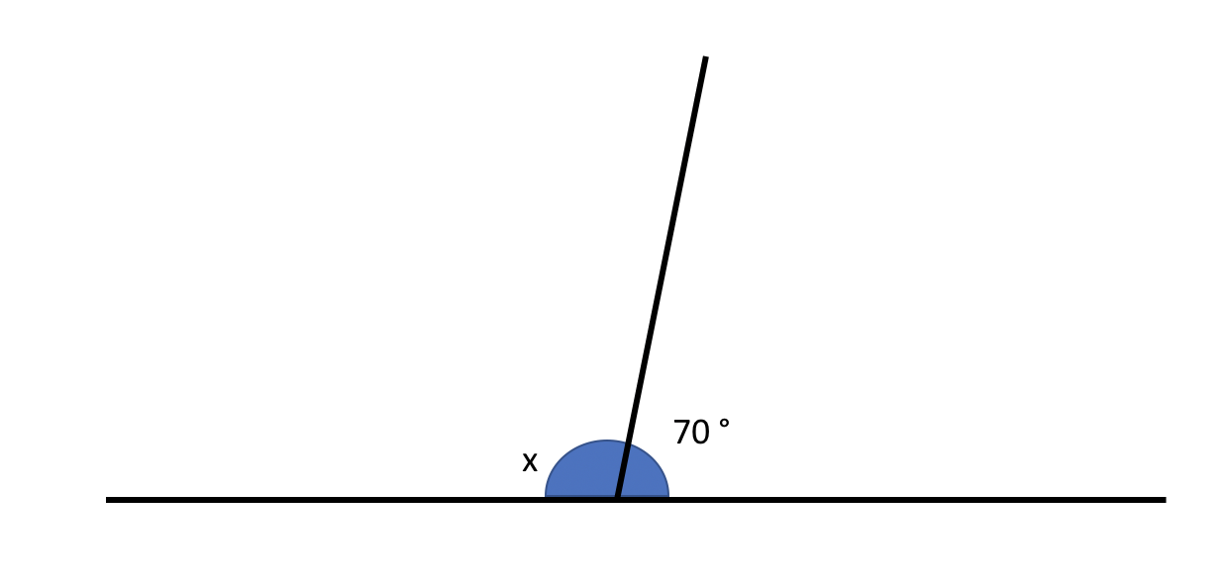

Here we have two angles on a straight line.
Can we work out the size of angle x?
60°
Angles on a straight line always add up to 180°.

Slide 56
60°
We know that angles on a straight line add up to 180°.
So, 60° plus something must equal 180°.
Or, we can say that 180° minus 60° equals the size of angle x.
Either way, our answer is 120°. x= 120°

Slide 57
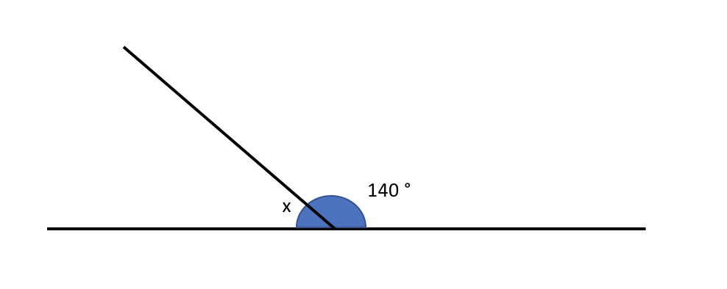
Try this on your own.
Can we work out the size of angle x?
155°
Angles on a straight line always add up to 180°.

Slide 58
155°
We know that angles on a straight line add up to 180°.
So, 155° plus something must equal 180°.
Or, we can say that 180° minus 155° equals the size of angle x.
Either way, our answer is 40°. x= 25°

Slide 59
Here we have three angles on a straight line.
Can we work out the size of angle x?
113°
50°
x
Angles on a straight line always add up to 180°.

Slide 60
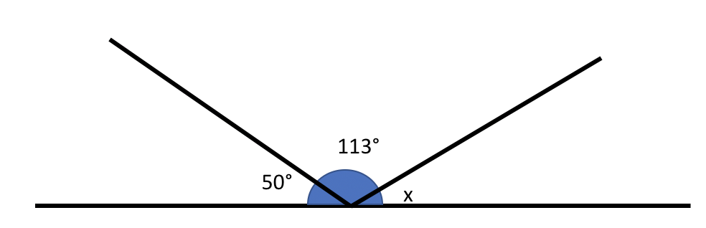
Here we have three angles on a straight line.
Can we work out the size of angle x?
We know that angles on a straight line add up to 180°.
So, 113° + 50° + something must equal 180°.
Or, we can say that 180° - 113° - 50° equals the size of angle x.
Either way, our answer is 17°.
x= 17°
113+50+ 17=180
180- 113 - 50 = 17

Slide 61
Try this on your own.
Can we work out the size of angle x?
Remember, we are doing the exact same method as before, but we have one more number to put into the working out.
85°
75°
x
Angles on a straight line always add up to 180°.

Slide 62
We know that angles on a straight line add up to 180°.
So, 75° + 85° + something must equal 180°.
Or, we can say that 180° - 75° - 85° equals the size of angle x.
Either way, our answer is 20°. x= 20°

Slide 63
Joe is measuring two angles on a straight line.
My angles measure 110° and 80°.
Why must one of Joe’s angles be wrong?

Slide 64
Joe is measuring two angles on a straight line.
My angles measure 110° and 80°.
Angles on a straight line ALWAYS add up to 180°. Joe’s angles add up to 190°.
Why must one of Emily’s angles be wrong?

Slide 65
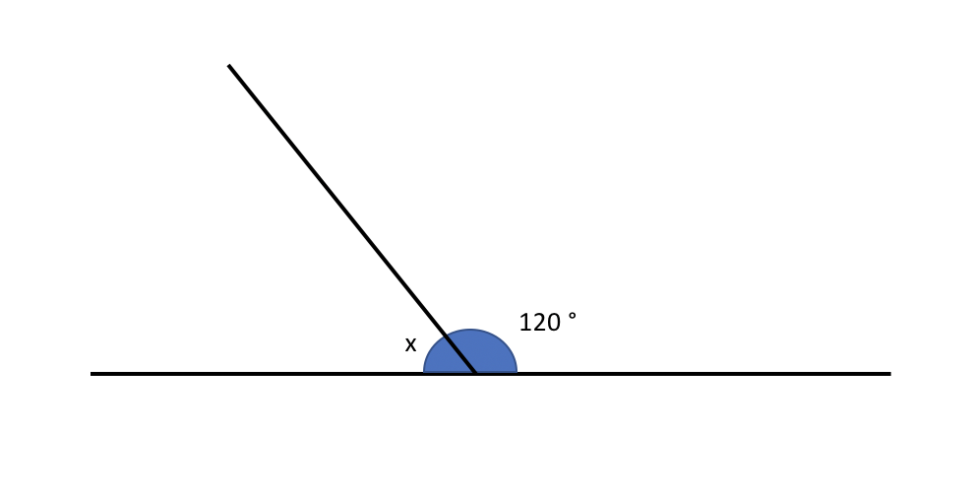
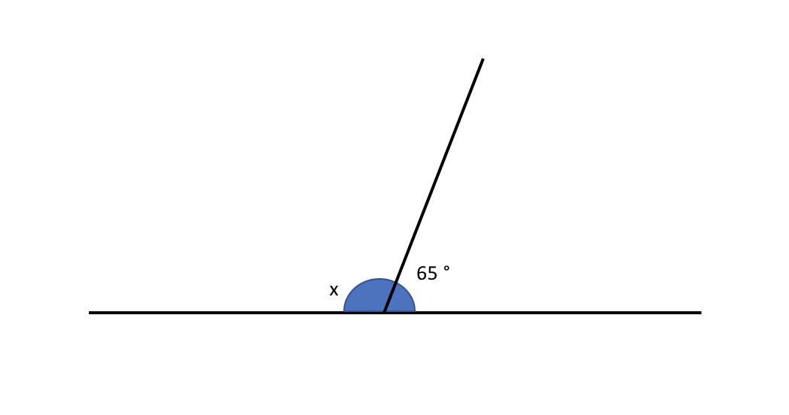
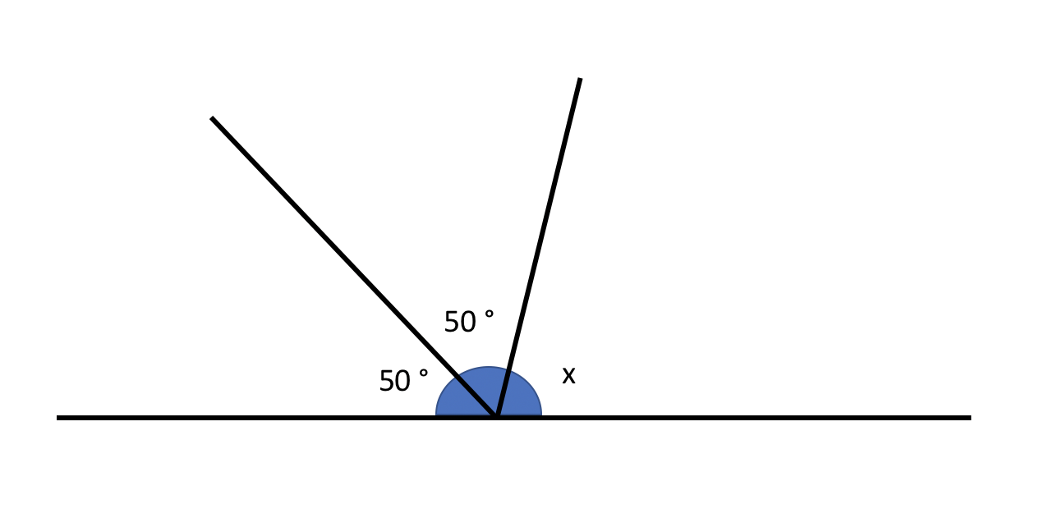
Work out the size of angle x for each question.
1.
3.
x
53°
63°
57°
2.
4.
103°
x
x
55°
65°

Slide 66
Work out the size of angle x for each question.
1.
3.
x
53°
63°
57°
x = 70°
x = 117°
2.
4.
x = 60°
103°
x
x
x = 73°
55°
65°

Slide 67
Date: 10.02.2021
LO: To be able to calculate angles around a point.
Subject: Maths

Slide 68
Times-table practise
Spend at least 15mins practising your times-tables.
This can be done on TTRS, hit the button or any other times-table website.
Use the Times-Tables Rock Stars app or website.
Alternatively, copy and paste the following link into a web browser:
https://www.topmarks.co.uk/maths-games/7-11-years/times-tables

Slide 69

Pre-recorded Teaching
Access the online teaching video below that will support you to complete the work in this lesson. This video will act as a support but all of the work can still be successfully understood & completed using paper-based versions of this pack. If you need further support to understand / complete work then please contact school via e-mail or telephone.
Play Video
You can also copy and paste this link if you would prefer:
https://classroom.thenational.academy/lessons/find-missing-angles-around-a-point-and-on-a-straight-line-c9k32c?activity=video&step=1

Slide 70
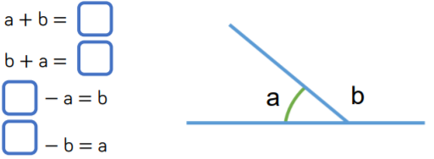
Recap
Can you complete the number sentences below?
Remember, angles on a straight line add up to 180°

Slide 71
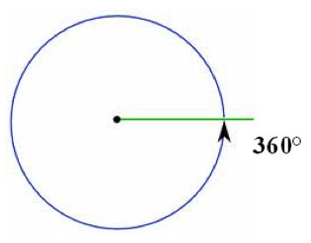
There are ____°in a full turn
360

Slide 72
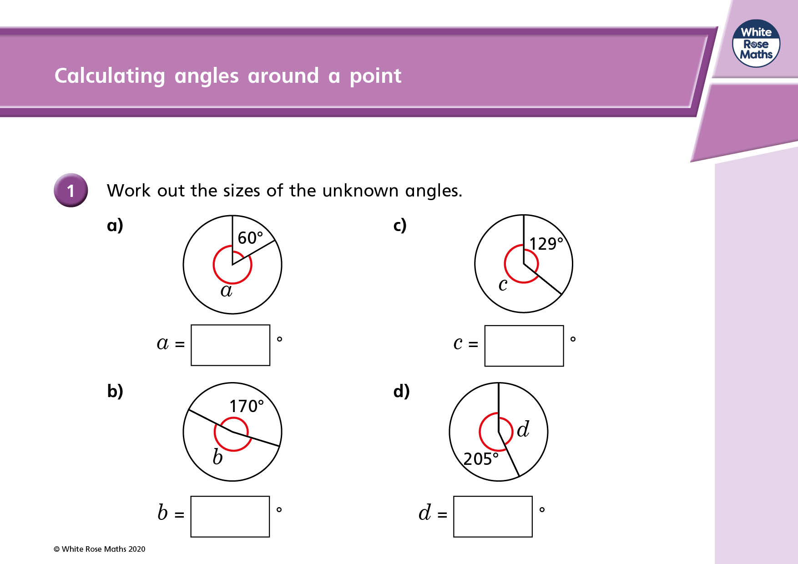
Angles that meet at a point
We know they will always have a total of 360°
To find a missing angle we can find the total of
the angles we have and subtract this from 360°
Here we have 60° already identified.
Therefore, we know the remaining angle (a) = 360° - 60°
So,
360° – 60° = 300°
Therefore, a = 140°

Slide 73
Angles that meet at a point
Another example:
Here we have 129° already identified.
Therefore, we know the remaining angle (c) = 360° - 129°
So,
360° – 129° = 231°
Therefore, c = 231°

Slide 74
Angles that meet at a point
Have a go at calculating angle d.
Remember, 360° - the know angle = missing angle.

Slide 75
How did you do?
360° - 205° = 155°
155°

Slide 76
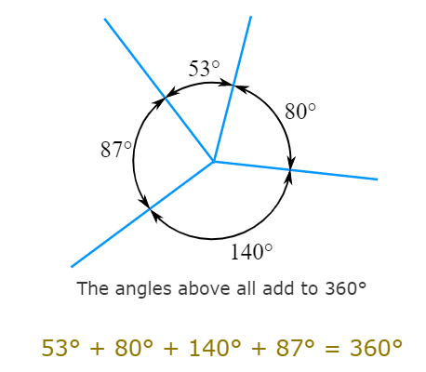
Multiple angles that meet at a point

Slide 77
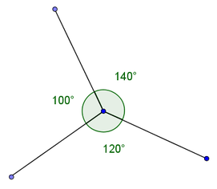
Angles that meet at a point
These will always have a total of 360°
To find a missing angle we can find the total of
the angles we have and subtract this from 360°
E.g.
95° + 125° = 220°
360° – 220° = 140°
Therefore, the missing angle is 140°
140°
95°
125°

Slide 78
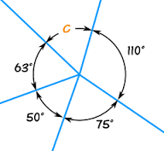
Angles that meet at a point
Another example:
To find the missing angle (c), we need to firstly add all of the known angles together.
110° + 80° + 40° + 60° = 290°
Next, we subtract this from 360°
360° - 290° = 70°
C = 70°
110°
60°
40°
80°

Slide 79
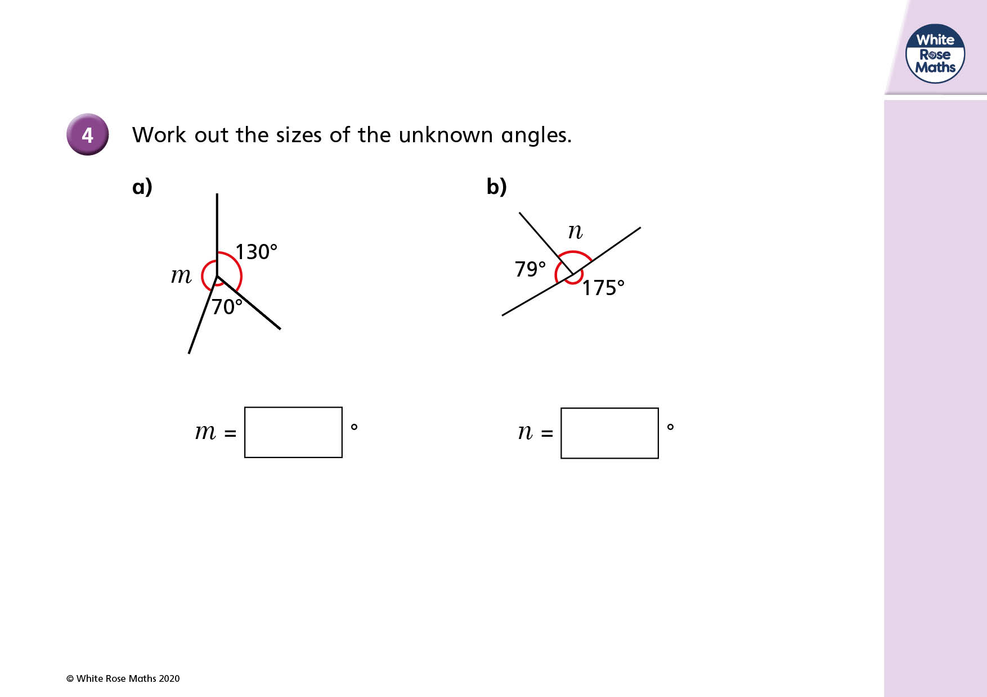
Angles that meet at a point
Another example:
Here we have 130° and 70° already identified.
Therefore, we know the remaining angle (m) = 360° - (130° + 70°)
So,
130° + 70° = 200°
360° – 200° = 160°
Therefore, m = 160°

Slide 80
Angles that meet at a point
Have a go at calculating angle n.
Remember, 360° - the known angles = missing angle.

Slide 81
How did you do?
175° + 79° = 254°
360° - 254° = 106°
106°

Slide 82
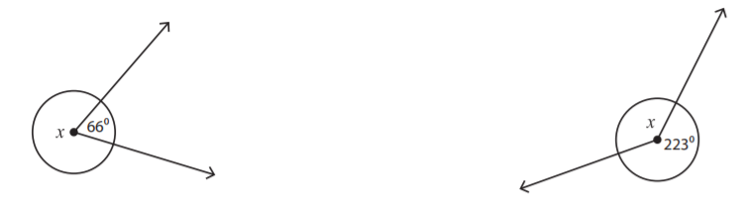
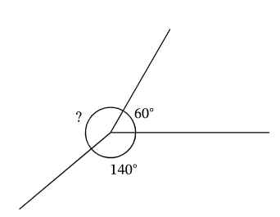
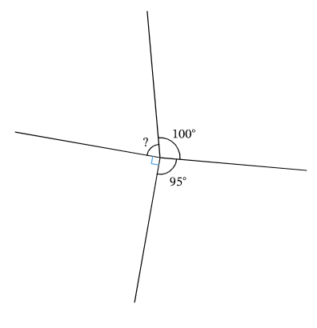
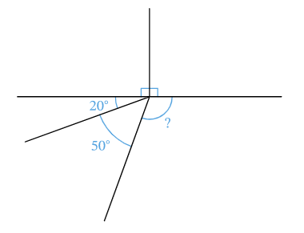
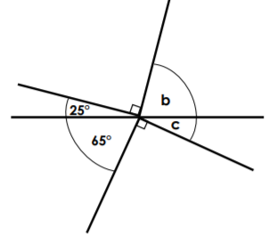
Task 1: Have a go at finding the missing angles.
1)
2)
Add the known angles
Subtract the known angles from 360.
Remember to add your °symbol in your answer.
3)
4)
100°
95°
5)
6)
20°
?
Remember what you have learnt about angles on a straight line to help you here.
50°

Slide 83
Task 1: Have a go at finding the missing angles.
1)
2)
294°
137°
Add the known angles
Subtract the known angles from 360.
Remember to add your °symbol in your answer.
3)
4)
160°
165°
100°
95°
5)
6)
65°
20°
130°
25°
?
50°

Slide 84
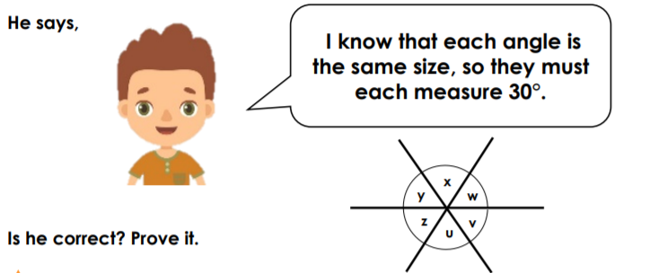
Task 2:
Toby has been calculating angles
He says...

Slide 85
Task 2 answer:
Toby has been calculating angles
He says...
Toby is incorrect. The angles around a point total 360 degrees, so each angle must measure 60 degrees.

Slide 86
End of Lesson

Slide 87
Date: 11.02.2021
LO: To be able to describe positions, in all four quadrants, and translate across them.
Subject: Maths

Slide 88
Times-table practise
Spend at least 15mins practising your times-tables.
This can be done on TTRS, hit the button or any other times-table website.
Use the Times-Tables Rock Stars app or website.
Alternatively, copy and paste the following link into a web browser:
https://www.topmarks.co.uk/maths-games/7-11-years/times-tables

Slide 89

Pre-recorded Teaching
Access the online teaching video below that will support you to complete the work in this lesson. This video will act as a support but all of the work can still be successfully understood & completed using paper-based versions of this pack. If you need further support to understand / complete work then please contact school via e-mail or telephone.
Play Video
You can also copy and paste this link if you would prefer:
https://www.youtube.com/watch?v=8Dtz5fBe7_Q

Slide 90
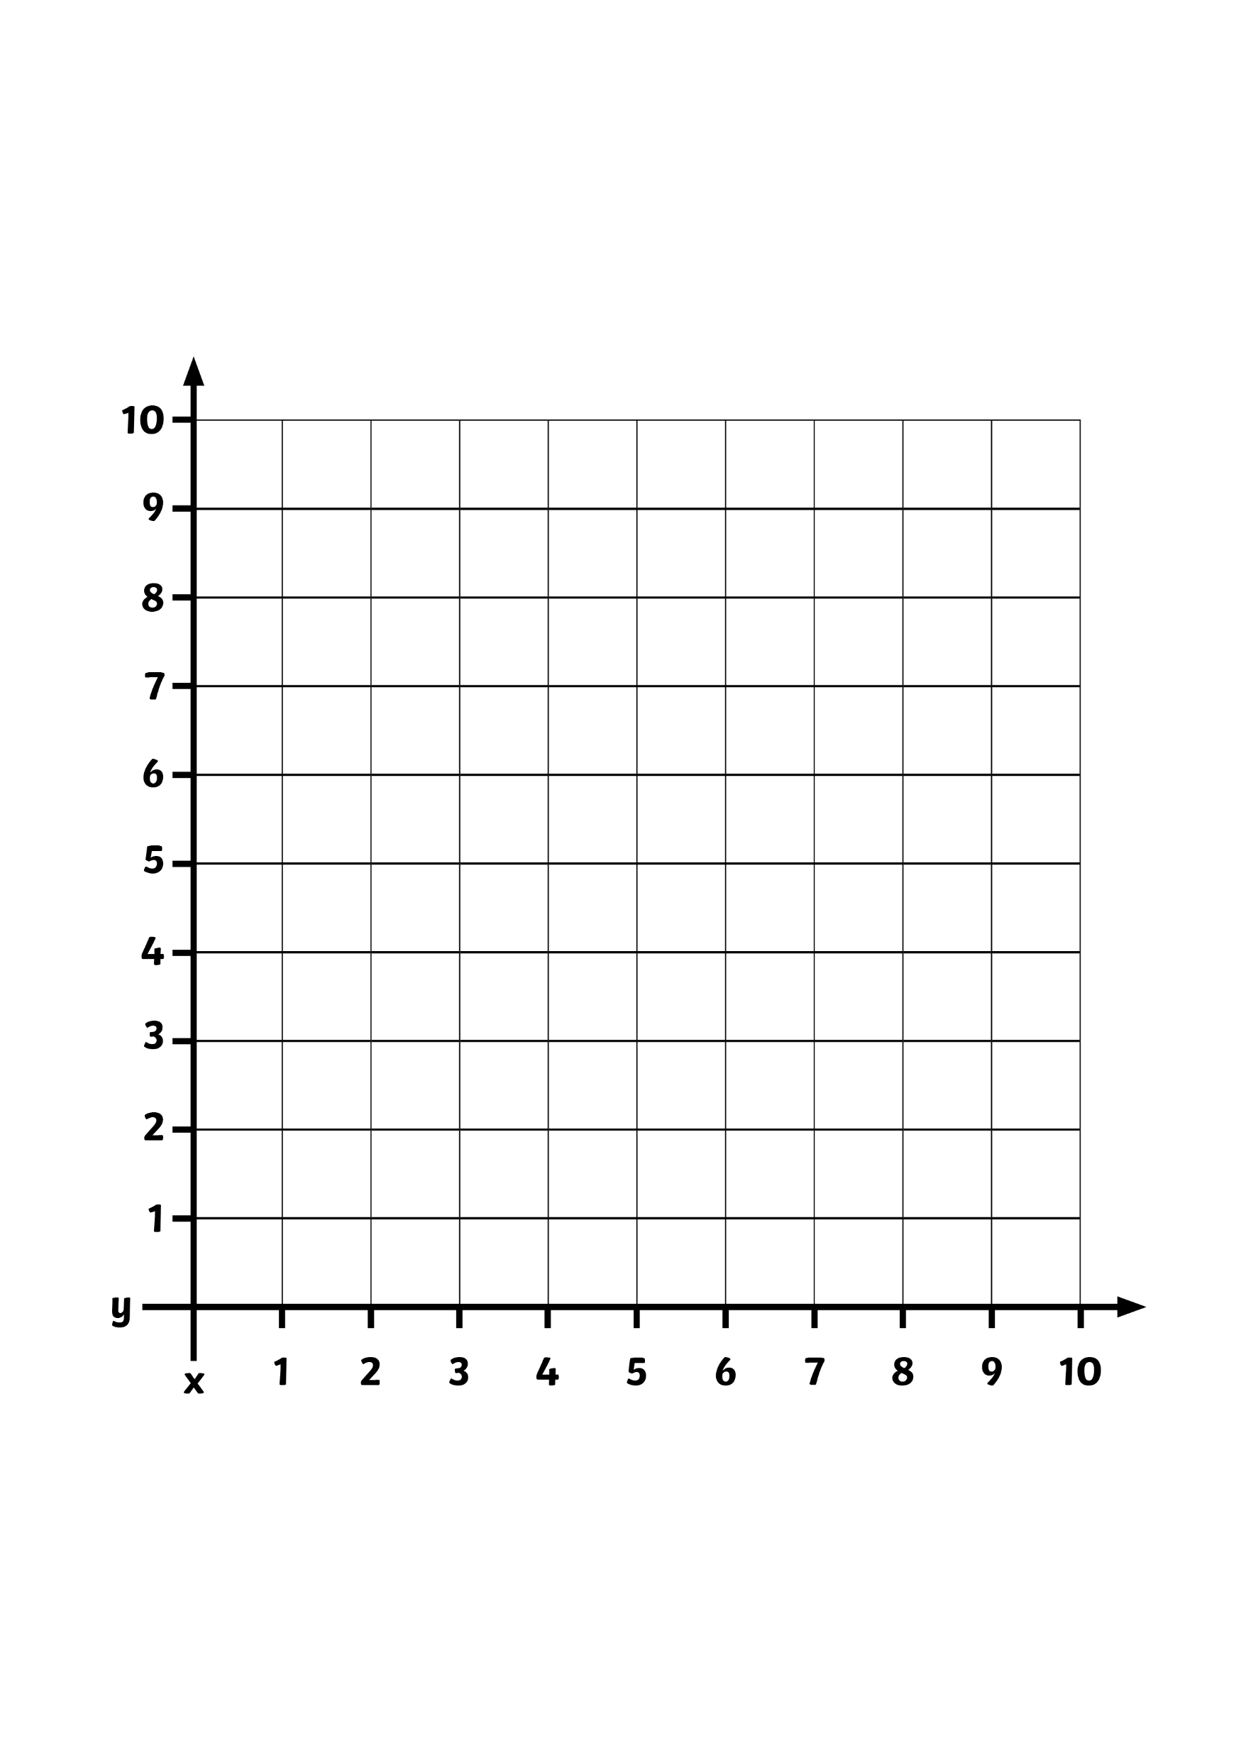

What is a Translation?
A translation is when a shape moves from one position to another without being rotated or flipped.
On this grid, rectangle A has been moved to position B.
B
A
x
y

Slide 91
Key Information about Translation
Translation is the process of moving something from one place to another. In mathematics, this is normally the movement of shapes.
Coordinates are a set of values that show an exact position. We use a pair of numbers separated by a comma and written inside brackets to describe a position on a grid, for example (4, 5).
The first number describes the position along the x-axis and the second describes the position along the y-axis.
The four quadrants tell us which area of the coordinates grid we are working in.

Slide 92
How to Translate…
5 squares to the right
To translate a shape, we must pick one of the shape’s vertices (corners).
We have chosen the top left hand corner on this rectangle.
I want to move this rectangle 5 squares to the right and 4 squares down.
We always move along the x-axis first, then then the y-axis
4 squares down
A
B
This point represents the top left hand corner of the rectangle
x
y

Slide 93
How to Translate…
6 squares to the left
To translate a shape, we must pick one of the shape’s vertices (corners).
We have chosen the top left hand corner on this rectangle.
I want to move this square 6 squares to the right and 3 squares down.
We always move along the x-axis first, then then the y-axis
3 squares down
A
B
This point represents the top left hand corner of the rectangle
x
y

Slide 94
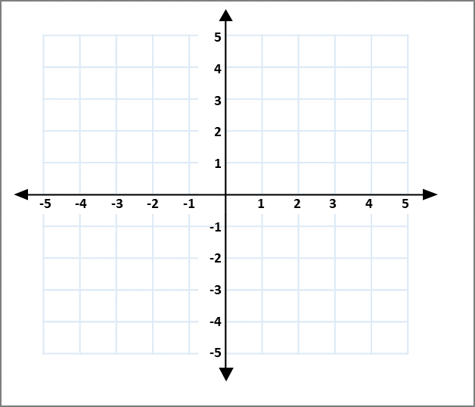
How to Translate…
5 squares up
To translate a shape, we must pick one of the shape’s vertices (corners).
We have chosen the top left hand corner on this rectangle.
I want to move this square 6 squares to the right and 3 squares down.
We always move along the x-axis first, then then the y-axis
B
A
5 squares to the left

Slide 95
Coordinates can also be used when describing translations..
A
y
I want to move A from (3,-2) to (1,4)
The vertices of shape x =
A= (3, -2)
B= (3, -5)
C= (5, -5)
They have been translated to:
A= (1, 4)
B= (1, 1)
C= (3, 1)
B
C
A
x
B
C

Slide 96
Choose the correct statement to describe the translation of shape A.
4 squares left and 2 squares up
5 squares left and 2 squares up
5 squares left and 3 squares up
7
6
5
4
3
2
1
A
-7 | -6 | -5 | -4 | -3 | -2 | -1 |  | 1 | 2 | 3 | 4 | 5 | 6 | 7

Slide 97
Choose the correct statement to describe the translation of shape A.
4 squares left and 2 squares up
5 squares left and 2 squares up
5 squares left and 3 squares up
7
6
5
4
3
2
1
A
-7 | -6 | -5 | -4 | -3 | -2 | -1 |  | 1 | 2 | 3 | 4 | 5 | 6 | 7

Slide 98
A shape is translated from position A to position B.
Complete the sentence:
The shape has moved squares to
the left and squares down.
8
7
6
5
4
3
2
1
0
A
B
0 | 1 | 2 | 3 | 4 | 5 | 6 | 7 | 8

Slide 99
A shape is translated from position A to position B.
Complete the sentence:
The shape has moved squares to
the left and squares down.
8
7
6
5
4
3
2
1
0
A
B
0 | 1 | 2 | 3 | 4 | 5 | 6 | 7 | 8
2
4

Slide 100
Translate this shape 7 squares to the right and 3 squares down.
What are its new coordinates?
7
6
5
4
3
2
1
-7 | -6 | -5 | -4 | -3 | -2 | -1 |  | 1 | 2 | 3 | 4 | 5 | 6 | 7

Slide 101
Translate this shape 7 squares to the right and 3 squares down.
What are its new coordinates?
(1, 3), (5, 3), (5, 0), (1, 0)
7
6
5
4
3
2
1
-7 | -6 | -5 | -4 | -3 | -2 | -1 |  | 1 | 2 | 3 | 4 | 5 | 6 | 7

Slide 102
This shape is translated so that point A moves to point B.
Draw the shape in its new position and write down the coordinates.
5
4
3
2
1
-1
-2
-3
-4
-5
 | B
 |  |  |  |  | A
-5 | -4 | -3 | -2 | -1 |  |  | 1 | 2 | 3 | 4 | 5

Slide 103
This shape is translated so that point A moves to point B.
Draw the shape in its new position and write down the coordinates.
(-3, 3), (-1, 3), (-1, 1), (-3, 1)
5
4
3
2
1
-1
-2
-3
-4
-5
 | B
 |  |  |  |  | A
-5 | -4 | -3 | -2 | -1 |  |  | 1 | 2 | 3 | 4 | 5

Slide 104
I draw shape ABCD on the grid. I want to translate the shape so that point D becomes the coordinate (-3,-2).
Do you agree? Explain why.
Point B will become the coordinate (1, 4).
4
3
2
1
-1
-2
-3
-4
A
B
-4 | -3 | -2 | -1 |  |  | 1 | 2 | 3 | 4
D
C

Slide 105
I draw shape ABCD on the grid. I want to translate the shape so that point D becomes the coordinate (-3,-2).
Do you agree? Explain why.
No, it is incorrect because…
Point B will become the coordinate (1, 4).
4
3
2
1
-1
-2
-3
-4
A
B
-4 | -3 | -2 | -1 |  |  | 1 | 2 | 3 | 4
D
C

Slide 106
I draw shape ABCD on the grid. I want to translate the shape so that point D becomes the coordinate (-3,-2).
Do you agree? Explain why.
No, it is incorrect. Point B will translate to (-1, 4). I forgot to include the negative sign.
Point B will become the coordinate (1, 4).
4
3
2
1
-1
-2
-3
-4
A
B
-4 | -3 | -2 | -1 |  |  | 1 | 2 | 3 | 4
D
C

Slide 107
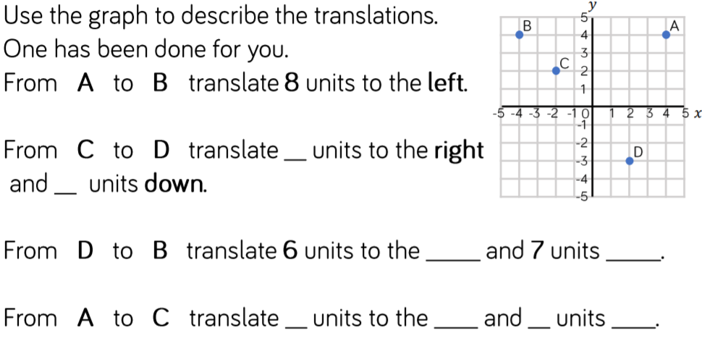
Task 1

Slide 108
Task 1 answers
4
5
left
up
6
left
2
down

Slide 109
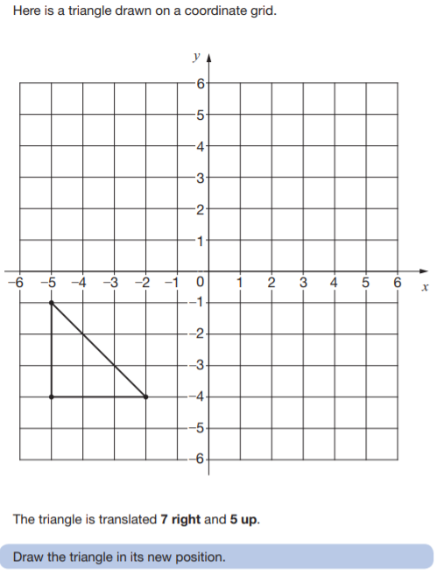
Task 2

Slide 110
Task 2 answer

Slide 111
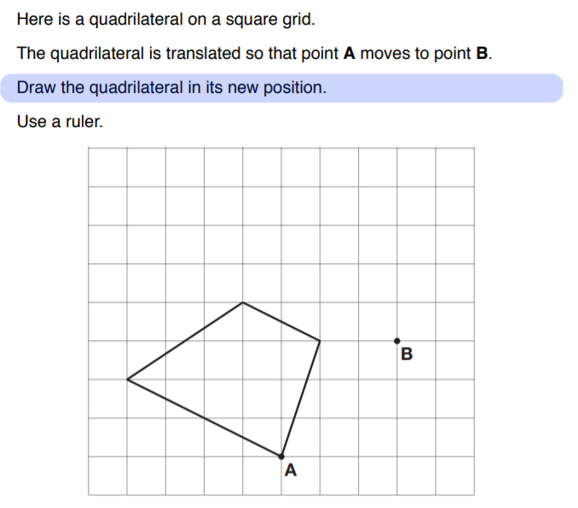
Task 3

Slide 112
Task 3

Slide 113
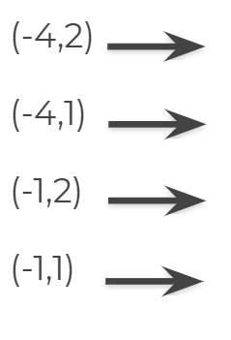
Task 4
A rectangle has the following vertices:
(-4,2) (-4,1) (-1,2) (-1,1).
It is translated 4 right and 2 down.
Draw the shape in its new position and record the coordinates on the right.

Slide 114
Task 4 answers
A rectangle has the following vertices:
(-4,2) (-4,1) (-1,2) (-1,1).
It is translated 4 right and 2 down.
Draw the shape in its new position and record the coordinates on the right.
(0,0)
(0,-1)
(3,0)
(3,-1)

Slide 115
End of Lesson

Slide 116
Date: 12.01.2021
LO: To be able to solve reasoning problems involving shape, space and measure.
Subject: Maths

Slide 117
Times-table practise
Spend at least 15mins practising your times-tables.
This can be done on TTRS, hit the button or any other times-table website.
Use the Times-Tables Rock Stars app or website.
Alternatively, copy and paste the following link into a web browser:
https://www.topmarks.co.uk/maths-games/7-11-years/times-tables

Slide 118
What is a Translation?
Recap
A translation is when a shape moves from one position to another without being rotated or flipped.
On this grid, rectangle A has been moved to position B.
B
A
x
y

Slide 119
How to Translate…
Recap
5 squares to the right
To translate a shape, we must pick one of the shape’s vertices (corners).
We have chosen the top left hand corner on this rectangle.
I want to move this rectangle 5 squares to the right and 4 squares down.
We always move along the x-axis first, then then the y-axis
4 squares down
A
B
This point represents the top left hand corner of the rectangle
x
y

Slide 120
How to Translate…
Recap
5 squares up
To translate a shape, we must pick one of the shape’s vertices (corners).
We have chosen the top left hand corner on this rectangle.
I want to move this square 6 squares to the right and 3 squares down.
We always move along the x-axis first, then then the y-axis
B
A
5 squares to the left

Slide 121
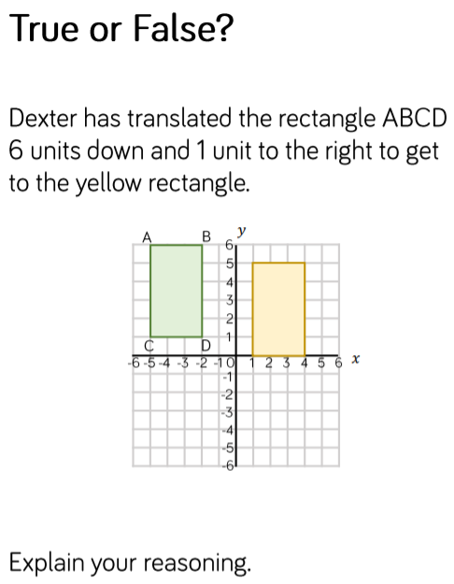
Task 1 - Translation

Slide 122
Task 1 - Translation answers
False.
The translation is 6 units to the right and 1 unit down.

Slide 123
Recap - Reflection
Reflect the triangle in the y-axis
X-AXIS
Y-AXIS

Slide 124
Recap - Reflection
Reflect the triangle in the y-axis
A
A
C
B
B
C
X-AXIS
Y-AXIS
Vertex A is (4, 4). From the y-axis it is four spaces to Vertex A.
Starting from y-axis, go four spaces left into the second quadrant. The new coordinate for Vertex A is (-4, 4).
Vertex B is (2, 2). From the y-axis it is two spaces to Vertex B.
Starting from y-axis, go two spaces left into the second quadrant. The new coordinate for Vertex B is (-2, 2).
Vertex C is (5, 2). From the y-axis it is five spaces to Vertex C.
Starting from y-axis, go five spaces left into the second quadrant. The new coordinate for Vertex C is (-5, 2).

Slide 125
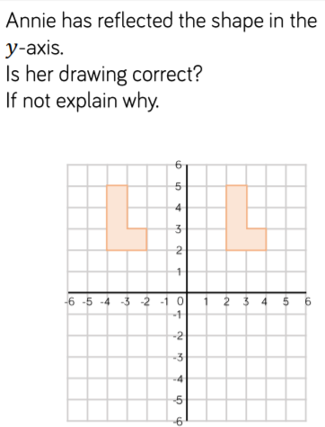
Task 2 - Reflection

Slide 126
Task 2 - Reflection answer
No, it has been translated, rather than reflected.

Slide 127
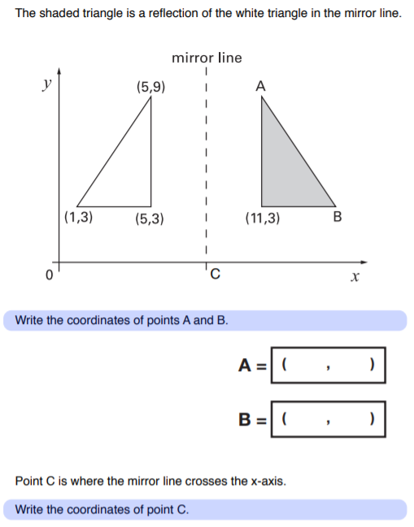
Task 3 - Reflection

Slide 128
Task 3 - Reflection answer
(11 , 9)
(15 , 3)

Slide 129
Recap – Angles on a straight line
Angles on a straight line ALWAYS add up to 180°.
180°

Slide 130
Recap – Angles on a straight line
Here we have two angles on a straight line.
100°
x
Because we don’t know the size of this angle, we will call it x.

Slide 131
Recap – Angles on a straight line
We do the same thing when we want to find the value of x.
We know that angles on a straight line add up to 180°.
So, 100° plus something must equal 180°.
Or, we can say that 180° minus 100° equals the size of angle x.
Either way, our answer is 80°.
x= 80°
100+80=180
100°
x
180- 100 = 80

Slide 132
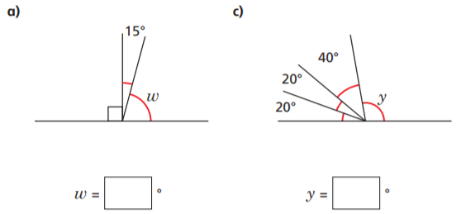
Task 4 – Angles on a straight line
Remember, angles on a straight line always add up to 180°.
180°

Slide 133
Task 4 – Angles on a straight line
Remember, angles on a straight line always add up to 180°.
180°
75°
100°

Slide 134
There are ____°in a full turn
Recap – Angles around a point
360

Slide 135
Recap – Angles around a point
We know they will always have a total of 360°
To find a missing angle we can find the total of
the angles we have and subtract this from 360°
Here we have 60° already identified.
Therefore, we know the remaining angle (a) = 360° - 60°
So,
360° – 60° = 300°
Therefore, a = 140°

Slide 136
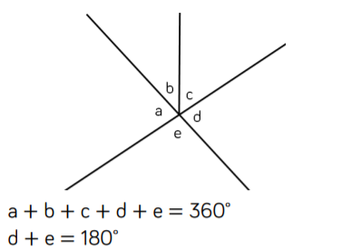
Task 5 - angles around a point
Remember, angles around a point add up to 360°
Write 3 more maths sentences, about this diagram.

Slide 137
Task 5 - angles around a point answers
Remember, angles around a point add up to 360°
Various answers e.g.
a + b + c = e + d
360˚ − e − d = 180˚ , etc.

Slide 138
End of Lesson

