Slide 1
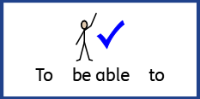
Date: Monday 28th June 2021
LO: To be able to accurately punctuate a simple sentence.
Subject: English

Slide 2
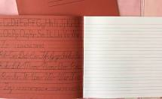
Starter Activity
In your hand writing book you have spellings for the week.
Write each of these words out three times.
Remember your neatest handwriting, we will get to see this next week!

Slide 3
Can you match the punctuation?
.
?
!
Question mark
Full stop
Exclamation mark
Think about the punctuation above, where is a sentence would it be placed?
Discuss with your adult when you use the different pieces of punctuation.

Slide 4
When do we use a full stop?
At the end of a sentence and to finish a point.
Which sentence is correct?
Highlight or underline.
The boy walked slowly.
The boy. walked slowly
.the boy walked slowly.
.
How do you know it is right?
Why did you choose that one?

Slide 5
When do we use a full stop?
Which sentence is correct?
The boy walked slowly.
The boy. walked slowly
.the boy walked slowly.
You should have chosen: The boy walked slowly.
We use a full stop at the end of the sentence to tell the reader we have finished our sentence.
Mini task: Is the sentence below correct? Rewrite this sentence with a correct piece of punctuation.
The girls. skipped to the shop
Ask your adult if you are correct.

Slide 6
When do we use a question mark?
At the end of a question. To tell the reader there is a question being asked.
Which sentence is current?
Highlight or underline.
? Are you okay?
Are you okay?
Are you? okay
?
How do you know it is right?
Why did you choose that one?

Slide 7
When do we use a question mark?
Which sentence is current?
? Are you okay?
Are you okay?
Are you? okay
You should have chosen: Are you okay?
We use a question mark at the end a question to tell the reader we have asked a question.
Mini task: Is the sentence below correct? Rewrite this sentence with a correct piece of punctuation.
Can we please? Buy some sweets
Ask your adult if you are correct.

Slide 8
When do we use an exclamation mark?
At the end of a sentence to show emotions like shouting.
Which sentence is current?
Highlight or underline.
Stop right there!
!stop right there
Stop! right there
!
How do you know it is right?
Why did you choose that one?

Slide 9
When do we use an exclamation mark?
Which sentence is current?
Stop right there!
!stop right there
Stop! right there
You should have chosen: Stop right there!
We use an exclamation mark to show emotions like shouting. And remember, we always place our punctuation at the end of a sentence.
Mini task: Is the sentence below correct? Rewrite this sentence with a correct piece of punctuation.
!On your marks, get set, go
Ask your adult if you are correct.

Slide 10
Task
In your books, there is work stuck in for today.
Check if the punctuation in your books is correct. Can you change the punctuation or would you leave it the same?
Rewrite the sentence with a correct piece of punctuation at the end.
Remember:
We use a full stop to finish a normal sentence.
We use a question mark after a question.
We use an exclamation mark to show emotion like, like shouting.

Slide 11
End of Lesson

Slide 12
Date: Tuesday 29th June 2021
LO To be able to accurately use capital letters.
Subject: English

Slide 13
Starter Activity
In your hand writing book you have spellings for the week.
Write each of these words out three times.
Remember your neatest handwriting, we will get to see this next week!

Slide 14
Can you find all of the Capital letter?
Highlight all of the capital letters. The first one has been done for you.
h
B
n
o
A
m
p
f
S
R
i
D
V
F
e
l
k
j
H
E
g
Y
C

Slide 15
When do we use capital letters?
We use capital letters at the beginning of a sentence.
Look at the two sentences below, which sentence do you think is correct?
Three dogs sat on the couch.
three dogs sat on the couch.
Three dogs sat on the couch.
Well done!

Slide 16
When do we use capital letters?
We use capital letters for the first letter of our name.
Look at the names below, which do you think are correct? Think about how you write your own name.
ali
Ann
tim

Slide 17
When do we use capital letters?
We use capital letters for pronouns like ‘I’.
Like:
I like to eat sweets.
Look at the two sentences below, which sentence do you think is correct?
Joseph and i went to the shops.
Sally and I are best friends.
Tell your adult why you think this.
The correct answer is:
Sally and I are best friends.
Well done!

Slide 18
Your task!
In your book you have a piece of paper that has already been stuck in.
You need to find all of the capital letters that have been written incorrectly in the text.
Circle the corrections and write the right answer underneath!
I cannot wait to see your amazing work next week!

Slide 19
End of Lesson

Slide 20
Date: Wednesday 30th June 2021
LO To be able to recognise verbs in a sentence.
Subject: English

Slide 21
Starter Activity
In your hand writing book you have spellings for the week.
Write each of these words out three times.
Remember your neatest handwriting, we will get to see this next week!

Slide 22
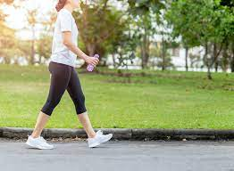
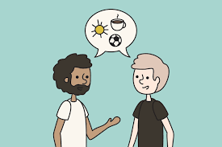
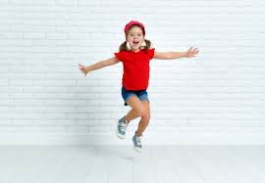
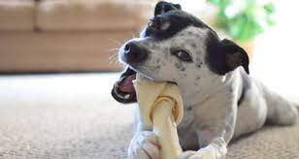
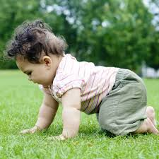
What is a verb?
A verb is a ‘doing word’, so a word we can act out.
Can you act out these words?
Walk
Talk
Jump
Chew
Crawl

Slide 23
Here are more verbs for you to think about.
Maybe you can think of more! Discuss with your adult verbs that are different to mine.
Think
Push
Jump
Pray
Run
Eat
Glue
Press
Talk
Repair
Stand
Slide
Tidy

Slide 24
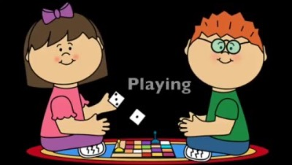
Watch this video

Slide 25
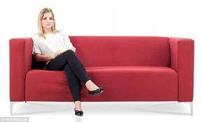
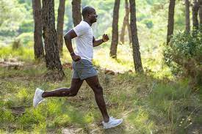
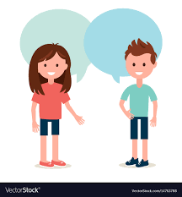
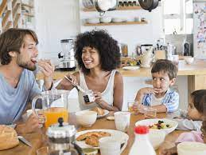
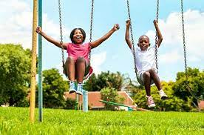
Here are some sentences. Can you find the verb?
We use verbs in sentences to tell the reader what the character is doing.
In there sentences, find the verb that tell the reader what actions the characters are doing.
My sister is sitting on the couch.
The man runs every morning.
Her brother talks a lot.
They eat their breakfast every morning.
I push my friends on the swings.

Slide 26
Here are some sentences. Can you find the verb?
We use verbs in sentences to tell the reader what the character is doing.
In there sentences, find the verb that tell the reader what actions the characters are doing.
My sister is sitting on the couch.
The man runs every morning.
Her brother talks a lot.
They eat their breakfast every morning.
I push my friends on the swings.

Slide 27
Your Task
Great work so far!
In your book, you have sentences stuck in.
Can you find the verbs in the sentences like we did together and underline them.
I can’t wait to see your work on Monday and see how much hard effort you have been putting into your work!

Slide 28
End of Lesson

Slide 29
Date: Thursday 1st July 2021
LO To be able to accurately write full sentences using verbs.
Subject: English

Slide 30
Starter Activity
In your hand writing book you have spellings for the week.
Write each of these words out three times.
Remember your neatest handwriting, we will get to see this next week!

Slide 31
Over the week we have been building our skills in writing sentences.
We have been looking at punctuation.
Capital letters.
And verbs
Now it is time to bring all of these skills together and begin writing sentences using verbs.

Slide 32
Punctuation
Where do we find the punctuation?
At the end of a sentence.
Full stop.
My sister is sitting on the couch.
Do we always need to use a piece of punctuation at the end of a sentence?
Yes.
Exclamation mark
Stop right there!
When do we use a full stop?
At the end of a simple sentence to tell the reader we have finished our point.
When do we use an exclamation mark?
At an expression as emotion like shouting.
Question Mark
Can I have help please?
When do we use a question mark?
At the end of the sentence and to tell the reader that we have written a question.

Slide 33
Why do we use Capital Letter?
At the beginning of a sentence.
The first letter of a name.
I like to eat sweets.
The pronoun ‘I’.

Slide 34
Verbs
What is a verb?
Can you give me some example of verbs?
Can you use the verbs in a sentence?
A verb is a doing word or an action word.
Walk / talk / sing / dance…
Everyday I walk to school.

Slide 35
Here are some sentences. Can you find the verb?
We use verbs in sentences to tell the reader what the character is doing.
In there sentences, find the verb that tell the reader what actions the characters are doing.
My sister is sitting on the couch.
The man runs every morning.
Her brother talks a lot.
They eat their breakfast every morning.
I push my friends on the swings.

Slide 36
Today’s task
In your books you have some sentences starters containing verbs.
It is your task to complete the sentences with the correct punctuation and capital letters.
Remember the sentences need to make sense and use this presentation to help you if you forget anything.

Slide 37
End of Lesson

Slide 38
Date: Friday 2nd July 2021
LO To be able to write sentences using your spellings for the week.
Subject: English

Slide 39
Starter Activity
In your hand writing book you have spellings for the week.
Write each of these words out three times.
Remember your neatest handwriting, we will get to see this next week!

Slide 40
Spelling Time
Now that you have been practicing your spellings throughout the week, it is your task to show me what you can do.
Your task today is to write each of your spelling words into a sentence.
Ask your adult for help with your spelling of other words.
Remember your skills this week of punctuation and capital letters, so I expect to see this correct in your work.
Great work this week! I cannot wait to mark your books!

Slide 41
End of Lesson

