Slide 1
Subject: Maths
Pack: A

Slide 2
Date: 22.02.21
L.O: To be able to identify the place value of decimal numbers.
Subject: Maths

Slide 3
Mental Starter: Identify the place value of the digit underlined
E.G 1720 = 20
12,893
124, 512
221, 601
156,059
131, 240
7,251,820
1,342,924
2,578, 135
12,245,831
42,927,628
Practise saying the number out loud when answering the question.
E.G One thousand, seven hundred and twenty.

Slide 4
Mental Starter: Identify the place value of the digit underlined
E.G 1720 = 20
12,893 = 90
124, 512 = 500
221, 601 = 20,000
156,059 = 0
131, 240 = 1000
7,251,820 = 7, 000, 000 (7 million)
1,342,924 = 40,000
2,578, 135 = 500, 000
12,245,831 = 10, 000, 000 (10 million)
42,927,628 = 900,000
Make any corrections which are needed.

Slide 5
Pre-recorded Teaching
Access the online teaching video below that will support you to complete the work in this lesson. This video will act as a support but all of the work can still be successfully understood & completed using paper-based versions of this pack. If you need further support to understand / complete work then please contact school via e-mail or telephone.
Play Video
Play the video from 4mins.
You can also copy and paste this link if you would prefer:
https://teachers.thenational.academy/lessons/recognising-decimal-tenths-part-1-ctgkcd

Slide 6
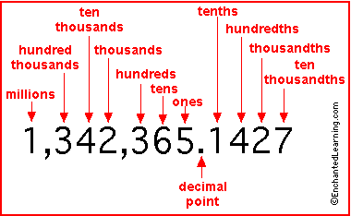
What are decimal numbers?
A decimal is a way of writing a number that is not whole.
Decimal numbers are 'in between' numbers. For example, 10.4 is in between the numbers 10 and 11. It is more than 10, but less than 11.
Take care when reading the values of decimal numbers:
4.2 means 4 and 2 tenths.
Today we will just be focusing on tenths as decimal numbers, known as 1 decimal place (1DP).

Slide 7
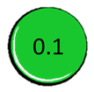
1 Decimal Place
The first digit after a decimal point is known as tenths.
1 whole is equal to 10 tenths.
E.G 1.2 = 1 whole and 2 tenths
We would say the number as one point two.

Slide 8
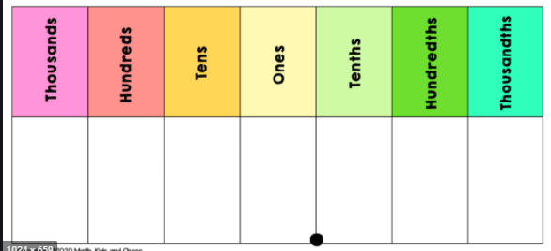
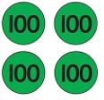
Representing other numbers to 1 D.P
Lets look at other numbers, the decimal numbers will not effect the whole digits (as long as there are no more than 10 tenths as remember 10 tenths= 1 whole).
E.G 1432.6
We would say one
Thousand, four
hundred and thirty- two
point six.

Slide 9
Lets have a try at creating a number to 1 D.P together.
3521.3
We would say this number as:
Three thousand, five hundred and twenty-one point three.

Slide 10
Now you try:
Draw the place value counters to represent the number and say it out loud.
3759. 8
You can just draw and
colour circles to represent
the place value counters.

Slide 11
Representing numbers to 2 decimal places
4.26 means 4 and 2 tenths and 6 one-hundredths.
If the hundredths was a zero, the zero does not need to be there
E.G 4.20 the number is 4 and 2 tenths.
Here is another example:
4.06 means 4 and 0 tenths and 6 one-hundredths.

Slide 12
Lets try this:
Write down the number represented in the place value chart:

Slide 13
0
1
2
0.12

Slide 14
Lets look at an example:
The number represented is 1.12
We say one point one, two.
What is the value of the underlined digit?
1.12 = 2 hundredths
Here the number represented is
2.23
We say two point two, three.
What is the value of the underlined digit?
2.23 = 3 hundredths

Slide 15
What is the value of the underlined digit?
24.89
You can draw the place value
counters if it helps.
When we say the number it is twenty-four point eight, nine.
The 9 is underlined, the 9 represents hundredths.
= 9 hundredths.

Slide 16
Write down the value of the underlined digit
356.81

Slide 17
Write down the value of the underlined digit
356.81
The digit underlined is 1 hundredth

Slide 18
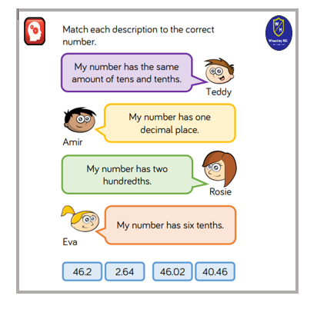
Write down the value of the underlined digit
245.64 Extension:
341.52
429.01
612.20
568.91
782.17
456.82
901.06

Slide 19
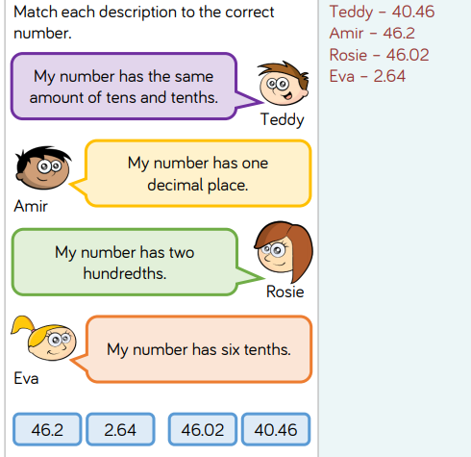
Lets check:
245.64 = 4 hundredths
341.52 = 5 tenths
429.01 = 0 tenths
612.20 = 0 hundredths
568.91 = 9 tenths
782.17 = 7 hundredths
456.82 = 8 tenths
901.06 = 6 hundredths

Slide 20
Times-table practise
Spend at least 15mins practising your times-tables.
This can be done on TTRS, hit the button or any other times-table website.
Use the Times-Tables Rock Stars app or website.
Alternatively, copy and paste the following link into a web browser:
https://www.topmarks.co.uk/maths-games/7-11-years/times-tables

Slide 21
End of Lesson

Slide 22
Date: 23.02.21
L.O: To be able to identify the place value of decimal numbers.
Subject: Maths

Slide 23
3 decimal places
1 D. P = tenths
2 D.P = hundredths
3 D.P = thousandths
10 thousandths make 1 hundredth.
Thousandths have a smaller value than hundredths.
100 thousandths make 1 tenth.
If 4 tenths = 0.4, 4 hundredths = 0.04, what is 4 thousandths?
0.004

Slide 24
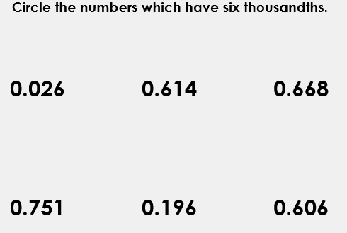
The place value chart represents the number 0.134
Visualise the numbers on the place value
chart to help you.
Task: Circle the numbers which have six
thousandths

Slide 25
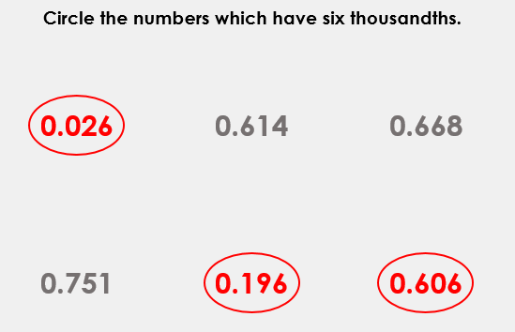

Slide 26
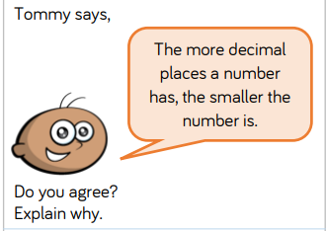
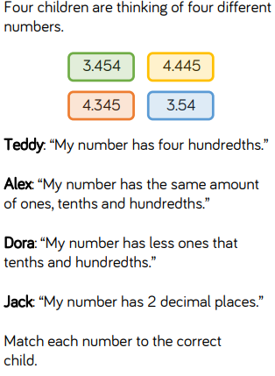
Write down the value of the underlined decimal number:
245. 902
312.234
451.451
623.120
802.829
240.123

Slide 27
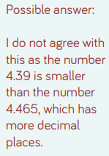
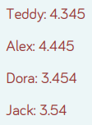
Lets check your answers:
245. 902= 9 tenths
312.234= 3 hundredths
451.451= 1 thousandths
623.120=0 thousandths
802.829 = 2 hundredths
240.123 = 1 tenth

Slide 28
Times-table practise
Spend at least 15mins practising your times-tables.
This can be done on TTRS, hit the button or any other times-table website.
Use the Times-Tables Rock Stars app or website.
Alternatively, copy and paste the following link into a web browser:
https://www.topmarks.co.uk/maths-games/7-11-years/times-tables

Slide 29
End of Lesson

Slide 30
Date: 24.02.21
L.O: To be able to compare decimal numbers.
Subject: Maths

Slide 31
Mental Starter: Write down the value of the underlined decimal numbers
563.922
342.014
561.905
419.216
789.123
452.568

Slide 32
Mental Starter: Write down the value of the underlined decimal numbers
563.922 = 2 thousandths
342.014 = 1 hundredth
561.905 = 9 tenths
419.216 = 1 hundredth
789.123 = 3 thousandths
452.568 = 5 tenths

Slide 33
Pre-recorded Teaching
Access the online teaching video below that will support you to complete the work in this lesson. This video will act as a support but all of the work can still be successfully understood & completed using paper-based versions of this pack. If you need further support to understand / complete work then please contact school via e-mail or telephone.
Play Video
Play the video from 3mins 30seconds.
You can also copy and paste this link if you would prefer:
https://teachers.thenational.academy/lessons/comparing-decimals-61j38d

Slide 34
Comparing numbers:
When comparing decimals, it is just like when we compare whole numbers.
We need to look at the digits to decide which number is bigger/ smaller.
E.G whole numbers- which is bigger 26 or 124?
We compare the digits and their place value. We can see 124 is bigger because it has 1 hundred, unlike 26 which has 0 hundreds, therefore making it the bigger number. Both numbers have the same number of tens (2 tens) and 26 has 6 ones which is more than 4 ones in 124. But this does not matter because of the early identified 1 hundred.

Slide 35
Comparing decimal numbers…
When comparing 0.7 with 1.3 we can place the numbers on a number line. Because 1.3 has 1 whole it is larger than 0.7 as it has 0 whole numbers, we know 1 is bigger than 0 within the number system.
When comparing the two numbers on a place value chart we can see clearly 1.3 is larger.

Slide 36
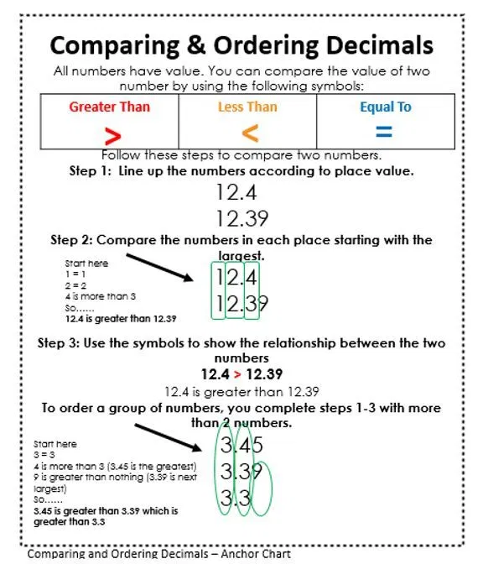
Here is a prompt sheet to support with comparing and ordering decimal numbers.

Slide 37
What about 0.6 and 0.8?
Because they both have 0 whole numbers, we need to look at the next digit which is tenths.
We know 8 is bigger than 6 which helps us to know 0.6 is smaller than 0.8 because 8 is larger.

Slide 38
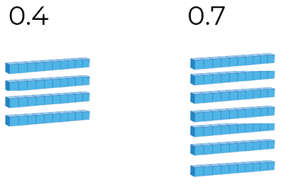
Which is greater 0.4 or 0.7?
Where would the numbers be positioned on the number line?
Both numbers have 0 ones.
Look at the tenths. Which digit is greater? 4 tenths or 7 tenths?
0.7
0.4

Slide 39
Answer:
0.7 is greater than 0.4
0.7 > 0.4
Remember < >
more than > less than

Slide 40
0.8 or 1.7?
____ > _____

Slide 41
1.7 > 0.8
1.7 is greater because it has 1 whole number compared to 0 for 0.8

Slide 42
What about 2 decimal places?
Just like with whole numbers, if all the digits are the same we progress through the digits (down in digit place value) until the digits differ.
E.G 134.72 134.75
As the digits are the same in each number we need to compare the hundredths.
Here we can see the difference between the digits to help us to decide which number is bigger. As 5 is larger than 2, we know 134.75 > 134.72

Slide 43
Which is greater 12.45 or 12.54?
Both the tens and ones are the same in each number: 12.45 12.54
So, we need to look at the tenths: 12.45 12.54
Which is bigger 4 tenths or 5 tenths?
Write down the bigger number _______ > _______ smaller number

Slide 44
Which is greater 12.45 or 12.54? 12.54 > 12.45 12.54 is greater than 12.45

Slide 45
What about numbers with 3 decimal places?
As with the previous numbers, if all the previous digits are of the same value we need to look at the thousandths and identify which has the larger value.
E.G 345.451 345.452
1 thousandth 2 thousandths 2 is greater than 1
345.451 < 345.452 345.451 is less than 345.452

Slide 46
Which is smaller 56.732 or 56.736
56.732 56.736
The red digits are all the same so we need to look at the thousandths and identify which is smaller.
.002 or .006
Write the smaller number_____ < _____ Write the larger number

Slide 47
Which is smaller 56.732 or 56.736? 56.732 < 56.736 56.732 is less than 56.736

Slide 48
Use < > symbols to compare the numbers
345.21 ____ 345.12
129.02 ____ 129.20
562.019 ____ 562.19
480.126 ____ 480.124
134.232 ____ 134.23
902.003 ____ 902.3
12.902 ____ 12.920
629.531 _____ 629.053

Slide 49
Check your answers:
345.21 > 345.12
129.02 < 129.20
562.019 < 562.19
480.126 > 480.124
134.232 > 134.23
902.003 < 902.3
12.902 < 12.920
629.531 > 629.053

Slide 50
Times-table practise
Spend at least 15mins practising your times-tables.
This can be done on TTRS, hit the button or any other times-table website.
Use the Times-Tables Rock Stars app or website.
Alternatively, copy and paste the following link into a web browser:
https://www.topmarks.co.uk/maths-games/7-11-years/times-tables

Slide 51
End of Lesson

Slide 52
Date: 25.02.21
L.O: To be able to order decimal numbers.
Subject: Maths

Slide 53
Mental Starter:
Match the correct card to the underlined digit.

Slide 54
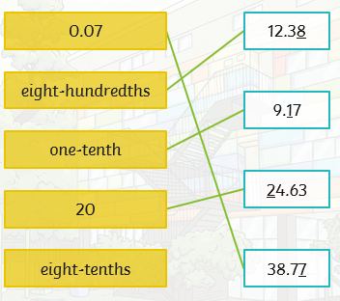
Check your answers.

Slide 55
Here is a prompt sheet to support with comparing and ordering decimal numbers.

Slide 56
Pre-recorded Teaching
Access the online teaching video below that will support you to complete the work in this lesson. This video will act as a support but all of the work can still be successfully understood & completed using paper-based versions of this pack. If you need further support to understand / complete work then please contact school via e-mail or telephone.
Play Video
You can also copy and paste this link if you would prefer:
https://teachers.thenational.academy/lessons/ordering-decimals-6gt66r

Slide 57
0.1 0.2 0.3 0.4 0.5 0.6 0.7 0.8 0.9
42.1 42.3 42.3 42.4 42.5 42.6 42.7 42.8 42.9
Recap: In between whole numbers, we have decimal numbers as the examples show. The first digit after the decimal point is known as tenths. When we say the decimal numbers out loud we say point 1, point 2 etc.

Slide 58
Ordering decimal numbers
First we need to compare the value of the digits and which is greater or smaller. If the digits we are comparing are the same, we need to look at and compare the next digit.
All the numbers have a 0 in the ones so we need to look at the tenths.
These examples have 0 tenths and 1 tenths. O is the smallest then 1 tenth.
These examples all have 4 tenths so we need to look at the hundredths

Slide 59
We need to compare those with 4 tenths to decide which is larger.
0.4 can be wrote as 0.40 to help with comparing against 0.41 and 0.42.
When we look at the representations, we can see 0.42 is larger because it has more cubes.
Smallest: 0.04 0.14 0.4 0.41 0.42 Largest

Slide 60
First look at the whole numbers, can this help with ordering?
Now look at the tenths, which has the largest tenth? Which has the smallest tenth?
If any have the same number of tenths, look at the hundredths and identify which is larger.
Largest: Smallest
_______ _______ ________ ________

Slide 61
Lets check our answers:
Largest: Smallest
0.625 0.562 0.526 0.256
This number had 6 tenths which was the most tenths, making it the largest.
Both these numbers had 5 tenths, we needed to look at the hundredths. As 6 is larger than 2, 0.562 was the second largest number.
This number had 2 tenths which was the least tenths, making it the smallest.

Slide 62
Order these numbers:
Smallest Largest
_________ ____________ ___________

Slide 63
Order these numbers:
Smallest Largest
0.02 2.07 2.72
Because it had 0 ones and 0 tenths, this number was the smallest
These numbers both have 2 ones, so we needed to look at the tenths.
The middle number has 0 tenths and the largest has 7 tenths, so as 0 is less than 7 it can not be the largest number.

Slide 64
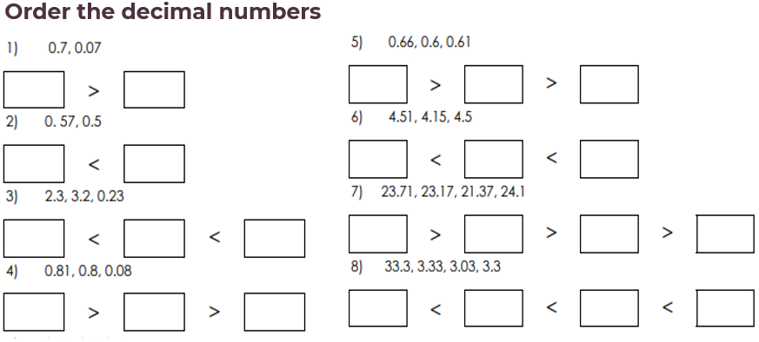
Look closely at the value of each digit to help order them correctly.

Slide 65
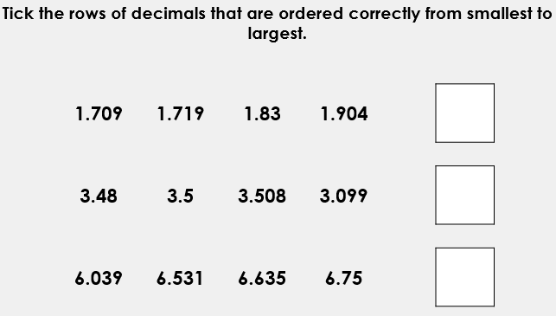
Extension:

Slide 66
Lets check the answers…
0.23 2.3 3.2
0.7 0.07
0.5 0.57
4.15 4.5 4.51
0.23 2.3 3.2
24.1 23.71 23.17 21.37
0.81 0.8 0.08
3.03 3.3 3.33 33.3

Slide 67
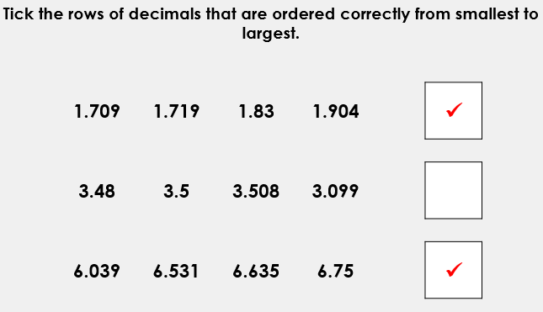
Lets check the answers…

Slide 68
Times-table practise
Spend at least 15mins practising your times-tables.
This can be done on TTRS, hit the button or any other times-table website.
Use the Times-Tables Rock Stars app or website.
Alternatively, copy and paste the following link into a web browser:
https://www.topmarks.co.uk/maths-games/7-11-years/times-tables

Slide 69
End of Lesson

Slide 70
Date: 26.02.21
L.O: To be able to solve reasoning problems involving decimal place value.
Subject: Maths

Slide 71
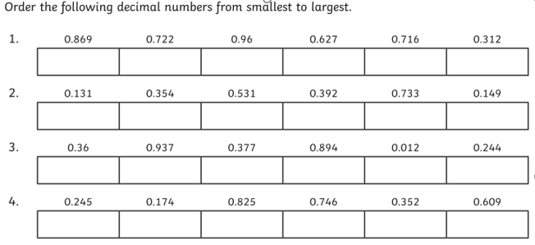
Mental Starter

Slide 72
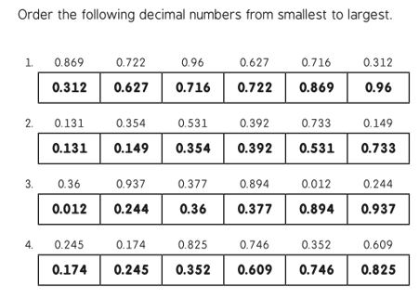
Lets check your answers:

Slide 73
Problem solving and reasoning tasks…
Complete the problem solving and reasoning tasks. Read the questions carefully and apply the knowledge you have learned during the week.

Slide 74
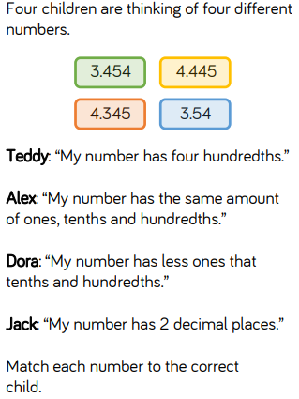
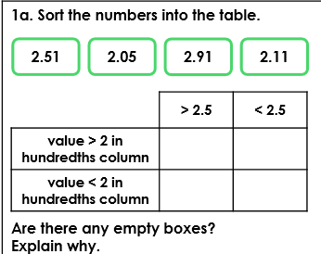

Slide 75
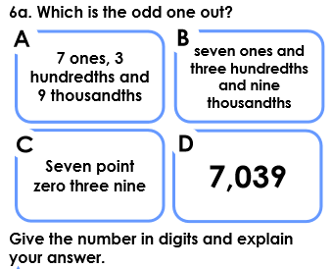

Slide 76
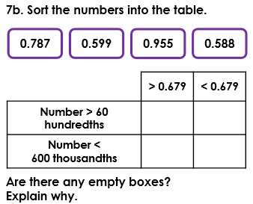

Slide 77
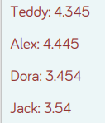
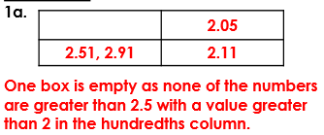
Lets check your answers:

Slide 79
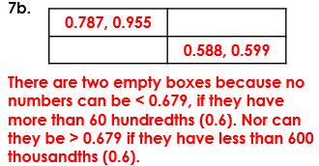

Slide 80
Times-table practise
Spend at least 15mins practising your times-tables.
This can be done on TTRS, hit the button or any other times-table website.
Use the Times-Tables Rock Stars app or website.
Alternatively, copy and paste the following link into a web browser:
https://www.topmarks.co.uk/maths-games/7-11-years/times-tables

Slide 81
End of Lesson

