Slide 1

Subject: English
Pack: A

Slide 2

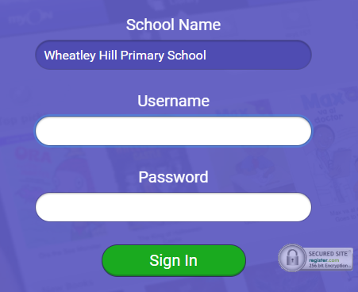
https://www.myon.co.uk/index.html
Remember to use myon for online reading
Example login -
Username
DavidW
Password
password1

Slide 3


Monday 1st March
L.O To be able to answer questions based on a text
Subject: English

Slide 4
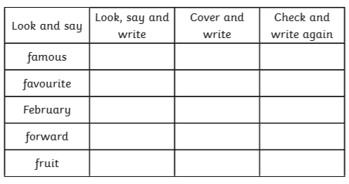
L.O To be able to spell words from the Y3/4 word list

Slide 5
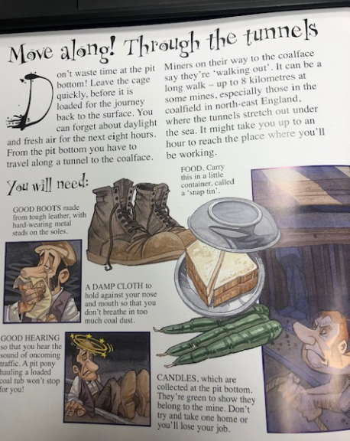

Read through the information.
There is also a recording
of this on the Pathfinders pages :)
Food. Carry this in a little container called a ‘snap tin’
Good boots made from tough leather, with hard-wearing metals studs on the soles.
A damp cloth to hold against your nose and mouth so you don’t breathe in too much coal dust.
Candles, which are collected at the pit bottom. They’re green to show they belong to the mine. Don’t try and take one home or you’ll lose your job!
Good hearing so that you hear the sound of oncoming traffic. A pit pony hauling a loaded coal tub won’t stop for you!

Slide 6
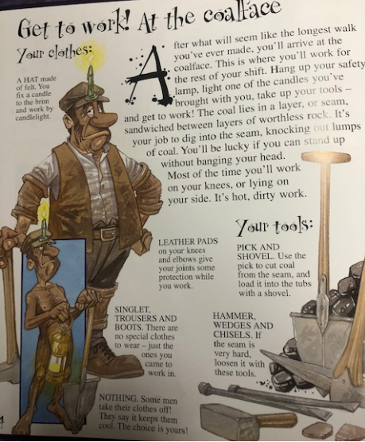
A hat made of felt. You fix a candle to the brim and work by candlelight.
Leathers pads on your knees and elbow give your joints some protection while you work
Pick and shovel. Use the pick to cut coal from the seam and load it into the tubs with a shovel.
There are no special clothes to wear- just the ones you came to work in.
Hammer, wedges and chisels. If the seams is very hard, loosen it with these tools.
Some men take their clothes off! They say it keeps them cool.

Slide 7

Remember to answer in full sentences. 1-4 answers found on first page of writing
How many hours do they spend in the mine?
____________________________________________________________________________________________________________________________________________________________________________________
How long could it take to walk to the coalface and where are some mines found?
________________________________________________________________________________________________________________________________________________________________________________________________________
3. List the things they needed to take with them to work.
________________________________________________________________________________________________________________________________________________________________________________________________________
4. Why were the candles green?
____________________________________________________________________________________________________________________________________________________________________________________

Slide 8
Remember to answer in full sentences. 5-7 answers found on the second page of writing
5. Where is the coal found?
____________________________________________________________________________________________________________________________________________________________________________________
6. How is the coal removed?
________________________________________________________________________________________________________________________________________________________________________________________________________
Why would it be so uncomfortable being down the mine?
_______________________________________________________________________________________________________________________________________________________________________________________________________

Slide 9
Tuesday 2nd March
L.O To be able to use pronouns
Subject: English

Slide 10
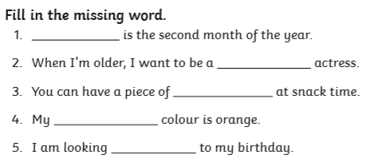
L.O To be able to spell words from the Y3/4 word list

Slide 11

Pre-recorded Teaching
Access the online teaching video below that will support you to complete the work in this lesson. This video will act as a support but all of the work can still be successfully understood & completed using paper-based versions of this pack. If you need further support to understand / complete work then please contact school via e-mail or telephone.
Play Video
https://teachers.thenational.academy/lessons/to-explore-pronouns-cmvkjr

Slide 12

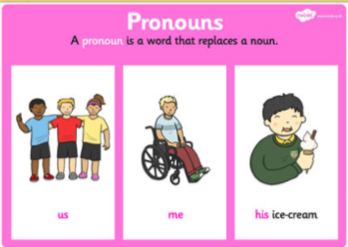
A pronoun is a word used to replace a noun.
Examples of pronouns are: he, she, it, they. We use pronouns so that we don't need to keep repeating the same nouns; for example, rather than repeat the noun 'the car' in this sentence, we use a pronoun (in bold):
We took the car to the garage because the car needed fixing.
We took the car to the garage because it needed fixing.

Slide 13

Personal Pronoun
A personal pronoun is a word which can be used instead of a person, place or thing.
There are twelve personal pronouns for people: I, you, he, she, it, we, they, me, him, her, us and them.
There are three personal pronouns for things: they, them, it.
Personal pronouns allow you to avoid repeating a word and to refer to someone already mentioned. If the noun is plural, so is the pronoun which replaces it.
_____________________________________________________________________________________________
Read these examples
The men took a Davy lamp to the mine, it warned them if there was going to be an explosion.
The men took a Davy lamp to the mine, the Davy lamp warned the men if there was going to be an explosion.
Which sentence sounds better and why?

Slide 14
Possessive Pronoun
Possessive pronouns are used to show ownership of a person or thing.
Some can be used on their own (mine, yours, his, hers, ours, theirs, whose); others must be used with a noun (my, your, his, her, its, our, their, whose).
Possessive pronouns are used to avoid repetition of the noun.
_____________________________________________________________________________________________
Read these examples
The owner charged the workers to use the owner’s candles.
The owner charged the workers to use his candles.
Which sentence sounds better and why?

Slide 15
Underline the pronouns in the following sentences. (clue- there may be more than 1)
The men had a candle in their hat to help them see.
The miner worked in very difficult conditions and had to be careful not to bump his head.
‘Come on!’ shouted the miner. ‘It’s time to have our break’.

Slide 16
Now try write sentences of your own containing pronouns.
my, yours, ours, his, her, their, you, us, me, he, she
4._______________________________________________________________________________________________________________________________
5._______________________________________________________________________________________________________________________________
6._______________________________________________________________________________________________________________________________

Slide 17
Wednesday 3rd March
L.O To be able to plan a non-chronological reports
Subject: English

Slide 18
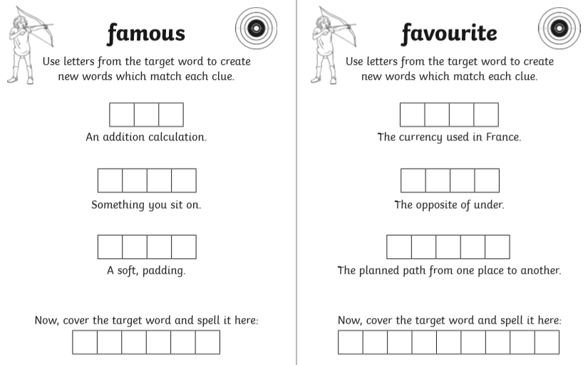
L.O To be able to spell words from the Y3/4 word list

Slide 19
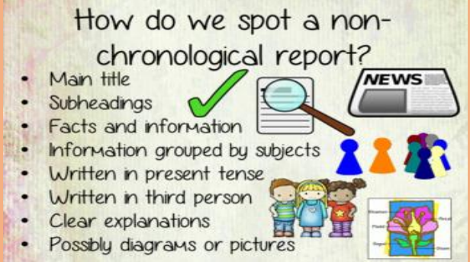
Remember last week we looked at the features of a non-chronological report.
Ours will be in past tense today as we are talking about a historic topic

Slide 20
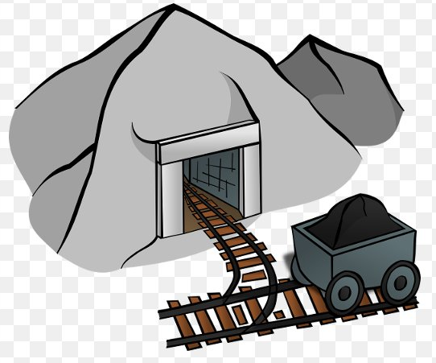
The main title is used to catch the reader’s attention as well as let the reader know what the report will be about.
Titles need to be short, to the point and catchy. They sometimes use alliteration where the words begin with the same letter.
e.g. Digging Deep Down, Collecting Coal,
Dangerous Digging, Mind that Mine!
Deep, Dark and Dangerous!
You can use one of these for your own report or it would be fantastic if you can write one of your own!
_________________________________________________
_________________________________________________

Slide 21
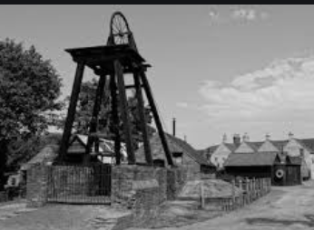
https://www.youtube.com/watch?v=HW0bmD7UESQ
Watch this video to remind you about the Victoria coal mines.
Today we are going to be planning a report to help us write tomorrow. I will give you a list of subheadings that we could include in our writing.
Children in the Mines
Dangerous Conditions
Mining Equipment
Mining in Wheatley Hill
Use all the information from the English work you have done as well as using
facts you have learnt in history lessons :)

Slide 22
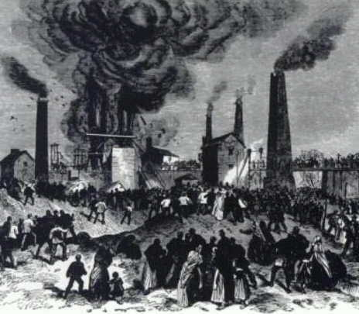
Remember that we are only planning today so we don’t need to write full sentences. We will use the planning from today to help us write paragraphs tomorrow.
We will do 1 together now using one of the subheadings.
Dangerous Conditions
Dark, dirty, dangerous
No daylight
Small spaces- have to bend down
Shaft- noisy, windy, eardrums burst
Coal dust in lungs
Did you know that workers were expected to work 12 hours a day,
6 days a week!

Slide 23
Now pick one of the other subheadings to write your own notes for it
__________________________________________
Did you know
Subheading
Add an extra did you know fact to go in your paragraph. It could be one we have already learnt or one
you have found yourself!

Slide 24
Now pick one of the other subheadings to write your own notes for
__________________________________________
Did you know
Subheading

Slide 25
Thursday 4th March
L.O To be able to write a non-chronological report
Subject: English

Slide 26
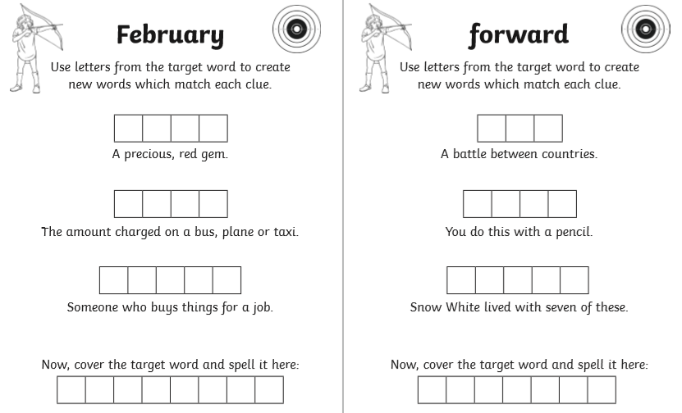
L.O To be able to spell words from the Y3/4 word list

Slide 27

Remember that we planned our non-chronological reports yesterday so that should make our work easier today.
Here is a check list of what you should include in your writing today.
Main title
Subheadings
Information/facts
Conjunctions (because, but, however, so, although)
Did you know fact
Past tense

Slide 28
Title
In the Victorian times, coal was the main source of power so coal mining was a very important job. It was a ______________________ , __________________ job and even children as young as 4 were made to work.
Read on to find out more about the ____________ , ____________ mines.
Introduction

Slide 29
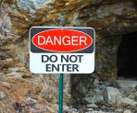
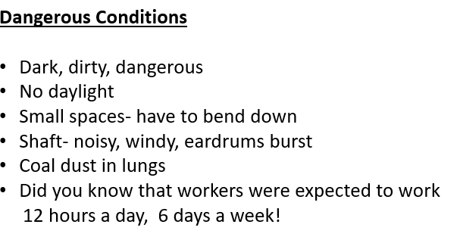
Dangerous Conditions
Working in the mines was an extremely dangerous, terrible place to work. The mines were small, tight spaces ____ the workers had to spend the main part of the day bent down. This caused them to have awful back problems, as well as having to be very careful not to bump their heads. The miners also suffered with breathing issues because the mines were dirty and filled with dust. ___________________________________________________________________________________________________________________________________________________________________________________________________
For today’s job you can use the notes from yesterday to put into full sentences.

Slide 30
_________________________
_______________________________________________________________________________________________________________________________________________________________________________________________________________________________________________________________________________________________________________________________________________________________________________________________________________________
Now look back to the planning you did yesterday and write your own sentences. Remember to look at the check list so you know what to add.
Paragraph 1

Slide 31
_________________________
_______________________________________________________________________________________________________________________________________________________________________________________________________________________________________________________________________________________________________________________________________________________________________________________________________________________
Now look back to the planning you did yesterday and write your own sentences. Remember to look at the check list so you know what to add.
Paragraph 2

Slide 32

Friday 5th March
L.O To be able to celebrate World Book Day.
Subject: English

Slide 33


Slide 34

Read your favourite book.
Read a story to a sibling or parent
Dress up as a character!
Make a
reading den.
Today we are celebrating World Book Day, here are some thing you could do today!
Draw your
Favourite character!
Design a book cover
Write a book review.

Slide 35
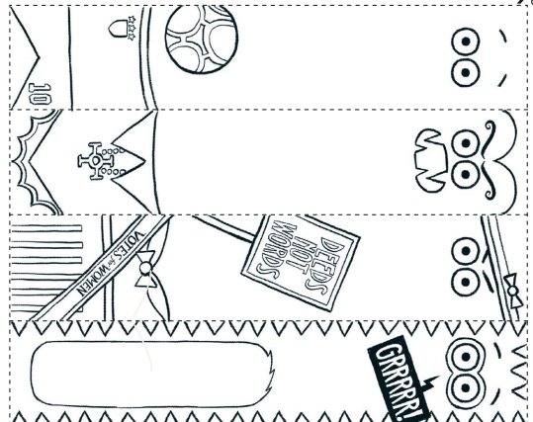
Make a bookmark!

Slide 36
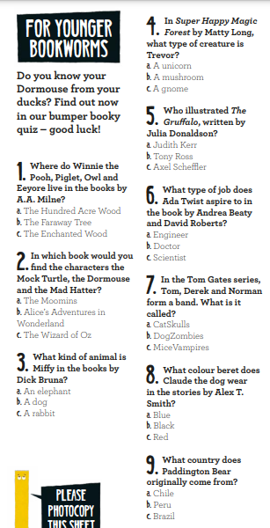
Quiz!

Slide 37
Quiz!

Slide 38
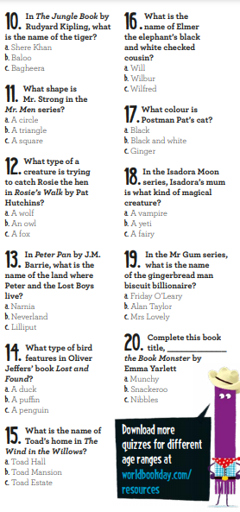

Slide 39

Well done for all your home learning.
We can’t wait to see you next week!

