Slide 1
Date: Tuesday 5th – Friday 8th January
L.O To be able to spell words from the Year 3 / 4 spelling list
Subject: English

Slide 2
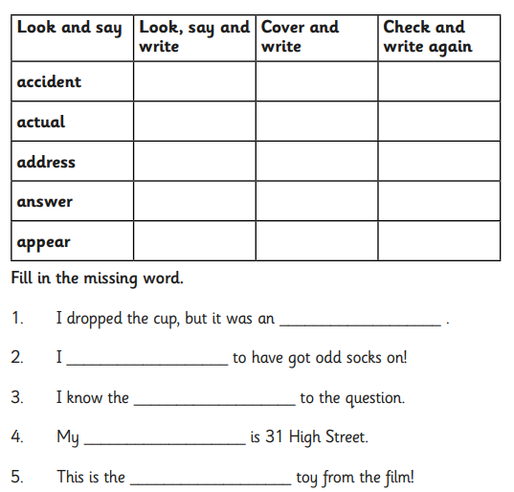
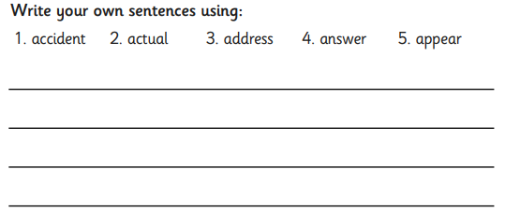
Try and practise these words
every day :)
Spelling game-
http://www.ictgames.com/mobilePage/spookySpellings/index.html

Slide 3
Date: Tuesday 5th January
L.O To be able to answer questions based on a text
Subject: English

Slide 4
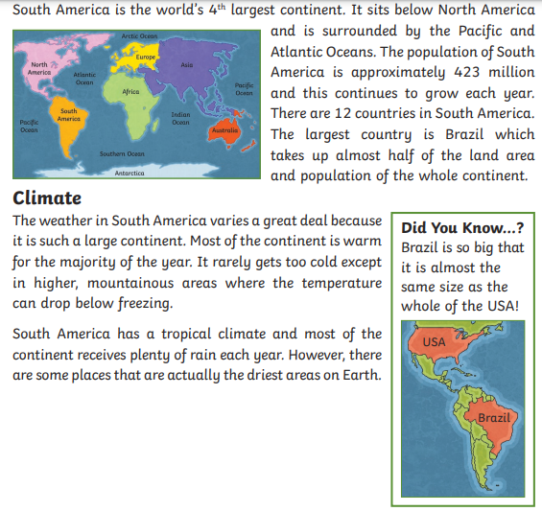
Part 1
Read through the information on this page

Slide 5
Answer the questions in full sentences, the first one has been done for you.
Which oceans surround South America
South America is surrounded by the Atlantic and Pacific Ocean.
How many countries are in South America?
____________________________________________________________________
3. Which is the largest country in the continent?
____________________________________________________________________
Describe what the weather is like in South America?
____________________________________________________________________

Slide 6
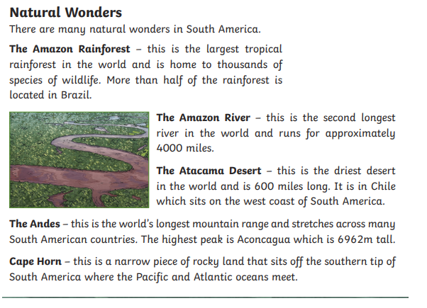
Part 2
Read through the information on this page

Slide 7
5. How long is the Amazon River?
____________________________________________________________
6. Which country is the Atacama Desert in?
____________________________________________________________
7. What is Cape Horn?
____________________________________________________________
8. Which natural wonder in South America would you like to visit and why?
_______________________________________________________________________________________________________________________________________________________________________________________

Slide 8
Date: Wednesday 6th January
L.O To be able to write descriptive sentences
Subject: English

Slide 9
Try and practise these words
every day :)
Spelling game-
http://www.ictgames.com/mobilePage/spookySpellings/index.html

Slide 10
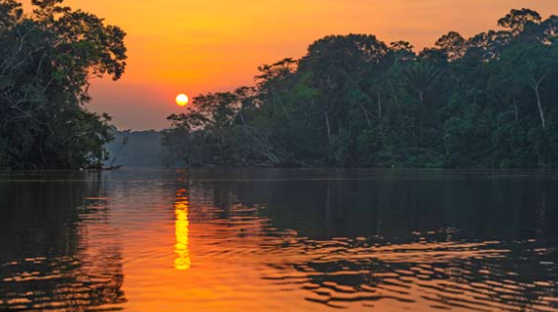
The Amazon River
The Amazon River is the largest river in the world by the amount or volume of water it carries. It flows through the tropical forests of South America, mainly in Brazil.

Slide 11
Adjectives are describing words.
Think of a list of words to describe what you
can see in the picture.
Impressive
Sun
Trees
Bright
Towering
Sky
Calm
Breath taking
Water/river
Remember to put a comma between your two describing words?

Slide 12
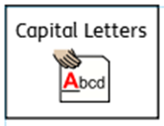
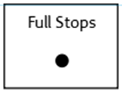
Use the adjectives you have came up with to write descriptive sentences
Write 5 descriptive sentences.
Don’t forget:
The beautiful, bright sun is reflecting on the peaceful, still Amazon River.

Slide 13
Date: Thursday 6th January
L.O To be able to write sentences using ly openers
Subject: English

Slide 14
Try and practise these words
every day :)
Spelling game-
http://www.ictgames.com/mobilePage/spookySpellings/index.html

Slide 15
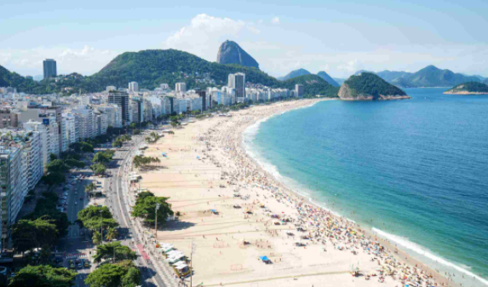
Ly openers
Ly openers are adverbs that go at the start of a sentence (fronted adverbials).
An adverb describes a verb
e.g. runs quickly, skips happily
Write a list of ly opener.
I have started you off.
Slowly
Gently
Happily
Joyfully
____________
____________
____________
____________
____________
____________
Rio de Janeiro (Brazil)

Slide 16
Ly openers
Ly openers are adverbs that go at the start of a sentence (fronted adverbials).
An adverb describes a verb
e.g. runs quickly, skips happily
Use the list of ly openers to write
sentences.
Try and write 5 sentences
of your own.
Peacefully, the crystal-clear sea
glides over the soft, sandy beach.
________________________________________________________________________________________________________________________________________________________________________________________________________________________________________________________________________________________________________________
Rio de Janeiro (Brazil)
Remember commas after your opener!

Slide 17
Date: Friday 8th January
L.O To be able to describe a picture using senses
Subject: English

Slide 18
Try and practise these words
every day :)
Spelling game-
http://www.ictgames.com/mobilePage/spookySpellings/index.html

Slide 19
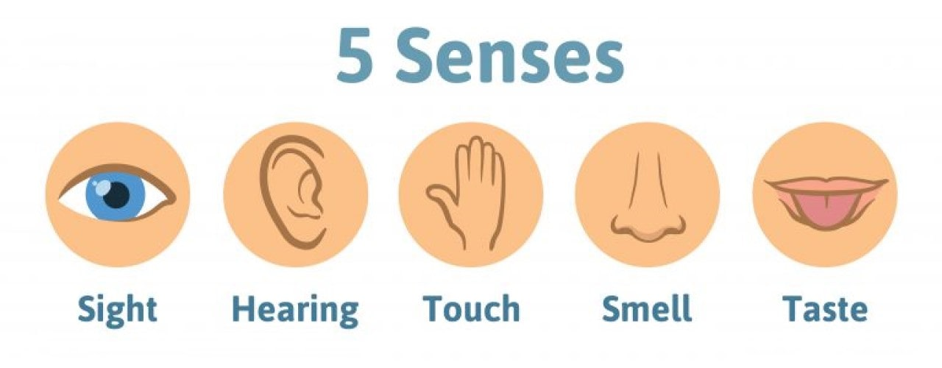
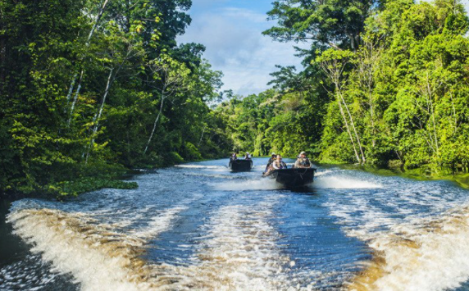
Imagine you are on a boat sailing through the Amazon River.
Think about your senses and how would feel.

Slide 20
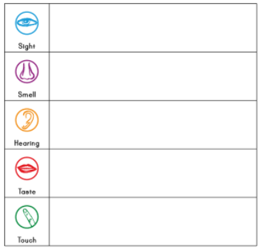
Tall trees towering above heads
The wet leaves on the forest floor.
The birds loudly squawking above
Try and fill out these boxes with what you would experience if you were on this exciting journey.
Some are much easier than others.
Cold water splashing my face.
The smooth ripples of the water.

Slide 21
Now write a paragraph describing your journey down the river. The first 2 sentences have been done for you.
Remember to include-
Above my head, I could hear the birds squawking loudly and the trees rustling in the hot breeze. Carefully, I reached out of our small boat and touched the smooth ripples of the water, it felt ______________ and ______________. The __________ sun shone down on the _________________________________________________________________________________________________________________________________________________________________________________________________________________________________________________________________________________________________________________________________________________

