Slide 1
Date: 5.1.2021
L.O To be able to count in multiples.
Go to Times Tables Rock Stars to warm up your number brain before you start your maths activity.
Subject: Maths

Slide 2
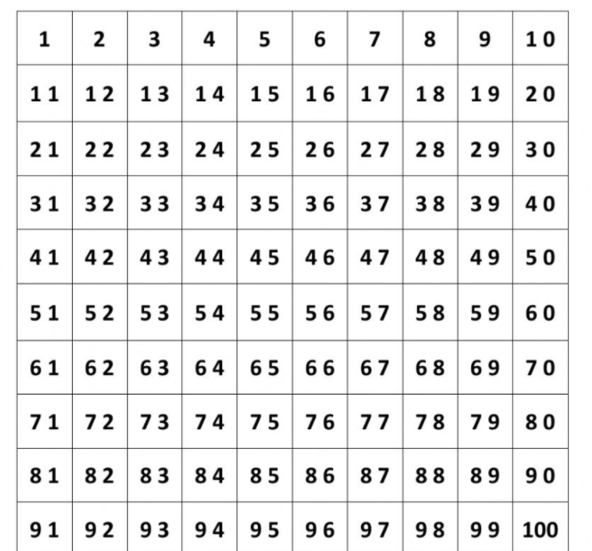
When you count in equal steps that is called counting in multiples .
Counting in multiples of 6 will start like this; 6 12 18 24 …
Colour all the multiples of 6 in one colour and all the multiples of 7 in a different colour.
Subject: Maths

Slide 3
Complete the number sequences by counting on in jumps of 6 or 7 .
1. ______ 12 18 24 ______
2. 24 ______ 36 ______ 48
3. 42 ______ 30 ______ 18
4. _______ ________ 18 _______ ________
5. 60 ______ 48 ______ _______
6. 7 _____ 21 ______ 35
7. _____ 28 ______ 42 _______
8. 49 _____ 35 ______ 21
9. 14 _______ ______ 35 ________
10. 70 ______ 56 ______ 42 ______
Tip: Count on or back from the last number. Use the number square on the last page to help.
Subject: Maths

Slide 4
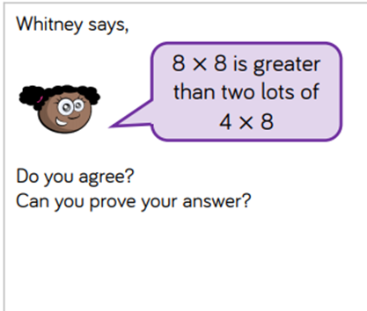
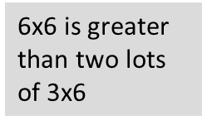
Try these challenges.
Subject: Maths

Slide 5
Date: 6.1.2021
L.O To be able to count in multiples.
Go to Times Tables Rock Stars to warm up your number brain before you start your maths activity.
Subject: Maths

Slide 6
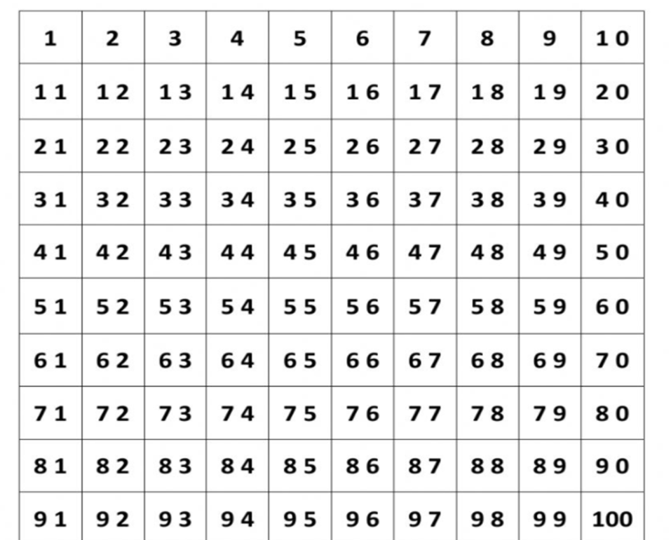
Yesterday you counted in multiples of 6 and 7. Today you are going to count in multiples of 9.
Colour all the multiples
of 9 in one colour.
Subject: Maths

Slide 7
Subject: Maths

Slide 8
Hint: All the digits in the number should add to make 9.
Subject: Maths

Slide 9
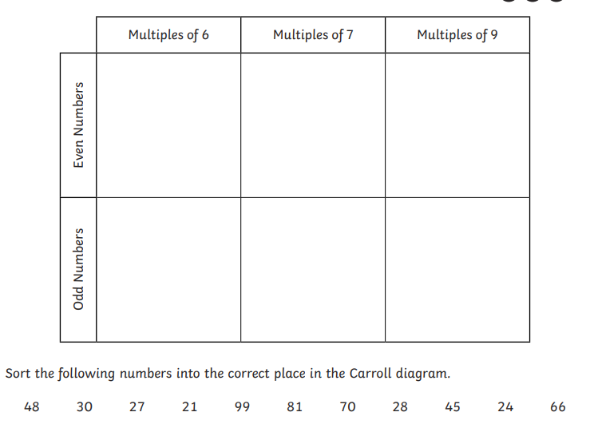
Try this challenge
Subject: Maths

Slide 10
Date: 7.1.2021
L.O To be able to double numbers.
Go to Times Tables Rock Stars to warm up your number brain before you start your maths activity.
Subject: Maths

Slide 11
To get a double of a number, we add the same number to itself. For example, the double of 7 is 7 + 7 = 14.
Double a 2 digit number by partitioning
into tens and ones
12
10 + 10
2 + 2
20
+
4
Double 12 is 24
Subject: Maths

Slide 12
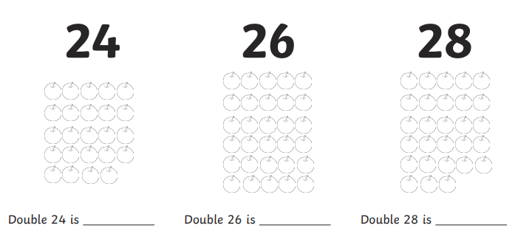
Double these numbers.
(20 + 20 6 + 6)
(20 + 20 8+8)
(20 + 20 4 + 4)

Slide 13
Now try these ones.
Double 13 =
Double 16 =
Double 22 =
Double 25 =
Double 31 =
Double 43 =
7. Double 63 =
8. Double 52 =
9. Double 37 =
10. Double 28 =
11. Double 61 =
12. Double 32 =

Slide 14
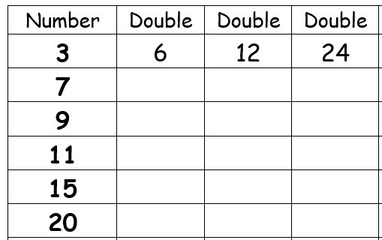
Try this challenge.

Slide 15
Date: 8.1.2021
L.O To be able to multiply numbers.
Go to Times Tables Rock Stars to warm up your number brain before you start your maths activity.
Subject: Maths

Slide 16
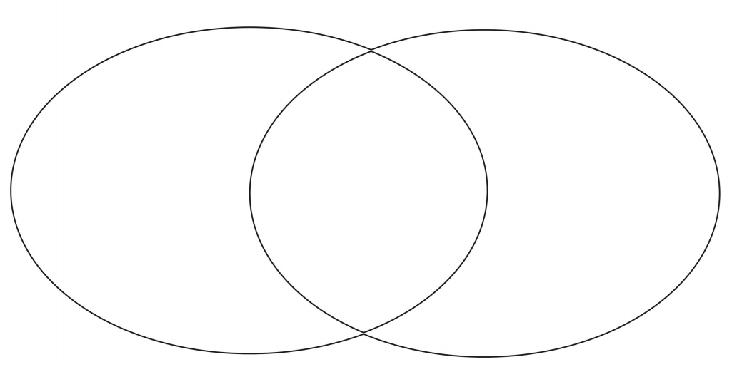
Place the numbers in the correct section of the Venn diagram.
4 6 12 2 18 16 22 30 24 48 36
Multiples of 6
Multiples of 4

Slide 17
Counting in multiples helps us learn our times tables. Use your 6,7 and 9
times tables to help solve these calculations.
4 x ___ = 24
____ x 6 = 36
7 x ____ = 63
____ x 9 = 18
6 x ____ = 60
8x ___ = 72
7. ___ x ___ = 42
8. 3 x ___ = 21
9. ____ x 7 = 35
10. ___ x ____ = 56
11. ____x ____ = 48
12. ____ x ____ = 90

Slide 18
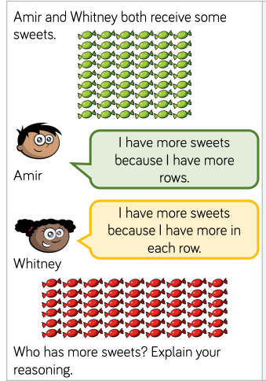
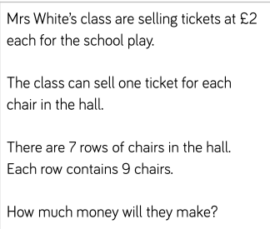
.

Slide 19
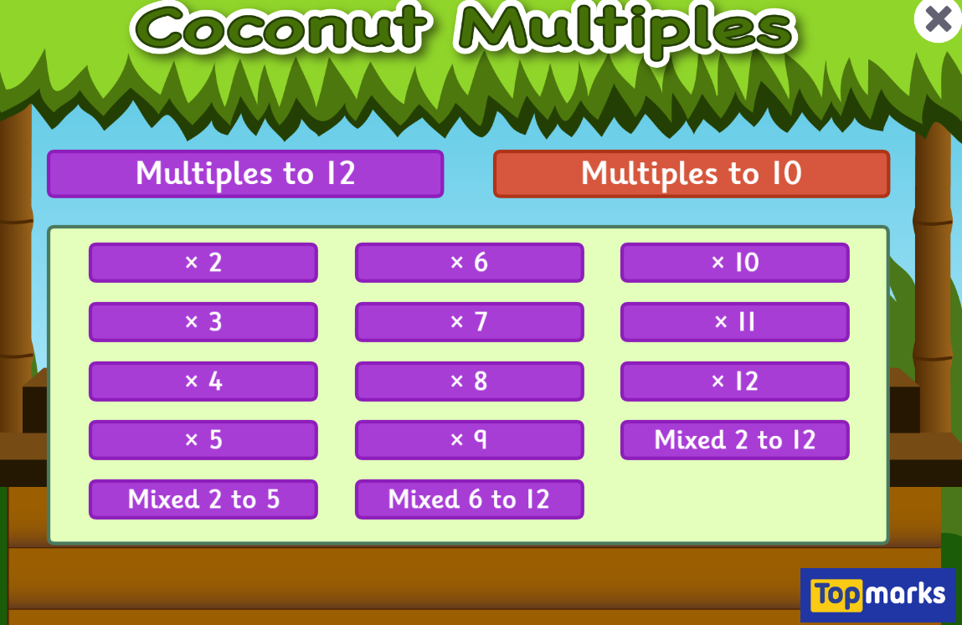
Fun Maths Games!
Copy and paste the link to play these fun maths games.
https://www.topmarks.co.uk/maths-games/hit-the-button
Times tables x4 x8 x3
https://www.topmarks.co.uk/times-tables/coconut-multiples
https://ttrockstars.com/
Multiples of numbers

