Slide 1
Date: 5.1.2021
L.O To be able to write numbers to 20
Subject: Maths

Slide 3
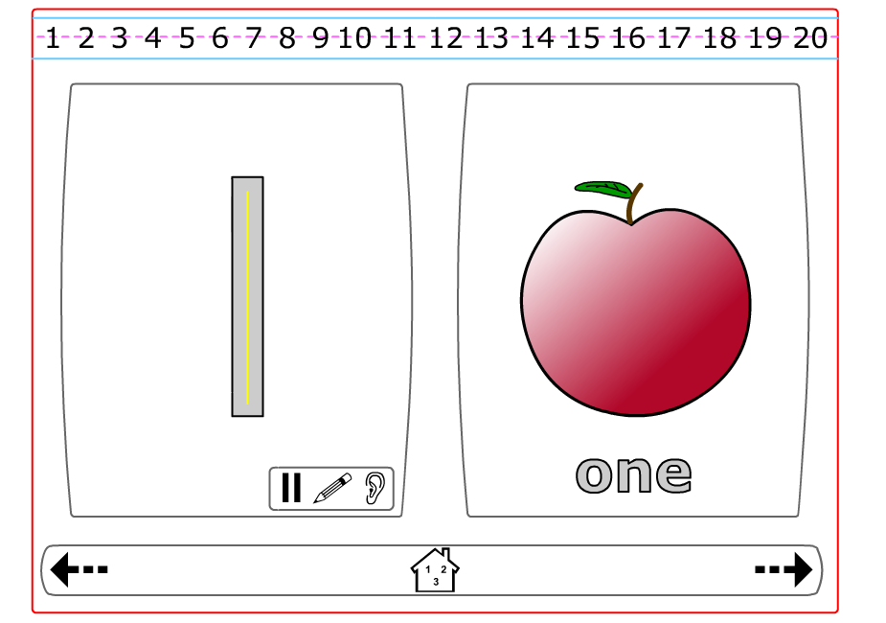
http://resources.hwb.wales.gov.uk/VTC/ngfl/ngfl-flash/numbers_eng/numbers_e.html

Slide 4
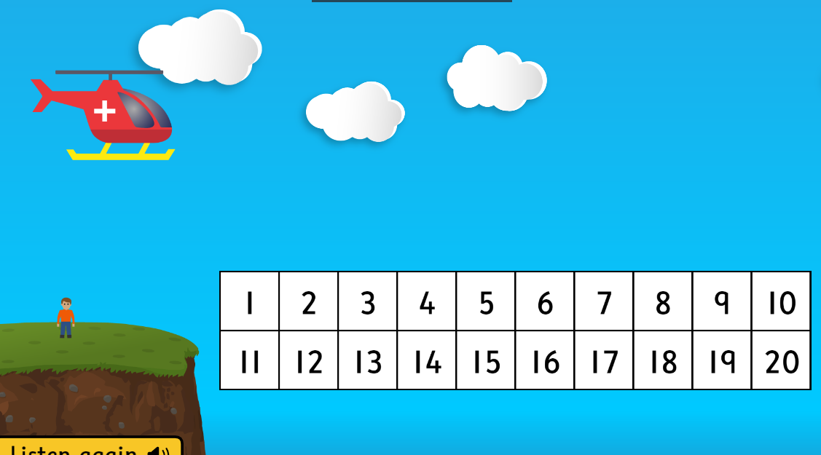
https://www.topmarks.co.uk/learning-to-count/helicopter-rescue

Slide 5
Date: 6.1.2021
L.O To be able to order numbers to 20
Subject: Maths

Slide 6
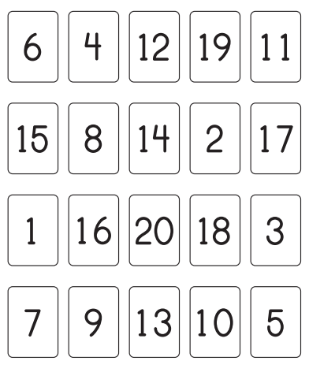

Slide 7
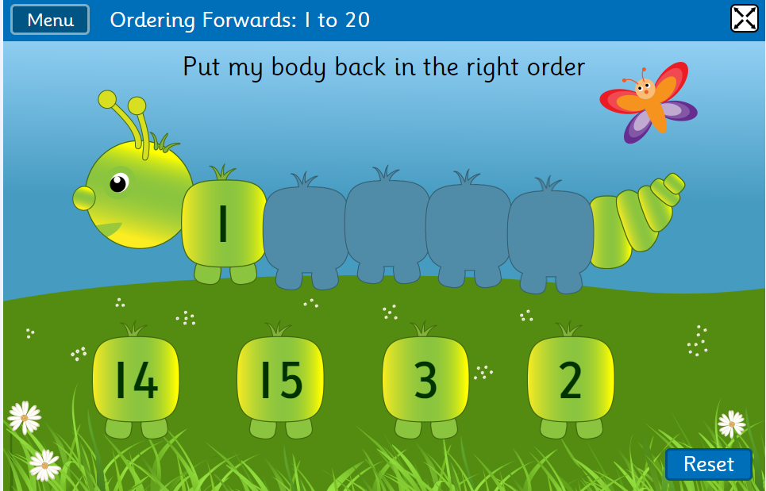
https://www.topmarks.co.uk/ordering-and-sequencing/caterpillar-ordering

Slide 8
Date: 7.1.2021
L.O To be able to find more and less than
(within 20)
Subject: Maths

Slide 10
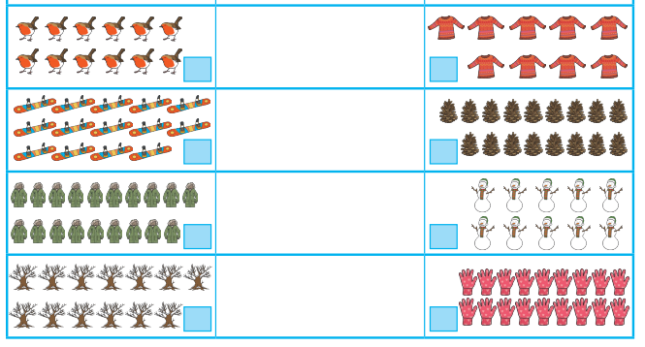

Slide 11
https://pbskids.org/curiousgeorge/busyday/bugs/

Slide 12
Date: 8.1.2021
L.O To be able to find missing numbers
Subject: Maths

Slide 13
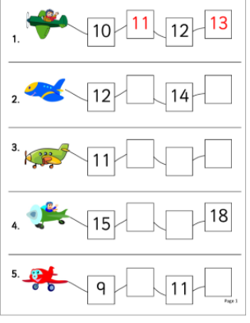

Slide 14
