Slide 1
Tuesday 5th January 2021
LO To be able to identify and mark on a map the different countries of South America
Subject: Geography

Slide 2
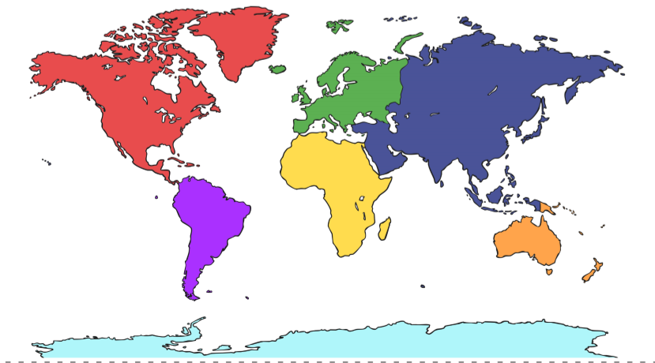
Did you know there are 7 continents in the world?
Can you label them?

Slide 3
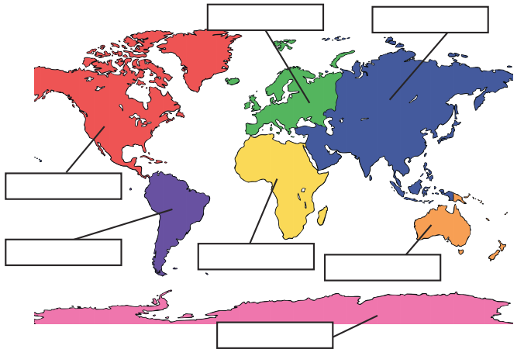
How did you do?
Europe
Asia
North America
South America
Africa
Australasia
Antarctica

Slide 4
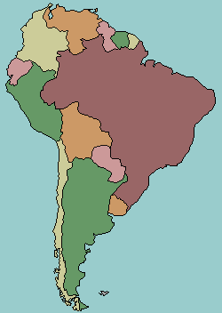
South America
South America only has 12 countries.
Major countries include Brazil and Argentina.
The Amazon Rainforest is the world’s biggest rainforest and is found here.
South America is a huge continent and so the climate can vary depending on where you are.
Most of South America is warm for most of the year. The climate is generally tropical so it never gets too cold but there are higher areas where it does get cold and the temperature drops below freezing.
Most of South America receives plenty of rain. There are areas that receive downpours, like the rainforest, but there are also areas that receive little or no rain.
Did you know that some parts of South America are the driest areas on Earth?

Slide 5
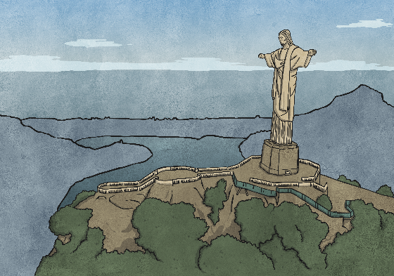
Human and physical features of South America
What is a human feature of a place?
A human feature is something that is man-made, for example a building or monument.
What is a physical feature of a place?
A physical feature is a natural landmark, such as a river or mountain.

Slide 6
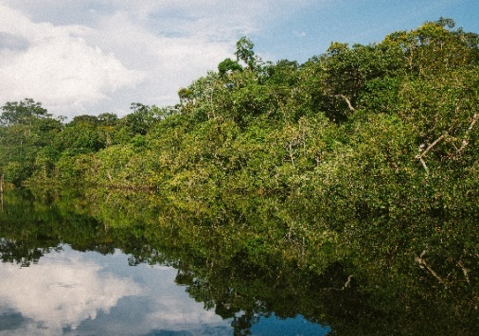
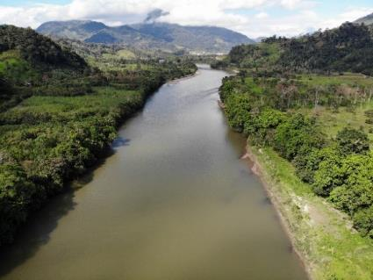
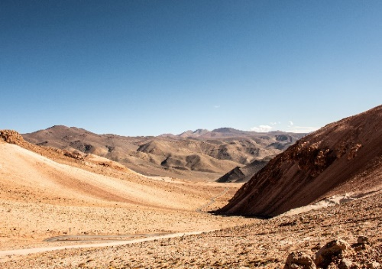
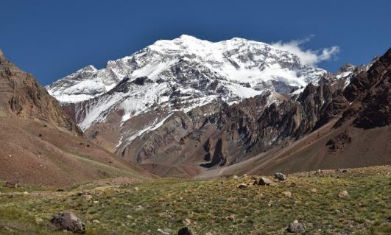
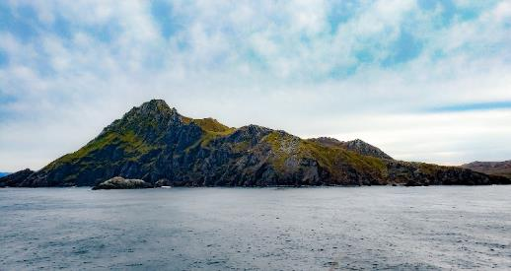
Famous Landmarks
Are these landmarks human or physical features of South America?
The Amazon Rainforest
The Amazon River
The Atacama Desert
Andes Mountains
Cape Horn

Slide 7
They are all physical features of South America
“Amazon rainforest near Puerto Maldonado” by [Ivan Mlinaric] is licensed under CC BY 2.0
The Amazon Rainforest
The Amazon River
The Atacama Desert
“Cape horn” by [Boris Kasimov] is licensed under CC BY 2.0
Andes Mountains
Cape Horn
Click on each photo below to find out more information about the landmark

Slide 8
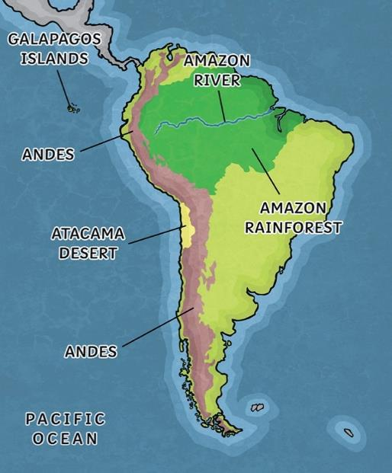
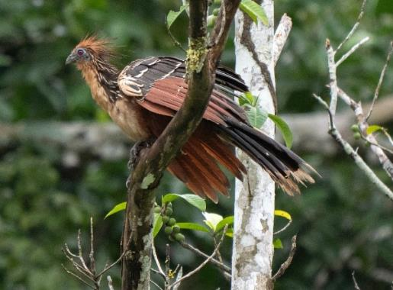
The Amazon Rainforest
Rainforests are warm and wet areas.
The Amazon Rainforest is the largest tropical rainforest in the world with more than half located in Brazil. It is full of wildlife.
Tribes of people still live in some areas of the rainforest with no contact with the outside world.
20% of the world’s bird species live here including toucans, hummingbirds and the hoatzin.
Back

Slide 9
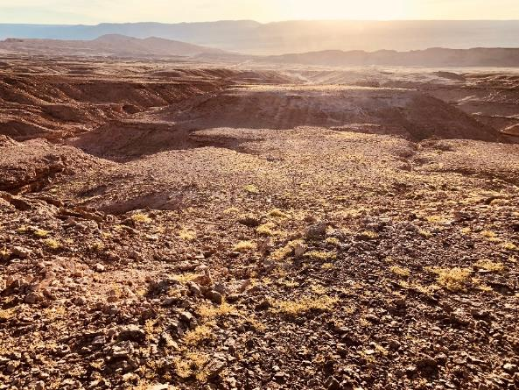
The Atacama Desert
The Atacama Desert is 600 miles long.
It is the driest desert in the world despite living right next door to the Pacific Ocean!
The areas around the Atacama desert are arid areas which are also severely dry.
Back

Slide 10
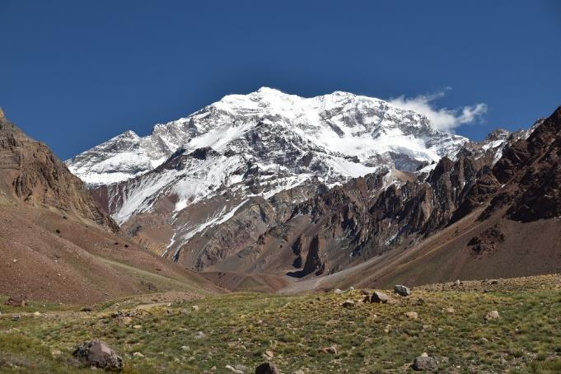
The Andes
The islands of Aruba, Bonaire and Curaçao in the Caribbean Sea, off the coast of Venezela, are the submerged peaks of the northern Andes Mountains.
The highest peak of the mountain range is Aconcagua, which rises to a height of 6,962 metres.
The Inca built their ancient city, Machu Picchu, in the Andes.
The world’s longest mountain range.
The Andes stretch the following countries: Argentina, Chile, Peru, Bolivia, Venezuela, Colombia and Ecuador.
Back

Slide 11
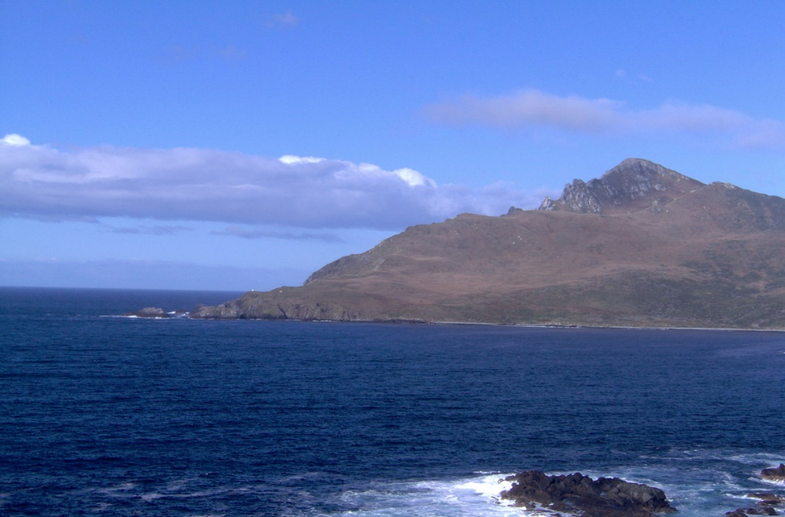
Cape Horn
The most southern point of South America.
The waters around Cape Horn are very dangerous due to icebergs, strong winds and large waves.
Penguins and seals live there.
Back

Slide 12
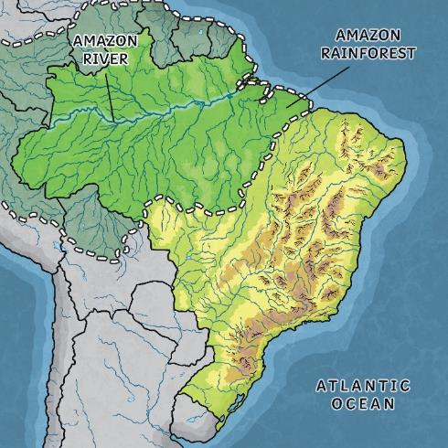
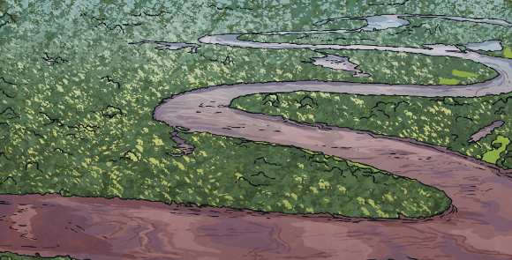
The Amazon River
The river is approximately 4,000 miles long, mostly flowing through rainforest.
It has around 200 tributaries.
It begins in the Andes Mountains and is the second longest river in the world.
Piranhas, anacondas and thousands of species of fish can be found here!
No bridges cross the river at any point.
Back

Slide 13
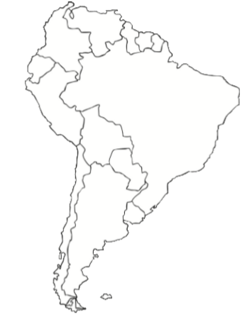
Can you identify and mark on a map the different countries of South America using a map?
If you are unable print this off you could add labels to the map on PowerPoint

Slide 14
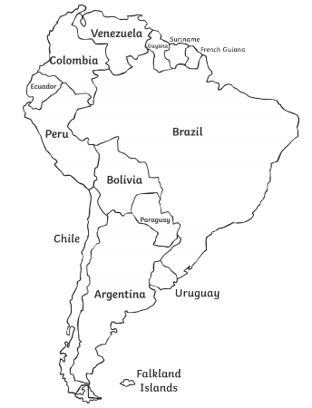
How did you do?

Slide 15
Wednesday 6th January 2021
LO To be able to identify major Brazilian cities on a map
Subject: Geography

Slide 16
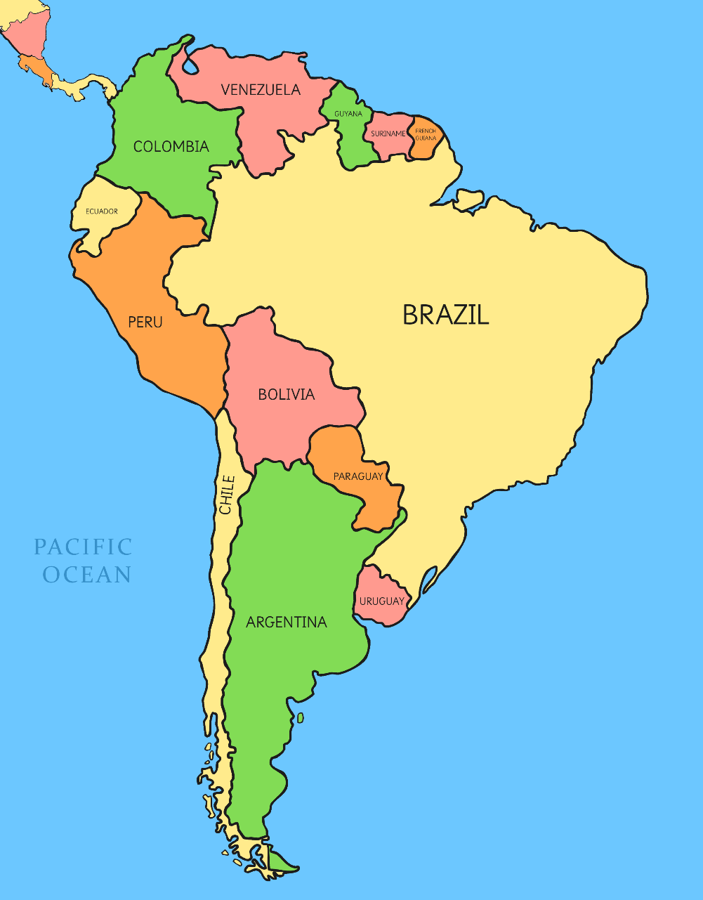
Where is Brazil?
Brazil is the largest country in South America and the fifth largest country in the world!
It has a long coastal border with the Atlantic Ocean and borders with ten different countries.
The capital city of Brazil is Brasilia
Its largest city is São Paulo
Their currency is Real
Its main religion is Catholicism
Official language is Portuguese
Did you know There are over 202 million people living in Brazil compared with 64 million people living in the UK.

Slide 17
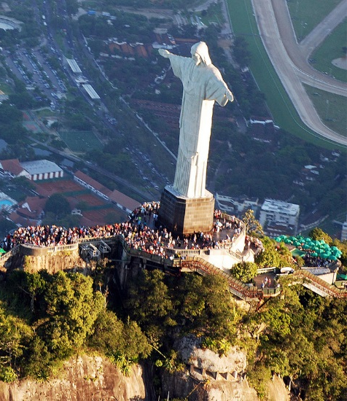
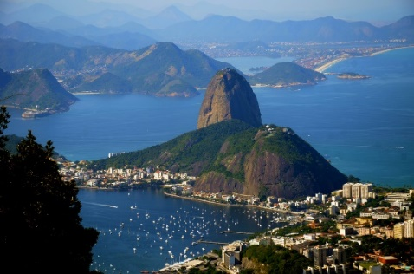
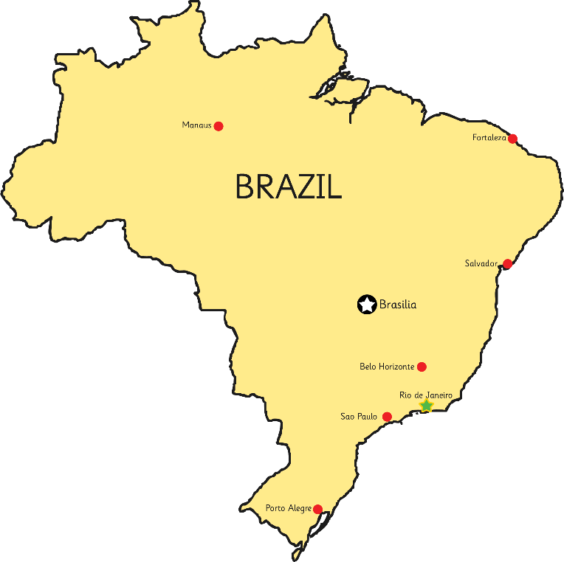
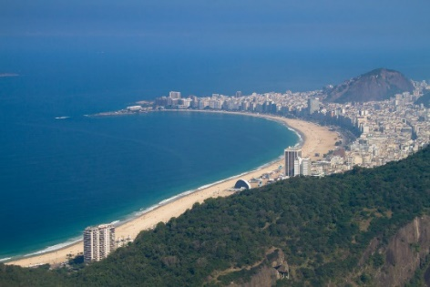
Rio de Janeiro
Human Features
Physical Features
People call Rio de Janeiro ‘Rio’ for short. It is the second largest city in Brazil.
Sugarloaf Mountain is a peak located at the mouth of Guanabara Bay. It is nearly 400 metres high.
Tijuca Forest is a hand-planted rainforest.
Christ the Redeemer statue is situated in Tijuca Forest and is a religious statue that stands on top of Corcovado Mountain.
Copacabana beach is 4km in length.
Rio is very famous for its carnivals too.
Click on the link to learn more! https://www.bbc.co.uk/bitesize/topics/zyhp34j/articles/zr2h47h

Slide 18
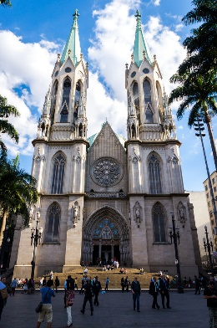
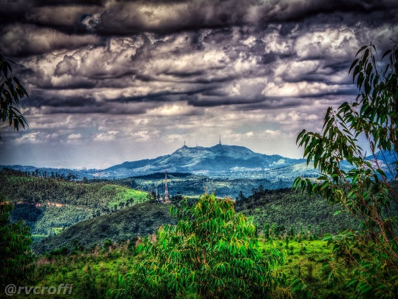
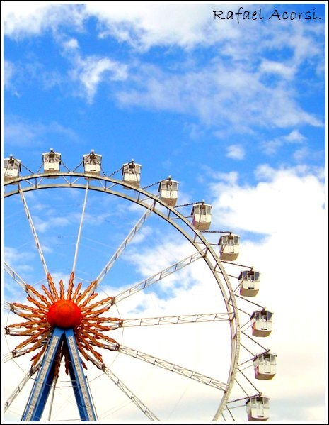
São Paulo
Human Features
Physical Features
This is the largest city in Brazil with over 11 million people living here. Those who live here are called Paulistanos.
São Paulo Cathedral is a Roman Catholic place of worship.
Pico do Jaraguá is the highest mountain of the city.
Parque Hopi Hari is a theme park in the city.

Slide 19
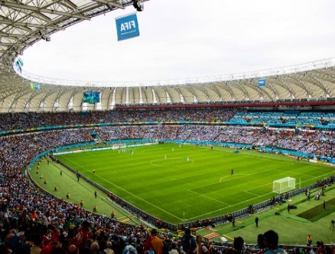
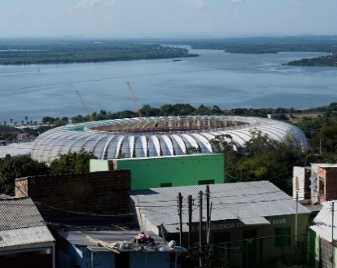
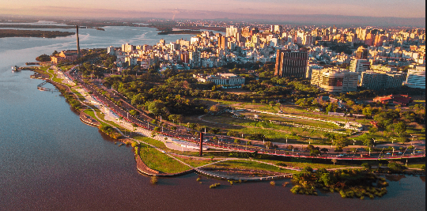
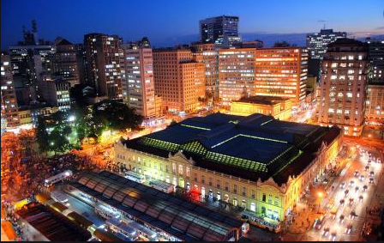
Porto Alegre
Human Features
’.
Porto Alegre is the capital city of the state of Rio Grande do Sul. It is next to the Atlantic Ocean.
It is considered one of the most dangerous cities in the world with high rates of crime including robbery and murder.
Estádio Beira-Rio was used to host 5 of the FIFA 2014 World Cup games.
The Portuguese translation of Porto Alegre is ‘joyful harbour’

Slide 20
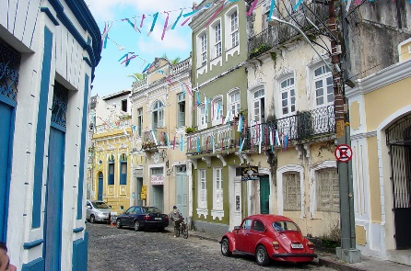
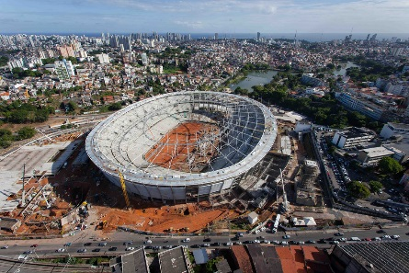
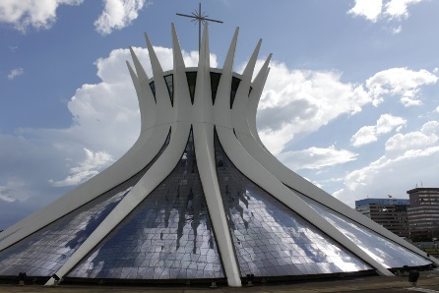
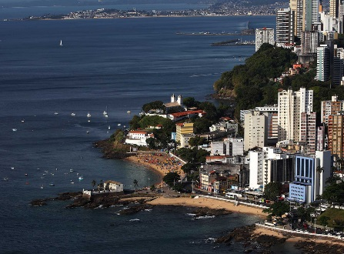
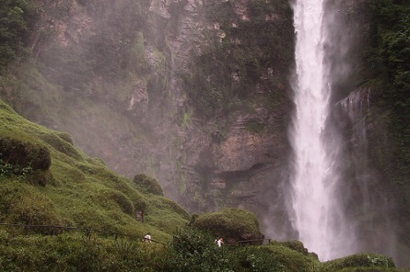
Quick City Facts
Salvador
Brasília
Human Features
Human Features
The historic centre with its pretty coloured buildings and interesting architecture.
The Palácio da Alvorada is the official residence of the President of Brazil.
Paranoá Lake is a man made lake on the east side of the city.
The Estádio Fonte Nova was used for several 2014 FIFA World Cup games.
Cathedral of Brasília is a Roman Catholic cathedral designed by a Brazilian architect.
Physical and Human Features
Physical Feature
The Porto da Barra beach is a physical feature with two human features built on to it: a white fort at one end and a small church on the opposite hill side.
Itiquira Falls is 168 metres high.

Slide 21
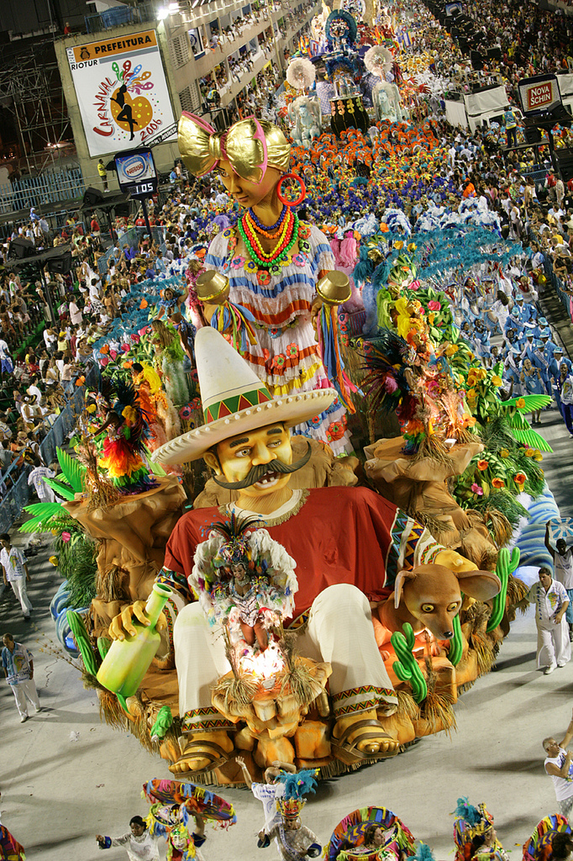
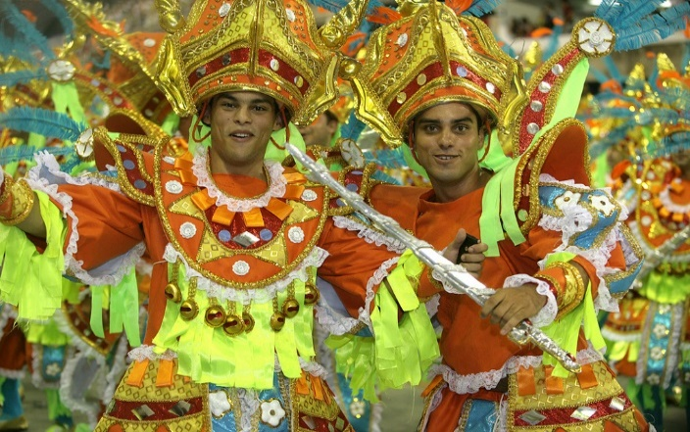
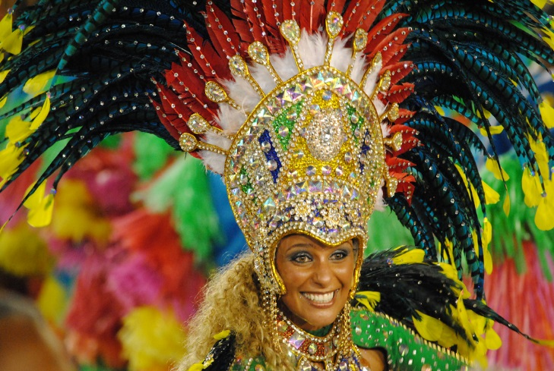
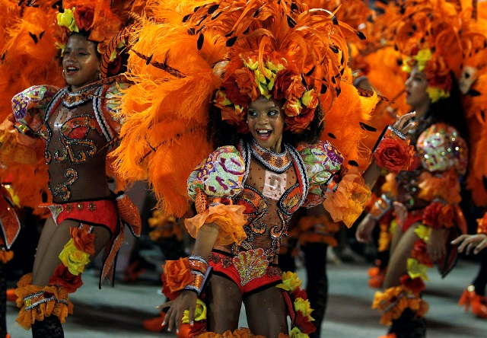
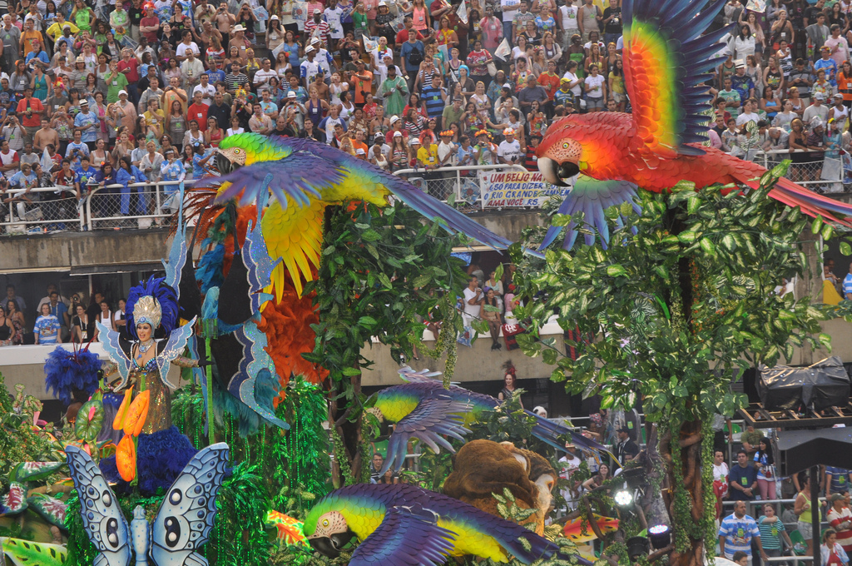
Carnival
Click on the link to learn how they make their carnival costumes!
https://www.bbc.co.uk/bitesize/clips/z26sb9q
Rio de Janeiro is famous for its carnival. Even though carnivals are celebrated all around the country, Rio is known as the capital of carnival.
Thousands go to the “Sambódromo”, an avenue specially built to host it.
The carnival lasts for three days. During that time, Rio is filled with dancing, music, singing and lots of street parades showcasing colourful costumed dancers performing the samba.

Slide 22
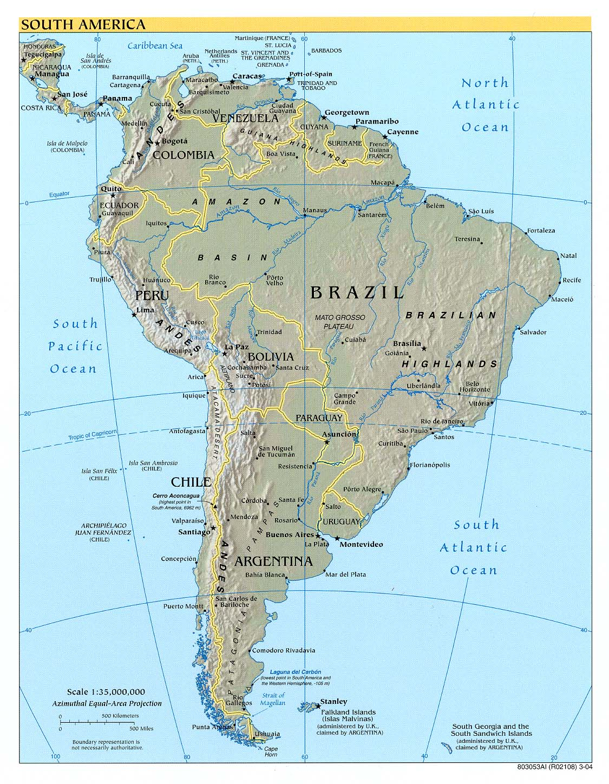
The Weather and Climate
Most of Brazil is in the Southern Hemisphere. The Brazilian winter lasts for only three months (roughly June to August) then summer arrives from around December until February.
Brazil has an average winter temperature of 15 degrees Celsius whereas during the summer months, temperatures can reach 40 degrees Celsius. Summers are also accompanied by frequent showers and heavy humidity.

Slide 23
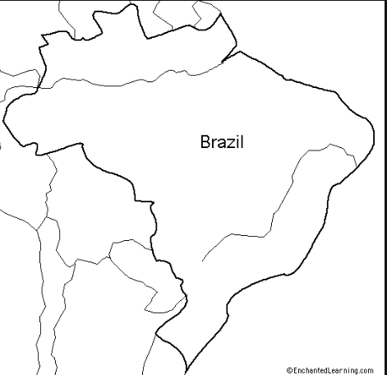
Can you identify these major Brazilian cities on a map
If you are unable print this off you could add labels to the map on PowerPoint
Locate:
Manus
Salvador
Belo Horizonte
Sau Paulo
Rio de Janeiro
Brasilia
Porto Alegre
Fortaleza

Slide 24
How did you do?

Slide 25
Thursday 7th January 2021
LO To be able to identify the main rivers of South America
Subject: Geography

Slide 26
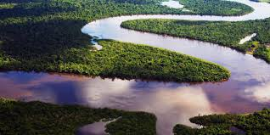
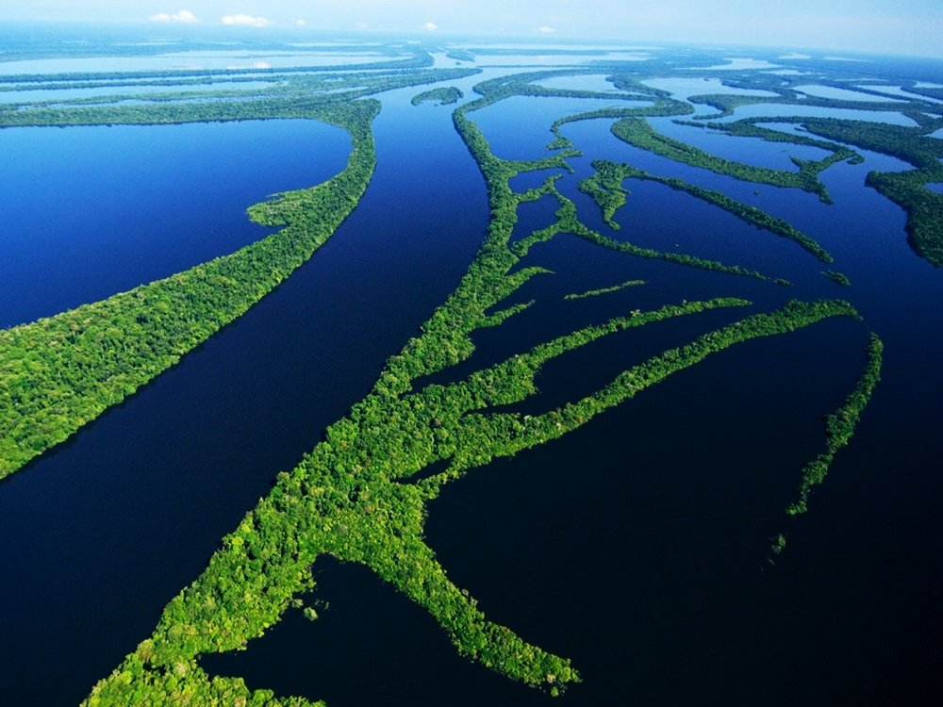
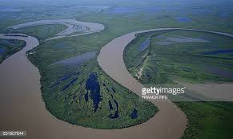
Human or Physical?
We have learnt about human and physical features. What are they?
What do you think rivers are, human or physical?

Slide 27
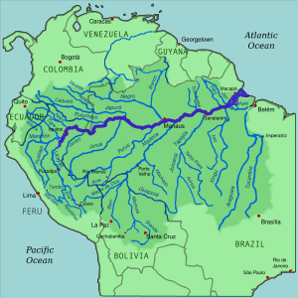
The Amazon River
The Amazon River is located in South America. It runs through Guyana, Ecuador, Venezuela, Bolivia, Brazil, Colombia and Peru.
The length of the Amazon River is approximately 6400 kilometres (4000 miles).
During the wet season, the Amazon River can reach over 190 kilometres (120 miles) in width.
There are no bridges that cross the Amazon, mostly because there is no need, the majority of the Amazon River runs through rainforests rather than roads or cities.

Slide 28
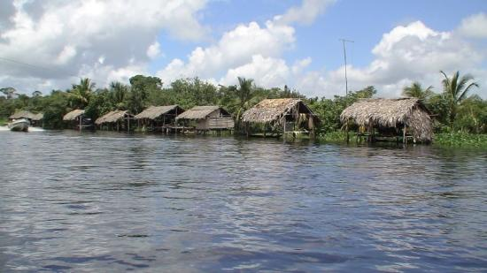
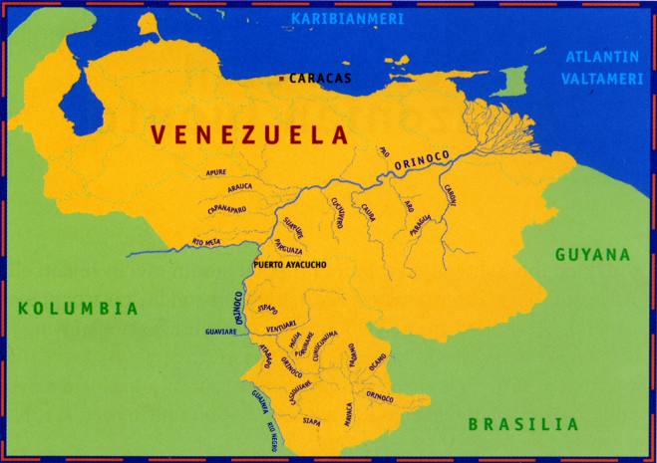
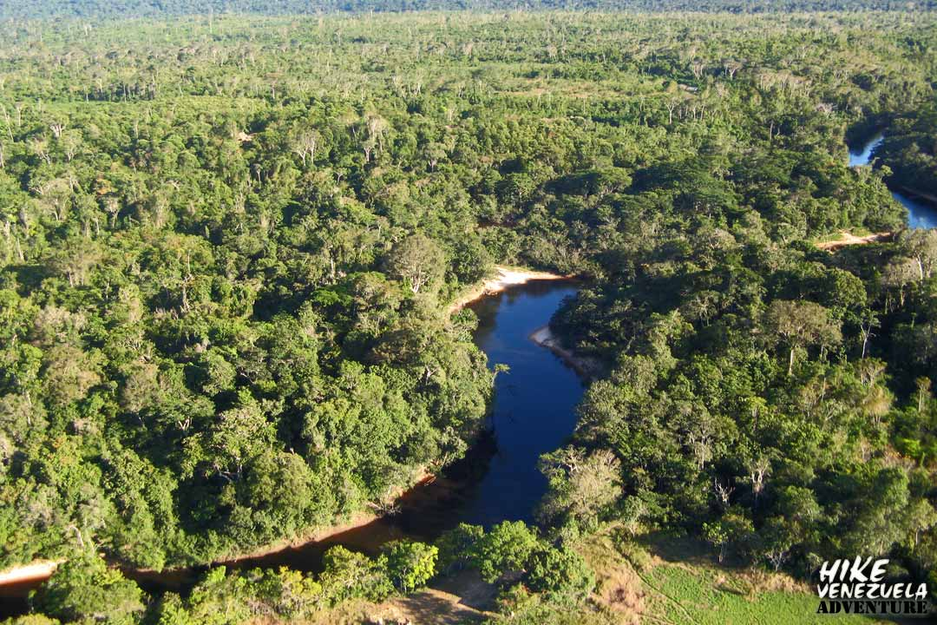
The Orinoco River
One of South America's longest rivers, it flows from Brazil through Venezuela to the Atlantic Ocean.
The Orinoco has a tropical climate.
It is the third longest river in South America
It only has two seasons, a rainy winter season which runs from April to October and a dry summer season from November to March
There are over 1,000 species of bird which live here
Most of the natural trees in this region have been eradicated through deforestation

Slide 29
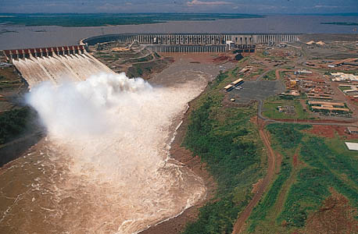
The Parana River
The Parana is the 14th-longest river in the world, flowing 2,485 miles across southeastern South America.
It starts in Brazil and flows southwest to the Paraguay River.
The river has the second largest drainage system on the continent.
Flooding is common on the southern Parana, which also is also where many waterfalls are found including a large dam also.
Oceangoing ships can also travel partway up the river, but most of the water traffic is commercial point-to-point.
Cruises do steam up and down the river, too.
This river is often damaged by humans because of tourism

Slide 30
Can you identify six these rivers in South America using a map?
The Amazon River
Orinoco River
Parana River
Rio de la Plata
Negro River
Madeira River
Xingu River
If you are unable print this off you could add labels to the map on PowerPoint

Slide 31
How did you do?

Slide 32
Friday 8th January 2021
LO To be able to draw Christ the Redeemer
Subject: Art & Design

Slide 33
Christ the Redeemer
Christ the Redeemer is a statue on top of Corcovado mountain in Brazil. It overlooks the country’s largest city and former capital, Rio de Janeiro.
The statue shows Jesus Christ with his arms outstretched. Around 89% of Brazil’s population belong to the Christian faith.

Slide 34
The History of Christ the Redeemer
In 1920, a group of Brazilians started ‘Semana do Monumento’, which is Portuguese for ‘Monument Week’. The group campaigned for a religious statue to overlook Rio de Janeiro and collected donations to pay for it.
Different designs were made, including one of a cross and one of Jesus holding a globe. The winning design was created by Heitor da Silva Costa and the sculptor Paul Landowski

Slide 35
The History of Christ the Redeemer
The statue has been struck by lightning and severely damaged several times. In 2008, the fingers, head and eyebrows of the statue were badly damaged.
In 2014, another thunderstorm caused one of the statue’s fingers to fall off.
The statue needs regular maintenance. The original soapstone is no longer available so modern additions are in a slightly darker stone.

Slide 36
In 2003, escalators and walkways were built to make it easier to reach the statue. Over 1m tourists visit the statue each year. At Easter in 2011, the statue received a record number of visitors in one day, with 14,000 tourists making the trip up Corcovado mountain.

Slide 37
Use this step by step guide to help you to draw Christ the Redeemer

