Slide 1
Subject: English
Pack: B

Slide 2
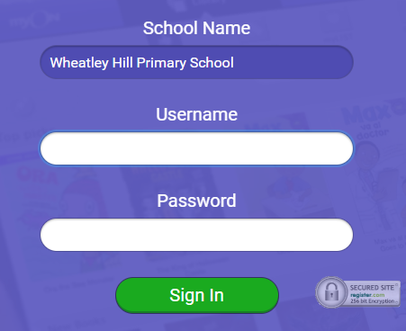
https://www.myon.co.uk/index.html
Remember to use myon for online reading
Example login -
Username
DavidW
Password
password1

Slide 3
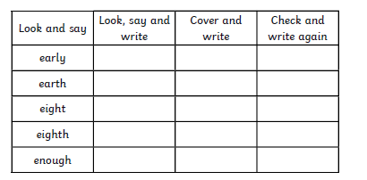
Monday 8th February 2021
L.O To be able to spell words from the Y3/4 word list

Slide 4
Monday 8th February 2021
L.O To be able to answer questions based on a text
Subject: English

Slide 5
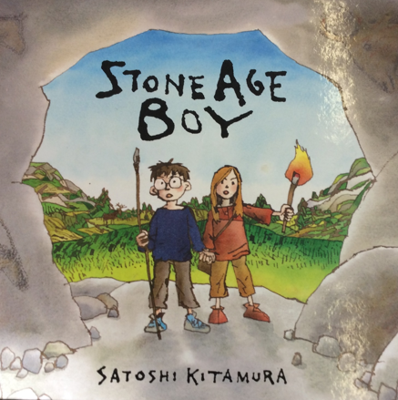
Today we are going to read the rest of the Stone Age boy

Slide 6
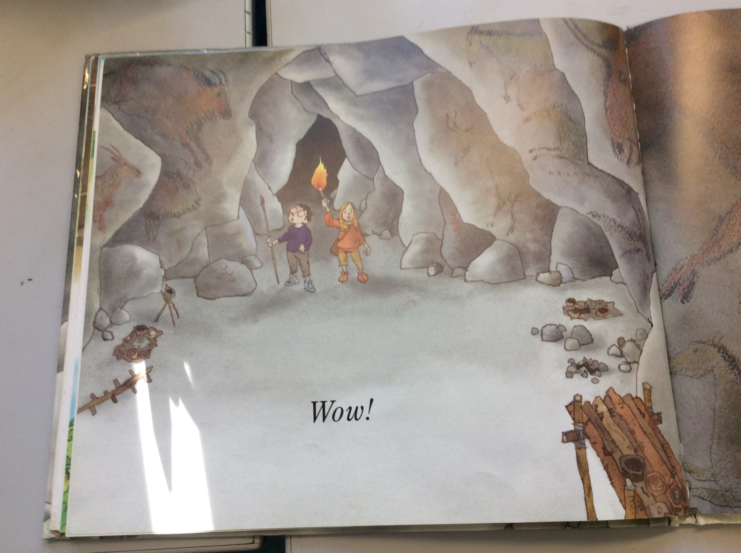

Slide 7
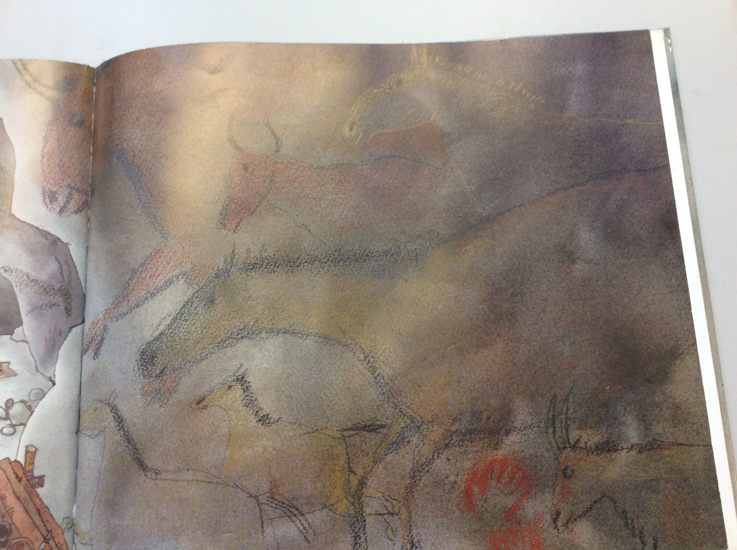

Slide 8
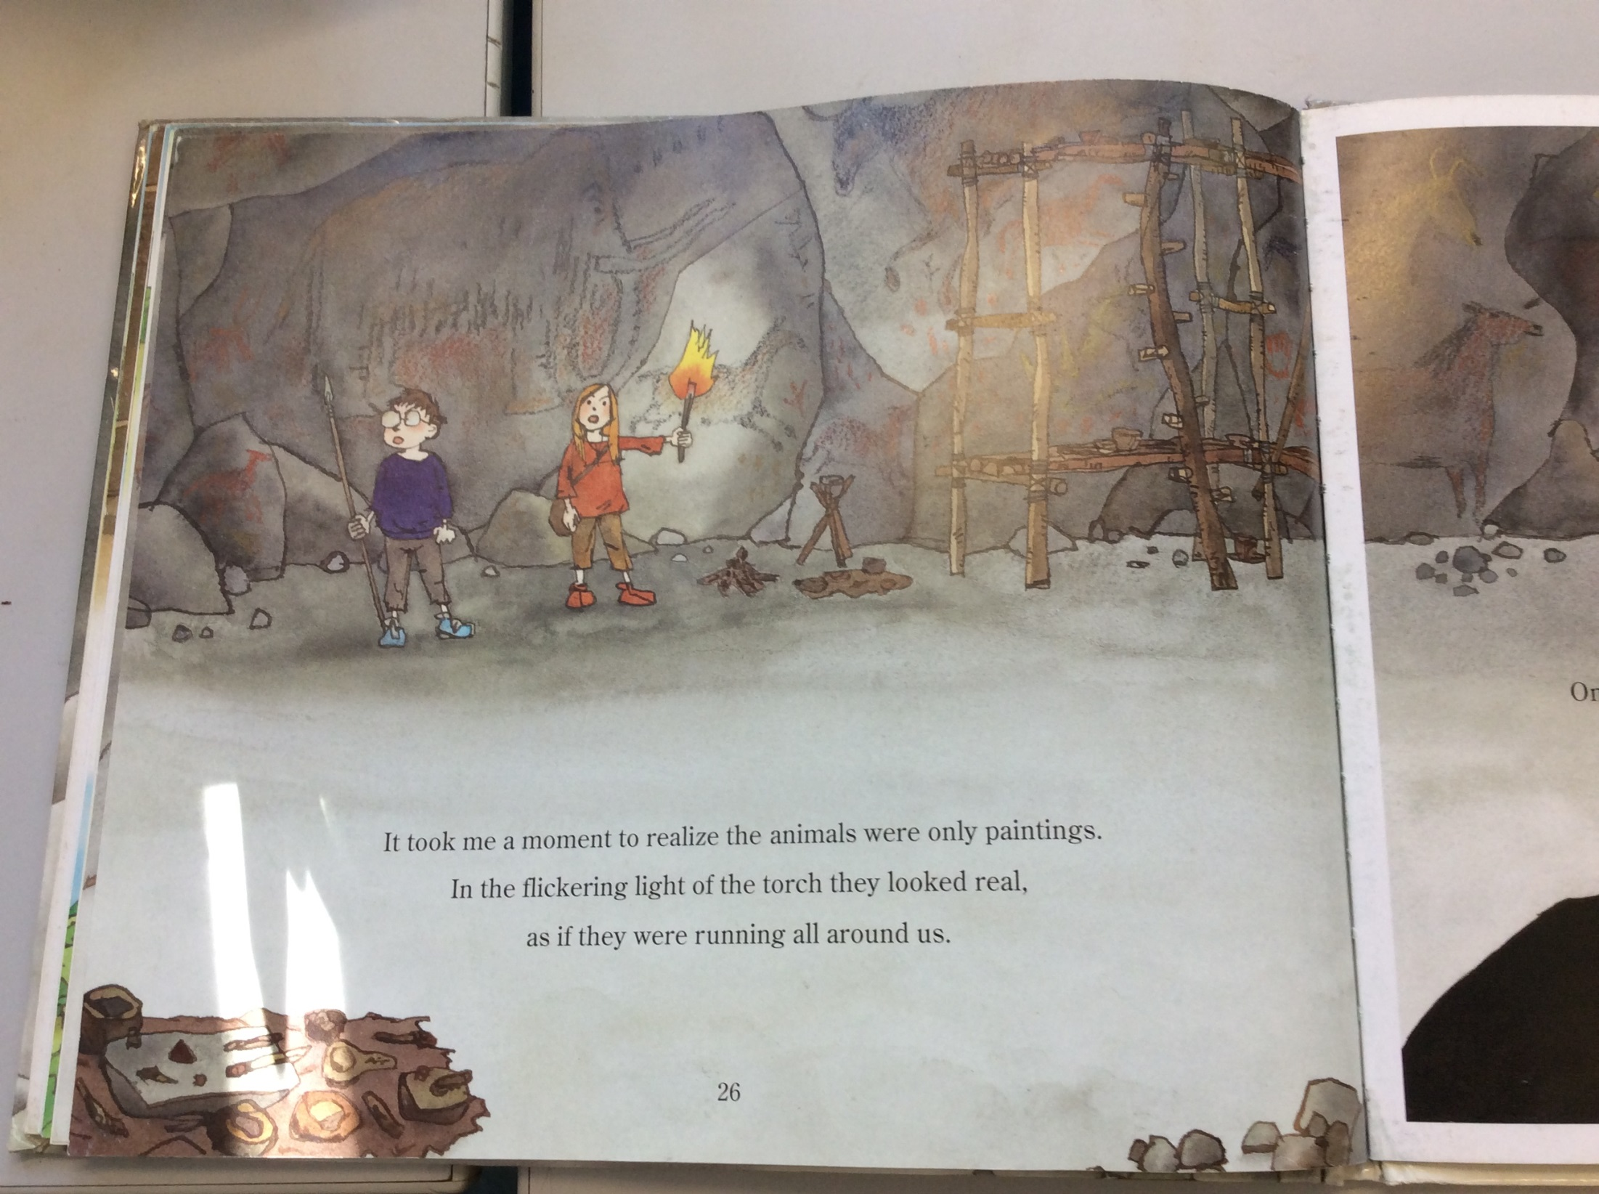

Slide 9
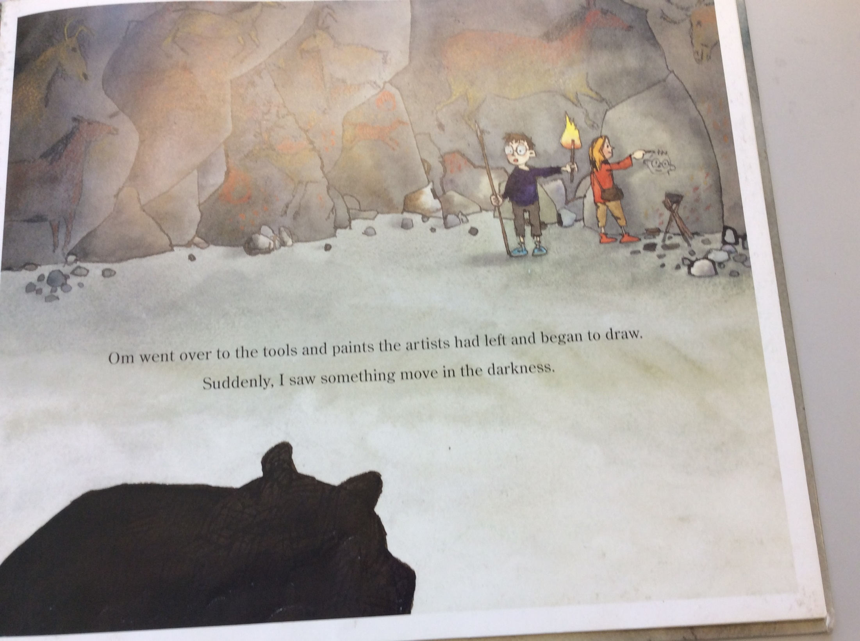

Slide 10
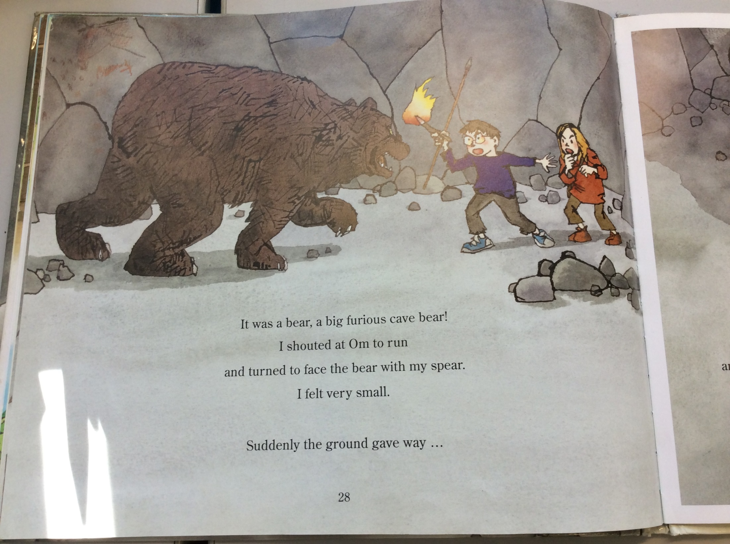

Slide 11
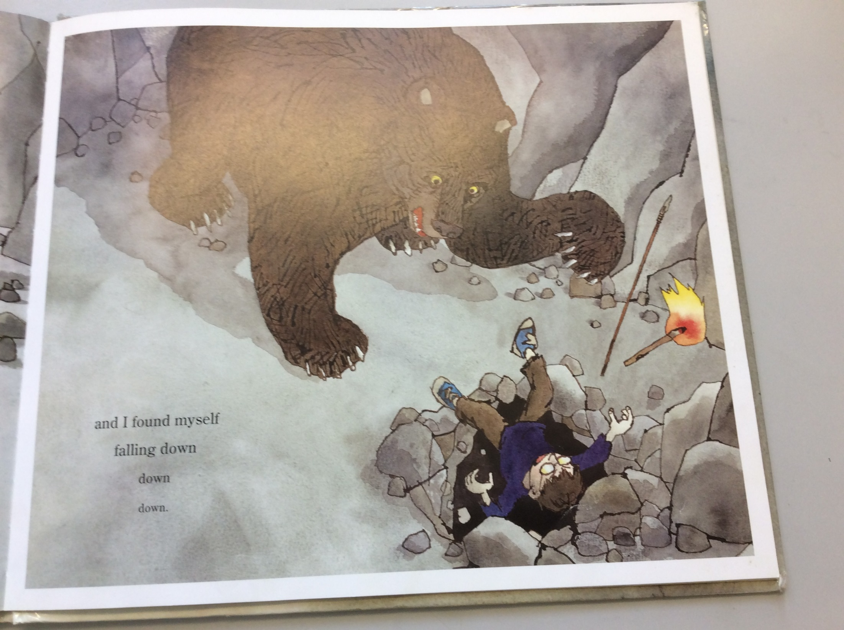

Slide 12
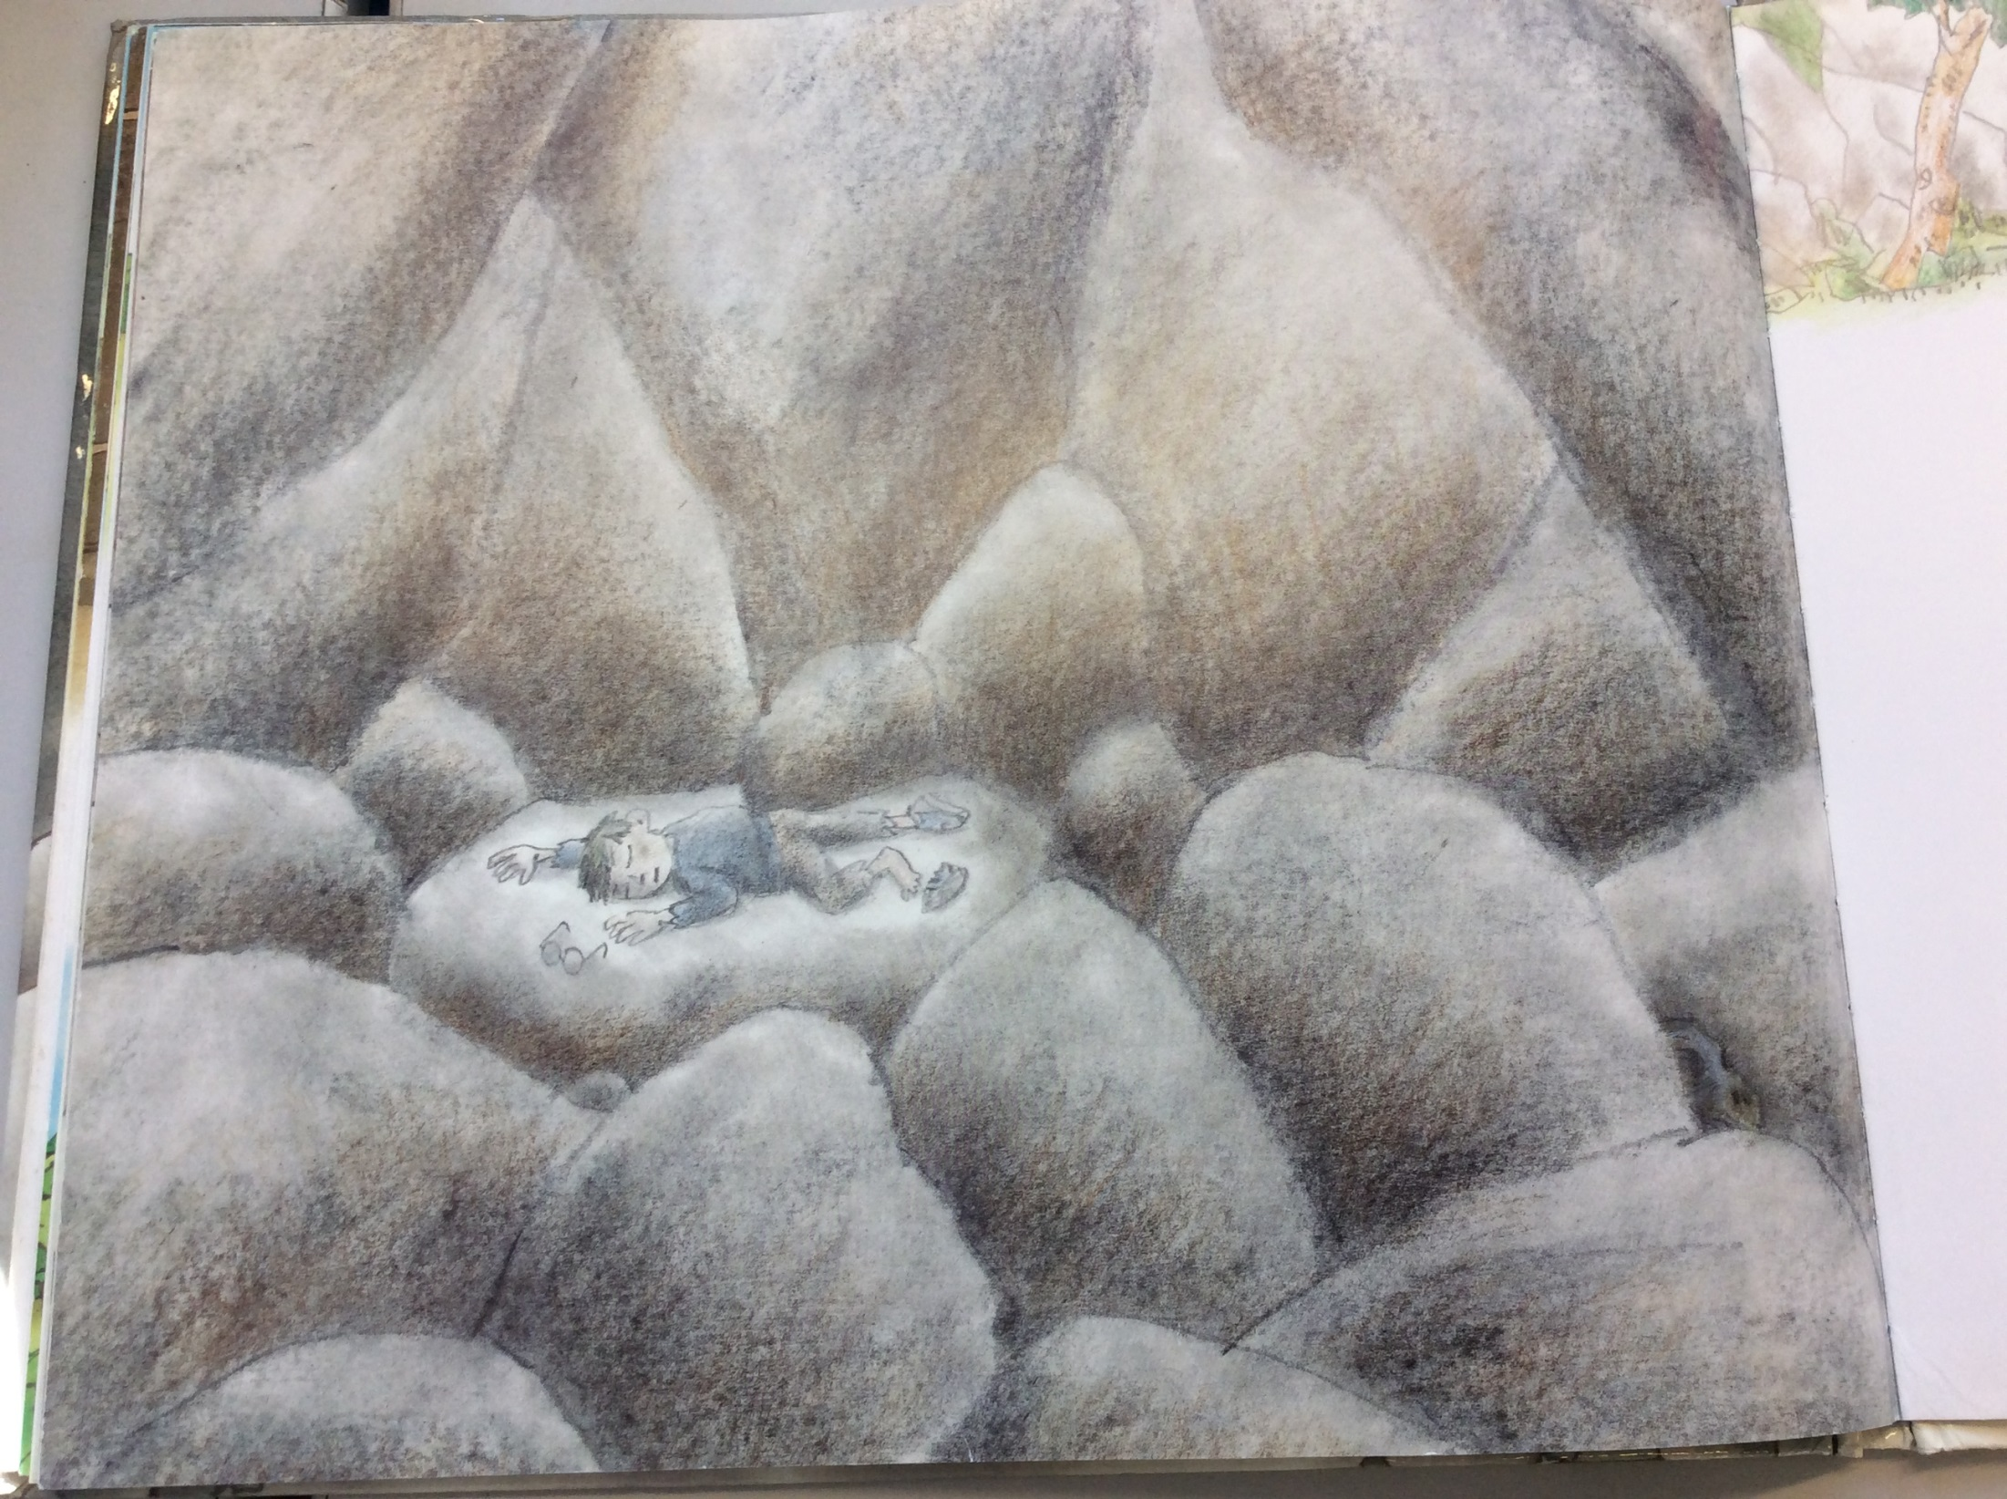

Slide 13
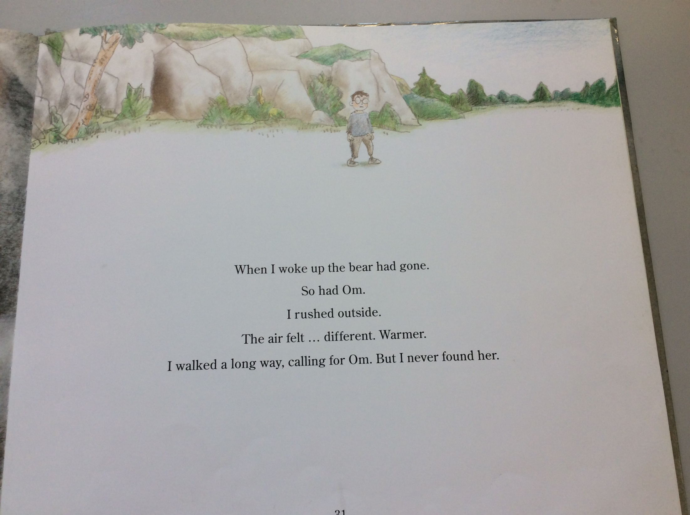

Slide 14
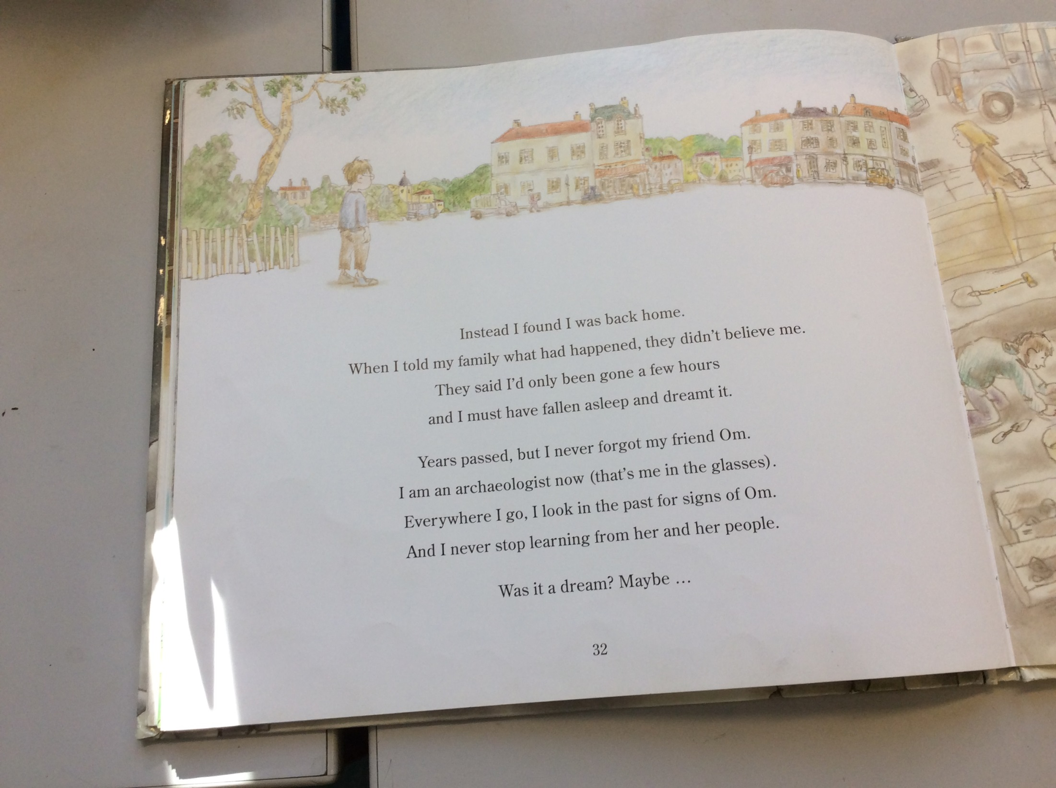

Slide 15
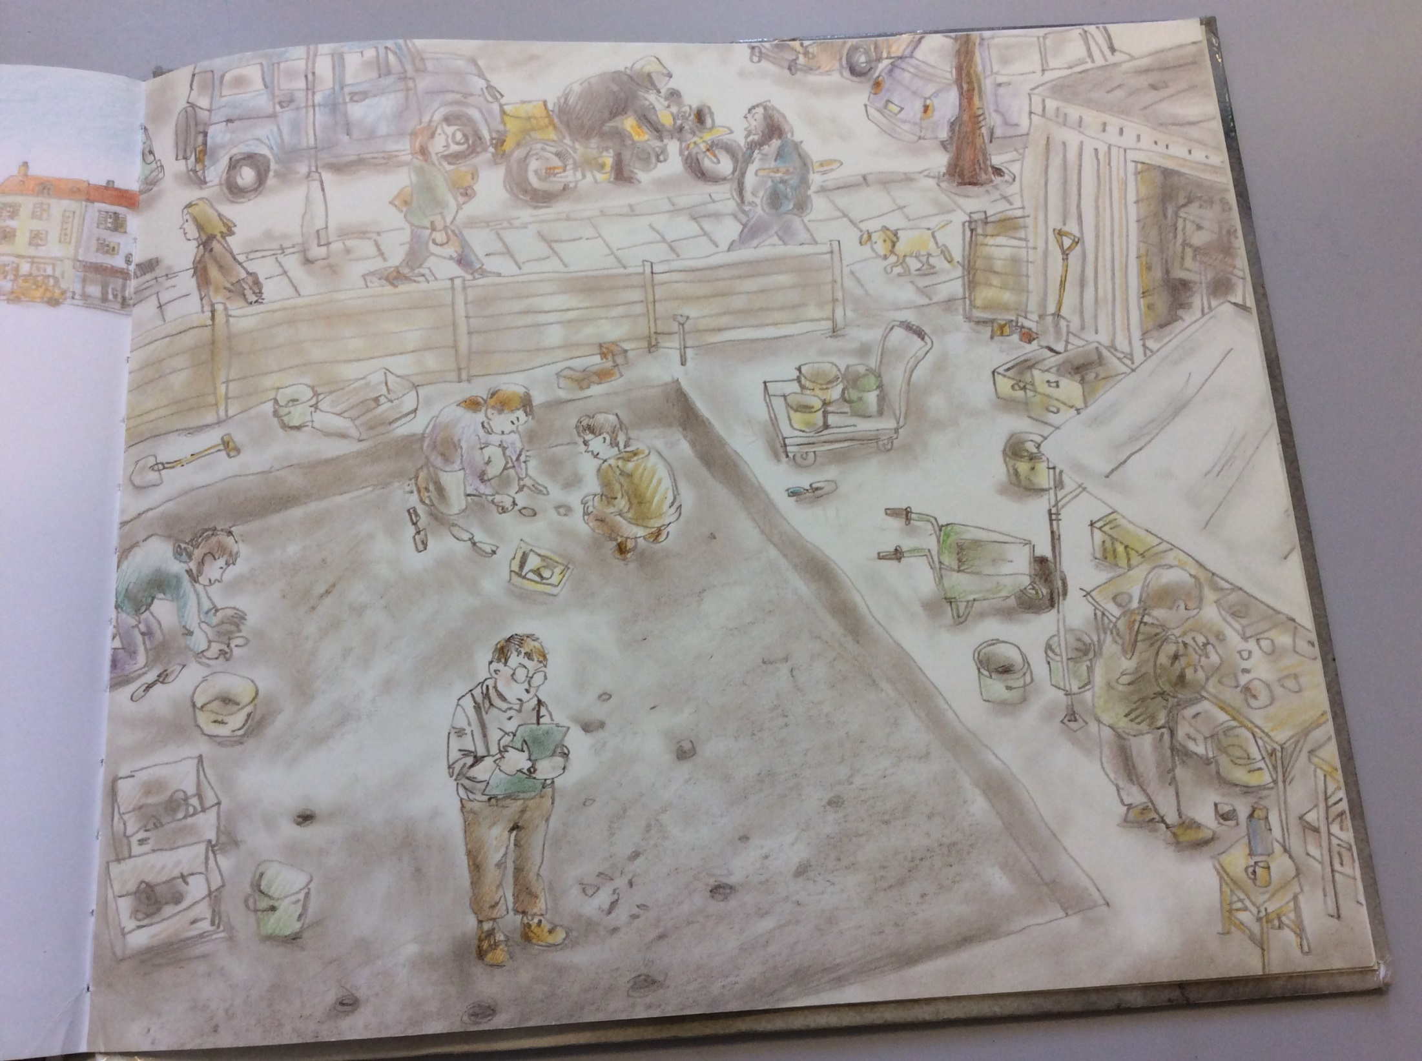

Slide 16
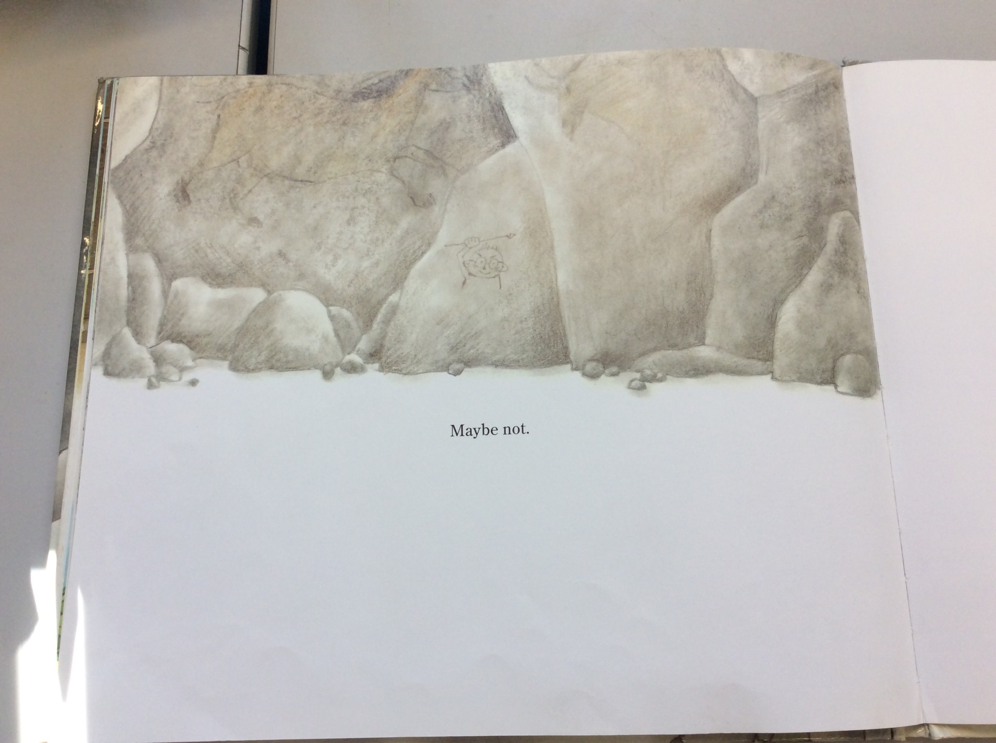

Slide 17
What made the paintings in the cave look real?
_____________________________________________________________________________________
_____________________________________________________________________________________
How do we know the bear was angry?
_____________________________________________________________________________________
_____________________________________________________________________________________
Why did the boy’s parents not believe him when he told them about being in the Stone Age?
_____________________________________________________________________________________
_____________________________________________________________________________________
What does the Stone Age boy mean when he says that he never stops learning from Om and her people?
_____________________________________________________________________________________
_____________________________________________________________________________________
Why does the boy think that his experience in the Stone Age wasn’t a dream?
_____________________________________________________________________________________
_____________________________________________________________________________________

Slide 18
End of lesson

Slide 19
Tuesday 9th February 2021
L.O. To be able to use apostrophes to show possession.
Subject: English

Slide 20
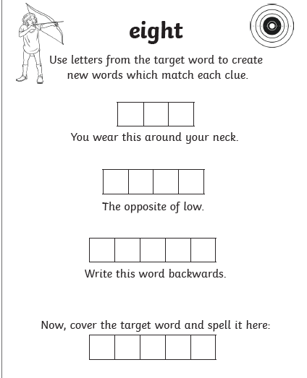
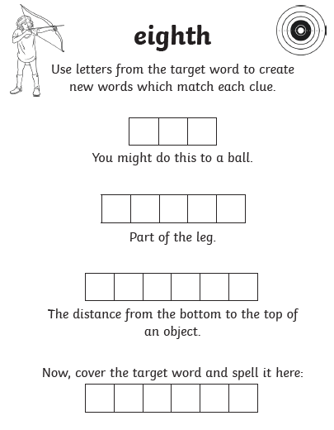
L.O To be able to spell words from the Y3/4 word list

Slide 21
Pre-recorded Teaching
Access the online teaching video below that will support you to complete the work in this lesson. This video will act as a support but all of the work can still be successfully understood & completed using paper-based versions of this pack. If you need further support to understand / complete work then please contact school via e-mail or telephone.
Play Video
You can also copy and paste this link if you would prefer: https://teachers.thenational.academy/lessons/to-introduce-apostrophes-for-singular-possession-6wr66d?from_query=apostrophes

Slide 23
Today we are looking at apostrophes to show singular possession.
Apostrophes are used to show something belongs to something or someone.
Example:
The cat’s tail was fluffy.
Cat is a singular noun meaning there is only one so we add an apostrophe and then an ‘s’ at the end to show the tail belongs to the cat.
Example:
Charles’ cat was naughty.
Charles is a singular noun that already ends in an ‘s’, so you need to add an apostrophe to show that the cat belongs to Charles.

Slide 24
Think about the different people and animals in the Stone Age boy. What kind of things could belong to them?

Slide 25
Here are my suggestions.
Glasses
Top
Shoes
Family
Tribe
Hair
Animals
Spears
Did you think of anymore?

Slide 26
I’m going to use my list and write some sentences about the Stone Age boy and girl using apostrophes.
The girl’s top was made out of animal skin.
The top belongs to the girl so we add an apostrophe and an ‘s’.
The Stone Age boy’s feet were sore from all of the running.
The feet belong to the boy so we add an apostrophe and an ‘s’.

Slide 27
Can you add the apostrophe in the correct place?
The tribes feast was full of delicious food.
The reindeers life flashed before his eyes.
The bears claws were as sharp as a knife.

Slide 28
Add an apostrophe to punctuate the first three sentences and then write three more of your own.
1 The childs glasses were dirty and broken from running after the reindeer.
2 Oms clothes were ragged and old unlike the Stone Age boy.
3 The reindeers legs were as fast as lightening when it ran away from the others.
4
5
6

Slide 29
Wednesday 10th February 2021
L.O To be able to use subordinating conjunctions
Subject: English

Slide 30
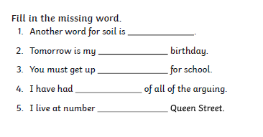
Tuesday 9th February 2021
L.O To be able to spell words from the Y3/4 word list

Slide 31
Pre-recorded Teaching
Access the online teaching video below that will support you to complete the work in this lesson. This video will act as a support but all of the work can still be successfully understood & completed using paper-based versions of this pack. If you need further support to understand / complete work then please contact school via e-mail or telephone.
Play Video
You can also copy and paste this link if you would prefer: https://teachers.thenational.academy/lessons/to-use-subordinating-conjunctions-c9k3ed

Slide 32
What is a conjunction?
A main clause is part of a sentence that makes sense on its on .
Example – The Stone Age boy fell asleep.
Main clause
A conjunction joins two clauses together to give the reader more information.
Example - The Stone Age boy fell asleep even though it was cold.
Conjunction

Slide 33
Today we will be looking at using conjunctions to write some sentences about The Stone Age boy
Example:
The Stone Age boy went for a walk although he was tired.
conjunction
The boy got up and continued to explore even though he fell over and hurt himself.
conjunction

Slide 34
Examples of different conjunctions.
Although
So that
Even though
As long as
Since
While
Until
Because
Can you think of anymore?

Slide 35
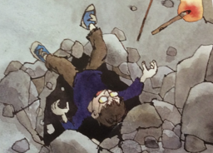
Lets think about the end of the Stone Age boy. Imagine the boy fell down the hole and didn’t end up back at home. What could have happened instead?

Slide 36
Here are some of my ideas:
He woke up still in the Stone Age.
Om went back to his time with him.
He woke up in Ancient Egypt.
He ended up in space.
What ideas did you get?

Slide 37
Imagine the Stone Age boy woke up back at home but he was with Om as well. Using conjunctions, I’m going to write some sentences about what could have happened.
Om was excited to see the Stone Age boy’s home although she wasn’t sure what to expect.
Om ran off to chase a deer while the boy was eating.
Om didn’t know how to speak to other people since she was from the Stone Age.
Notice how I have used a conjunction to join two of my ideas together.

Slide 38
Complete the sentences using a subordinating conjunction.
Om didn’t have anything to eat ___________ she was hungry.
The boy said he would take Om to meet his friends ______________ she acted normal.
Om attacked a wild rabbit _____________ she wasn’t in the Stone Age anymore.
Conjunctions to use:
although, so that, even though, as long as, since, while, until, because

Slide 39
Write six sentences of your own about something that could have happened after the children fell down the hole using a subordinating conjunction.
1. When Om and the boy woke up they knew they weren’t in the Stone Age anymore _____________everything looked different.
2. The girl ran towards a deer _____________ she wasn’t allowed to hunt them anymore.
3. The boys parents were scared of Om ____________________________.
4. ___________________________________________________________
5. ___________________________________________________________
6. ___________________________________________________________
Word list suggestions
Although, So that, Even though, As long as, Since, While, Until

Slide 40
End of lesson

Slide 41
Thursday 11th February 2021
L.O To be able to punctuate and write direct speech
Subject: English

Slide 42
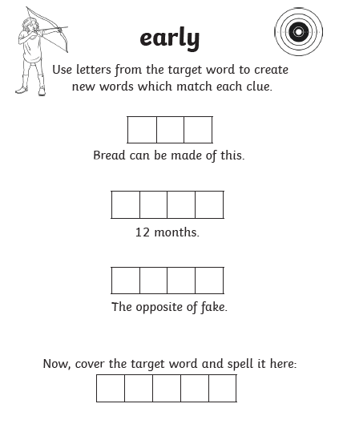
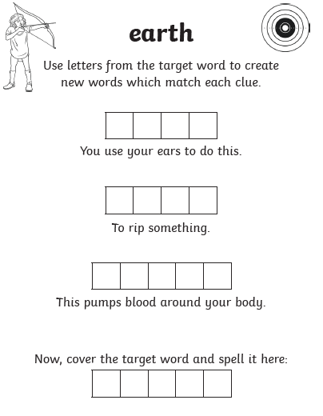
Wednesday 10th February 2021
L.O To be able to spell words from the Y3/4 word list

Slide 43
Pre-recorded Teaching
Access the online teaching video below that will support you to complete the work in this lesson. This video will act as a support but all of the work can still be successfully understood & completed using paper-based versions of this pack. If you need further support to understand / complete work then please contact school via e-mail or telephone.
Play Video
You can also copy and paste this link if you would prefer: https://teachers.thenational.academy/lessons/punctuating-speech-correctly-crwp6c?from_query=direct+speech

Slide 44
What is direct speech?
Direct speech is all the words that are spoken by the character.
Example
“I’m scared of all these cars,” said Om.
“Don’t be afraid, I’ll take care of you,’’ the boy replied.
Remember
Inverted commas (speech marks) go around the part that has been spoken.
Punctuation ? ! , goes inside the inverted commas.
Who is speaking can go before or after the speech.
.
Remember speech always starts with a capital letter!

Slide 45
“In this era, we use a knife and fork to eat,’’ replied the boy.
“But why?’’ Asked Om.
The spoken words have inverted commas round them and the punctuation is inside of the inverted commas.

Slide 46
Always remember when you are writing a conversation you need a new line for a new speaker
Correct example
“ We don’t need to make a fire to keep warm in the house Om, we have heating,’’ said the boy.
“What does heating mean?’’ Asked Om.
Incorrect example
“We don’t need to make a fire to keep warm in the house Om, we have heating,’’ said the boy. “What does heating mean?” Asked Om.
This is incorrect because Om is a new speaker so her speech should be on a new line.

Slide 47
Put the inverted commas around the words that have been spoken.
Why aren’t we allowed to kill animals in the street? Om asked.
We aren’t allowed because you buy food from the shops in this era, said the boy.
Ok, so will you show me around your strange village, asked Om.
Yes Om but be careful of the cars, they are very dangerous, explained the boy.

Slide 48
Finish the conversation with four sentences of your own.
Think about what Om and the boy would talk about if she was in his era and not the Stone Age.

Slide 49
End of lesson

Slide 50
Friday 12th February 2021
L.O To be able to write an ending to a story
Subject: English

Slide 51
L.O To be able to spell words from the Y3/4 word list
Write your own sentences using these words
________________________________________________________________________________________________________________________________________________________________________________________________________________________________________________________________________________________________________________________

Slide 52
Today your going to write your own ending to the Stone Age Boy!

Slide 53
Imagine that when the boy fell down the hole he and Om ended up in his era.
What might Om see that would be unusual to her?

Slide 54
Here are my ideas
Cars
Buildings
Ground
Electricity
Television
Running water
Mirrors
What people are wearing
Food

Slide 55
Imagine the boy and Om have fallen down the hole and have arrived back in the boy’s era. What happens next?
Your challenge is to write the end of this chapter. To start this chapter off, I want you to use the conversation that you wrote yesterday and then complete the story with what you think happened.
I have given you my example on the next page.

Slide 56
What a good one looks like
Can you fill in the missing gaps with subordinating conjunctions?
“Why aren’t we allowed to kill animals in the street?’’ Om asked.
“We aren’t allowed because you buy food from the shops in this era,’’ said the boy.
“Ok, so will you show me around your strange village?’’ asked Om.
“Yes Om but be careful of the cars, they are very dangerous,’’ replied the boy.
Since Om was from the Stone Age, she didn’t know what cars were or why they were dangerous. Om then ran out into the street and started chasing all of the traffic ___________ she wasn’t in the Stone Age anymore. The boy ran after her ____________ he was tried and tried to stop her. Om tiptoed towards a giant, grey building _________ the boy watched her anxiously.

Slide 57
You can use my example to help you get started or write your own
__________________________________________________________ __________________________________________________________ ________________________________________________________________________________________________________________________________________________________________________________________________________________________________________________________________________________________________________________________________________________________________________________________________________________________________________________________________________________

Slide 58
My work is finished when
One independent paragraph
Capital letters
Full stops
Subordinating conjunctions
Speech (inverted commas)
Commas
Challenge
Add in an apostrophe to show possession
Apostrophe The girl’s feet felt strange in shoes.

Slide 59
End of lesson

